Slide 1



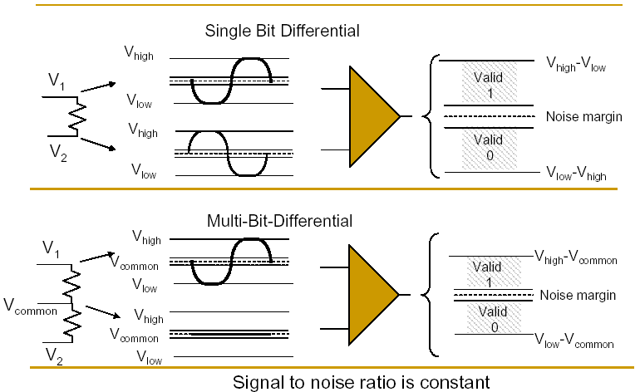
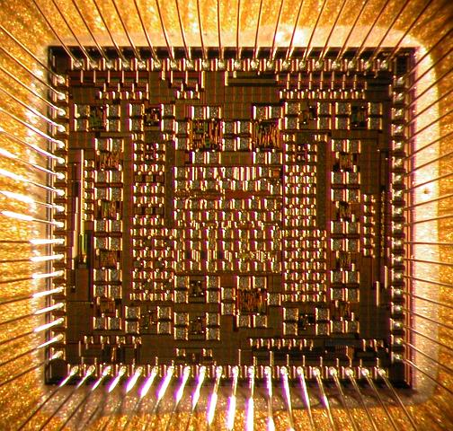
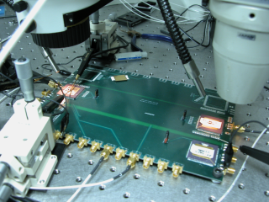
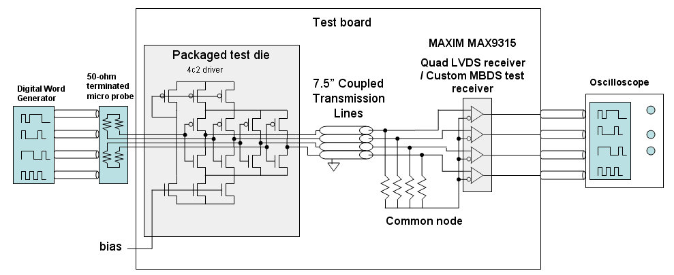
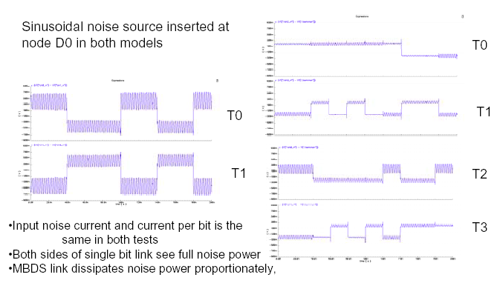
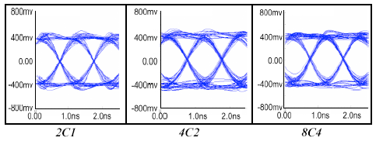
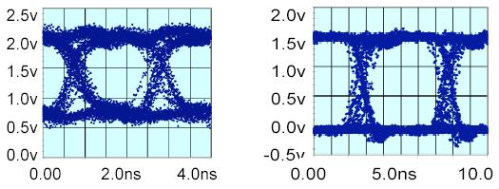
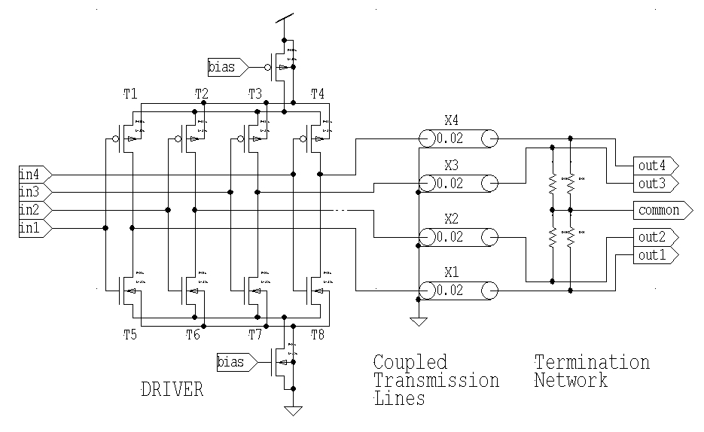
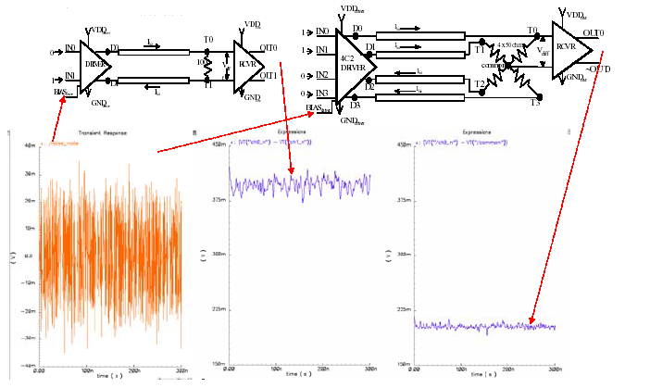
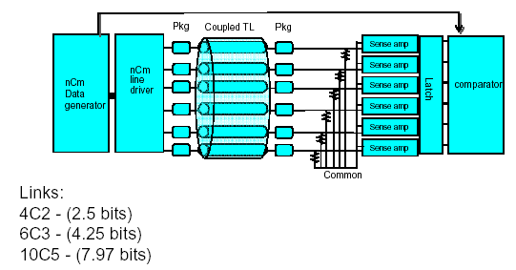
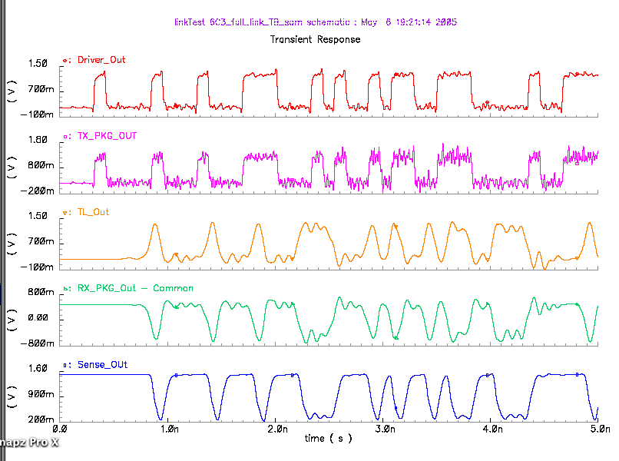
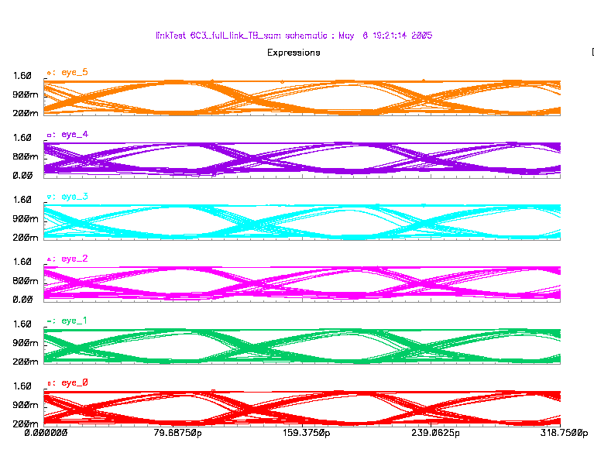
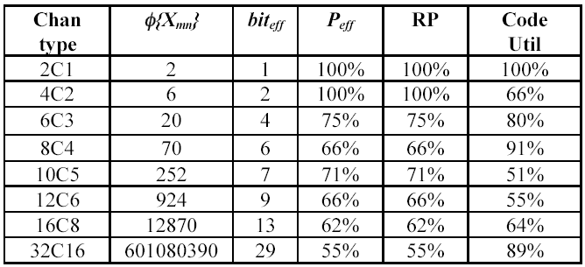
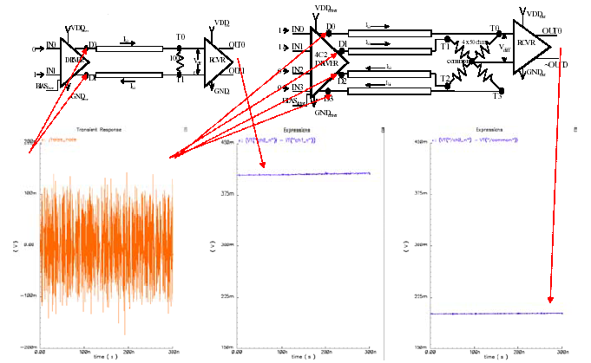
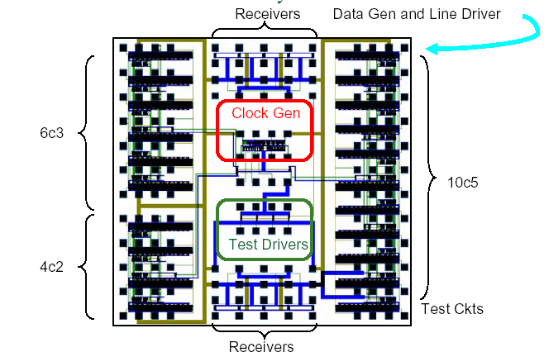
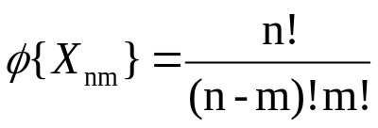
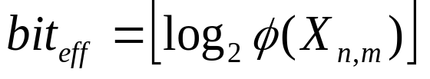
Area, Power, and Pin Efficient Bus Transceiver Using Multi-Bit-Differential Signaling
Donald M. Chiarulli, Jason D. Bakos, Joel R. Martin, Steven P. Levitan
University of Pittsburgh, Pittsburgh, PA USA
MBDS Extends Differential Signaling Technology for Higher Channel Code Density
Single-bit vs. Multi-bit Differential Signals
Test chip 1: .5 um IBM 5HP SiGe
Low Voltage Differential Signaling (LVDS)
Multi-Bit Differential Signaling (MBDS)
Data encoded as
  {01} or {10}
Advantages
  Low switching noise
  No reference noise
  Coupled transmission lines
  Noise rejection => low voltage swing
Disadvantages
  Two connections for each bit
  Wasteful in I/O pads
Data encoded with fixed number of one-bits
  N-choose-M (nCm)
  Example: 4c2 code set:
    {0011}, {0101}, {0110}, {1001}, {1010}, {1100}
Advantages
  Same noise rejection as differential
  Higher information capacity
Diagram of test setup
Image of test setup
Image of fabricated and packaged die
Electrical Characteristics of MBDS are Comparable to Pairwise (Single-bit) Differential
Test results: 500 Mbps with custom receiver (left) and 200 Mbps with commercial LVDS receiver (right)
Common-Mode Noise Rejection
Simulations of pair-wise differential, 4c2, and 8c4 channels at 1 Gbps
Common Mode Noise rejection
Differential Receiver
Test chip 2: .18 um MITLL FDSOI (in fab)
40 Gbps 6C3 Link Simulations
Current Steering Driver (supply noise)
High GDP tolerance
6 wires @9.4GBs/wire (compare to 8 wires/4 pairs @ 10Gb/pair)
4.25 bits/symbol
= 40Gbs throughput 8cm FR4
Coupled Electromagnetics/EMI cancellation
Chip architecture
“N choose M” Channel Encoding
EXAMPLE
6-wire MBDS channel
code size = 20 codes
effective bits = 4
equivalent to 8-wire differential channel
25% fewer pads (8 versus 6)
25% less power (4 1-bits on versus 3)
125% code capacity (20 codes versus 16)
Gaussian noise source on bias input.
Common
Code set size
Effective bits
Gaussian noise on data lines.
Chip layout

