Slide 1


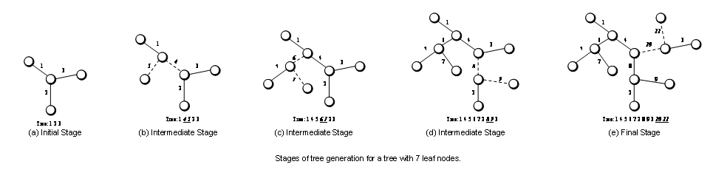
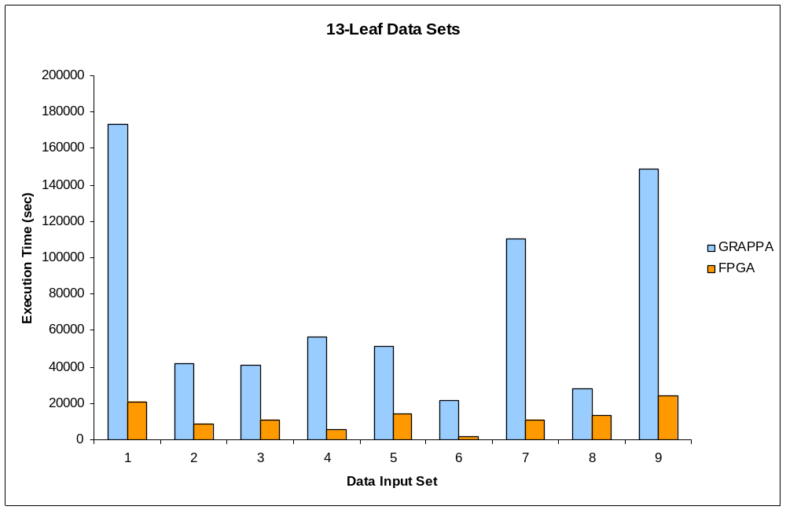
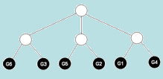
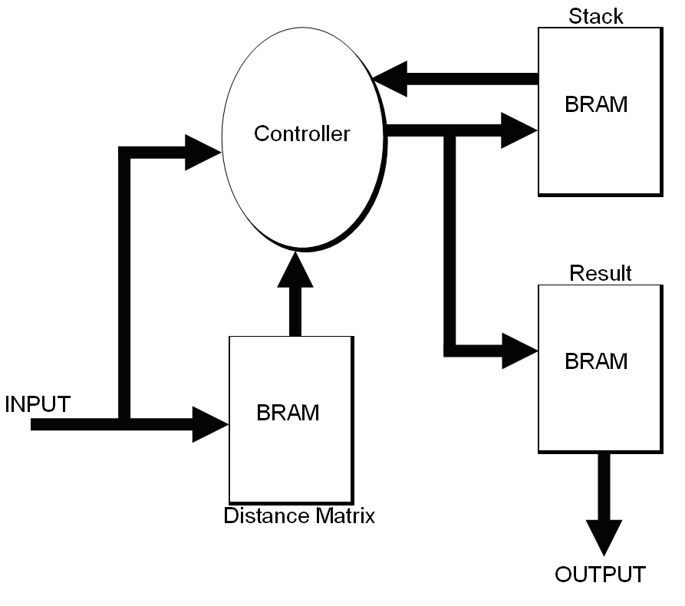
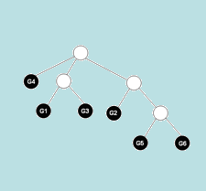
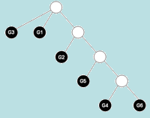
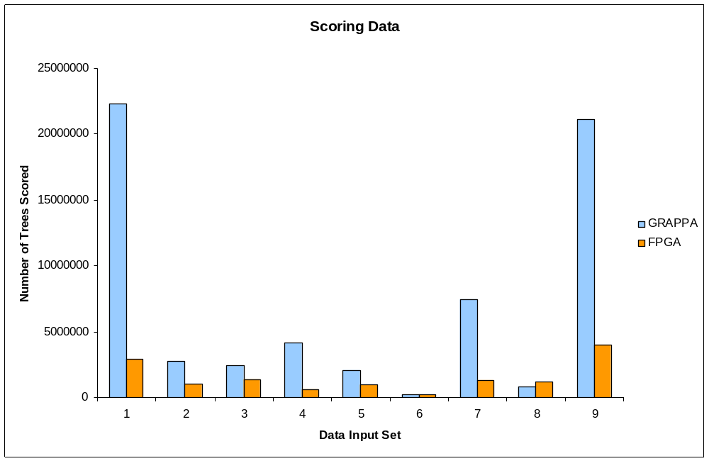
A Cluster-On-A-Chip Architecture For High Throughput Phylogeny Search
Tiffany Mintz and Dr. Jason Bakos
Department of Computer Science & Engineering, University of South Carolina, Columbia, SC 29208
OBJECTIVE
We describe an FPGA-based co-processor architecture that performs a high-speed branch-and-bound search of the space of phylogenetic trees corresponding to the number of input taxa. This co-processor architecture is designed to accelerate maximum-parsimony phylogeny reconstruction for gene-order and sequence data and is amenable to exhaustive and heuristic tree searches. Our architecture exposes coarse-grain parallelism by dividing the search space among parallel processing elements and each processing element exposes fine-grain parallelism by exploiting memory parallelism within the lower-bound computation.
BACKGROUND
Phylogeny Reconstruction
Phylogenetic analysis is the study of evolutionary lineage amongst a set of species. A phylogeny (or phylogenetic tree) is an unrooted binary tree where each vertex represents information associated with a species and each edge represents a series of evolutionary events that effectively transformed one species into another. In general, the problem of phylogenetic reconstruction can be summarized as the acquisition of a phylogeny that most closely resembles the true evolutionary history of the input species. GRAPPA is an exhaustive search method, moving systematically through the space of all possible phylogenetic trees to find the tree with the lowest sum of edge lengths.
FPGA ACCELERATOR
Tree Generation
Tree represented by list of integer edge orderings
Tree begins as an initial three edge structure
Two new vertices are added until a complete structure is generated
At each stage of construction, the tree is separated into 3 parts
  Prefix – segment before new edges
  Insertion – new edges
  Suffix – segment after new edges
Parallelism within the design allows 4 edges to be processed simultaneously
Core Architecture
The controller is a finite state machine that implements most of the tree generation and branch-and-bound functionality
Three sets of block RAM (BRAM)
  Distance Matrix Storage
  Stack
  Result
Lower bounds are computed parallel to tree generation
Trees are scored by the host machine if their lower bound exceeds the global upper bound
The tree space is equally divided among 16 cores
PERFORMANCE ANALYSIS
Throughput & Scalability
Software Platform: 3.4 GHz Intel Xeon processor
Hardware Platform: Xilinx Virtex-2 Pro 100 FPGA
Exclusive performance of entire tree space generation and bounding
Input data sets with search space sizes of 10,395 trees (8 leaf trees) to 316,234,143,225 trees (14 leaf trees)
Speedup increases as input size increases
16 core accelerator able to process larger data sets as much as 40x faster
End-to-End Utilization
Experiments performed on 13 leaf input data sets (13,749,310,575 possible trees)
Operating on 16 core parallel architecture
Maximum utilization of approximately 77%
FPGA prunes more trees in the branch and bound search for almost every data set
PERFORMANCE ANALYSIS cont.
End-to-End Speedup
Execution time includes communication costs between FPGA and host machine
FPGA consistently outperforms GRAPPA
Speedups range from 2.14x to 13.71x
Experiments with higher utilization have faster execution times
Deviations in speedup are mostly due to differences in pruning rate and utilization
Higher pruning rates contribute to faster execution times
 | Execution Time (sec)
Input # | GRAPPA | FPGA | FPGA Speedup
1 | 173207 | 20793 | 8.33
2 | 41930 | 8856 | 4.73
3 | 40838 | 11207 | 3.64
4 | 56203 | 5554 | 10.12
5 | 51453 | 14121 | 3.64
6 | 21641 | 1578 | 13.71
7 | 110273 | 11161 | 9.88
8 | 28181 | 13168 | 2.14
9 | 148571 | 24114 | 6.16
 |  | Execution Time (sec) |  |  | FPGA Speedup
# of Leaves | # of Trees | Software | FPGA 1 PE | FPGA 16 PEs | 1 PE | 16 PEs | 1 to 16 PE Speedup
10 | 2.03E+06 | 2 | 1 | 1 | 2.00 | 2.00 | 1.00
11 | 3.45E+07 | 44 | 14 | 2 | 3.14 | 22.00 | 7.00
12 | 6.55E+08 | 898 | 265 | 34 | 3.39 | 26.41 | 7.79
13 | 1.37E+10 | 20442 | 5807 | 692 | 3.52 | 29.54 | 8.39
14 | 3.16E+11 | > 604800 | 133172 | 15516 | > 4.54 | > 38.98 | 8.58
 | # of Trees Scored |  | % of Trees Scored
Input # | GRAPPA | FPGA | GRAPPA | FPGA
1 | 22310765 | 2912228 | 0.1623% | 0.0212%
2 | 2772469 | 1041965 | 0.0202% | 0.0076%
3 | 2434468 | 1415052 | 0.0177% | 0.0103%
4 | 4177687 | 622079 | 0.0304% | 0.0045%
5 | 2045558 | 936178 | 0.0149% | 0.0068%
6 | 207910 | 222527 | 0.0015% | 0.0016%
7 | 7483701 | 1325416 | 0.0544% | 0.0096%
8 | 808902 | 1169870 | 0.0059% | 0.0085%
9 | 21153803 | 4031965 | 0.1539% | 0.0293%
CONCLUSIONS
Successfully demonstrated the use of heterogeneous computing with an FPGA accelerator to enhance performance of a branch-and-bound computation
Branch and bound approach for optimizing tree search is further accelerated on the FPGA
Processing extremely large data sets is made feasible through a dual focused parallelized FPGA architecture that encompasses both fine grained and course grained parallelism

