Slide 1

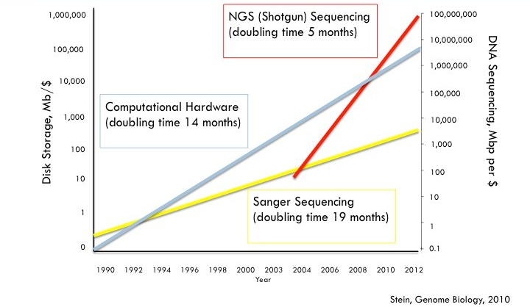
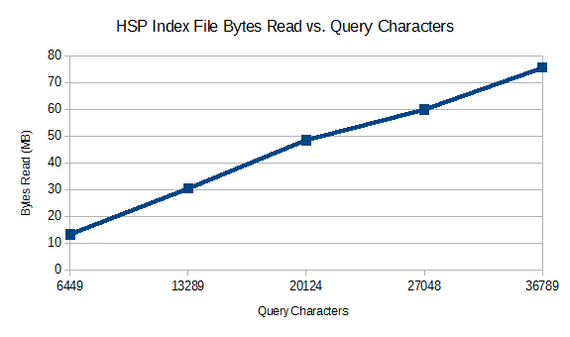
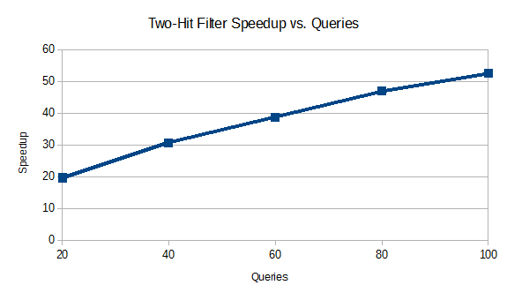
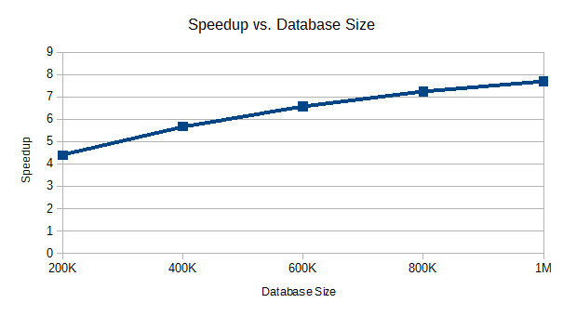

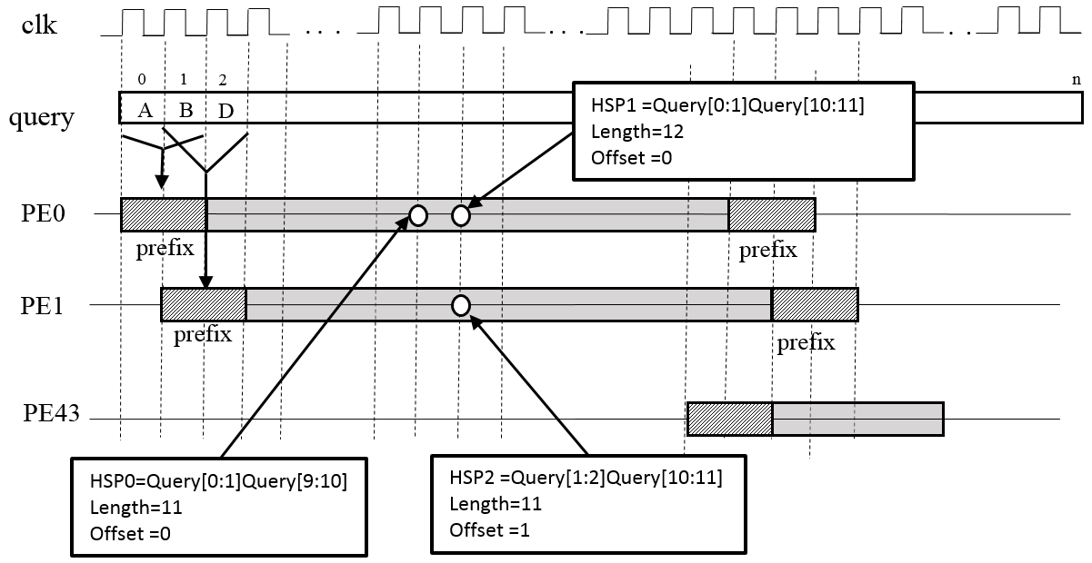
High-Level Synthesis of a Genomic Database Search Engine
Rasha Karakchi, Jordan Bradshaw, Dr. Jason D. Bakos
University of South Carolina Columbia, SC
Motivation
Our Approach (con't)
Experimental Results
Synthesized pipeline depth vs. maximum DRAM latency
800 MB database
DRAM Latency (cycles) | II | Pipeline Depth | Clock rate (MHz)
5 | 44 | 80 | 369
10 | 44 | 90 | 369
15 | 44 | 100 | 369
20 | 44 | 110 | 369
25 | 44 | 120 | 369
30 | 44 | 130 | 369
Result: less total data read per query
20-50X speedup for filtering operation
4-8X speedup overall
Identifies valid HSPs in query
(1 Mb)
Map each (HSP,length) to list of database hits
(off-chip)
List of databse its for each (HSP,length)
(on disk)
Preprocessing
Runtime
Performance vs. # PEs
Suffix Table
Table of Contents
HSP Index
Seeds
HSP Suffixes
Query Processor
FPGA
Query
# PEs | II | Pipeline Depth | Clock rate (MHz) | Throughput (Mchars/s)
12 | 12 | 40 | 369 | 9.2
16 | 16 | 44 | 369 | 8.4
20 | 20 | 48 | 369 | 7.7
24 | 24 | 52 | 369 | 7.1
28 | 28 | 56 | 369 | 6.6
32 | 32 | 60 | 369 | 6.2
36 | 36 | 64 | 369 | 5.8
40 | 40 | 68 | 369 | 5.4
44 | 44 | 72 | 369 | 5.1
NCBI BLAST
 | AC | BC | CB | CV
AC | 0 | 1 | 0 | 1
BC | 0 | 0 | 0 | 0
CB | 0 | 1 | 0 | 1
CV | 0 | 0 | 0 | 0
HSP / Length | Start | Length
ACBC-8 | 0 | 1
ACCV-9 | 1 | 1
CBBC-6 | 2 | 1
CBCV-7 | 3 | 1
Record | Start
0 | 2
0 | 2
0 | 4
0 | 4
High Scoring Pairs
Table of Contents
Matches
Database is filtered using the query
Records
HSP Finder
High Scoring Pairs
Query
A subset of the database containing likely matches is aligned against databse
HSP Index
Extension
Expectation Value
Database
Database’
Alignment
Performance is limited by I/O throughput (often from disk or network!)
Smith-Waterman
Results
Objective: For each query, identify patterns of the form AB{0,40}CD
Approach:
Instance 44 PEs, each of which tracks pattern instances in consecutive "windows" of 44 characters
For each hit, match against an off-chip table to determine if there is a database HSP with the same length
If so, output offset and length of corresponding section in HSP Index
Design:
Use Vivado HLS 2016.1
Assume DRAM b/w of 36 bytes per cycle (10.8 GB/s @ 300 MHz, one PE iteration per cycle)
Schedule pipeline for worst-case number of memory accesses, i.e. access arracys every iteration
Set DRAM latency from 5 to 30 cycles
Database filter:
Convert query into high scoring pairs
Query
Seeds
Resource Requirements
AACBBAV
AAC
ACB
CBB
BBA
BAV
# PEs | LUTs | DSPs | BRAMs
12 | 59349 | 14 | 50
16 | 78990 | 18 | 50
20 | 98655 | 22 | 50
24 | 117989 | 26 | 50
28 | 137654 | 30 | 50
32 | 157276 | 34 | 50
36 | 176948 | 38 | 50
40 | 196258 | 42 | 50
44 | 216002 | 46 | 50
High Scoring Pairs (HSPs)
Match against corresponding HSPs from each database entry
AAC
ACB
CBB
BBA
BAV
AAC.{0,40}BAV
ACB.{0,40}BAV
CBB.{0,40}BAV
Our Approach
Decompose database into set of HSPs
Store as hierarchical set of tables
Database
Performance vs. CPU
Query
Database’
Smith-Waterman
 | upper bound |  | lower bound
Threads | time/char (ns) | Thrp't. (Mc/s) | time/char (ns) | Thrp't. (Mc/s)
1 | 115 | 8.7 | 421 | 2.4
2 | 87 | 11.5 | 256 | 3.9
3 | 120 | 8.3 | 219 | 4.6
4 | 143 | 7.0 | 219 | 4.6
5 | 164 | 6.1 | 273 | 3.7
6 | 200 | 5.0 | 277 | 3.6
7 | 215 | 4.7 | 298 | 3.4
8 | 237 | 4.2 | 320 | 3.1
Database
Seeds
Use 2-character seeds to store all HSP enumerations on chip
AACBBCV
AA
AC
CB
BB
BC
CV
Use DB filter to filter queries, require less total I/O
High Scoring Pairs (HSPs)
AC.{0,40}BC
AC.{0,40}CV
CB.{0,40}BC
CB.{0,40}CV
AA
AC
CB
BB
BC
CV

