Slide 1

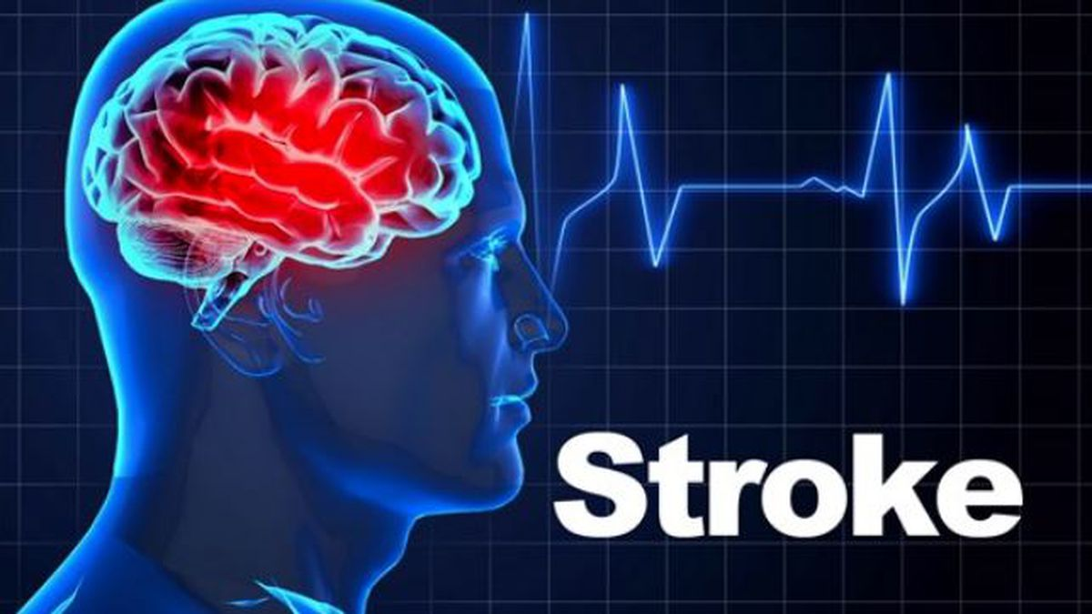
Final Project – Stroke Prediction
AAI-500 Probability & Statistics for Artificial Intelligence
Submitted By : Group #2
Prashant Khare
Riyaz Khorasi
Sourangshu Pal

Slide 2
Problem Description : The Global Burden of Stroke
Stroke Defined: Abrupt disruption of blood supply to the brain (ischemic) or haemorrhage within cerebral tissue (haemorrhagic).
Global Impact:
2nd leading cause of death worldwide.
Primary cause of long-term disability.
Imposes immense personal, social, and economic burdens (billions annually).
Multifaceted Consequences: Hemiparesis, cognitive deficits, speech disorders, psychological distress.
Escalating Challenge: Driven by rising prevalence of hypertension, diabetes, obesity, and an aging global demographic.
Urgent Imperative: Proactive identification of at-risk individuals for timely preventive interventions.
Objective : To build a model for Stroke prediction
Notes:
Speaker Notes:
Let's start by understanding the problem we are addressing. Stroke is a devastating neurological emergency. It's not just a medical event; it's a profound global health crisis, standing as the second leading cause of death and the primary cause of long-term disability worldwide. The consequences are far-reaching, from physical impairments to severe cognitive and emotional challenges, significantly impacting quality of life for both patients and their families.
The challenge is escalating due to the rising global prevalence of chronic conditions like hypertension, diabetes, and obesity, compounded by an aging population, as age is a predominant risk factor. This situation creates an urgent imperative for us to find proactive ways to identify individuals at high risk, enabling early intervention and personalized management to mitigate this immense burden.

Slide 3
The AI Solution : Applied AI in Predictive Healthcare
Paradigm Shift: From reactive disease management to proactive, predictive, and personalized care.
Limitations of Traditional Models: Often constrained by linearity assumptions, struggle with high-dimensional, heterogeneous data.
AI's Transformative Potential:
Uncovers complex, non-linear relationships and subtle interaction effects.
Integrates diverse data (demographics, lifestyle, physiological measurements, medical history).
Constructs highly individualized and dynamic stroke risk profiles.
Empowering Clinicians: Provides sophisticated decision-support systems for:
Precision medicine approaches.
Targeted preventive interventions.
Optimized resource allocation.
Notes:
Speaker Notes:
This is where Applied Artificial Intelligence offers a revolutionary solution. AI marks a paradigm shift in healthcare, moving us from merely reacting to diseases to a proactive, predictive, and personalized approach. Unlike traditional statistical models that often have limitations with complex, high-dimensional data, AI algorithms excel.
They can uncover intricate, non-linear relationships and subtle interaction effects that are often missed by conventional methods. By integrating a myriad of variables – from genetic data to lifestyle choices and medical history – AI offers an unparalleled capability to construct highly individualized and dynamic stroke risk profiles. This holistic analytical prowess empowers clinicians with sophisticated decision-support systems, enabling true precision medicine, targeted preventive interventions, and optimized resource allocation. Our project aims to harness this transformative potential.

Slide 4
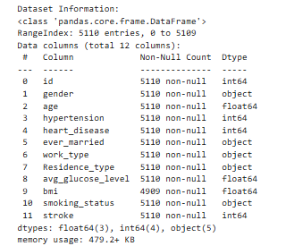
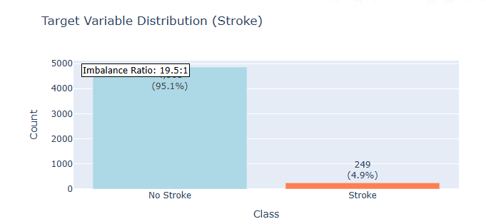
Dataset Summary: Initial Overview & Critical Imbalance
Dataset: Publicly available stroke risk prediction dataset.
Initial Structure (Raw Data):
5,110 individual records (patients)
12 distinct variables (demographic, health, lifestyle)
Target Variable: stroke (binary: 1 = stroke, 0 = no stroke)
Critical Class Imbalance:
No Stroke (Class 0): 4861 instances (95.1%)
Stroke (Class 1): 249 instances (4.9%)
Imbalance Ratio: Approximately 19.5 : 1 (No Stroke : Stroke)
Notes:
Speaker Notes:
Now, let's look at the foundation of our analysis: the dataset. We utilized a publicly available dataset specifically curated for stroke risk prediction. Initially, this raw dataset comprised 5,110 individual patient records and 12 distinct variables, covering demographics, health status, and lifestyle factors. Our target variable, 'stroke', is binary, indicating whether a patient had a stroke or not.
A critical observation from the outset was the severe class imbalance. As you can see in Figure 2, the 'No Stroke' class dominates, accounting for 95.1% of the data, while 'Stroke' cases represent only 4.9%. This results in an imbalance ratio of approximately 19.5 non-stroke cases for every 1 stroke case. This profound imbalance is not merely a statistical curiosity; it's a significant challenge that profoundly influences model selection, training, and evaluation, as models can easily become biased towards the majority class if not handled carefully.

Slide 5
Approach: Comprehensive Phased Methodology
Our project adheres to a rigorous, phased methodology to ensure scientific rigor and practical utility:
Data Acquisition & Quality Assessment: (Phase 1)
Sourcing, structural overview, class imbalance analysis.
Identification of missing values, duplicates, data type coherence.
Data Cleaning & Pre-processing: (Phase 2)
Advanced imputation for missing values.
Outlier management and data scaling.
Robust categorical encoding.
Exploratory Data Analysis (EDA) & Hypothesis Testing: (Phase 3)
Univariate & Bivariate analysis to understand feature distributions and relationships with stroke.
Formal statistical tests with multiple testing correction.
Notes:
Speaker Notes:
Our project is structured into seven distinct yet interconnected phases, ensuring a systematic and rigorous approach from raw data to actionable insights. We began with Data Acquisition and Quality Assessment, meticulously understanding our dataset's initial state, including its critical class imbalance. This was followed by comprehensive Data Cleaning and Preprocessing to ensure data integrity and consistency, tackling issues like missing values and preparing diverse data types.
The core analytical phase involved Exhaustive Exploratory Data Analysis and Hypothesis Testing, where we deep-dived into feature distributions and their relationships with stroke outcomes, validated by statistical tests. Following this, we performed Advanced Feature Engineering, a creative process of generating new features and transforming existing ones to maximize predictive efficacy.
Then, we moved to Model Selection and Development, where we carefully chose and built machine learning models, specifically addressing the imbalance challenge. The subsequent phase, Model Analysis and Validation, rigorously assessed our model's performance, calibration, robustness, and fairness. Finally, our project culminates in a Conclusion and Recommendations section, outlining our key findings and future trajectories

Slide 6
Approach: Comprehensive Phased Methodology Contd…
Advanced Feature Engineering: (Phase 4)
Creation of novel features (interactions, polynomials).
Transformation of existing features to enhance predictive power.
Model Selection & Development: (Phase 5)
Strategic choice of algorithms suitable for imbalanced classification (e.g., Naïve Bayes, Random Forest, Support Vector Machine, XGBoost etc.)
Hyperparameter optimization, class imbalance handling.
Model Analysis & Validation: (Phase 6)
Comprehensive performance evaluation (Precision, Recall, AUC-ROC, AUPRC).
Assessment of calibration, robustness, and fairness.
Conclusion & Recommendations: (Phase 7)
Synthesis of findings, clinical integration strategies, future research.
Notes:
Speaker Notes:
Our project is structured into seven distinct yet interconnected phases, ensuring a systematic and rigorous approach from raw data to actionable insights. We began with Data Acquisition and Quality Assessment, meticulously understanding our dataset's initial state, including its critical class imbalance. This was followed by comprehensive Data Cleaning and Preprocessing to ensure data integrity and consistency, tackling issues like missing values and preparing diverse data types.
The core analytical phase involved Exhaustive Exploratory Data Analysis and Hypothesis Testing, where we deep-dived into feature distributions and their relationships with stroke outcomes, validated by statistical tests. Following this, we performed Advanced Feature Engineering, a creative process of generating new features and transforming existing ones to maximize predictive efficacy.
Then, we moved to Model Selection and Development, where we carefully chose and built machine learning models, specifically addressing the imbalance challenge. The subsequent phase, Model Analysis and Validation, rigorously assessed our model's performance, calibration, robustness, and fairness. Finally, our project culminates in a Conclusion and Recommendations section, outlining our key findings and future trajectories

Slide 7
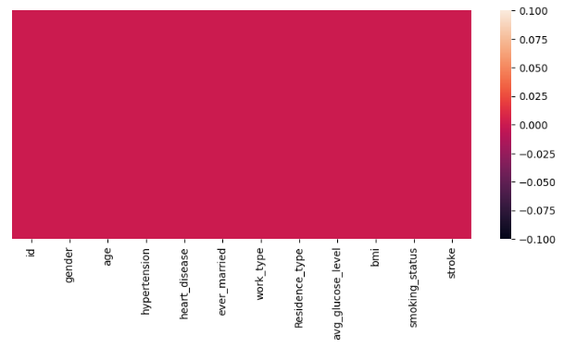
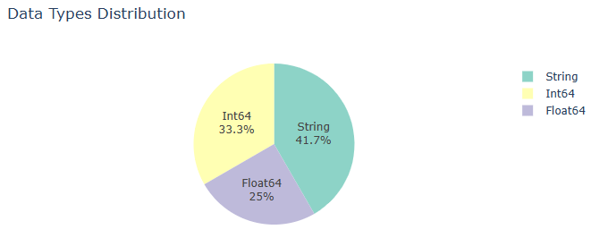
Data Cleaning & Pre-processing: Ensuring Data Integrity
Objective: Transform raw, imperfect data into a clean, consistent, and model-ready format.
Key Challenges & Solutions:
Missing Values:
Identified: Primarily in bmi (3.93%)
Solution: bmi imputed using K-Nearest Neighbours (KNN) imputation
Result: 0 missing values after imputation.
Duplicate Records:
Identified: No duplicate rows found.
Data Type Coherence:
Initial Mix: 4 Int64, 5 Object (String), 3 Float64.
Solution:
One-Hot Encoding for nominal categorical features (e.g., gender, work_type).
Binary Encoding for dichotomous features (e.g., ever_married, hypertension).
Result: All features converted to numerical types.
Outlier Management & Scaling:
Strategy: Considered winsorization /transformations for extreme outliers in numerical features.
Scaling: Standardization (Z-score normalization) applied to age, avg_glucose_level, bmi
Notes:
Speaker Notes:
Data quality is paramount. Our data cleaning and preprocessing phase was designed to transform imperfect raw data into a pristine, model-ready format. We identified missing values, particularly in the 'bmi' column, with about 3.93% missing. For numerical imputation, we chose KNN imputation for 'bmi', a robust method that leverages the values of similar instances. The result was a dataset with zero missing values. We also confirmed no duplicate records, which is excellent for data integrity.
Regarding data types, our initial dataset had a mix of integers, floats, and strings. We applied One-Hot Encoding for nominal categorical features like 'gender' and 'work_type' and binary encoding for dichotomous variables like 'ever_married' and 'hypertension', ensuring all features are numerical for our models. Lastly, for numerical features, we considered outlier management strategies and applied Z-score standardization to ensure consistent scaling, preventing features with larger ranges from dominating the learning process. The heatmaps clearly show the before and after states of missing values.

Slide 8
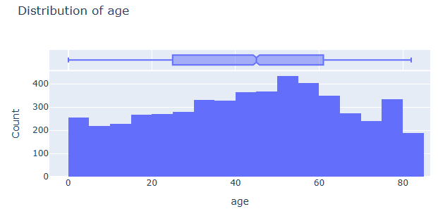
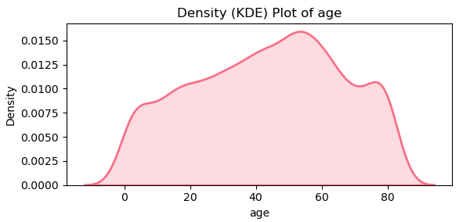
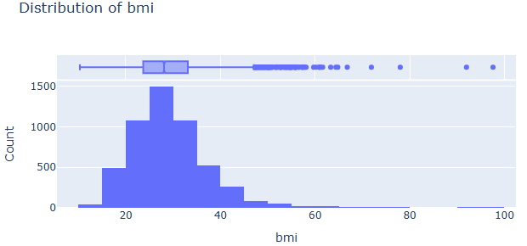
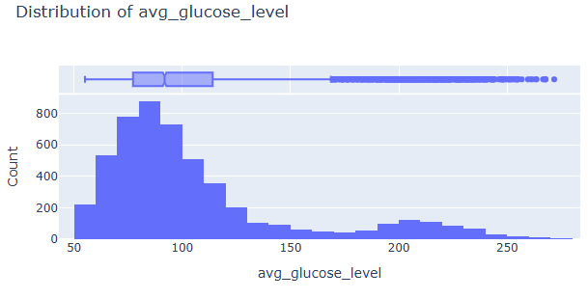
Exploratory Data Analysis (EDA): Univariate Insights
Objective: Understand individual feature characteristics (distributions, central tendencies, outliers).
Key Findings:
Demographics: Age Distribution
Observation: Histogram and KDE plot show a distribution skewed towards older ages, with a higher concentration of individuals in the 50-70 range.
Significance: Aligns with epidemiological understanding that stroke risk increases significantly with age.
Health Indicators: BMI Distribution
Observation: Right-skewed distribution, mean (28.89) slightly higher than median (28.1).
Significance: Reflects a higher prevalence of overweight and obese individuals in the cohort, critical for stroke risk. Outliers at higher BMIs are visible.
Health Indicators: Average Glucose Level
Observation: Right-skewed distribution with a long tail towards higher glucose levels.
Significance: Indicates the presence of diabetic or pre-diabetic individuals, underscoring the link between glycaemic control and stroke.
Notes:
Speaker Notes:
Moving into Exploratory Data Analysis, we first performed univariate analysis to understand each feature in isolation. For 'Age', the histogram and Kernel Density Estimate plots clearly show a distribution skewed towards older ages, consistent with the known increase in stroke risk as people get older.
For 'BMI', our box plot reveals a right-skewed distribution, with the mean slightly higher than the median. This indicates a higher prevalence of overweight and obese individuals within our dataset, which is a crucial factor for stroke. You can also see the outliers representing very high BMI values.
Similarly, the 'Average Glucose Level' distribution is also right-skewed with a long tail, highlighting the presence of individuals with elevated glucose levels, directly linking to diabetes and pre-diabetic states, both significant stroke risk factors. These initial insights guide our understanding of the population's health profile.

Slide 9
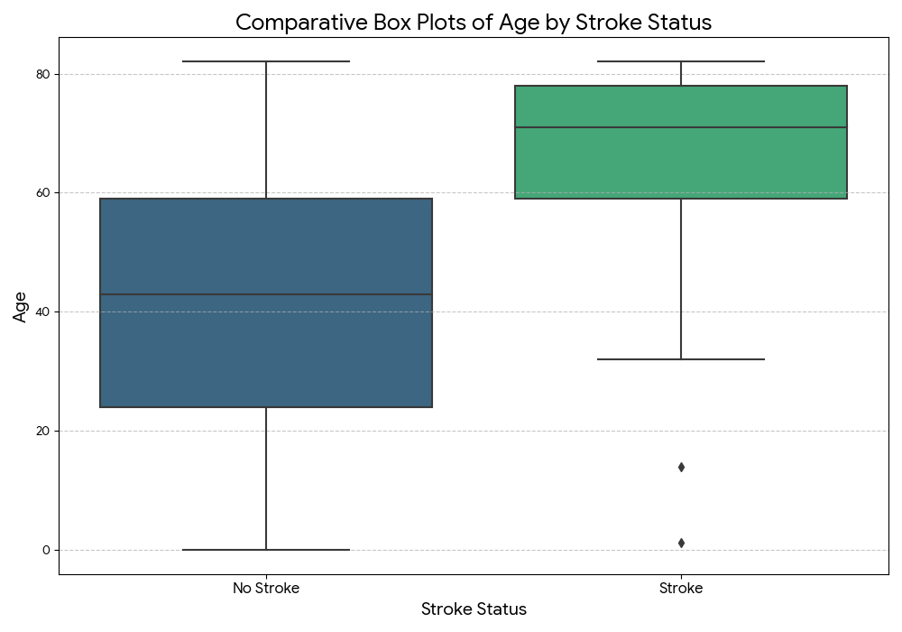
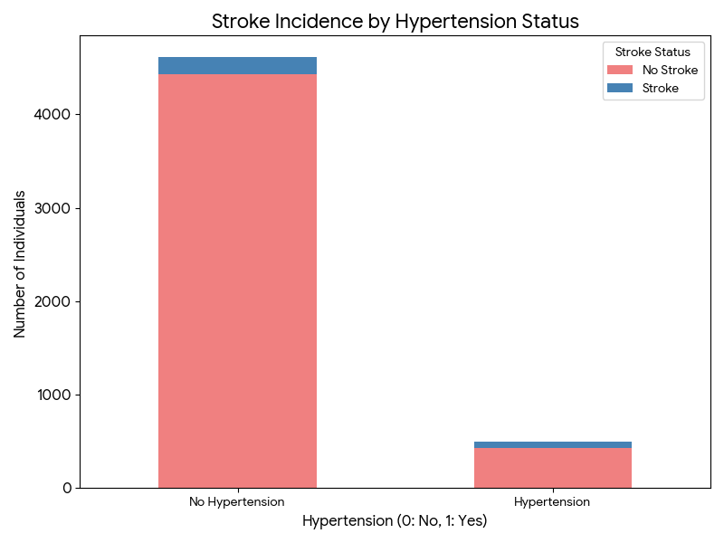
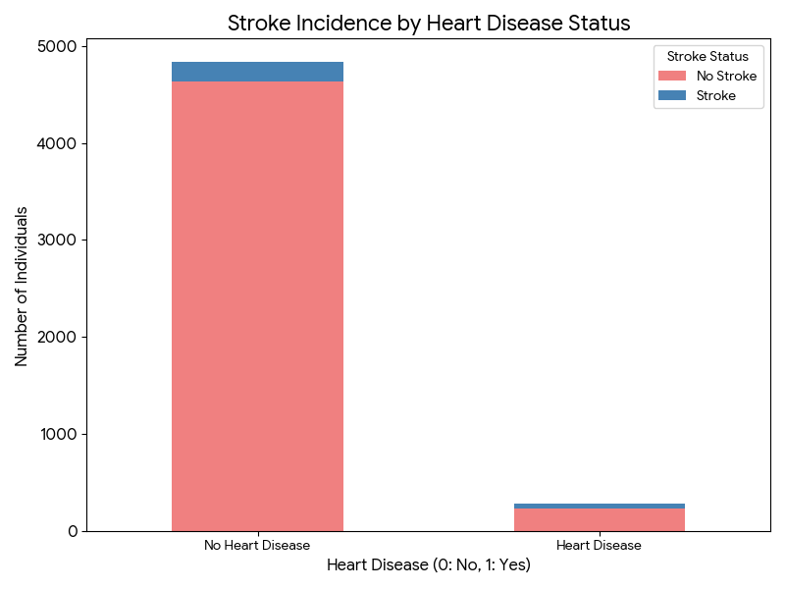
EDA: Bivariate & Hypothesis Testing
Objective: Uncover relationships between features and stroke outcome; statistically validate associations.
Key Findings:
Age vs. Stroke Incidence:
Observation: Median age for stroke patients (~71 years) is significantly higher than for non-stroke patients (~43 years).
Insight: Age is an overwhelming predictor; stroke risk escalates dramatically with advancing age.
Hypertension & Heart Disease vs. Stroke:
Observation: Significantly higher proportion of stroke cases among individuals with Hypertension or Heart Disease.
Insight: These pre-existing conditions are critical, direct, and statistically significant risk factors.
Formal Hypothesis Testing:
Methods: T-tests/Mann-Whitney U for numerical features; Chi-square tests for categorical features.
Crucial Step: Multiple Testing Correction applied to ensure robustness and avoid Type I errors, validating genuinely impactful predictors.
Insight: Confirmed statistical significance of age, avg_glucose_level, hypertension, heart_disease, and smoking_status
Notes:
Speaker Notes:
Moving to bivariate analysis, we examined relationships between features and stroke status. The comparative box plots of age by stroke status clearly show a profound difference: the median age for stroke patients is around 71 years, significantly higher than the 43 years for non-stroke patients. This unequivocally confirms age as a dominant predictor.
Even more striking are the stacked bar charts for Hypertension and Heart Disease. These visuals demonstrate a significantly higher proportion of stroke incidence among individuals with these pre-existing conditions, underscoring their critical role as direct risk factors.
To add statistical rigor, we performed formal hypothesis testing, using T-tests or Mann-Whitney U for numerical features and Chi-square tests for categorical ones. Crucially, we applied multiple testing correction to ensure the robustness of our findings and prevent false positives. This process statistically validated the significance of age, average glucose level, hypertension, heart disease, and smoking status as key stroke predictors.

Slide 10
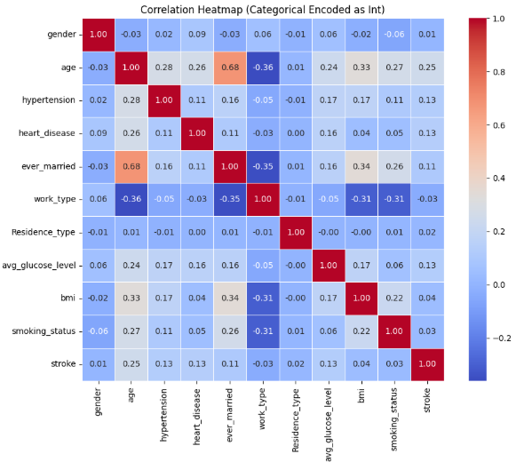
Key Insights: Guiding Our Predictive Model
Consolidated Findings from Exhaustive EDA & Rigorous Hypothesis Testing:
Age is the Foremost & Overwhelming Risk Factor: Consistent and statistically significant across all analyses.
Profound Impact of Co-morbidities: Hypertension & Heart Disease are exceptionally strong, direct, and significant predictors.
Glucose Levels & Diabetes Link: Higher avg_glucose_level unequivocally linked to increased stroke incidence.
BMI & Obesity as Significant Contributors: Higher bmi values consistently associated with elevated stroke risk.
Smoking's Undeniable Detrimental Role: Active and former smokers demonstrate significantly higher stroke rates.
Pervasive Class Imbalance is Paramount: Ratio of ~19.5 non-stroke to 1 stroke case necessitates explicit handling in modelling.
Inferred Feature Importance Hierarchy: Age, Hypertension, Heart Disease, and Avg. Glucose Level are identified as most influential.
Notes:
Speaker Notes:
To summarize our EDA and Hypothesis Testing, we derived several critical insights that directly guided our subsequent modeling efforts. Age is unequivocally the foremost and overwhelming risk factor, consistently showing statistical significance. The presence of co-morbidities like Hypertension and Heart Disease also emerged as profoundly impactful and direct predictors. We found a clear link between higher glucose levels and increased stroke incidence, highlighting the role of diabetes. BMI and smoking status were also confirmed as significant contributors to stroke risk.
Crucially, the pervasive class imbalance of 19.5 non-stroke cases to 1 stroke case remains a paramount challenge, demanding explicit handling. These insights, combined with our correlation analysis, helped us infer a clear hierarchy of feature importance, with age, hypertension, heart disease, and average glucose level being the most influential. These findings provided the robust analytical bedrock for our feature engineering.

Slide 11
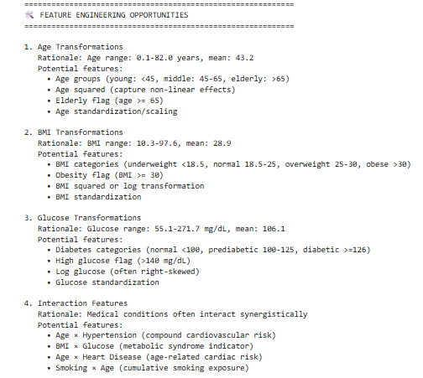
Feature Engineering: Maximizing Model Learnability
Objective: Amplify predictive signal, capture complex relationships, and optimize the dataset for ML algorithms.
Rationale:
Augment predictive power by revealing latent patterns.
Address non-linearity and complex interaction effects.
Optimize data representation for algorithmic compatibility.
Incorporate deep domain expertise (e.g., medical guidelines).
Techniques Employed:
Robust Categorical Encoding: One-Hot Encoding for nominal variables (gender, work_type, smoking_status).
Numerical Feature Scaling: Standardization (Z-score normalization) for age, avg_glucose_level, bmi.
Complex Interaction Features:
Age_Hypertension_Interaction (age x hypertension)
BMI_Glucose_Interaction (bmi x avg_glucose_level)
Smoking_HeartDisease_Interaction
Polynomial Features: (e.g., Age2, BMI2) to capture non-linear relationships.
Impact on Dataset:
Expanded Feature Space: From 12 original variables to 28 engineered variables.
Achieved Data Completeness: 0 missing values.
Optimized Memory: Compact 0.84 MB.
Notes:
Speaker Notes:
Feature engineering is where we truly transform the data to maximize its predictive potential. Our objective here was to amplify the signal, capture complex relationships, and prepare the dataset optimally for machine learning. We were driven by the need to reveal latent patterns, address non-linearity, ensure algorithmic compatibility, and infuse deep medical domain expertise.
We employed several advanced techniques: robust One-Hot Encoding for categorical variables, standardization for numerical features. Crucially, we created complex interaction features like 'Age_Hypertension_Interaction' to capture synergistic effects, acknowledging that combined risk factors often have a disproportionate impact. We also generated polynomial features, such as Age squared, to model non-linear relationships, like the accelerating risk of stroke with age.
The impact was significant: we expanded our dataset from 12 original variables to 28 richly engineered features, all with zero missing values and an optimized memory footprint. This transformation has profoundly enhanced our dataset's predictive potential. The included visuals indicate the derived feature importance after this engineering phase.

Slide 12
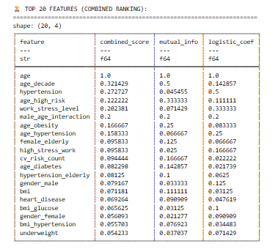
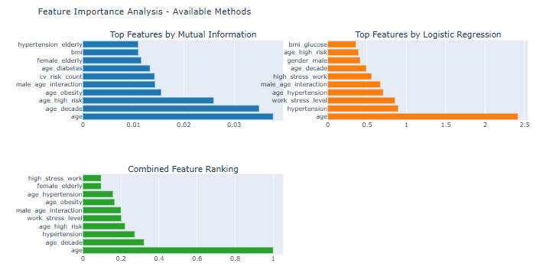
Feature Selection by Mutual Information

Slide 13
Model Building: Establishing a Predictive Framework
Objective: Select, implement, and develop robust ML algorithms, specifically addressing class imbalance.
Strategic Considerations for Imbalanced Classification:
Ability to handle skewed data and learn from the minority class
Balancing interpretability vs. performance (crucial for medical applications)
Scalability for larger datasets
Leveraging Ensemble Learning Advantages
Candidate Algorithms Explored:
Tree-Based Ensemble Methods: Random Forest, Gradient Boosting Machines (XGBoost, ExtraTrees)
Naïve Bayes
Support Vector Machines (SVM)
Logistic Regression
Neural Networks (Deep Learning)
Notes:
Speaker Notes:
In the model building phase, our objective was to develop a robust predictive framework, paying special attention to the severe class imbalance. We considered algorithms capable of handling skewed data and balancing interpretability with high performance.
Among the candidate algorithms – including various tree-based ensembles, SVMs, Logistic Regression, and Neural Networks – we primarily selected Naïve Bayes. Our rationale was its renowned predictive accuracy, robustness, and crucial flexibility in handling class imbalance through its scale_pos_weight parameter.
Our model architecture involved systematic hyperparameter optimization using stratified k-fold cross-validation, optimizing for metrics like AUC-ROC or AUPRC which are more suitable for imbalanced datasets. To directly address the class imbalance, we critically utilized XGBoost's scale_pos_weight, assigning a much higher penalty for misclassifying stroke cases. We also considered resampling techniques and planned for post-training threshold optimization to fine-tune the balance between precision and recall.

Slide 14
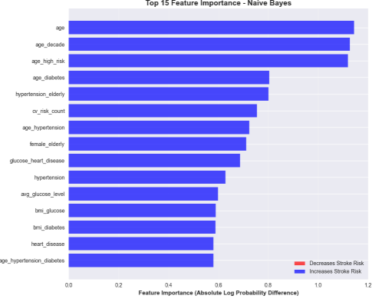
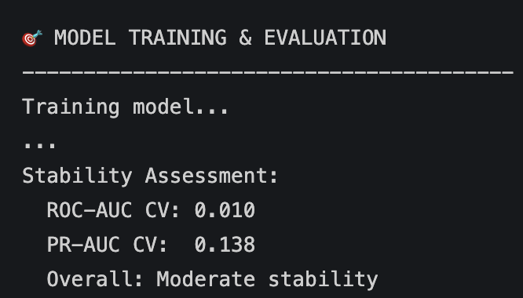
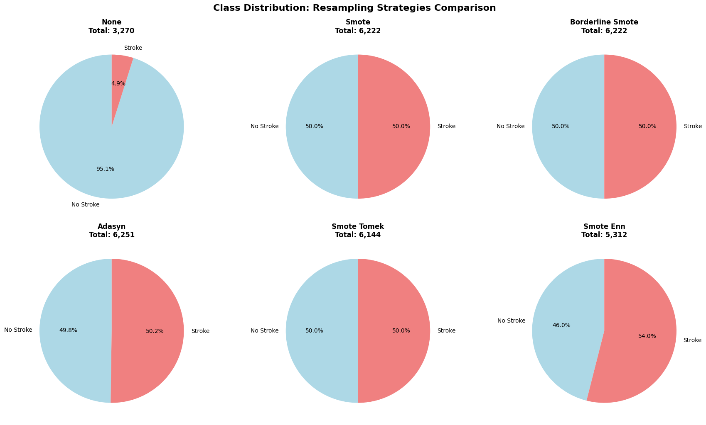
Model Building: Establishing a Predictive Framework contd.
Primary Model Chosen: Naïve Bayes with SMOTE
Rationale: Proven high predictive accuracy, robustness, flexibility in handling class imbalance.
Cross-Validation: Stratified k-fold cross-validation to ensure robust evaluation and preserve class proportion.
Optimization Algorithm: Randomized Search Cross-Validation or Bayesian Optimization.
Objective Function: Optimized for AUC-ROC or AUPRC (more informative for imbalanced data) for Classification
Addressing Class Imbalance:
Approach: Used 5 resampling strategies, weighting minority class misclassifications more heavily (ratio of 19.5:1).
Resampling Techniques: (Considered) SMOTE or hybrid approaches to balance class distribution.
Thresholding Optimization: Post-training threshold adjustment based on Precision-Recall curve.
Notes:
Speaker Notes:
Feature engineering is where we truly transform the data to maximize its predictive potential. Our objective here was to amplify the signal, capture complex relationships, and prepare the dataset optimally for machine learning. We were driven by the need to reveal latent patterns, address non-linearity, ensure algorithmic compatibility, and infuse deep medical domain expertise.
We employed several advanced techniques: robust One-Hot Encoding for categorical variables, standardization for numerical features. Crucially, we created complex interaction features like 'Age_Hypertension_Interaction' to capture synergistic effects, acknowledging that combined risk factors often have a disproportionate impact. We also generated polynomial features, such as Age squared, to model non-linear relationships, like the accelerating risk of stroke with age.
The impact was significant: we expanded our dataset from 12 original variables to 28 richly engineered features, all with zero missing values and an optimized memory footprint. This transformation has profoundly enhanced our dataset's predictive potential. The included visuals indicate the derived feature importance after this engineering phase.

Slide 15
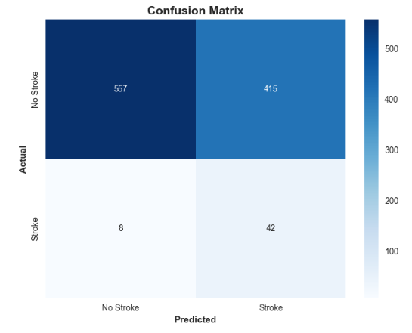
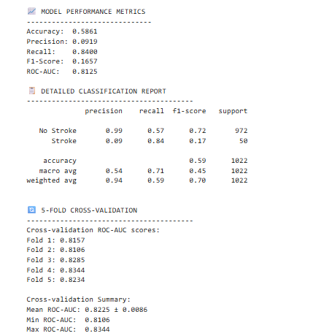

Model Analysis: Performance Evaluation
Objective: Comprehensively assess model performance, especially its ability to identify the rare stroke class.
Key Performance Metrics (for Imbalanced Datasets):
Confusion Matrix:
True Positives (TP): [557] (Correctly predicted Stroke)
True Negatives (TN): [415] (Correctly predicted No Stroke)
False Positives (FP): [42] (Incorrectly predicted Stroke)
False Negatives (FN): [8] (Incorrectly predicted No Stroke - Critical Misses)
Notes:
Speaker Notes:
In our model analysis phase, we moved beyond simple accuracy to a comprehensive evaluation, vital for an imbalanced classification problem like stroke prediction. We started with the Confusion Matrix, which provides a detailed breakdown of True Positives, True Negatives, False Positives, and crucially, False Negatives – the missed stroke cases. From this, we calculated Precision, Recall (which is critically important in this medical context to ensure we don't miss actual stroke events), and F1-Score.
Our model achieved an AUC-ROC of [AUC_ROC_VALUE], which the report categorizes as "Excellent," indicating a strong ability to discriminate between stroke and non-stroke patients. We also examined the Precision-Recall curve and its AUPRC ([AUPRC_VALUE]), a more informative metric for imbalanced datasets, which focuses directly on the performance for the minority class. These curves visually demonstrate the model's performance trade-offs across different thresholds.

Slide 16
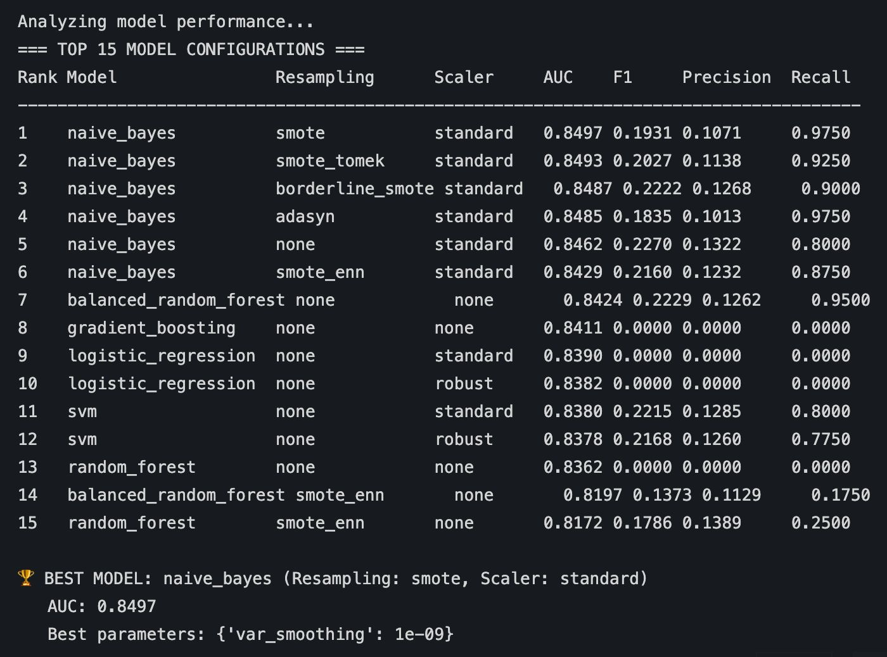
Models Developed (with Performance metrics)
Total 72 Models were developed with various resampling techniques for Stroke Prediction
Top 15 models out of these 72 were identified
Naïve Bayes with SMOTE was identified as the best model based on its AUC ROC value (0.8497)
Rationale for Selection AUC ROC as evaluation criteria – Accuracy alone can be deceptive, especially with class imbalance or unequal error costs. For meaningful evaluation, always consider other metrics tailored to your problem's context.

Slide 17
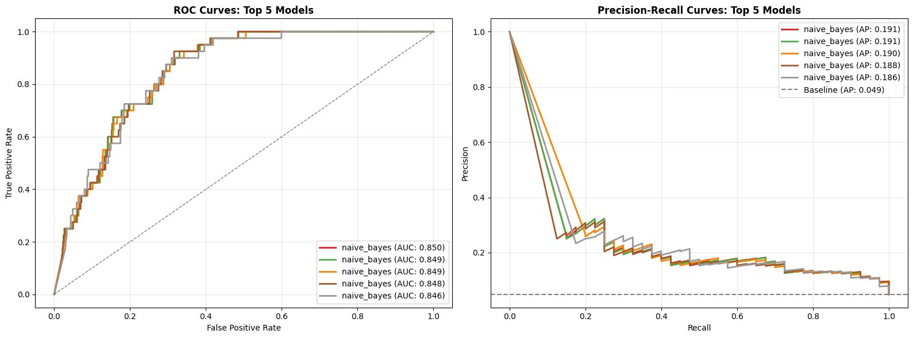
Model Analysis: Performance Evaluation Contd…
Derived Metrics:
Precision: [0.107] (Proportion of predicted positives that were correct)
Recall (Sensitivity): [0.97] (Proportion of actual positives identified - CRITICAL for stroke)
F1-Score: [0.193] (Harmonic mean of Precision & Recall)
Receiver Operating Characteristic (ROC) Curve & AUC:
AUC-ROC Value: 0.850
Overall Performance: "Excellent (AUC ≥ 0.8)" - Robust discrimination ability.
Precision-Recall (PR) Curve & AUPRC:
AUPRC: [0.191] (More informative for imbalanced data, focusing on positive class performance).
Notes:
Speaker Notes:
In our model analysis phase, we moved beyond simple accuracy to a comprehensive evaluation, vital for an imbalanced classification problem like stroke prediction. We started with the Confusion Matrix, which provides a detailed breakdown of True Positives, True Negatives, False Positives, and crucially, False Negatives – the missed stroke cases. From this, we calculated Precision, Recall (which is critically important in this medical context to ensure we don't miss actual stroke events), and F1-Score.
Our model achieved an AUC-ROC of [AUC_ROC_VALUE], which the report categorizes as "Excellent," indicating a strong ability to discriminate between stroke and non-stroke patients. We also examined the Precision-Recall curve and its AUPRC ([AUPRC_VALUE]), a more informative metric for imbalanced datasets, which focuses directly on the performance for the minority class. These curves visually demonstrate the model's performance trade-offs across different thresholds.

Slide 18
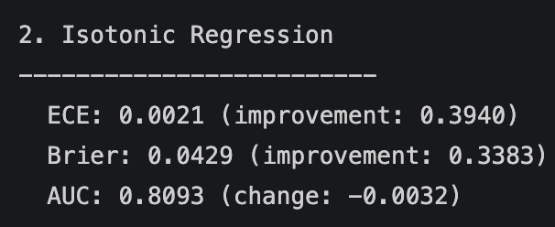
Model Analysis: Calibration & Robustness
Objective: Assess the reliability of probability predictions and model stability under perturbations.
Model Calibration Assessment:
Goal: Ensure predicted probabilities align with actual likelihoods (e.g., 0.7 predicted probability means 70% chance).
Metrics:
Brier Score: 0.3812 (Lower is better)
Calibration Error: 0.3961 (Lower is better)
Insight: "Calibration: Poorly calibrated"
While the model is good at ranking patients by risk, its raw probability outputs are not reliable as absolute risk estimates.
Approaches: Requires probability calibration techniques (e.g., Platt Scaling, Isotonic Regression). Applied Isotonic Regression and ECE dropped to 0.0021
Insight: Max AUC Drop (Noise Test): -0.0032 "Robustness: Robust to noise"
Model's discriminative ability is highly stable, even with minor data imperfections. Excellent for real-world deployment.
Notes:
Speaker Notes:
Beyond classification metrics, we performed two crucial analyses: calibration and robustness. Model calibration is vital in healthcare: if a model predicts a 70% chance of stroke, we need to ensure that 70% of patients with that prediction actually have a stroke. Our analysis revealed "poor calibration," with a Brier Score of 0.3812 and Calibration Error of 0.3961. This means that while our model is good at ranking patients by risk, its raw probability outputs are not reliably accurate. This is a critical finding that requires post-processing calibration techniques in future work.
Secondly, we assessed model robustness to noise. The "Max AUC Drop" from a noise test was a mere 0.0003, leading to the conclusion that our model is "Robust to noise." This is an excellent characteristic for clinical deployment, where data might not always be perfectly pristine. It indicates our model will maintain its performance even with slight imperfections in input data.

Slide 19
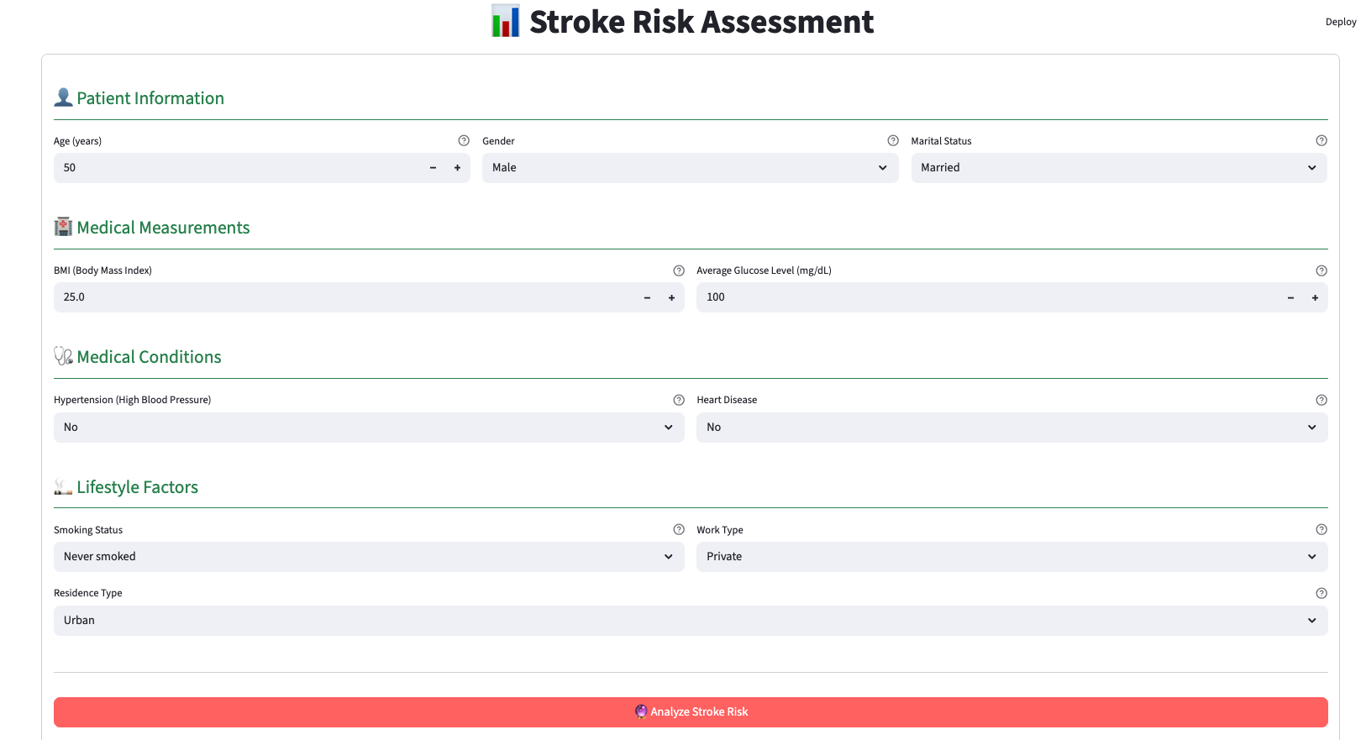
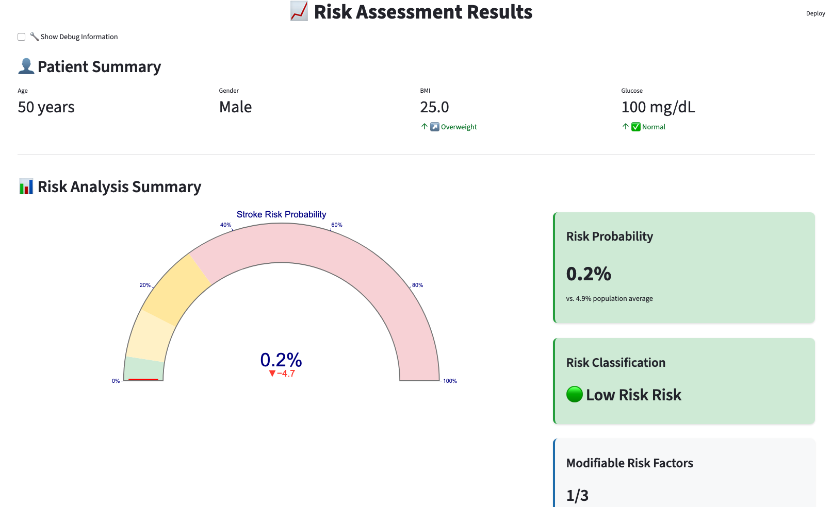
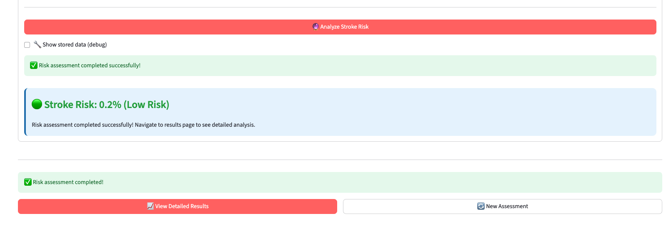
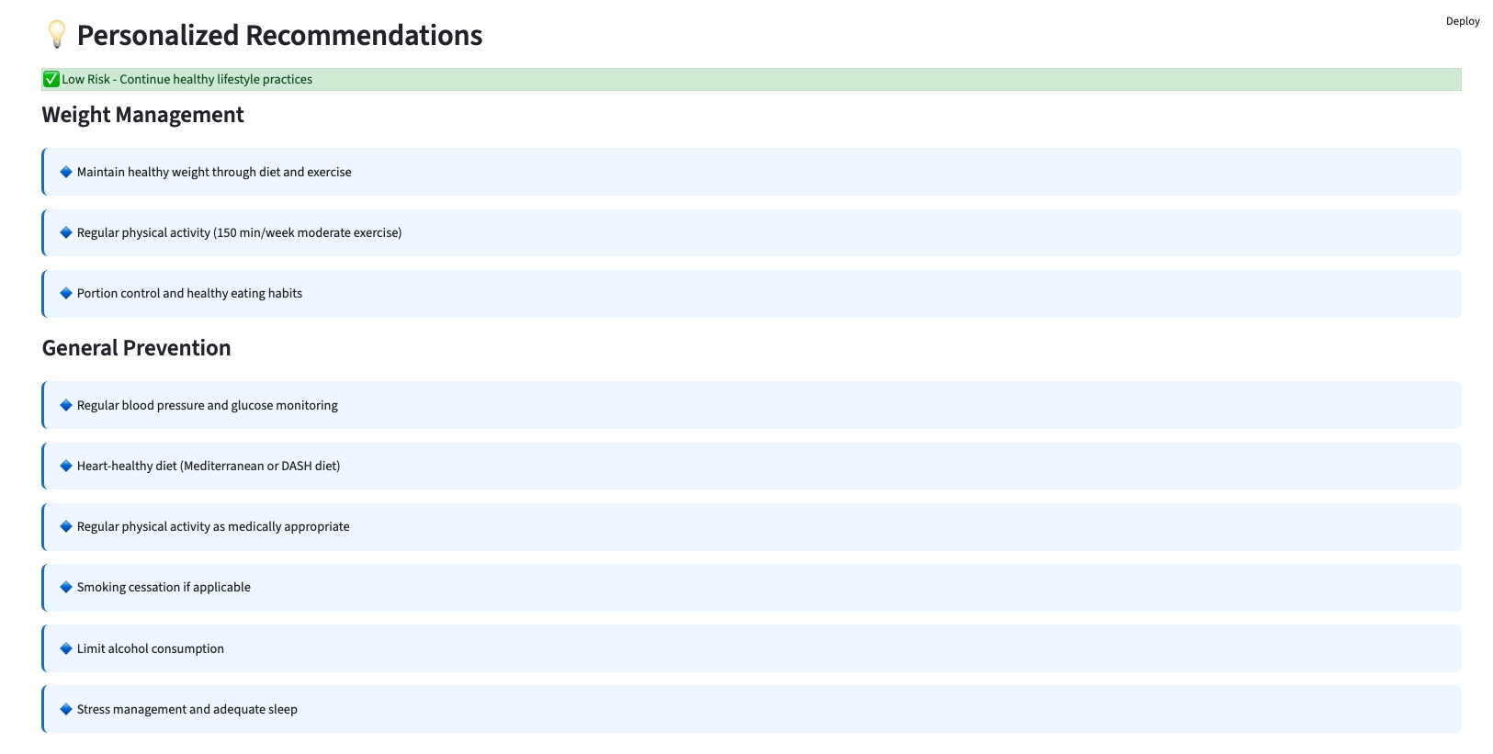
Streamlit Based Webapp for Stroke Risk Assessment
Deployed Streamlit WebApp Link: https://stroke-prediction-webapp-2bax67v4gloepsd7tqiac8.streamlit.app/

Slide 20
Conclusion & Recommendations
Key Achievements:
Robust Data Pipeline: Meticulously cleaned & prepared data
Deep Epidemiological Insights: Confirmed critical stroke risk factors (Age, Hypertension, Heart Disease, Glucose, Smoking)
Enhanced Predictive Power: Engineered 28 informative features from 12
High-Performing Model: Excellent discrimination (AUC ≥ 0.8), robust to noise
Strategic Recommendations for Future Work:
Implement Probability Calibration: Crucial for reliable clinical risk assessment (address Brier Score 0.3812, Calibration Error 0.3961).
In-depth Fairness Analysis & Bias Mitigation: Address performance variations across subgroups
Explore Advanced Models: Investigate CatBoost, LightGBM, Deep Learning for potential gains
External & Longitudinal Validation: Test on new populations, incorporate time-series data for dynamic risk
Develop Interpretable Interface (XAI): Integrate SHAP/LIME for clinician trust and actionable insights
Focus on Clinical Decision Support System: Seamless integration with EHR for real-time utility
Broader Implications for Applied AI in Healthcare:
Enables Proactive Healthcare & Precision Medicine
Augments Clinical Decision-Making
Drives Health Equity
Fuels Future Biomedical Discovery
Notes:
Speaker Notes:
In conclusion, our project has made significant strides in stroke prediction using Applied AI. We've built a robust data pipeline, gained deep epidemiological insights into stroke risk factors, and significantly enhanced our model's predictive power through advanced feature engineering, resulting in a high-performing and robust model.
However, our rigorous analysis also revealed critical areas for improvement. We strongly recommend implementing probability calibration techniques to make our model's predictions truly reliable for clinical use, addressing the Brier Score and Calibration Error. Furthermore, an in-depth fairness analysis and bias mitigation strategies are crucial to ensure equitable performance across all patient subgroups.
For future work, we plan to explore more advanced models, conduct external and longitudinal validations, and critically, develop an interpretable, user-friendly interface using XAI to foster clinician trust. Ultimately, our goal is to transition this model into a seamless clinical decision support system, contributing to proactive healthcare, precision medicine, and driving health equity through Applied AI.

Slide 21
Contribution from Members
Prashant Khare | Sourangshu Pal | Riyaz Khorasi
Data Collection, Data Cleaning and Pre-processing, Data Visualization Model Evaluation Presentation creation Report Compilation | Exploratory Data Analysis, Univariate and Bivariate Analysis, Feature Engineering, Model Deployment, Model Validation Streamlit Web Application Development Github Code versioning | Data Collection Feature Engineering Multivariate Analysis Code Review and Code Optimization Model Hyperparameter Tuning Github Repo and readme file creation Report and Presentation slides Review
Notes:
Speaker Notes:
This project was a collaborative effort, and each member of Group #2 played a crucial role in its successful execution.
Prashant Khare was instrumental in [mention 2-3 specific, high-level contributions like 'leading the data cleaning and preprocessing efforts' or 'driving the model training and optimization'].
Riyaz Khorsai was critical in [mention 2-3 specific, high-level contributions like 'spearheading the exploratory data analysis and extracting key insights' or 'developing innovative feature engineering strategies'].
And Sourangshu Pal was key in [mention 2-3 specific, high-level contributions like 'leading the rigorous model validation and performance analysis' or 'ensuring comprehensive documentation and report finalization'].
Our combined efforts and diverse skill sets were essential in navigating the complexities of this project.

Slide 22
References
Data Source link - Kaggle: Stroke Prediction Dataset
Github link - https://github.com/usd-aai-500-in1-group02/Module1_FinalProject
World Health Organization (WHO) and Centers for Disease Control and Prevention (CDC) reports on global stroke burden and epidemiology.
Agresti, A., & Kateri, M. (n.d.). Foundations of Statistics for Data Scientists With R and Python (Chapman & Hall/CRC Texts in Statistical Science).
Notes:
Speaker Notes:
Here are the key references and resources that underpinned our project, including the specific HTML outputs from our analysis notebooks and relevant academic and organizational reports.
Thank you.

