Slide 1
Equity Delivery
U.S. Digital Service // // 2023-2024

Slide 2
Hello.
We’re the USDS Equity Delivery Team, and you can join us.
Celeste Espinoza
Designer
Jeremy Zitomer
Engineer
Alex Bornkessel
Designer
Natasha Jamal
DEIA Director

Slide 3
Equity is everyone’s job
"Advancing equity is not a one-year project – it is a generational commitment that will require sustained leadership and partnership with all communities.”
President Joe Biden
Notes:
No matter your role, equity should matter to you. No matter where you are with your equity fluency, journey – we can always learn more. When it comes to equity, there is always room for improvement.

Slide 4
Equity is not a checklist
What’s one way you can lean into equity in your work? OR
What resources are you currently using to help you, your team center equity in your work? OR
Where are you, your team struggling with equity? OR
What can we help answer or help you work through in this conversation?
Notes:
No matter your role, equity should matter to you. No matter where you are with your equity fluency, journey – we can always learn more. When it comes to equity, there is always room for improvement.
There’s always more to learn.

Slide 5
Tools You Can Use

Slide 6
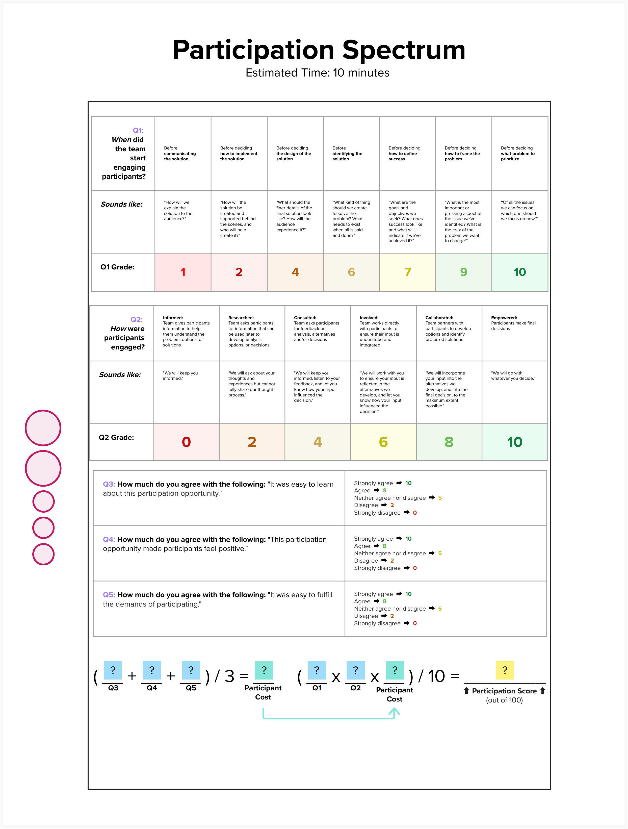
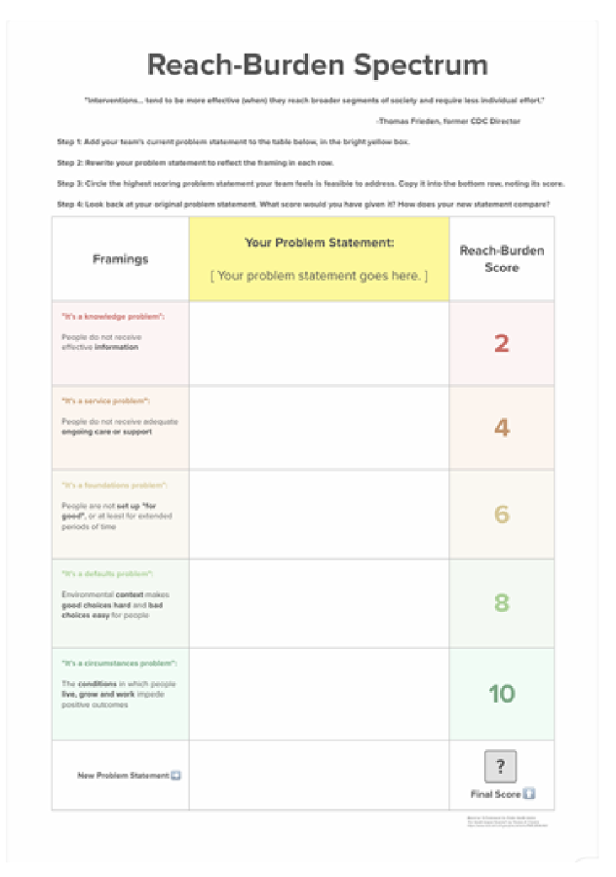
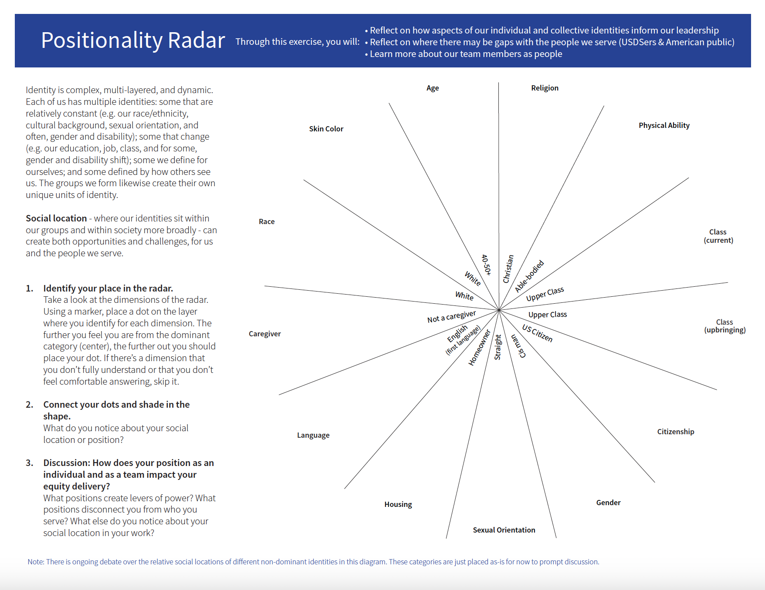
At-a-Glance
Reach Burden Spectrum
Positionality
Participation Spectrum

Slide 7
A Closer Look
Reach Burden Spectrum
Positionality
Participation Spectrum
Why? USDS teams can benefit from adjusted problem statements that maximize reach and minimize burned for the people we serve.
Desired outcome: Challenges teams to consider different levers of change and do a risk-benefit analysis among them.
Who’s using it? FFS IVaaS, HHS Grants.gov, CMS Cybersecurity, Project Toolkit, CX Disaster Relief
Why? USDSers need better awareness of the limitations of their own perspectives to deliver equitable outcomes.
Desired outcome: Prompts teams to reflect on their lived experiences and highlights gaps and opportunities between the team’s experience and the communities being served.
Who’s using it? USDS Leadership, HRSA OPTN, FFS IVaaS, CX 0-5
Why? USDS teams don’t have a simple and meaningful way to evaluate the integrity of public participation.
Desired outcome: USDS teams develop a North Start for the timing, burden and purpose of pubic participation.
Who’s using it? HRSA OPTN, SSA*, CX 0-5, DOJ NLEAD

Slide 8
Keep going
Looking for tools and resources?
Equity Git Repo
Have a question or something you want to troubleshoot?
Equity Consultation
Want to connect with equity practitioners?
Equity CoP

Slide 9
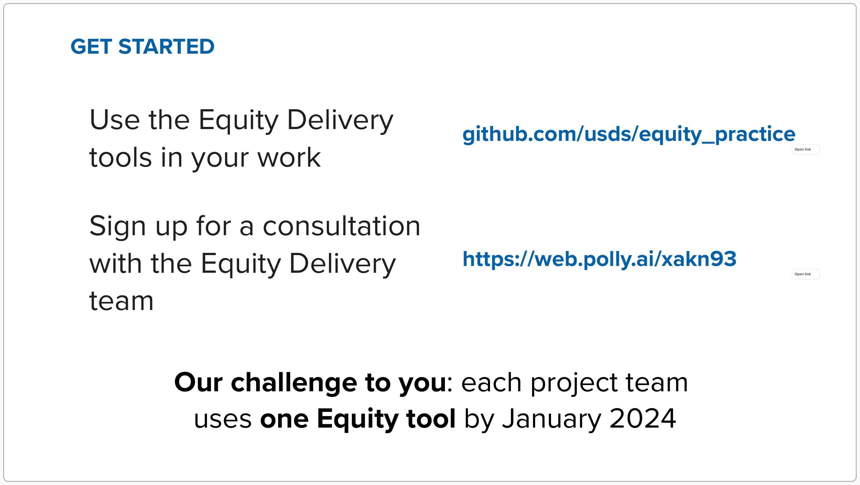

Slide 10
Discussion

Slide 11
Extra

Slide 14
Origin Story

