Slide 1
National Law Enforcement Accountability Database (NLEAD): Handoff Document
DRAFT: DELIBERATIVE AND PRE-DECISIONAL
U.S. Digital Service // February 2024
Notes:
Thank you for taking the time to meet with us, and we appreciate the collaboration and sense of One Team One Dream that we’ve built in standing up and launching the National Law Enforcement Accountability database. It has been an honor to embed with the JMD team and to earn trust with many of the components across the DOJ. I’m going to tell you about the project, what we did, what we learned, and what next steps are. I’m excited to be part of a data driven culture – really excited to be part of the movement toward data driven decision making in the government. I think this project showed how this can happen. BUT – this didn’t come without growing pains. Let’s talk about what we accomplished.

Slide 2
Executive summary
Context: Post-discovery sprint – USDS embedded with the DOJ team from August 2023 – February 2024 to support the launch of the National Law Enforcement Accountability Database.
Summary of Progress: Congratulations to the DOJ for successfully launching the database on schedule and for prioritizing security and end users.
Remaining Risks: Uncertainty around data compliance remains one of the biggest risks across the interagency and DOJ needs a clear plan for stakeholder engagement to reduce risk of limited adoption, poor public reception, and litigation.
The Work Ahead:
DOJ Justice Management Division: Operationalize data quality and compliance to enable data-driven project decisions.
DOJ: Set up an interagency governance structure with diverse stakeholders like DCSA, DHS, and BJS to include multiple perspectives to ensure the success of NLEAD.
DOJ: Develop a path forward for STLT users to access NLEAD & iterate on stakeholder engagement with non-Federal partners to fulfill the EO commitment about public trust.
DPC: Continue to support NLEAD implementation with monthly check-ins to maintain alignment.
DRAFT: DELIBERATIVE AND PRE-DECISIONAL
Notes:
Take a beat – the work ahead is what they’re already doing – on the right path – they’re headed down this path. Rolling off because we’re confident in this team. Re #2: DOJ’s key partners outside of the federal government include law enforcement organizations, police officers, judiciaries, civil society organizations, and the communities we serve. Put another way:
Duty-bearers, e.g. police depts, FOP, personnel security, local/state govts, community advisory boards
NGOs and CBOs, e.g. civil rights orgs, legal associations, victim/witness orgs
The communities we serve, i.e. affected individuals or businesses without a relevant, binding fiduciary/governing/job responsibility

Slide 3
Meeting A NEED
We’re actually just finalizing the process of catching two inspectors who were doing exactly what this database is designed to stop. They were working somewhere until they got wind that they were under investigation and moving somewhere else before it could catch up to them. ​
- Agency onboarding meeting
DRAFT: DELIBERATIVE AND PRE-DECISIONAL

Slide 4
Background
Notes:
Quick touch on background

Slide 5
SCOPE OF THE WORK: Section 5 of EO 14074
Section 5 of EO 14074 on Accountable Policing outlines that DOJ shall establish a ‘National Law Enforcement Accountability Database’ (NLEAD) with misconduct and commendation records to inform hiring decisions
EOP and DOJ leadership aligned that the NLEAD would be launched by end of calendar year 2023, as noted in a May 2023 White House Fact Sheet
NLEAD launched on December 18, 2023
Interagency data submitted on February 16, 2024
Public report will launch in December 2024
* USDS signed an MOU in August 2023 and supported the project through March 2024. Thank you to our DOJ colleagues for partnering to meet this aggressive timeline
DRAFT: DELIBERATIVE AND PRE-DECISIONAL

Slide 6
STAKEHOLDERS ENGAGED AND USDS STAFFING
Federal Stakeholders | Non-Federal Stakeholders
EOP Stakeholders Domestic Policy Council, Racial Justice and Equity Team (RJE) White House Counsel (WHCO) | Civil society stakeholders International Association of Law Enforcement Standards and Training (IADLEST) International Association of Chiefs of Police (IACP) Fraternal Order of Policy (FOP)
Stakeholders across the DOJ Office of the Deputy Attorney General Justice Management Division, leadership and the PMO office Office of Privacy and Civil Liberties | Congressional Black Caucus
USDS team Karin Underwood (Product), Sunil Manchikanti (Design), Laura Chang (Design), Keith Otis (Data Science), and Kyle Aungst (Engineering)
DRAFT: DELIBERATIVE AND PRE-DECISIONAL

Slide 7
SELECTED PRESS and external inquiries
New US background database unlikely to stop police misconduct, critics warn | US policing | The Guardian (emphasizes that it’s hard to know whether it’s working in its current state, potentially indicating the risks of limited external engagement)
The Justice Department has launched a database to track law enforcement misconduct | AP News (also emphasizes that it is internal only)
Recent FOIA request seeking full contents of NLEAD database
DRAFT: DELIBERATIVE AND PRE-DECISIONAL
Notes:
BUT – this didn’t come without growing pains.

Slide 8
LASTING TECHNICAL STRUCTURES
Legal Documents
System of Records Notice
User Agency Agreement
Privacy Impact Assessment
Policy Documents
Deputy Attorney General Memo and follow-up Human Resources memo on usage
PAC PMO CONOPS paper to implement NLEAD within the federal investigative standards
Technical Structures
Authority to Operate
DRAFT: DELIBERATIVE AND PRE-DECISIONAL

Slide 9
NLEAD WINs
The DOJ team rapidly staffed up contractors through an existing contract vehicle, which allowed development to begin
JMD has brought an iterative mindset to product development, with practices like scrum and agile
The JMD team has engaged with USDS during several rounds of user research, leading to a more informed product
DRAFT: DELIBERATIVE AND PRE-DECISIONAL

Slide 10
Findings: EARLY Metrics SHOW Promising participation
Outcome Metrics
Agencies with Data in Production | Est. Total | Q4 2023 | Q1 2024 | Increase
Federal Law Enforcement Agencies / Sub-Agencies | 57 | 7 | 41 | +587%
Target |  | 2 | 15
Total |  | 12%
Records | Est. Total | Q4 2023 | Q1 2024
NLEAD Records | 3308 | 381 | 1432 | +375%
Target |  | 500 | 3000
Total |  | 76% | TBD
Users | Est. Total | Q4 2023 | Q1 2024
NLEAD End Users | 18400 | 16 | 366 | +2287%
Target |  | 100 | 100
Total |  | 16% | 29%
Queries | Est. Total | Q4 2023 | Q1 2024
NLEAD Queries | - | 31 | 939 | +303%
Target |  | 100 | -
Total |  | 31% | -
* Data last updated from AWS on 3.5.2024
DRAFT: DELIBERATIVE AND PRE-DECISIONAL
Notes:
System in the early phase of development

Slide 11
The Work Ahead

Slide 12
Consensus Next STEPS for DPC/WHCO/DOJ + USDS
DOJ ODAG: Measure the data consistency across the interagency – ask for metrics on a regular basis to understand how NLEAD is working across the government.
DOJ Justice Management Division: Prioritize data-driven project decisions (i.e. by staffing a data expert).
DPC RJE: Continue to support NLEAD implementation with monthly check-ins.
DOJ Justice Management Division: Set up an interagency governance structure with representation from ‘data stakeholders’ like DCSA, and iterate on stakeholder engagement, including a feedback structure for non-Federal partners.
DOJ: Fulfill EO commitment by making a meaningful path forward for State, Local, Tribal, and Territorial (STLT) users to access NLEAD.
USDS: Potential to lead a stakeholder engagement workshop.
DRAFT: DELIBERATIVE AND PRE-DECISIONAL
Notes:
This is not new – this is what the team is already doing. CAN DO
JMD is the only team that has a business need for visibility across the entire data ecosystem. Only team that can and should be looking to see possible discrepancies in the way that data was collected and provided between agencies.

Slide 13
Integrate data, development, and design expertise directly in the DOJ OCIO and JMD TEAM TO SUSTAIN NLEAD
1
Get long-term trusted resources in place, included by funding human centered design and in-house data science.
The DOJ is dependent on contractors, and which led to costly turnover in this project due to a lack of communication and alignment.
Mission-focused developers would join the DOJ team in-house, especially to focus on a social-impact project like NLEAD (USDS validates this).
Position in-house tech to develop domain expertise that can help improve the project.
Cross-functional teams with expertise on both technology and end-user needs can reduce the overall risk in project delivery.
DRAFT: DELIBERATIVE AND PRE-DECISIONAL

Slide 14
Provide resources and support for Reporting, STAKEHOLDER ENGAGEMENT, and interagency governance
2
Observations and Recommendations
The Justice Management Division should regularly provide bi-weekly or monthly proactive updates to ODAG to minimize direct ODAG management of NLEAD.
PMO can collaborate with HRA to contribute to these.
JMD should provide a product roadmap to ODAG in order to communicate the 1-year and 5-year product plan.
Develop a stakeholder engagement plan for key non-Federal partners
Create an interagency governance structure with both DCSA and BJS to represent end users and ensure that we continue to monitor data quality over time
DRAFT: DELIBERATIVE AND PRE-DECISIONAL

Slide 15
Expand Role-Based access for State and Local Law Enforcement
3
To fulfill the EO requirement to encourage STLT LEAs to contribute to and use the NLEAD, DOJ will need to issue guidance and technical assistance. Next steps could include:
Plan for how NLEAD data will intersect with data from the National Decertification Index
Create clear messaging for STLT LEAs how and when to contribute to the NLEAD vs. NDI
Host a joint convening with NDI users and the DOJ to celebrate the shared accountability efforts
Further assess the data ownership rights and security specifications of the NDI and enter data sharing agreements as needed with IADLEST
Note: As documented in our USDS discovery sprint, this should be a ‘fast follow’ after the NLEAD launch.
DRAFT: DELIBERATIVE AND PRE-DECISIONAL

Slide 16
POTENTIAL 1-YEAR and 5-YEAR Roadmaps
Targets | 2024 Scope | 2029 Scope
Officer types included | All by February 16th | All across all agencies
Contributing LEAs - Federal | DOJ Agencies DHS DOD | All agencies regularly committing data, with automated reporting systems
Contributing LEAs - STLT | No contributing STLT LEAs | Collaboration between NLEAD and STLT LEA Data
Querying LEAs - Federal | DOJ agencies (ATF, DEA, FBI, OIG, USMS) and 1 DHS agency | All FLEA personnel security
Querying LEAs - STLT | No ability to query | Ability to query a Y/N function
Non-Federal stakeholder engagement | IADLEST | Range of LEAs and civil society orgs
Annual report | Initial annual report | Regular public reporting
Data submission pathway | Highly manual data collection with record review | Standardization / automation within agencies
DRAFT: DELIBERATIVE AND PRE-DECISIONAL

Slide 17
SUSTAINMENT/OWNERSHIP MOVING FORWARD
Decision/ Workstream | ODAG | Executive Board | Advisory Board | Working Groups | JMD Product + TSP | JMD PMO | JMD HRA | AAG | OIGs
Governance Process Changes | Responsible | Consulted | Consulted | Informed | Informed | Informed | Informed | Informed | -
Data integrity evaluation and user feedback | Informed | Accountable | Informed | Consulted | Responsible | Consulted | Consulted | Informed | -
Non-federal stakeholder engagement | Consulted | Accountable | Consulted | Informed | Informed | Consulted | Consulted | Informed | -
Data schema improvements | Informed | Accountable | Informed | Consulted | Consulted | Responsible | Informed | Informed | -
DOJ Compliance strategy and communications | Consulted | Consulted | Consulted | Informed | Consulted | Responsible | Consulted | Informed | Accountable
Product Decisions/ Product Improvement | Informed | Informed | Informed | Consulted | Accountable | Responsible | Consulted | Informed | -
PAC PMO Regulatory Change | Informed | Informed | Accountable | Informed | Informed | Informed | Responsible | Informed | -
Financial Sustainment | Informed | Informed | Informed | Consulted | Responsible | Consulted | Informed | Informed | -
OIG engagement | Informed | Informed | Informed | Informed | Informed | Responsible | Consulted | Informed | -
SLTT workstream | Informed | Informed | Informed | Informed | Informed | Informed | Consulted | Responsible | -
DRAFT: DELIBERATIVE AND PRE-DECISIONAL

Slide 18
OPPORTUNITY

Slide 19
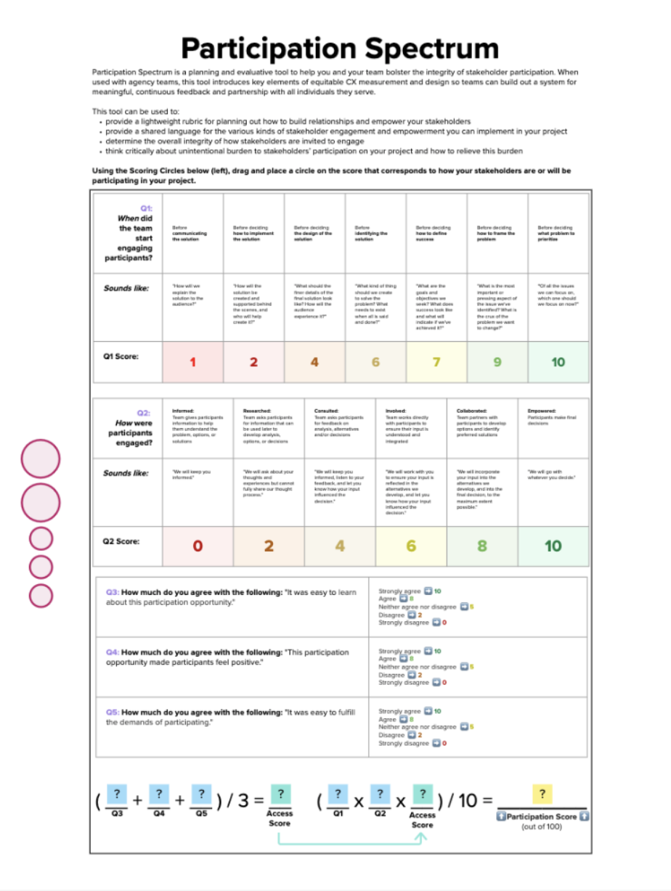
USDS can help you build a plan for stakeholder engagement
A USDS tool – the Participation Spectrum – enables agencies to design a meaningful approach to stakeholder engagement that optimizes the timing, burden, and purpose of engagement.
Notes:
USDS can help build out a plan through a workshop and various tools, and this is an example of one of these tools. The dimensions of robust stakeholder engagement include:
Timing: When stakeholders are being engaged
- Timing done well means engaging people early
Purpose: To what extent stakeholders’ input is heeded
- Purpose done well means listening to people when they speak
Burden: How easy it is for stakeholders to engage
- Burden done well means making it easy for people to engage
Representation: Which stakeholders are being engaged
- Representation done well means casting a wide net, with specific focus on those most impacted
We might consider that each of these different dimensions supports a core tenet of demonstrating public trust–those tenets being competence, integrity, and concern. For example, if you’re willing to ”show your work” by bringing in the public early, that demonstrates competence. If you heed the input you are given, that demonstrates concern. And so on.
Now, USDS has curated a collection of tools and workshops designed to maximize public impact and promote robust stakeholder engagement across agencies.
<Read slide content>
More information on the Participation Spectrum available in the appendix.

Slide 20
THANK YOU
Notes:
The fact that we now have 41 agencies and robust data shows what we can do with these kinds of efforts. As we roll off, thank you.

Slide 21
APPENDIX

Slide 22
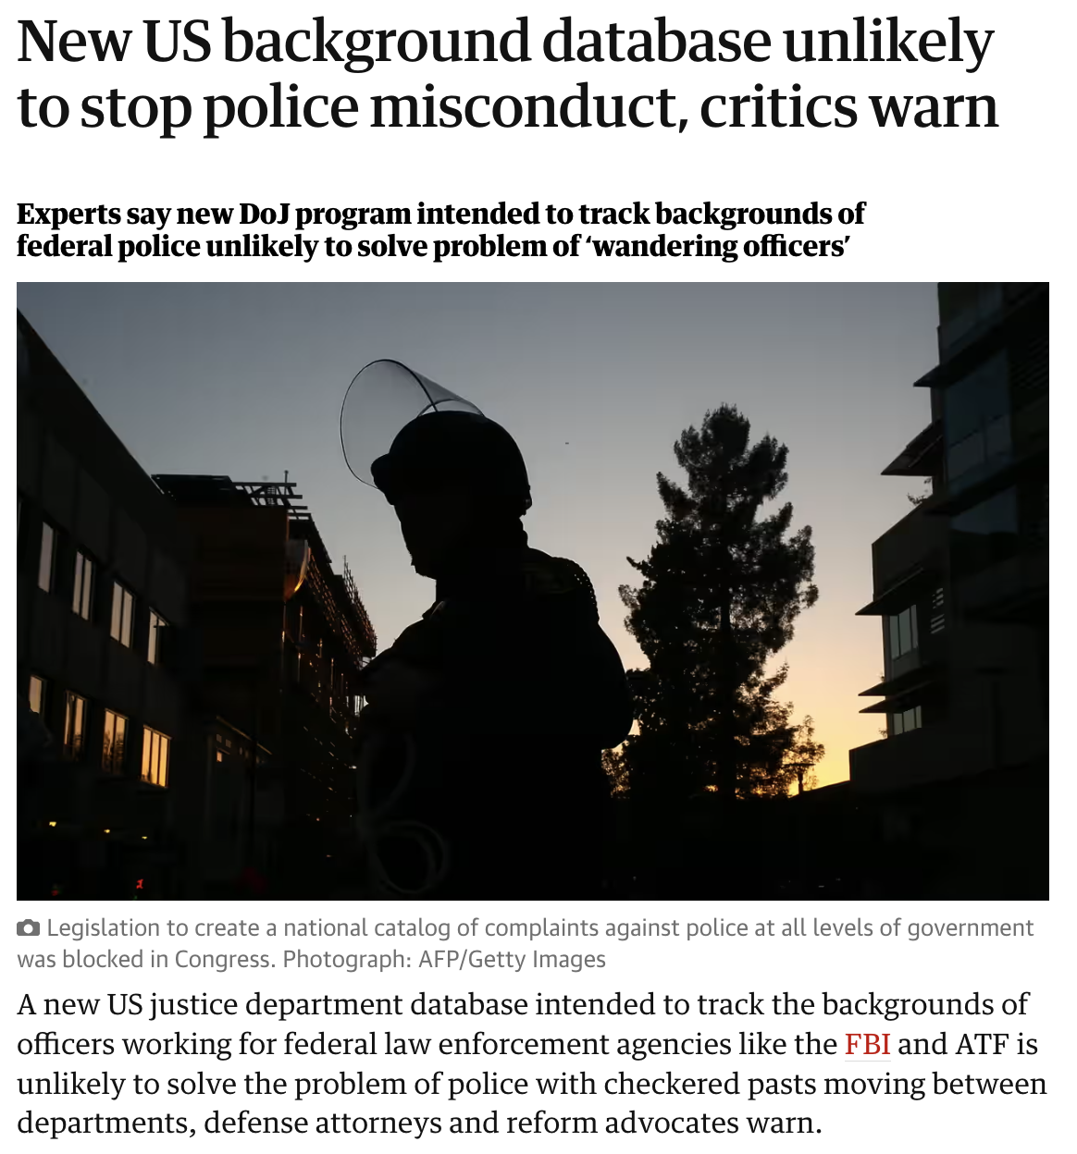
For discussion: In what ways might the future success of NLEAD depend on stakeholder engagement?
Source: The Guardian
Notes:
Extra voiceover question: what risks might DOJ mitigate?

Slide 23
SOME WAYS YOU MIGHT USE THE PARTICIPATION SPECTRUM
The “Relationship Tracker”
Best for: Agencies or teams whose success depends on maintaining strong relationships with stakeholder communities.
How it Works: Creates a time series plotting the extent to which stakeholders feel their input is heeded, over time.
Value-Add: Visualizes the strength of various stakeholder relationships, identifies relationships in danger.
The “Pulse Check”
Best for: Agencies or teams who want fast feedback on the resonance of stakeholder engagement touchpoints.
How it Works: Collects stakeholder feedback on the difficulty and psychological impact of every engagement touchpoint.
Value-Add: Measures baseline investment and interest with new stakeholder groups; enables fast iteration on engagement styles.

Slide 24
NLEAD Data Quality Sprint Debrief and Lessons Learned
Date: 1/30/2024
For Delivery to: NLEAD Program Team (NLEAD PMO, NLEAD Advisory Board, NLEAD HRA)

Slide 25
Context for Review
General profile of NLEAD interviewees
Sprint of 5 data calls (ATF, BOP, FBI, USMS, DEA)
Generally, HR related staff
Technical skills varied, but only two representative agencies claimed technical knowledge
Mostly Data Manager roles and/or their support staff
Suggestion for additional discussions
Legal Staff (completed reviews for all agencies and made final determinations)
Suitability Staff (to get more information on usage of the front NLEAD UI)

Slide 26
Agency Data Preparation
Almost all agencies followed this process:
Initial data pull loosely based on criteria matching NLEAD
Example: Pulling a larger population of misconduct data from an HR system
First pass at removing folks who do not meet NLEAD criteria
Generally manual with OGC involved
Usually required reviewing every record by hand
Some agencies had an interim manual step to add in data from other systems like job codes or duty stations. Or IT support staff to help with formatting.
Final legal review
Also manually reviewed all records

Slide 27
Agency Issues
Data could be in multiple systems.
No set methodology or job code directly aligns to NLEAD
Manual Review of each individual from a data and legal standpoint
Unclear definitions
Some of these have been clarified, such as LEO or adjudicated record versus exhausting all appeals
For clarified definitions it should be revisited with the pilot agencies to make certain they all add, update, or remove records that do not meet these definitions
Other questions still pending (see Areas for Clarification)

Slide 28
Unique Agency Solutions
Of DOJ agencies interviewed, 3 of 5 are planning or have implemented policy and/or system changes to facilitate data collection for NLEAD
One agency allowed us to share their solution:
Generated a new report (they worked with an in-house staff developer to build it) to allow them to export a csv report with 8 types of misconduct and 7 flags of NLEAD to support data request moving forward
System changes to support data attribute such as job series or duty station (deprecated)
Procedural changes to flag records at time of adjudicated decision with correct flags

Slide 29
Data Review Utility (Future Backlog)
Of agencies interviewed, 3 of 5 expressed interest in a data review utility
3 of 5 agencies would like a way to review data in NLEAD
1 agency strongly requested the ability to not only view/audit but also maintain their data in NLEAD (Add, Update, Delete)
If a live application change was not in scope, 2 agencies requested a report of all active records on a quarterly or yearly basis

Slide 30
Opportunities / Needed Clarification
Event Date
If a person had repeated offenses of the same action that were related, what event date should be utilized? Stated another way: Do you use the first or last date all actions were related and reviewed together?
Resignation and Retirement under Investigation/Appeals
Agencies still need clarity on the following: If someone separates while under investigation they need to have a flag provided even though it is not fully adjudicated or exhausted appeals
Death or Notification of Deceased
If an LEO is deceased, should their records be sent to NLEAD?
If an LEO dies while a record is still active in NLEAD, what should happen with that information?
Further Clarity of Definitions Provided
Could certain definitions have examples or additional clarity? Example: What constitutes ‘Excessive Force’ or is misuse of funds considered ‘Theft’?

Slide 31
Suggested Areas for Clarification Continued
Data Collection after Separation
What are the expectations for data collections AFTER separation? An agency was concerned that they were now being asked to continue to follow up on the investigation and provide flags (such as a 1 for a later criminal conviction) AFTER separation. Clarity is needed.
Assistance with actions required post NLEAD
Prior to NLEAD, if another agency had called to request information about a prior employee HR would have only provided dates of employment, and nothing else. What are the expectations for disclosure when someone contacts them now?
Timeframes for Future (Productization)
What will be the exact time of data pulls after the next off cycle request for the expanded LEO definition? Their procedures will always require a final manual verification of the data and they would like to have a concrete timeframe so they can reserve resources for data pulls. Example: Every 90 days from X date going forward.

Slide 32
Guidance Needed
Further Definition and Follow Up
Along with Agency questions, we learned that some agencies have interpreted data points differently. These should be addressed for data quality
Example: Agencies may have slight variations on what makes the “event date” Some may be using the first known date in a series of related events some are using the last event. Others have provided no clarity on how they decided each event should be combined or separated.
Example: Some agencies provided records only when appeals were exhausted. Some provided records after the adjudication was complete
File Creation
Two agencies still expressed concerns, either on the cadence of prepping data or on the creation of the file format.
All agencies expressed appreciation that they had a person willing to do a live call, for assistance. Having these staff on call would be helpful moving forward.

Slide 33
Summary and Recommendations: NLEAD & Agency Lessons Learned
Personal Touch
All agencies expressed appreciation of resources that were available to help them with the process of data creation
Expect personnel will need to be available for more than email support
May need clearance level to be able to see data and issues
Data Manager Utility
Most agencies would appreciate a utility for data review as well as a method for update and deletion
Many agencies have secondary staff that assist in data prep and need reports or access to assist the Data Manager
Later Touchpoints
Agencies may not come forward with questions but will ask them if a small group opportunity is present
Later review will allow NLEAD an opportunity to improve data quality by finding weak areas of interpretation

Slide 34
Summary and Recommendations: NLEAD & Agency Lessons Learned
Later Touchpoints Continued
Several agencies suggested meeting with other staff for feedback on the UI and data questions after the NLEAD product has been in use for a period of time. Top areas for feedback that have not yet been solicited after go live:
Legal
Suitability staff

Slide 35
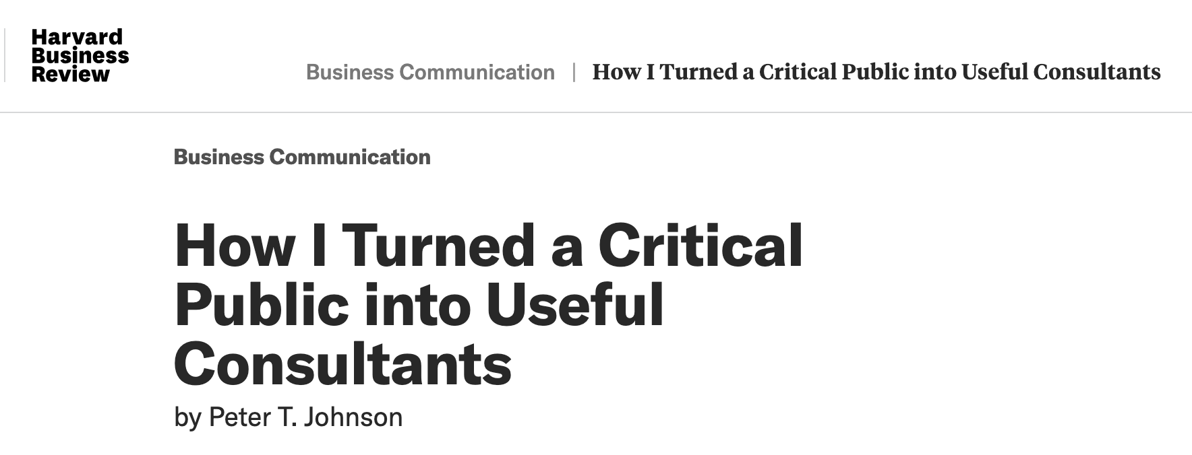
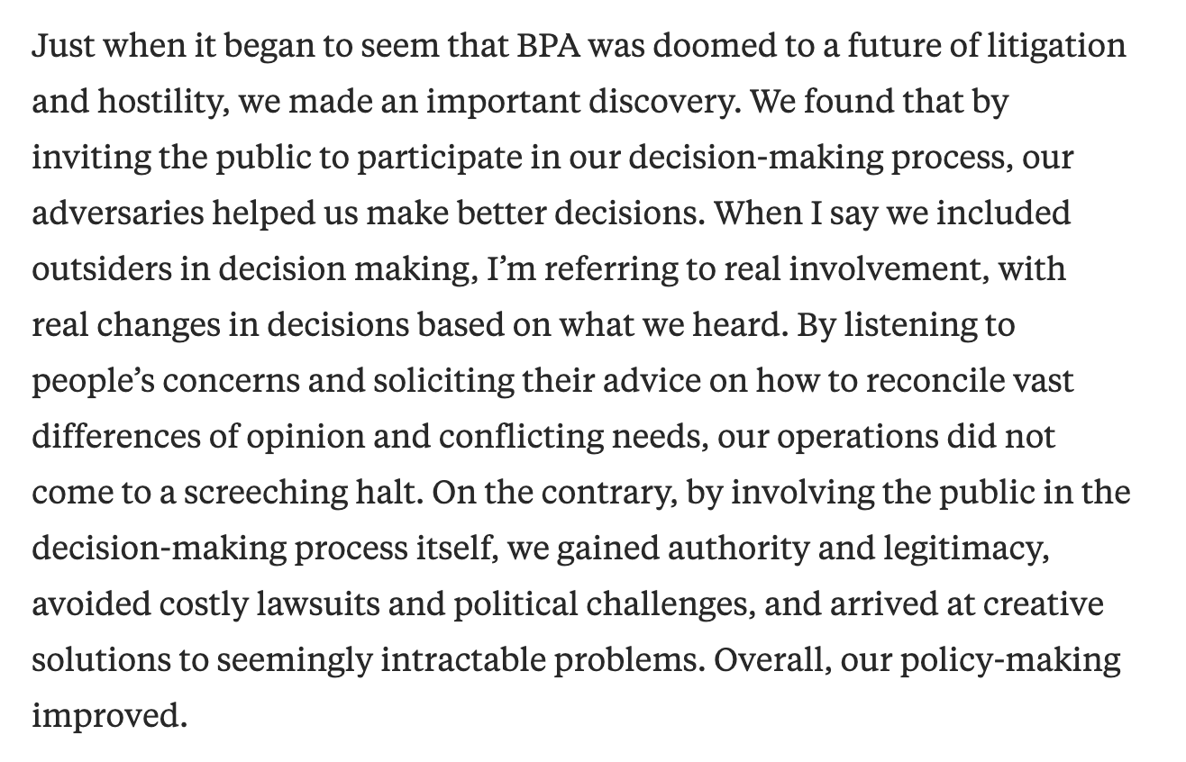
WHY non-federal STAKEHOLDER ENGAGEMENT IS CRITICAL
Builds public trust
Creates more effective policies, programs and products
It’s risk mitigation
Surfaces issues early
Reduces litigation
More cost-effective
For discussion: How might DOJ develop a stakeholder engagement plan that builds trust, minimizes risk, and maximizes effectiveness of NLEAD?
DRAFT: DELIBERATIVE AND PRE-DECISIONAL
Notes:
<Voiceover below after reading off the bullets>
One of my favorite stories of stakeholder engagement: the Bonneville Power Administration, or BPA, a federal agency created to market and transmit hydroelectric power in the Pacific Northwest.
A few years back, in the midst of major financial and reputational stresses including the near-failure of some of its major power plants, the BPA, began receiving complaints from major constituencies that its public involvement opportunities were limited to a project by project basis, and did not offer involvement on major strategic decisions and on budget. BPA’s own attorneys warned their administrator, Peter Johnson, against increasing public involvement, warning that it would force the premature release of important documents, that BPA would forfeit its flexibility and become hostage to its own policies and guidelines, that outsiders would have the leverage to make unreasonable demands, and that BPA would become vulnerable to lawsuits left and right.
However, other advisors warned Johnson that public outcry for BPA to be more accountable was not going to disappear and that attempts to exercise arbitrary authority would get them into trouble. The legal risks the attorneys had pointed to were real, but those risks had to be balanced against many other risks to the organization. In the private sector, third parties had limited power to bring down a business, but in a government agency, political pressure and litigation could absolutely keep the organization from implementing its programs. That risk had to be taken seriously.
After extensive consideration, Johnson ultimately decided to embrace the route of public participation. BPA began consulting extensively with the public on policy decisions, including both strategic issues and program implementation plans, particularly around BPA's rate-setting decisions. Not only was public response very favorable, but the amount of litigation surrounding BPA's rate-setting process reduced dramatically.
Back to NLEAD, I think we can all agree that similar problems are already knocking on our door – the Muckrock FOIA request is a canary in the coalmine that it would be unwise for us to ignore.

