Slide 1

Justice40 Open Source Community Orientation
U.S. DIGITAL SERVICE // LAST UPDATED OCT 2021

Slide 2
Front matter
Agenda, working agreements, etc

Slide 3
What’s in here?
FRONT MATTER
Justice40 Initiative Overview
Justice40 Open Source Community
What we’re building and why?
What do we mean by open source?
Ways to participate

Slide 4
Working agreements
FRONT MATTER
Embrace a culture of learning, and educate each other.
Take space and give space.
Be present.
When joining a conversation for the first time, please introduce yourself by providing a brief intro that includes:
your related organization (if applicable)
your pronouns
disclosure of any current or potential financial interest in this work

Slide 5
Justice40 Initiative

Slide 6
What is Justice40?
JUSTICE40 INITIATIVE
Justice40 is a government wide effort to ensure that federal agencies work with states and local communities to make good on President Biden’s promise to deliver at least 40 percent of the overall benefits from federal investments in climate and clean energy to disadvantaged communities directed by the Biden Administration’s January 27th Executive Order 14008.
https://www.whitehouse.gov/briefing-room/presidential-actions/2021/01/27/executive-order-on-tackling-the-climate-crisis-at-home-and-abroad/

Slide 7







Focus program areas
JUSTICE40 INITIATIVE
Climate change
Clean energy and energy efficiency
Clean transit
Affordable and sustainable housing
Remediation of legacy pollution
Clean water infrastructure
Training and workforce development
(related to climate, natural disasters, environment, clean energy, clean transportation, housing, water and wastewater infrastructure, and legacy pollution reduction, including in energy communities)

Slide 8









Who is working on the Justice40 initiative?
JUSTICE40 INITIATIVE
White House Environmental Justice Advisory Council (WHEJAC)
Inter Agency Council (IAC)
Executive Office of the President
You are here!
Council on Environmental Quality (CEQ)
Office of Management and Budget (OMB)
United States Digital Service (USDS)
Justice40 Open-Source Group
National Climate Advisor

Slide 9
Justice40 Open Source Development

Slide 10
The role of USDS (usds.gov)
JUSTICE40 OPEN-SOURCE COMMUNITY
USDS is assisting CEQ in developing the definition of disadvantaged communities and assisting agencies in their Justice40 work.
We are:
Building an open-source geospatial Climate and Economic Justice Screening Tool (CEJST)
Launching an open data platform to make the source datasets, tooling, and related discussion publicly available
Bringing together working groups to help
Enriching and “ground truthing” the data with the participation of the communities most affected

Slide 11
Goals of USDS Environmental Justice Team
JUSTICE40 INITIATIVE
Ensure government benefits and investments go to the most historically overburdened and underserved communities
Empower communities to participate in decisions that may affect them
Improve the government's ability to measure environmental, economic, and climate justice metrics
Build community trust

Slide 12

Climate and Economic Justice Screening Tool (CEJST)
JUSTICE40 OPEN-SOURCE COMMUNITY
The CEJST web application and open data platform, along with the open-source community, will help policymakers and federal program offices make more informed decisions about where to direct the benefits of their programs.
This new tool will:
Include interactive map with indicators
Display the communities identified by CEQ’s definition on the map
Make the list of communities and other data sets available for download or use by federal employees and the public

Slide 13
The USDS team’s short term roadmap
JUSTICE40 OPEN-SOURCE COMMUNITY
Inventory landscape of available data related to environmental justice
Identify data gaps and issues
Select initial data for the tool based on CEQ policy guidance and make data open and available for use at every step of our open data pipeline
Implement CEQ’s definition of disadvantaged community in the CEJST
User research with federal program officers who will use this tool
Foster community collaboration and network building between environmental justice, civic tech, and data communities

Slide 14
The USDS team’s long term roadmap
JUSTICE40 OPEN-SOURCE COMMUNITY
Develop a robust and scalable process to maintain this participatory data roadmap in a sustainable way, to support the Justice40 data community and the needs of the Climate and Economic Justice Screening Tool (CEJST)
Identify host agency partner for long term development and maintenance of CEJST
Support federal programs and their stakeholder engagement and implementation plans (this is the actual sending of money/benefits)
Develop a scorecard with OMB and CEQ to track progress and ensure accountability
Continue fostering community collaboration and network building
Develop ground-truthing and data improvement programs to improve the identification of and support for environmental justice communities

Slide 15
Limitations we live with as a federal entity
JUSTICE40 OPEN-SOURCE COMMUNITY
We cannot:
Survey the public without authorization (Paperwork Reduction Act requirements)
Call on the White House Environmental Justice Advisory Committee (WHEJAC) or its members in their official capacity
Make decisions about Justice40 federal policy

Slide 16
Why open source?
JUSTICE40 OPEN-SOURCE COMMUNITY
The USDS Environmental Justice team uses open source in the spirit of our transparency and participatory principles, to ensure that all software tools published are available for public observation, input, and reuse.
We believe that the best software is built in the open and through collaboration, and we look forward to incorporating feedback and contributions from the wide and diverse community of environmental justice and civic tech practitioners.

Slide 17


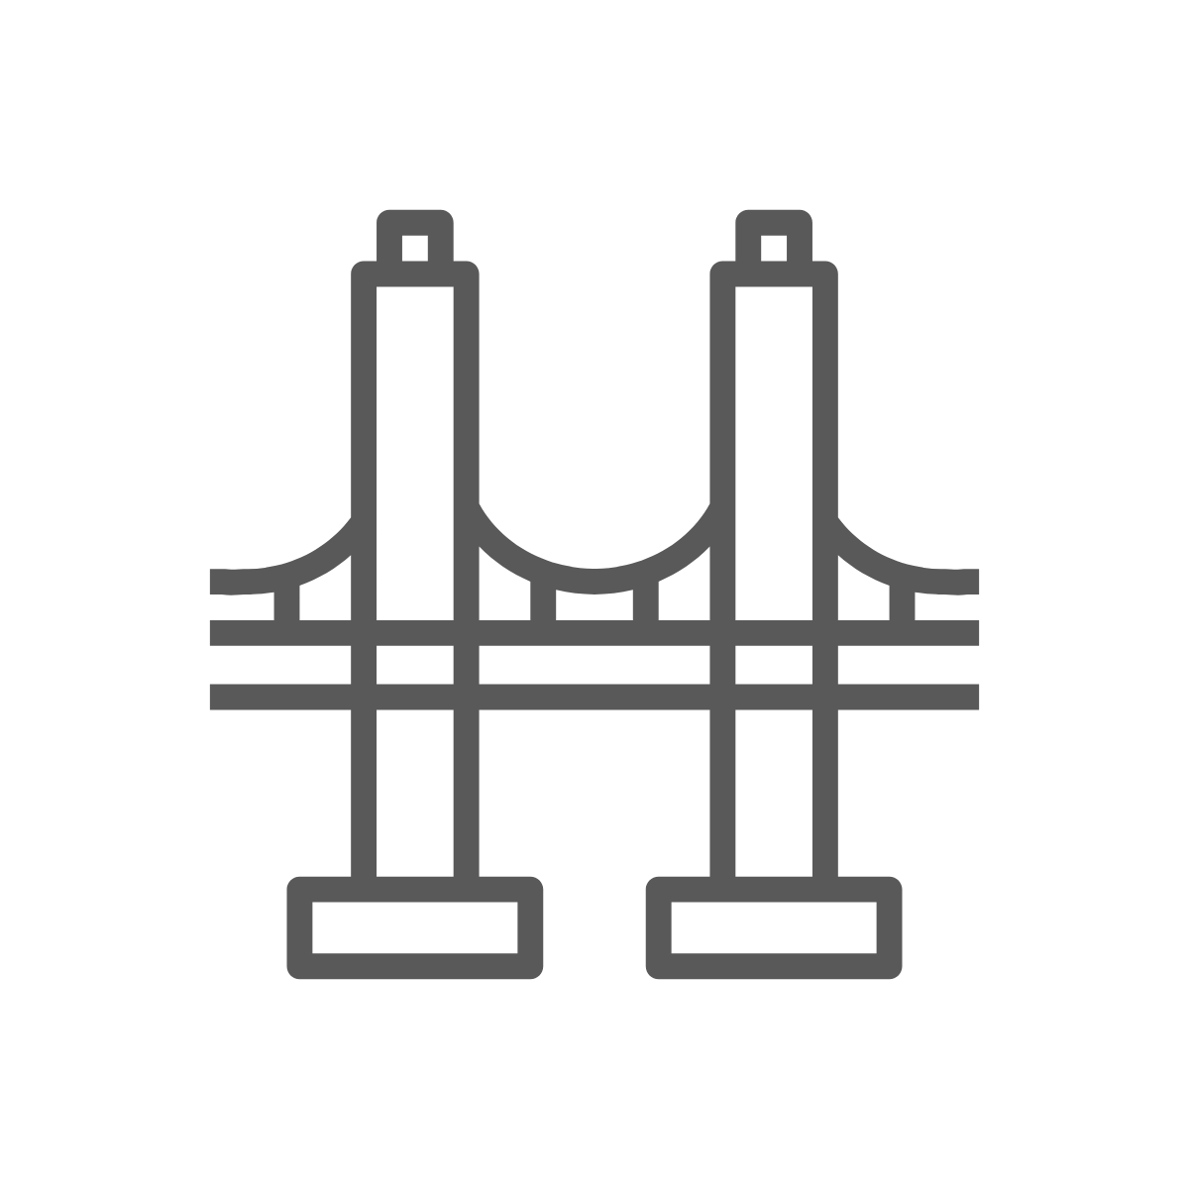






We need technologists and communities
JUSTICE40 OPEN-SOURCE COMMUNITY
We seek to build bridges between government, academic, nonprofit, private sector, and environmental justice communities to better develop the CEJST and improve the development of tech and data tools to advance environmental justice causes. We encourage and support participation from all communities and individuals, no matter your technology experience.
Open participation
CEJST
Open-Source Code

Slide 18
What is ground truthing?
JUSTICE40 OPEN-SOURCE COMMUNITY
Ground truthing is a process through which community members close gaps between datasets and their lived experiences by working with researchers and advocates.
For example, a California community added previously unknown burdens, such as auto body shops and areas where trucks frequently idled, to environmental maps.
We hope to use ground truthing to improve our understanding of environmental justice communities and to improve the data currently or potentially used to describe those communities.
READ MORE
Ground-Truthing Validation to Assess the Effect of Facility Locational Error on Cumulative Impacts Screening Tools
“Ground Truthing” Policy Using Participatory Map-Making to Connect Citizens and Decision Makers

Slide 19
Working principles
JUSTICE40 OPEN SOURCE COMMUNITY
“Open” means transparent and participatory.
We take a modular and modern approach to software development.
We build open source software and open source process.
We value ease of implementation.
Fostering community includes building capacity and making our software and processes accessible to participants with diverse backgrounds and skill sets.
Data (and data science) is as important as software and process. We build open data sets where possible.
We seek to advance transparency in algorithms and to identify places where we might introduce biases.
We prioritize data sets that address community vulnerabilities for programs in Justice40.

Slide 20
Ways to Participate
Notes:
Poll the room: How have you been involved in OSS?

Slide 21
We’d love to know….
WAYS TO PARTICIPATE
What brings you here today?
What do you want to learn?
How do you want to contribute?
Send us a note at justice40open@usds.gov, or introduce yourself to the Google Group!

Slide 22
How to participate
WAYS TO PARTICIPATE
There are three main ways to participate:
Contribute to coding/development
Contribute to research needs
Contribute direct or indirect lived experiences of environmental justice issues

Slide 23
Do you have any of these skills?
WAYS TO PARTICIPATE
RESEARCH
USER EXPERIENCE and DESIGN
PRODUCT
ENGINEERING
Research planning
Creating research protocols
Recruiting for research
Facilitating research sessions
Research synthesis
Creating research artifacts
Research reports
Sharing research findings
Data Visualization
Information Architecture
Making prototypes
Storytelling
Visual design
Teaching people about design and research
Writing
Workshop facilitation
Creating Roadmaps
Presenting
Relationship building
Create your own products that use our data or tools!
Adding data sources to our open data pipeline (Python)
Fixing bugs in front end (JavaScript) or backend (Python) code
Front end feature development, including improving our map (JavaScript, MapLibre)
Data analysis

Slide 24
WAYS TO PARTICIPATE
Interested in…. | Here’s how you can get involved:
Introduction to the Open-Source Group | Join our Google group: https://groups.google.com/g/justice40-open-source. Open Source Community Chat every third Monday of the month at 5-6pm ET Zoom: https://pitc.zoomgov.com/j/1612477826?pwd=ZlNjVVdpVWFxelBVT014TFNjakR5UT09 During our monthly chat we cover community updates, do deep-dives into topics relevant to the community, and review anything of note that’s come out of the office hours. Office hours: Join us every Wednesday 4-5pm ET for office hours. Zoom: https://pitc.zoomgov.com/j/1610695095?pwd=NHkrU1R2bk1DbnNYNUZ1S3VpNVcrUT09 Come to an office hours session if you want to learn more about how to contribute to the project, talk through any “Help wanted” issues in Github, pair through an approach to a Github issue you're working on, or get help setting your environment up -- or if you don't know how to use this Github thing and want an intro.
Providing Product Strategy | Participate in the data roadmap with suggestions, feedback, and research on proposed data sets: https://docs.google.com/spreadsheets/d/14Zwja62gbrZErhf70lo-I2ode85O-XZC1NKA7bEV6Bk/edit#gid=742302133
Providing Coding/ Development Support | Contribute code to GitHub Contributing guidelines here: https://github.com/usds/justice40-tool/blob/main/CONTRIBUTING.md Open “Help Wanted” Issues here: https://github.com/usds/justice40-tool/issues?q=is%3Aopen+is%3Aissue+label%3A%22help+wanted%22
Providing Research Support | Conduct research and gather info for research items in GitHub Look for issues that start with “Research” and are marked “help wanted”
Sharing direct or indirect lived experiences | Sign up for updates and discussion topics in our Google group. We aim to have regular opportunities for collaboration and knowledge sharing in the form of group workshops, topic deep-dives, and ground-truthing programs. Join our Monthly Community Chat to meet others and join in the conversation.

Slide 25
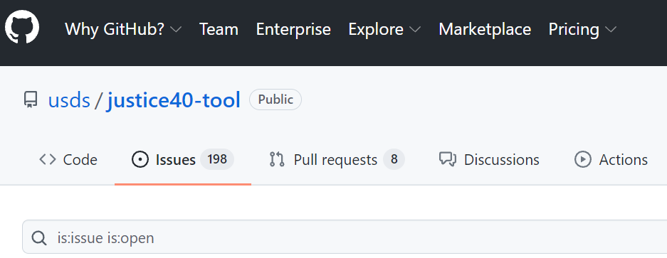
Navigating GitHub
WAYS TO PARTICIPATE
https://github.com/usds/justice40-tool/issues?page=4&q=is%3Aissue+is%3Aopen
In GitHub, look under Issues
Open Issues
Items tagged with “help wanted”

Slide 26
Steps to contribute on Github
WAYS TO PARTICIPATE
Check out the following docs:
Contributing guidelines: https://github.com/usds/justice40-tool/blob/main/CONTRIBUTING.md
Community participation guidelines: https://github.com/usds/justice40-tool/blob/main/COMMUNITY_GUIDELINES.md
Code of Conduct: https://github.com/usds/justice40-tool/blob/main/CODE_OF_CONDUCT.md
Create a Github account if you don’t already have one.
Now you can contribute your input or research to issues in the form of comments, or contribute code to the code base (see next slide).
You can also create new issues if you have a feature request, bug report, or other code or data related conversation topic.

Slide 27
Contributing code on Github
WAYS TO PARTICIPATE
Fork the Justice40 Tool repository on your own Github account: https://github.com/usds/justice40-tool
Create a new branch related to the issue you’re working on
Commit changes and push to Github
On Github, click on Pull Requests on the navigation bar
You should see a “Compare and Pull Request” green button
Open the PR against the upstream repository, i.e. usds/justice40-tool

Slide 28
Reference Materials

Slide 29
Resources
REFERENCE MATERIALS
Open source code: https://github.com/usds/justice40-tool
Open Source Community Google Group: https://groups.google.com/g/justice40-open-source
Ongoing survey of the environmental justice data landscape: https://docs.google.com/spreadsheets/d/14Zwja62gbrZErhf70lo-I2ode85O-XZC1NKA7bEV6Bk/edit#gid=742302133
Executive order on Justice40: https://www.whitehouse.gov/briefing-room/presidential-actions/2021/01/27/executive-order-on-tackling-the-climate-crisis-at-home-and-abroad/
Justice40 Interim Guidance: https://www.whitehouse.gov/wp-content/uploads/2021/07/M-21-28.pdf
Ground-Truthing Validation to Assess the Effect of Facility Locational Error on Cumulative Impacts Screening Tools: https://www.researchgate.net/publication/281412916_Ground-Truthing_Validation_to_Assess_the_Effect_of_Facility_Locational_Error_on_Cumulative_Impacts_Screening_Tools
“Ground Truthing” Policy Using Participatory Map-Making to Connect Citizens and Decision Makers: https://media.rff.org/archive/files/sharepoint/WorkImages/Download/RFF-Resources-162_GroundTruthing.pdf

Slide 30
Glossary (see full here: https://github.com/usds/justice40-tool/blob/main/docs/glossary.md)
CEJST | Climate and Environmental Justice Screening Tool. This is the tool we are building to support the Justice40 initiative and help identify historically overburdened and underserved communities for benefits.
Contributor | Someone who participates in the open source community by contributing code, documentation, information, discussion, etc.
Data Roadmap | Our way to keep track of what data has been suggested for inclusion in the CEJST and manage prioritization and eventual integration into the tool.
Github | An online tool for publishing, sharing, and discussing code.
Google Group | A listserv / mailing list product from Google that lets you subscribe to updates and participate in discussions.
Ground Truthing | A process through which community members close gaps between datasets and their lived experiences by working with researchers and advocates.
Indicator | An environmental indicator is a numerical value that helps provide insight into the state of the environment or human health. Indicators are developed based on quantitative measurements or statistics of environmental condition that are tracked over time.
Issue | A Github issue is a way to report a bug, request a feature, or start a discussion on a topic in a Github code repository.
Maintainer | A project maintainer is someone who has special responsibilities and privileges in an open source project, such as an admin or owner.
Pull Request | Way to submit code or documentation for review on Github before it is integrated into the source code.
Repository | A repository on Github is the place where source code for a system or app is published, and it has collaborative features such as issues, project boards, and pull requests.

Slide 31
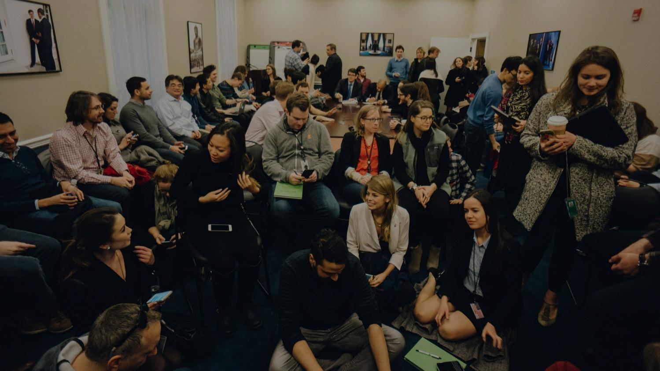


Notes:
The United States Digital Service is a startup in the Federal government, using design and technology to deliver better services to the American people.

