Slide 1



Analysis of paired categorical data
Chi-square analysis for interventions, rater agreement and confusion matrices
Ben Meuleman, Ph.D.
Swiss Center for Affective Sciences
Université de Genève
R Lunch
October 3, 2023

Slide 2
Contents
Background
Chi-square analysis and McNemar's test
Rater agreement and log-linear analysis
Confusion matrices

Slide 3

Personal background
2003 – 2007 Bachelor in Psychology
2007 – 2009 Master in Psychology
2009 – 2010 Master in Statistical Data Analysis
2011 – 2015 Ph.D. in Psychology
2016 – 2019 Postdoc in Psychology
2019 – … Statistician
Doctoral dissertation—including two publications—written on the application of machine learning to emotion data.
Part-time statistical assistant at CISA, offering regular consulting services for researchers, bi-monthly mailings, and workshops (machine learning, multilevel regression, statistics tips). Presented twice at the R Lunch series of UNIGE.
Personal CISA page
http://use-r-carlvogt.github.io/prochains-lunchs/

Slide 4
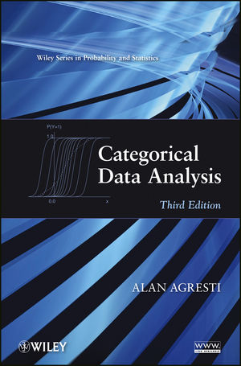
Background literature
Agresti, A. (2012). Categorical Data Analysis (3rd edition). John Wiley and Sons.
Standard reference work on categorical data analysis. Extremely detailed and comprehensive but also highly mathematical and dry.
Up until the 2nd edition, practical examples were for SAS language only, which is an expensive software for which UNIGE does not have a license.
The 3rd edition reportedly has new examples in R, but I have not had a chance to review them.

Slide 5

Logistic regression workshop
The present slides are adapted from a longer workshop on logistic regression (Part 3), the full version of which can be found on my personal webpage.
The workshop follows the outline of Agresti (2002) but also a course on categorical data analysis by Rosseel (2008), famous chiefly as the author of R package lavaan for structural equation modelling (SEM).
Today's R scripts were also adapted from that course.
In addition to the workshop, there is also a newsletter I wrote with a very concise overview of today's topic.
Rosseel, Y. (2008). Categorical Data Analysis. Course slides for the Master in Statistical Data Analysis. University of Ghent, 2008–2009.

Slide 6
Chi-squared recap and McNemar's test

Slide 7
Paired categorical data
It may occur that we measure the same categorical response twice, and as such have a paired categorical sample. For example:
Participants choose one of 2 products before (T1) and after (T2) an information intervention. Pre and post choices are cross-tabulated (2×2).
Two raters code the use of 8 emotion regulation strategies from written survey responses to recalled events. Raters' classifications are cross-tabulated (8×8).
A statistical model predicts death on Game of Thrones. Model predictions are cross-tabulated against the true death outcomes (2×2).
As is clear, in each of these cases that the resulting frequency table is A × A square.
Special analyses have been developed to deal with these cases. Let us examine these.

Slide 8

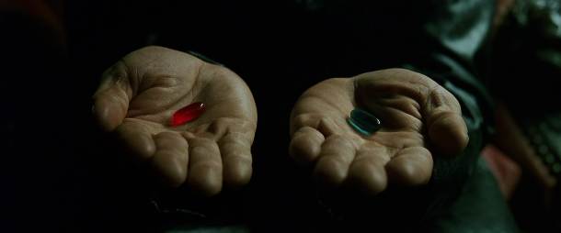
An intervention study
Morpheus has realized that his red/blue pill dilemma may not be entirely ethical. He therefore conducts an experiment in the matrix with 200 people targeted to be freed. He first offers them the original choice of blue=ignorance and red=unknown (T1). Once they have chosen, he tells them the truth about the matrix, and re-offers the pill choice (T2). He records the following responses:
Is there an association between pill choice at T1 and T2? Intuitively, a researcher may decide to run a chi-square test for the answer…
 | Pill T2
Pill T1 | Blue | Red
Blue | 51 | 12
Red | 48 | 89
Pearson's Chi-squared test with Yates' continuity correction
data: pills
X-squared = 34.583, df = 1,
p-value = 4.085e-09
OR = 7.79

Slide 9
Chi-square analysis
Chi-square analysis is applied to contingency/frequency tables, traditionally two-dimensional, although one-dimensional is possible. For an A×B table, the test poses the question if the distribution of frequencies in A are modified by levels of B. This is an interaction question. If non-significant, it means the distributions of A and B are independent. The test statistic follows a chi-square distribution with (A−1) × (B−1) degrees of freedom.
For 2×2 tables, it is also conventional to quantify the strength of association with an odds ratio (OR), which is the ratio of the A1/A2 odds in B1 with the A1/A2 odds in B2. An OR=1 equals perfect A×B independence.
The test is extremely significant, with an OR=7.79. But is this truly informative here…?
 | Pill T2
Pill T1 | Blue | Red
Blue | 51 | 12
Red | 48 | 89
Pearson's Chi-squared test with Yates' continuity correction
data: pills
X-squared = 34.583, df = 1,
p-value = 4.085e-09
OR = 7.79

Slide 10
Marginal homogeneity
A chi-square analysis is usually trivial for paired categorical data, in that the largest frequencies are expected to occur on the diagonal, and hence the null hypothesis of A × A independence will be rejected.
All it confirms here is that people tend to stick with their choice, e.g., those who chose blue before the truth stick with blue after.
The more interesting question for these data is whether the marginal distribution of pill choices changes between T1 and T2 (green cells)? This question addresses the null hypothesis of marginal homogeneity. Descriptively, it seems people preferred the red pill at T1…
 | Pill T2
Pill T1 | Blue | Red
Blue | 51 | 12 | 63
Red | 48 | 89 | 137
 | 99 | 101

Slide 11


Marginal homogeneity
It may be tempting to run our chi-square analysis on the left table below but this is wrong! The same person is now observed in two cells of the table, which means the counts are no longer independent, as is required for a chi-square test.
In the original table, every person is only in one cell, thus preserving independence. We can run McNemar's test of marginal homogeneity on this table:
mcnemar.test(pills)
 | Time
Pill | T1 | T2
Blue | 63 | 99
Red | 137 | 101
 | Pill T2
Pill T1 | Blue | Red
Blue | 51 | 12
Red | 48 | 89
McNemar's Chi-squared test with continuity correction
data: pills
McNemar's chi-squared = 20.417, df = 1,
p-value = 6.228e-06

Slide 12
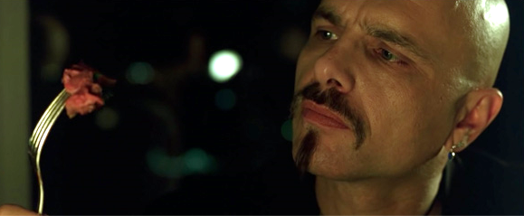
Marginal homogeneity
The test is highly significant so we reject marginal homogeneity. In other words, there was a significant change in pill choice distribution between T1 and T2. Follow-up tests can be done with regular proportion tests, e.g., on the margin tables:
So strong preference for red pills before Morpheus tells the truth, and equal preference for red and blue after the truth. This result does not quite capture the effect of the intervention, however. From the table it is clear that people primarily switched from red to blue, rather than vice-versa. It is this asymmetry that rejected marginal homogeneity. We should explicitly compare the two off-diagonal cells of our table:
prop.test(48,48+12)
It turns out that this is identical to McNemar's test! This also illustrates that, in a 2×2 table, symmetry implies marginal homogeneity, and vice-versa.
margin.table(pills,1) prop.test(63,200) X2 = 26.645, df=1, p=2.445e-07
margin.table(pills,2) prop.test(99,200) X2 = 0.005, df=1, p=0.9436
1-sample proportions test with continuity correction
data: 48 out of 60, null probability 0.5
X-squared = 20.417, df = 1, p-value = 6.228e-06

Slide 13
K × 2 × 2 analysis
Morpheus extends his experiment to find out why people switch pills. He stratifies the sample by age (young, old), to obtain a 2×2×2 table. Inspecting the frequencies, it seems that the information intervention mainly prompted older people to switch choice.
With our knowledge that McNemar's test is simply a proportion test on the diagonal frequencies, we can extend the analysis easily to include K independent groups.
We rearrange our table to include only the diagonal frequencies, and then run a chi-square test on that table. A significant result implies that groups differed in marginal time homogeneity. Follow-up proportion tests can confirm the direction of the pattern.
age <- array(c(9,3,14,34),dim=c(2,2), dimnames=list(Age=c("Young","Old"),
T1_T2=c("Blue-Red","Red-Blue")))
chisq.test(age)
prop.test(9,9+14)
prop.test(3,3+34)
 |  | Pill T2
Age | Pill T1 | Blue | Red
Young | Blue | 20 | 9
 | Red | 14 | 57
Old | Blue | 31 | 3
 | Red | 34 | 32
 | T1-T2
Age | Blue-Red | Red-Blue
Young | 9 | 14
Old | 3 | 34
χ²(1) = 6.70, p = 0.0096

Slide 14
Rater agreement and log-linear analysis

Slide 15
Rater agreement
319 people responded to a survey on stressful life events. An event is recalled and the respondent describes how they coped with it.
The written responses are then coded by two experts on emotion regulation, who classify the coping behavior into 1 of 8 regulation strategies. The classifications of the two raters are cross-tabulated.
Once again, the largest counts are on the diagonal, suggesting that the two raters agree substantially.
As well, there seem to be notable “confusions” (light blue cells), in that disagreements are between similar regulation strategies (e.g., reappraisal and humor).
 | Rater B
Rater A | Avoidance | Problem solving | Reappraisal | Humor | Relaxation | Acceptance | Suppression | Social support
Avoidance | 22 | 0 | 0 | 0 | 0 | 2 | 0 | 2 | 26
Problem solving | 0 | 32 | 8 | 0 | 1 | 0 | 0 | 1 | 42
Reappraisal | 0 | 6 | 50 | 9 | 0 | 2 | 0 | 0 | 67
Humor | 0 | 0 | 12 | 28 | 0 | 1 | 0 | 4 | 45
Relaxation | 0 | 0 | 0 | 0 | 47 | 15 | 0 | 0 | 62
Acceptance | 1 | 0 | 7 | 2 | 10 | 23 | 0 | 0 | 43
Suppression | 0 | 0 | 0 | 0 | 0 | 0 | 5 | 0 | 5
Social support | 2 | 4 | 0 | 3 | 0 | 0 | 1 | 19 | 29
 | 25 | 42 | 77 | 42 | 58 | 43 | 6 | 26

Slide 16
Rater agreement
Inspecting the table margins, the distribution of classifications is nearly identical. There seems to be no evidence for significant disagreement.
Cohen proposed a measure of rater agreement for A × A tables known as Cohen's Kappa. Kappa will be equal to 0 when the raters are completely independent, and equal to 1 when agreement is perfect. Negative values may occur if there is strong (to perfect) disagreement but this is rare in practice. For the regulation data, we use CohenKappa from DescTools:
CohenKappa(regul,conf.level=0.95)
A value of 0.655 indicates strong agreement. The version above is the so-called “unweighted” Kappa. Weighted versions have been proposed that take advantage of ordinal categories by downweighting adjacent confusions. Other generalizations allow Kappa to be calculated for more than 2 raters, such as available in DescTools with the function KappaM.
Kappa interpretation (Cohen, 1988)
Limits Agreement
[....,0.00] none
]0.00,0.20] weak
]0.20,0.40] fair
]0.40,0.60] moderate
]0.60,0.80] substantial
]0.80,1.00] perfect
kappa lwr.ci upr.ci
0.655 0.596 0.714

Slide 17
Rater agreement
Can we also test for marginal homogeneity? McNemar's test does not generalize to A × A tables, but a log-linear alternative is available that is little known. The test is available in the custom script square_tests.r with the function square.tests. Let us run this on the regulation data:
source("C:/myfilepath/square_tests.r")
square.tests(regul)
The test is non-significant, χ²(7) = 5.592, p = 0.5881, so we accept marginal homogeneity. Contrary to the intervention example, for rater agreement we normally hope to accept the null hypothesis! Marginal heterogeneity would imply significant disagreement!
A number of other tests appear in the output which we have not yet discussed…
Test LRT DF P
1 Independence 719.817400 49 0.000000e+00
2 Quasi-independence 157.746720 41 1.332268e-15
3 Symmetry 10.188428 28 9.991678e-01
4 Quasi-symmetry 4.596438 21 9.999346e-01
5 Marginal homogeneity 5.591991 7 5.881125e-01

Slide 18
Log-what? Tables to data frames…
Chi-square analysis is a special case of so-called log-linear analysis, which are Poisson regression models where all of the explanatory variables are categorical. They require a different data format for analysis, e.g., for the Morpheus experiment:
Which is known as a grouped data frame. The only difference with the 2×2 contingency table is the appearance of an explicit third variable, the frequency of choice. This is a count variable, hence one can fit:
pillsdf <- as.data.frame.table(pills)
model <- glm(Freq ~ Pill_T1*Pill_T2, data=pillsdf, family=poisson)
car::Anova(model,type=2)
Pill T1 | Pill T2 | Freq
Blue | Blue | 51
Blue | Red | 12
Red | Blue | 48
Red | Red | 89
 | Pill T2
Pill T1 | Blue | Red
Blue | 51 | 12
Red | 48 | 89

Slide 19
Log-linear analysis
The ANOVA breakdown produces:
Which gives is the classical chi-square test under the interaction effect of Pill_T1 × Pill_T2, as well as “main effects” for the marginal Pill_T1 and Pill_T2 distributions. This is incredibly handy to have all these effects in one place.
This illustrates that even chi-square analysis fits into a model-comparison framework. As well, the log-linear approach can be extended to tables of any dimension, e.g., A×B×C×D!
Analysis of Deviance Table (Type II tests)
Response: Freq
LR Chisq Df Pr(>Chisq)
Pill_T1 28.042 1 1.187e-07 ***
Pill_T2 0.020 1 0.8875
Pill_T1:Pill_T2 38.426 1 5.688e-10 ***
---
Signif. codes:
0 ‘***’ 0.001 ‘**’ 0.01 ‘*’ 0.05 ‘.’ 0.1 ‘ ’ 1
Pearson's Chi-squared test with Yates' continuity correction
data: pills
X-squared = 34.583, df = 1,
p-value = 4.085e-09
OR = 7.79
Chi-square test of independence!

Slide 20
Log-linear analysis
We can produce the same breakdown for the regulation coding:
But once again these are trivial results. Independence is rejected because the raters tended to agree (so largest frequencies on the diagonal). The significant main effects indicated that both raters coded some regulation strategies significantly more often than others, but it does not tell us these two main effects are identical (=marginal homogeneity).
Analysis of Deviance Table (Type II tests)
Response: Freq
LR Chisq Df Pr(>Chisq)
R1 84.53 7 1.635e-15 ***
R2 91.71 7 < 2.2e-16 ***
R1:R2 719.82 49 < 2.2e-16 ***
---
Signif. codes:
0 ‘***’ 0.001 ‘**’ 0.01 ‘*’ 0.05 ‘.’ 0.1 ‘ ’ 1

Slide 21
Quasi-independence
Test LRT DF P
1 Independence 719.817400 49 0.000000e+00
2 Quasi-independence 157.746720 41 1.332268e-15
3 Symmetry 10.188428 28 9.991678e-01
4 Quasi-symmetry 4.596438 21 9.999346e-01
5 Marginal homogeneity 5.591991 7 5.881125e-01
The standard chi-square test is found at the top of the square.tests output, under “independence”. As expected, the result is massively significant and uninteresting. However, what if we ignored the diagonal cells and ran the chi-square analysis only on the off-diagonal cells? This is a null hypothesis of quasi-independence, i.e., the rows and columns are independent, disregarding the diagonal cells.
While we have previously tested off-diagonal independence with McNemar's test, in 2×2 tables quasi-independence, marginal homogeneity and symmetry coincide, whereas this is not necessarily true for more general A × A tables.
For such tables, quasi-independence tests whether the pattern of confusions is random. A rejection would imply that some pairs of levels are confused more than expected under independence. This seems to be the case for the regulation data (e.g., reappraisal-humor, relaxation-acceptance) and unsurprisingly, the test for quasi-independence is strongly significant in the square.tests output.
The underlying model for this test is a log-linear regression where the diagonal values of the table are treated as “structural zeroes” by the use of dummy variables (one for each diagonal cell). The technical details are explained further in Agresti (2002).

Slide 22
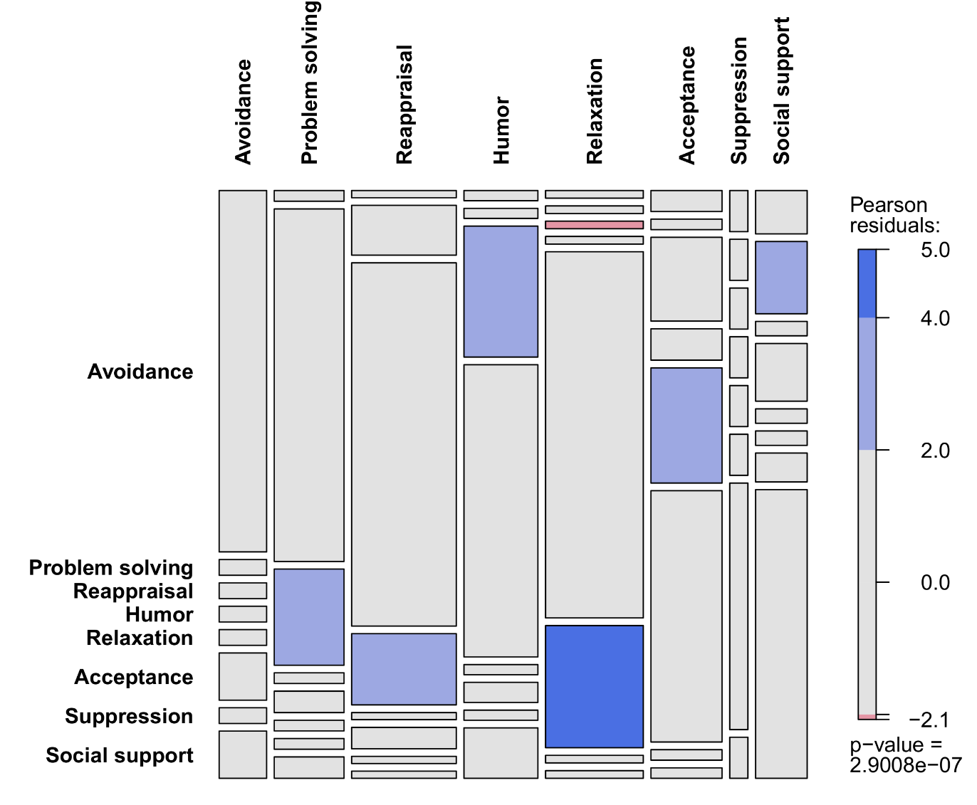
Quasi-independence
A significant test of quasi-independence can be followed with a residual analysis, to see which cells had larger or smaller counts than expected.
The square.tests function stores this information in its output, which can be plugged into a mosaic plot for visual inspection.
out <- square.tests(regul)
mosaic(regul+1,shade=TRUE,
expected=out$Fitted$Qindependence+1,
df=41)
This confirms more or less our descriptive expectations of important confusion patterns.

Slide 23
Symmetry and quasi-symmetry
While a test of quasi-independence can tell us if there are specific confusion patterns, it does not tell us if there is a significant direction to the confusions. This question addresses the null hypothesis of symmetry.
This can be tested by fitting a loglinear model in which mirroring off-diagonal cells are constrained to be equal. For the regulation data, we get a non-significant test, meaning we accept symmetry:
Note however that symmetry implies marginal homogeneity. We can also construct a test that removes this constraint, which is known as quasi-symmetry. Its primary use is for constructing the marginal homogeneity test for A × A tables, since we can do this by a formal comparison of the symmetry and quasi-symmetry models. The resulting test is non-significant for these data, again supporting agreement between the two raters.
Test LRT DF P
1 Independence 719.817400 49 0.000000e+00
2 Quasi-independence 157.746720 41 1.332268e-15
3 Symmetry 10.188428 28 9.991678e-01
4 Quasi-symmetry 4.596438 21 9.999346e-01
5 Marginal homogeneity 5.591991 7 5.881125e-01

Slide 24
Multiple raters and disagreement
Cohen's Kappa has been extended to allow more than 2 raters. However, having more often lowers reliability, especially when there are many categories to be coded. As such, a low Kappa does not necessarily mean that the raters were poor, it could reflect the complexity of the rating task.
If there is no special interest in analyzing rater agreement, one could simply employ a large group of raters, and decide on a final coding by simple majority (e.g., if the majority codes reappraisal, that's the final answer). This will ensure that the final coding reflects a typical/consensus opinion.
For two raters, disagreements will need to be solved, whether or not Kappa was low and/or marginal homogeneity was rejected. This could be achieved in a number of ways, e.g.:
Break disagreements at random
The two raters meet and discuss disagreements to reach an consensus
A third independent rater solves disagreements
Once the final coding has been decided, the data can be analyzed in conventional ways. As such, the log-linear analysis of agreement is merely an intermediate step!

Slide 25


Marginal homogeneity
Quasi-symmetry

Slide 26
Confusion matrices

Slide 27
Confusion matrices
In the preceding example, the two raters represented equally valid opinions. Often, however, a confusion matrix is generated from one rater (or multiple) being compared against a “ground truth” rating. For example, participants in a study view videos expressing 1 of 14 emotions (e.g., anger, fear, sadness), and classify each video using 1 of the 14 emotions:
 | Rating
Truth | Amu. | Anger | Anxiety | Despair | Disgust | Fear | Interest | Irritation | Joy | Pleasure | Pride | Relief | Sadness | Surprise
Amusement | 290 | 2 | 0 | 4 | 3 | 2 | 5 | 3 | 106 | 39 | 21 | 14 | 1 | 20
Anger | 3 | 390 | 7 | 4 | 12 | 2 | 6 | 72 | 4 | 2 | 1 | 4 | 2 | 1
Anxiety | 7 | 7 | 202 | 30 | 18 | 106 | 26 | 22 | 1 | 4 | 6 | 13 | 3 | 65
Despair | 2 | 63 | 19 | 140 | 34 | 50 | 1 | 38 | 0 | 2 | 1 | 4 | 154 | 2
Disgust | 0 | 6 | 27 | 42 | 314 | 42 | 3 | 23 | 0 | 2 | 2 | 6 | 34 | 9
Fear | 2 | 132 | 63 | 45 | 9 | 136 | 7 | 78 | 0 | 3 | 5 | 6 | 6 | 18
Interest | 12 | 6 | 96 | 7 | 6 | 3 | 205 | 30 | 4 | 13 | 10 | 25 | 3 | 90
Irritation | 11 | 34 | 46 | 59 | 47 | 5 | 82 | 150 | 4 | 7 | 28 | 20 | 6 | 11
Joy | 80 | 0 | 2 | 0 | 0 | 0 | 8 | 4 | 241 | 55 | 42 | 11 | 1 | 66
Pleasure | 32 | 2 | 6 | 2 | 0 | 1 | 10 | 4 | 57 | 184 | 22 | 180 | 0 | 10
Pride | 49 | 1 | 6 | 7 | 3 | 3 | 33 | 14 | 96 | 67 | 202 | 24 | 0 | 5
Relief | 13 | 3 | 7 | 11 | 5 | 0 | 19 | 4 | 19 | 47 | 13 | 365 | 2 | 2
Sadness | 0 | 6 | 56 | 142 | 40 | 67 | 7 | 22 | 1 | 3 | 2 | 11 | 152 | 1
Surprise | 5 | 1 | 98 | 18 | 17 | 22 | 47 | 16 | 4 | 4 | 7 | 20 | 2 | 249

Slide 28
Confusion matrices
For these data, we do not wish to analyze rater agreement, but rather accuracy. How well do our rater(s) perform against truth? Sometimes, the rater/classifier might not even be a human but a model that makes predictions. The resulting confusion matrix then quantifies how well the model performs, against the observed data.
For rater accuracy, the log-linear analysis for paired data is not the intermediate step, but the target analysis of interest. It allows us to have an in-depth look at accuracy patterns:
Independence: Is the pattern of all responses independent (=chance level), which would indicate extremely poor performance?
Quasi-independence: Ignoring the accurate classifications (=diagonal), is there significant confusion between pairs of outcome levels?
Symmetry: Among confusions, is there significant asymmetry?
Marginal homogeneity: Does the rater/classifier significantly disagree with the ground truth?
Let us run square.tests on these data, as well as Cohen's Kappa…

Slide 29
Confusion matrices
This produces:
Kappa=0.41, surprisingly good for such large data, so decent overall classification accuracy.
All square tests have p-values = 0, so significant accuracy, but also significant confusion, and significant asymmetry. Because of the table size, these test results are not very informative practically. Chi-square analyses are quickly overpowered in many situations!
In order to find out how the accuracies differ from ground truth, we can inspect the residuals of each model above. These residuals are the deviations between the observed cell frequencies and those imposed by the fitted Poisson model. They are stored in the R object outputted by square.tests.
Test LRT DF P
1 Independence 13904.9316 169 0
2 Quasi-independence 5430.9269 155 0
3 Symmetry 975.5646 91 0
4 Quasi-symmetry 735.7172 78 0
5 Marginal homogeneity 239.8474 13 0
kappa lwr.ci upr.ci
0.4087481 0.3963608 0.4211354

Slide 30
Residual analysis of quasi-independence model
Large positive residuals indicate observed frequencies higher than expected under quasi-independence. Large neative values indicate frequencies lower than expected under quasi-independence.
Here, residuals below |10| have been set to zero, to identify only the most important confusions. This cutoff value may depend on the size of the table.
Some notable confusions:
Joy mistaken for amusement
Fear mistaken for anger
Anxiety mistaken for fear
Despair for sadness
But are the confusions symmetric?
 | Rating
Truth | Amu | Anger | Anxiety | Despair | Disgust | Fear | Interest | Irritation | Joy | Pleasure | Pride | Relief | Sadness | Surprise
Amusement |  | 0 | 0 | 0 | 0 | 0 | 0 | 0 | 23 | 0 | 0 | 0 | 0 | 0
Anger | 0 |  | 0 | 0 | 0 | 0 | 0 | 20 | 0 | 0 | 0 | 0 | 0 | 0
Anxiety | 0 | 0 |  | 0 | 0 | 16 | 0 | 0 | 0 | 0 | 0 | 0 | 0 | 0
Despair | 0 | 0 | 0 |  | 0 | 0 | 0 | 0 | 0 | 0 | 0 | 0 | 30 | 0
Disgust | 0 | 0 | 0 | 0 |  | 0 | 0 | 0 | 0 | 0 | 0 | 0 | 0 | 0
Fear | 0 | 23 | 0 | 0 | 0 |  | 0 | 0 | 0 | 0 | 0 | 0 | 0 | 14
Interest | 0 | 0 | 11 | 0 | 0 | 0 |  | 0 | 0 | 0 | 0 | 0 | 0 | 0
Irritation | 0 | 0 | 0 | 0 | 0 | 0 | 12 |  | 0 | 0 | 0 | 0 | 0 | 10
Joy | 17 | 0 | 0 | 0 | 0 | 0 | 0 | 0 |  | 0 | 0 | 0 | 0 | 0
Pleasure | 0 | 0 | 0 | 0 | 0 | 0 | 0 | 0 | 0 |  | 0 | 31 | 0 | 0
Pride | 0 | 0 | 0 | 0 | 0 | 0 | 0 | 0 | 16 | 11 |  | 0 | 0 | 0
Relief | 0 | 0 | 0 | 0 | 0 | 0 | 0 | 0 | 0 | 12 | 0 |  | 0 | 0
Sadness | 0 | 0 | 0 | 19 | 0 | 0 | 0 | 0 | 0 | 0 | 0 | 0 |  | 0
Surprise | 0 | 0 | 13 | 0 | 0 | 0 | 0 | 0 | 0 | 0 | 0 | 0 | 0
 | Rating
Truth | Anger | Fear
Anger | 390 | 2
Fear | 132 | 136
2×2 sub-table for
anger-fear classification

Slide 31
Residual analysis of symmetry model
A lower cutoff was chosen (<5) for highlighting the interesting cells.
This time, the sign of the residuals gives the direction of asymmetry, with positive meaning more mistakes, and negative less, in that direction.
Some notable asymmetries:
Fear was mistaken for anger more often than vice-versa
Irritation was mistaken for anger less often than vice-versa
Despair was mistaken for sadness more often than vice-versa
 | Rating
Truth | Amu | Anger | Anxiety | Despair | Disgust | Fear | Interest | Irritation | Joy | Pleasure | Pride | Relief | Sadness | Surprise
Amusement |  | 0 | 0 | 0 | 0 | 0 | 0 | 0 | 0 | 0 | 0 | 0 | 0 | 0
Anger | 0 |  | 0 | -5 | 0 | -10 | 0 | 10 | 0 | 0 | 0 | 0 | 0 | 0
Anxiety | 0 | 0 |  | 0 | 0 | 8 | -5 | 0 | 0 | 0 | 0 | -5 | -5 | 0
Despair | 0 | 0 | 0 |  | 0 | 0 | 0 | 0 | 0 | 0 | 0 | 7 | 7 | -5
Disgust | 0 | 0 | 0 | 0 |  | 5 | 0 | 0 | 0 | 0 | 0 | 0 | 0 | 0
Fear | 0 | 10 | -8 | 0 | -5 |  | 0 | 9 | 0 | 0 | 0 | -6 | -6 | 0
Interest | 0 | 0 | 5 | 0 | 0 | 0 |  | -6 | 0 | 0 | 0 | 0 | 0 | 0
Irritation | 0 | -10 | 0 | 0 | 0 | -9 | 6 |  | 0 | 0 | 5 | 0 | 0 | 0
Joy | 0 | 0 | 0 | 0 | 0 | 0 | 0 | 0 |  | 0 | 0 | 0 | 0 | 8
Pleasure | 0 | 0 | 0 | 0 | 0 | 0 | 0 | 0 | 0 |  | 0 | 0 | 0 | 0
Pride | 0 | 0 | 0 | 0 | 0 | 0 | 0 | -5 | 0 | 0 |  | 0 | 0 | 0
Relief | 0 | 0 | 0 | 0 | 0 | 0 | 0 | 0 | 0 | -5 | 0 |  | 0 | 0
Sadness | 0 | 0 | 5 | -7 | 0 | 6 | 0 | 0 | 0 | 0 | 0 | 0 |  | 0
Surprise | 0 | 0 | 0 | 5 | 0 | 0 | 0 | 0 | -8 | 0 | 0 | 0 | 0
 | Rating
Truth | Anger | Fear
Anger | 390 | 2
Fear | 132 | 136
2×2 sub-table for
anger-fear classification

Slide 32
Residual analysis
Especially for large tables, residual analysis makes the most sense after significant omnibus tests. It is the quickest way to identify notable confusions and asymmetries between 2×2 pairs of levels. It is descriptive and a cutoff must be chosen to decide what residual size is "notable".
For those notable pairs, one can still choose to run conventional tests, on that 2×2 subtable, including a chi-square test or McNemar's test.
Likewise, for comparing any pair of proportions, one can run a proportion/binomial test.
Although mosaic plots are sometimes recommended for visualizing residual analysis, the cells will rescale in size, relative to their raw frequency, which often makes large tables very difficult to read. A simple, evenly spaced matrix with colors will be more useful.

Slide 33
Model performance
As mentioned, the preceding approach can be applied to confusion matrices of model performance (e.g., in a machine learning setting), extending the analysis of goodness-of-fit of the model:
got <- array(c(11,54,11,132),dim=c(2,2),dimnames=
list(Observed=c("No","Yes"), Predicted=c("No","Yes")))
square.tests(got)
CohenKappa(got,conf.level=0.95)
So poor agreement between predicted and observed outcomes, with a low Kappa value, marginal homogeneity rejected, and even a non-significant chi-square test!
 | Observed
Predicted | No | Yes
No | 11 | 11 | 22
Yes | 54 | 132 | 186
 | 65 | 143
Test LRT DF P
1 Independence 3.765678e+00 1 5.231465e-02
2 Quasi-independence 8.881784e-16 0 0.000000e+00
3 Symmetry 3.100276e+01 1 2.576616e-08
4 Quasi-symmetry -6.661338e-16 0 1.000000e+00
5 Marginal homogeneity 3.100276e+01 1 2.576616e-08
kappa lwr.ci upr.ci
0.112627986 -0.009337359 0.234593331

Slide 34
Fit statistics for 2×2 confusion matrices
Name(s) | Formula | GOT model
Sensitivity, recall, hit rate, or true positive rate (TPR) | TP / (TP + FN) | 92.3%
Specificity, or true negative rate (TNR) | TN / (FP + TN) | 16.9%
Precision, or positive predictive value (PPV) | TP / (TP + FP) | 71.0%
Negative predictive value (NVP) | TN / (TN + FN) | 50.0%
Fall-out, or false positive rate (FPR) | 1 − TNR | 83.1%
False discovery rate (FDR) | 1 − PPV | 29.0%
Miss rate, or false negative rate (FNR) | 1 − TPR | 7.7%
Accuracy (ACC) | (TP + TN) / N_{total} | 68.8%
Error, or misclassification rate (ERR) | 1 – ACC | 31.2%
F1 score | 2TP / (2TP + FP + FN) | 80.2%
Matthews correlation coefficient (MCC) | (TP × TN − FP × FN) / sqrt((TP+FP)(TP+FN)(TN+FP)(TN+FN)) | 13.9%
https://en.wikipedia.org/wiki/Confusion_matrix
https://onlineconfusionmatrix.com/

Slide 35
Model performance
For quantifying model performance, a large number of alternative measures exist, however most of these require binary outcomes (=binary classification problem), such that the resulting confusion matrix is 2×2.
For multi-class classification problems, fewer measures exist, although Cohen's Kappa can be applied, as well as the square tests presented today, to analyze the precise pattern of accuracy, yielding more information.

Slide 36
Thank you for your attention…!

