Slide 1
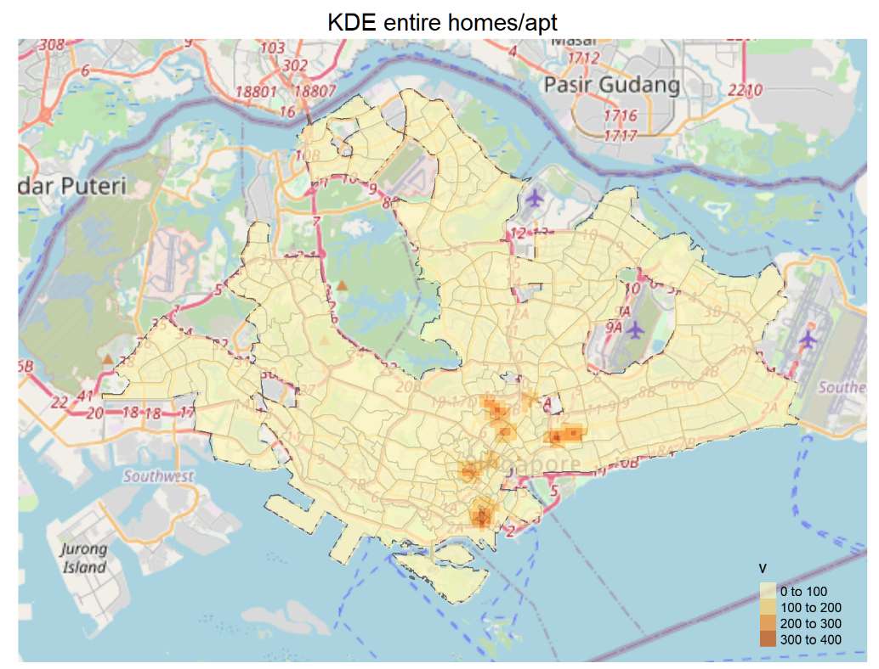
Functional Programming & Parallelization in
Spatial Point Pattern Analysis

Slide 2
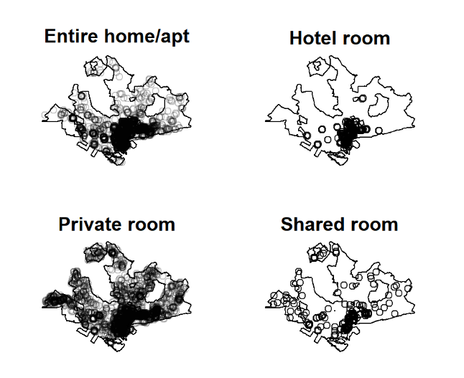
Agenda
Introduction
Issues faced
Parallelization code
Key takeaways
Notes:
Hi there! My name is Clara and I’m here to talk about my project on Geospatial Analysis of Airbnb in Singapore, specially on the use of functional programming and parallelization in Spatial Point Pattern Analysis.
The data was taken from InsideAirbnb in September 2020.

Slide 3
Hi there!
Project: Geospatial Analysis of Airbnb in Singapore
Topic: Functional Programming & Parallelization in Spatial Point Pattern Analysis (SPPA)
Dataset: InsideAirbnb, September 2020
Notes:
Hi there! My name is Clara and I’m here to talk about my project on Geospatial Analysis of Airbnb in Singapore, specially on the use of functional programming and parallelization in Spatial Point Pattern Analysis.
The data was taken from InsideAirbnb in September 2020.

Slide 4
What is SPPA?
Study of the distribution of events / interaction of events generated by a point process within a bounded area of interest.
1st Order properties: measure the distribution of events in the study region, namely the intensity and spatial density.
2nd Order properties: measure the interaction between 2 points or observations
Notes:
Those who are new to geospatial analysis might be wondering what is Spatial Point Pattern Analysis or SPPA? It’s basically the study of distribution of events or interaction of events generated by a point pattern within a bounded area of interest. We look at the distribution (the intensity or density of the events / locations) and the interaction between the points or observations (e.g. whether there are clusters).

Slide 5
For this project…
Determine if Airbnb listings are clustered in Singapore and where they occur using Ripley’s K-function test
Split by room type / region
Packages used:
Spatial Data
Parallelization
spatstat
sf
maptools
tmap
tidyverse
foreach
doParallel
Notes:
For this project, we wanted to determine if Airbnb listings were clustered in Singapore, and where they occur and at what distance do they cluster at.
The packages used are listed here.

Slide 6
How does the K-Test work?
spatstat provides a function Kest() to compute an unbiased estimate of K(t)
Run a series of Monte Carlo simulations using the envelope() function to compare it to the theoretical value.
Ho: Complete Spatial Randomness
H1: Not
Clustering: simulated values fall higher than the upper bounds of the theoretical values. Competitive processes: simulated values lower than the lower bound of theoretical values

Slide 7
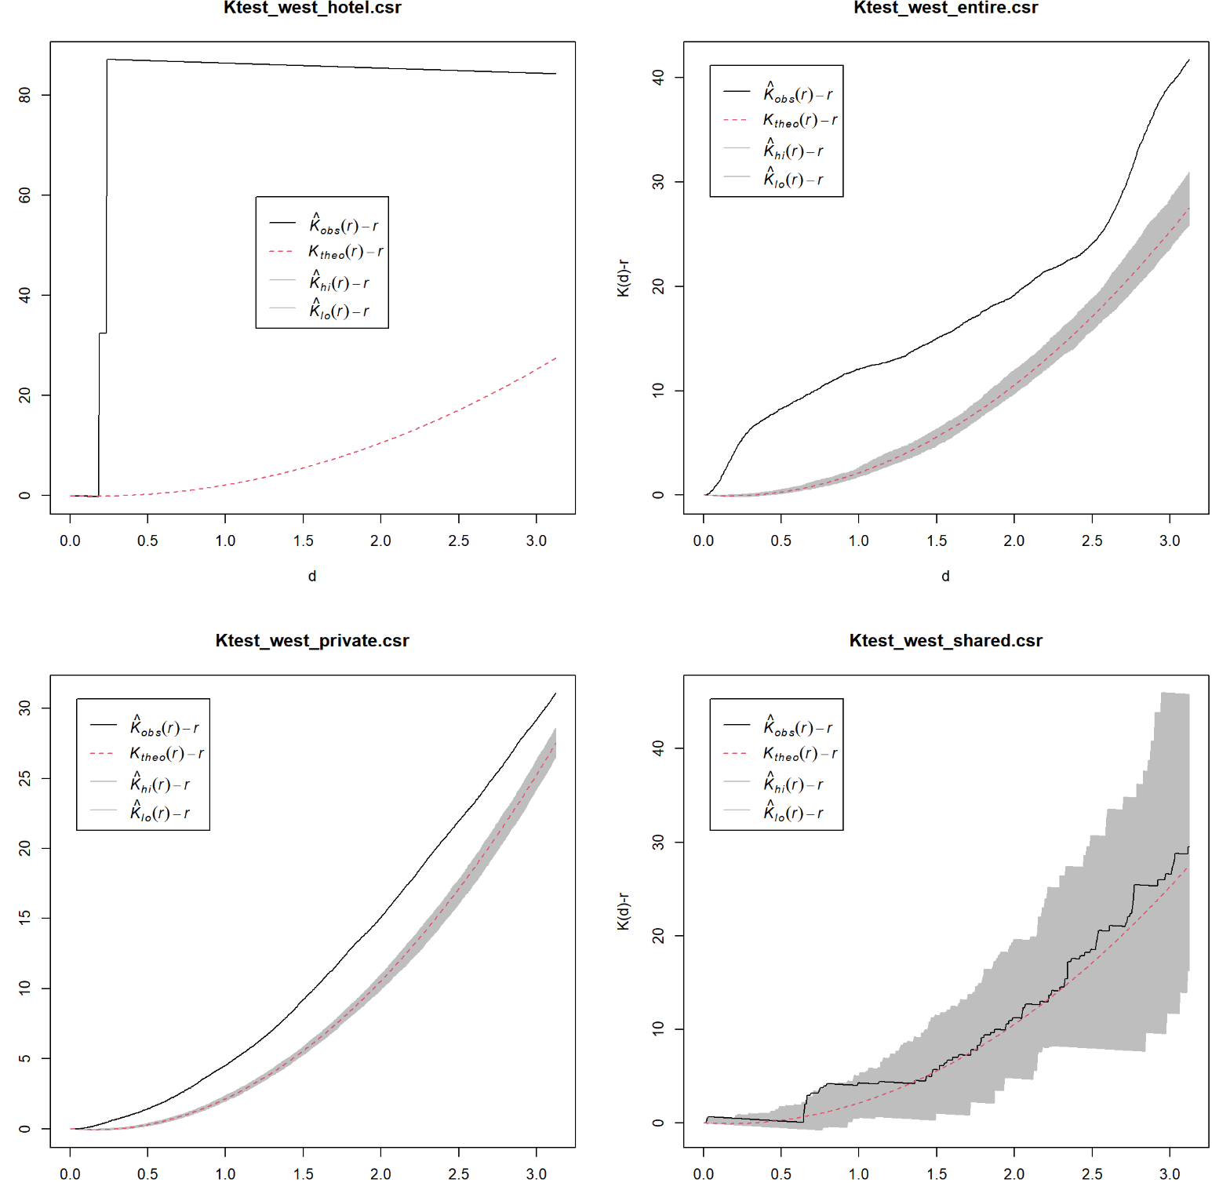
Graphs produced
Above the envelope: Shows signs of clustering
Within the envelope: Complete Spatial Randomness

Slide 8
Issues
Computationally intensive for large datasets (~7,000 points) or data with non-uniform observation windows.
No in-built parallelization methods in spatstat. Parallelisation is also dependent on OS – functions such as `mclapply` from the base parallel package works for Mac and Linux, but not for Windows.

Slide 9
What we did
Split the analysis by the 5 different subregions (East, West, Central, North and Northwest) and room types (Private room, Entire home/apt, Hotel room, shared room)
Create functions that benefit from functional programming:
`envelope()` function over the different subregions, and for different room types.
plot the envelope results for the K-tests.
Notes:
As it was computationally intensive to run the Monte Carlo simulation for the whole of Singapore, we split the analysis by the 5 different subregions (East, West, Central, North and Northwest) and room types (Private room, Entire home/apt, Hotel room, shared room)
Create functions that benefit from functional programming:
`envelope()` function over the different subregions, and for different room types.
plot the envelope results for the K-tests.

Slide 10
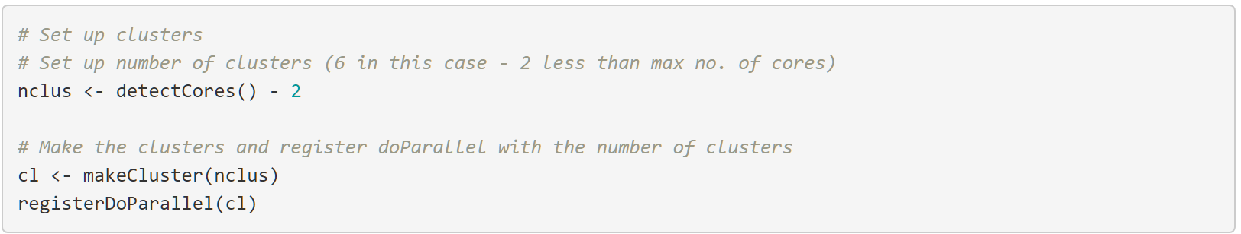
Parallelization (1) Set up Clusters
Parallelisation is done by splitting the number of simulations between the different cores, then combining the results back together.
Notes:
Firstly we need to set up clusters for parallelisation. We use `detectCores()` to see how many cores there are in the laptop/desktop that can be used. Typically we use 1 or 2 less cores than the total number of cores to cater for other systems running in the background (e.g. OS). We then create clusters via 'sockets' using `makeCluster()` and use `registerDoParallel()` to register the parallel backend with the `foreach` package.

Slide 11
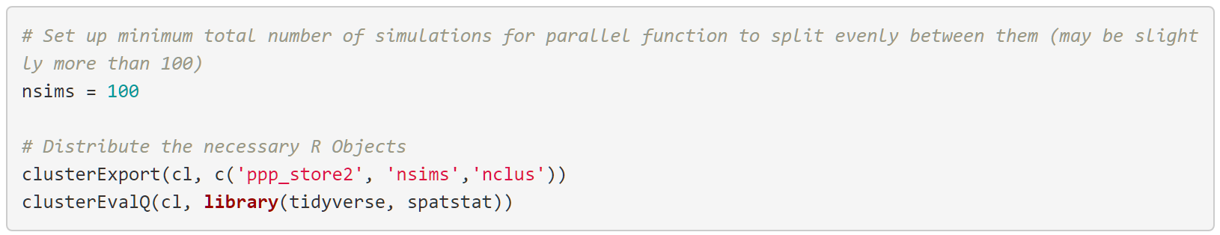
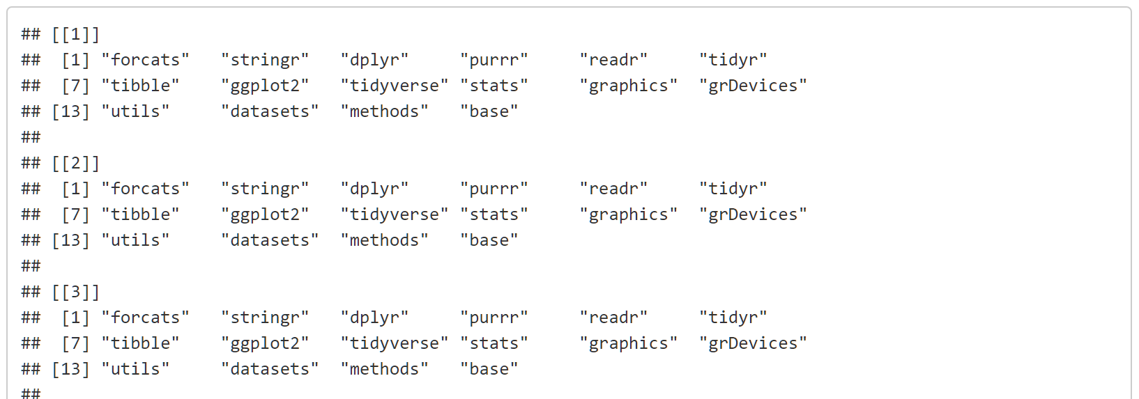
Parallelization – (2) Set up simulations and distribute objects
Notes:
While we have set up our clusters, they are a blank slate and we need to load objects, functions and packages that they need to run the computation. We only export the minimum required to the clusters as each object will take up memory in each of the clusters / processes. We use `clusterExport()` to export the data to the clusters and `clusterEvalQ()` to export the required libraries to each of the cores.

Slide 12
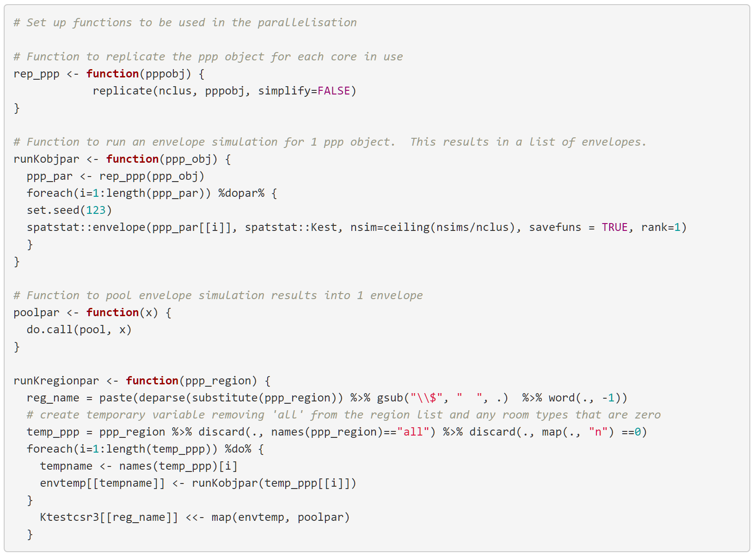
Parallelization – (3) Set up helper functions
Notes:
rep_ppp For each ppp object we will need to replicate it n number of times for the n cores that we set up in the cluster (nclus). We set simplify to FALSE so that it returns a list of ppp objects to iterate over, otherwise it returns a matrix of owins, and not a list of ppp objects.
runKobjpar This function is the core of the parallel operations. It takes the argument of the ppp object, runs the rep_ppp function to replicate it. Then for each of the replicated ppp object, we run an envelope of simulations using the spatstat functions envelope, using the passed function Kest into the envelope. We also set the number of simulations to be equally distributed, rounded up to the nearest number using the ceiling() function. Hence we will get a minimum of 100 simulations but sometimes more depending on the number of simulations and cores used. In this case we will have 102 (17*6) simulations in total. We need to ensure that savefuns is set to true so that each output is saved as an envelope object, otherwise we will not be able to pool them together later.
Generally, foreach with %do% is used to execute an R expression repeatedly, and return the results in some data structure or object, which is a list by default. It takes the form of for(iterator) %do% {this function}. The parallelisation happens in the foreach package with the %dopar% operator.

Slide 13
Parallelization – (4) Set up functions
Notes:
poolpar This is just a simple function to pool the envelopes from the outputs from the parallel job into a single envelope.
runKregionpar This function brings the 3 helper functions above together to run the parallel tests for all the room types in a region. Similar to the other 2 functions, we remove the segments with ‘all’, and any room types that do not exist in that region. We then run a foreach along the temporary ppp object created, set a seed for reproducibility across the 6 cores, and run the parallelisation for that room type in that region. Results are then pooled and saved to the Ktestcsr3 store in the form Ktestcsr3$region$room_type similar to the other 2 function outputs.

Slide 14
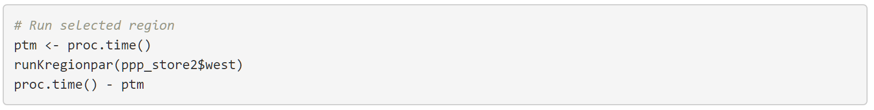
Parallelization – (3) Run functions & Stop Clusters
Notes:
poolpar This is just a simple function to pool the envelopes from the outputs from the parallel job into a single envelope.
runKregionpar This function brings the 3 helper functions above together to run the parallel tests for all the room types in a region. Similar to the other 2 functions, we remove the segments with ‘all’, and any room types that do not exist in that region. We then run a foreach along the temporary ppp object created, set a seed for reproducibility across the 6 cores, and run the parallelisation for that room type in that region. Results are then pooled and saved to the Ktestcsr3 store in the form Ktestcsr3$region$room_type similar to the other 2 function outputs.

Slide 15
Parallelization is 4x faster
Used microbenchmark and ran simulation 10 times

Slide 16
Alternative: Kest-fft()
The Kest.fft() function is an alternative to analyse large pattern of points.
Kest() computes the distance between each pair of points analytically and would therefore take a long time in computing large datasets (N-1 points * No. of simulations).
Kest.fft() function discretises the point pattern onto a rectangular raster and applies Fast Fourier Transform (FFT) techniques to estimate the K-function.
In essence, the Fast Fourier Transform algorithm allows the estimates to be computed in parallel, by splitting them pairwise, and aggregating them again.
Caveat: This only applies to the K-function test, so hopefully the last few slides weren’t a complete waste of your time.

Slide 17
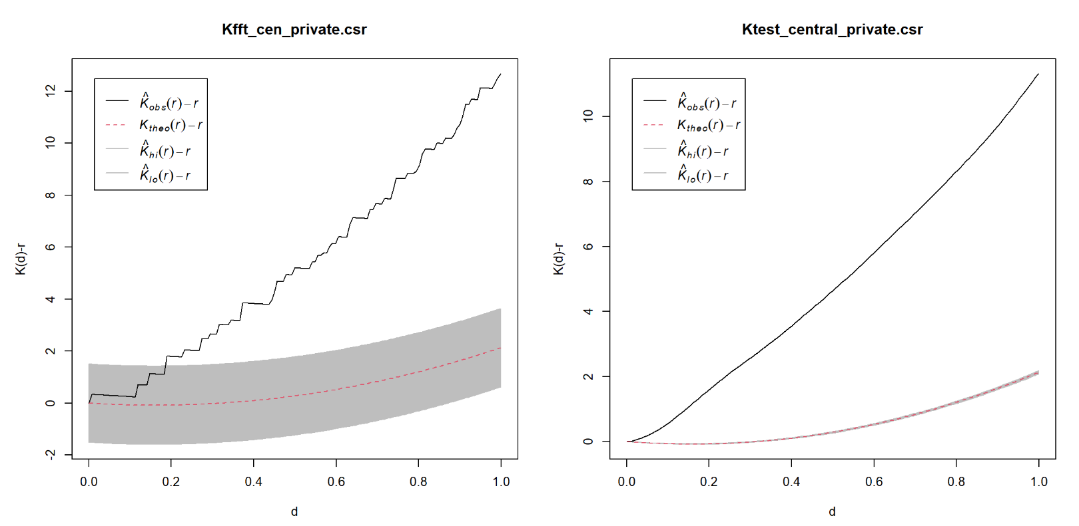
Kest-fft() Results

Slide 18
Takeaways
Learn parallelisation so you can apply it to your problems
Learn how to set up a VM with better hardware specs
RTFM – there might be a function written specifically for your problem

Slide 19


Thank You!
: https://rpubs.com/clarachua/airbnbA1
: https://clarachua.netlify.app/projects/

Slide 20
What is the K-Function?
Ripley’s K-function measures the number of events found up to a given distance of any particular event.
K(t)=λ−1E[number of extra events within distance t of a randomly chosen event]

Slide 21
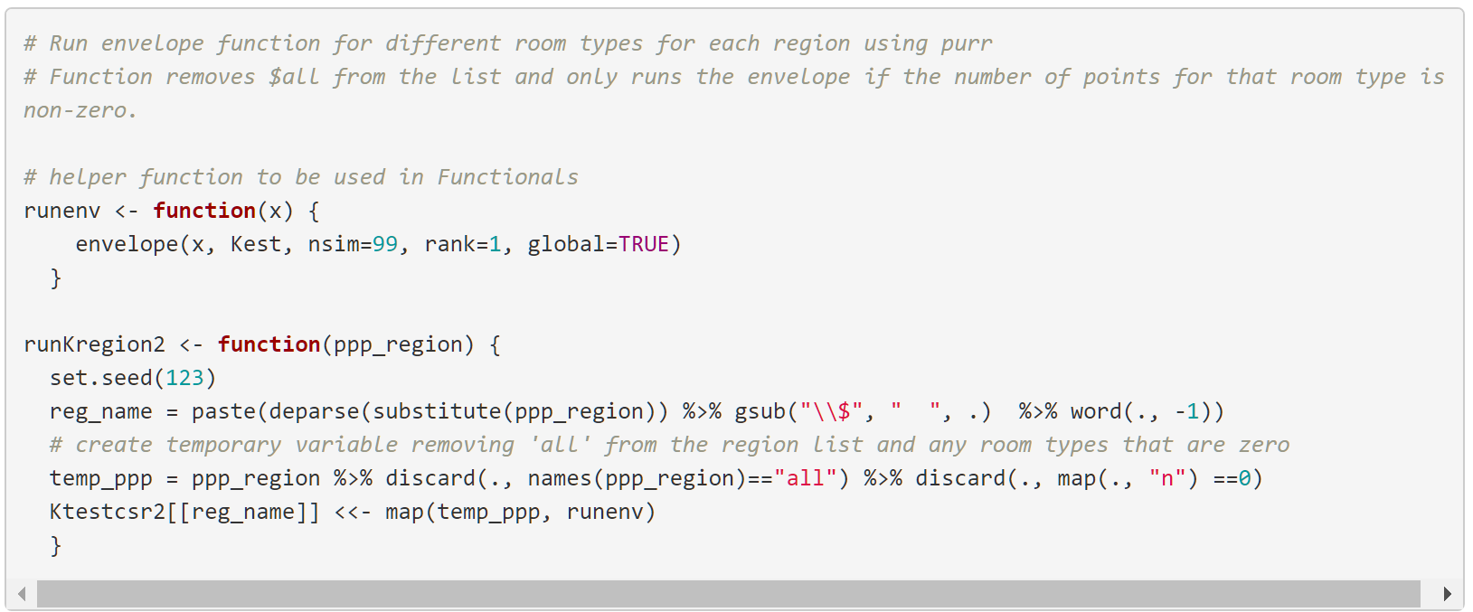
Functional Programming Code

Slide 22
Benefits of Functional Programming
Readability: Each functional is tailored for a specific task and users can understand why and how it is being used. This keeps it modular, and makes it easier to find and debug a function, instead of going through lines of code to fix any issues.
Better workflows: Functionals can help to create better workflows as we can pipe data before or after the map() or apply() function.
Computation time: As R is a vectorized language, using functionals such as `*apply()` and `map()` will typically reduce computation time, as it applies the function to a vector, matrix or dataframe. This is not always the case and it will depend on the structure of the data and/or function run.

