Slide 1
useR! 2021
Abstract: The COVID-19 pandemic required an unprecedented response from the pharmaceutical industry, both in terms of developing new antiviral medicines and vaccines as rapidly and safely as possible, and in continuing to deliver its existing portfolio of important new medicines. As many countries went into lockdown to slow the spread of the disease, sponsors faced the twin dilemma of replanning study delivery on the fly, while rebalancing their portfolios to meet the emergent medical need. Our multidisciplinary team at GSK tackled the problem of delayed recruitment due to the pandemic.
We aggregated external data on the pandemic across 42 countries into epidemiological forecasts, designed a novel Bayesian hierarchical model with 3 levels: site initiation, patient screening, and patient randomization, to link classical recruitment predictions with epidemiological COVID-19 predictions. We obtained COVID-adjusted estimates of time to achieve key recruitment milestones via forward sampling from posterior distributions of the model parameters.
The results of this exercise were summarized and deployed in a user-friendly Shiny application to assist study teams with recruitment planning in the face of the pandemic. Here we showcase the results of the effective collaboration of statisticians and data scientists and how it fits into decision-making framework in the clinical operations.
Nicky Best, Graeme Archer,
Jack Euesden, Christina Fillmore,
Dave Lunn, Inna Perevozskaya,
Valeriia Sherina, Doug Thompson,
Magda Zwierzyna
July 2021
useR! 2021

Slide 2
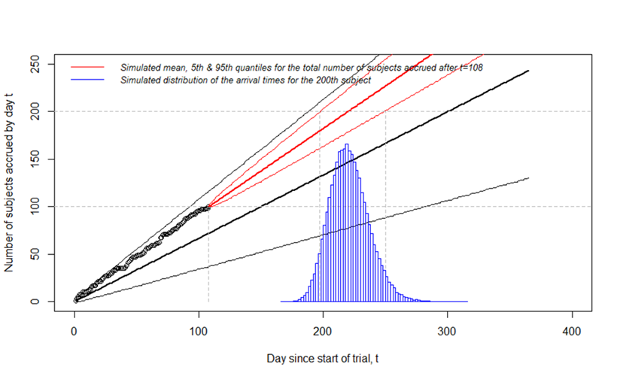
Monitoring recruitment progress with Poisson-Gamma Model
What we really want to know is how to set the realistic “target” – the one we can achieve with pre-set probability (e.g. 80%)
In order to answer “target” question, need to track the distribution of “recruitment complete” milestone or Last-Subject-First-Visit (LSFV)
Hypothetical example of Bayesian Poisson-Gamma model use N=200 target recruitment, black is original plan, red is updated plan
LSFV
Original plan generated based on prior distributions of model parameters (black lines)
Based on enrollment data of first 100 patients, the distribution of model parameters is updated (estimation)
And new enrollment projections generated (prediction) based on posterior distributions of parameters (red lines)
This allows us to answer the question: What’s the likelihood of enrolling the study by target date X?
Enrollment Target

Slide 3




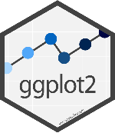


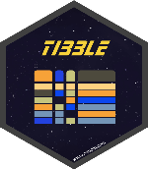

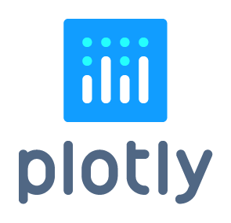



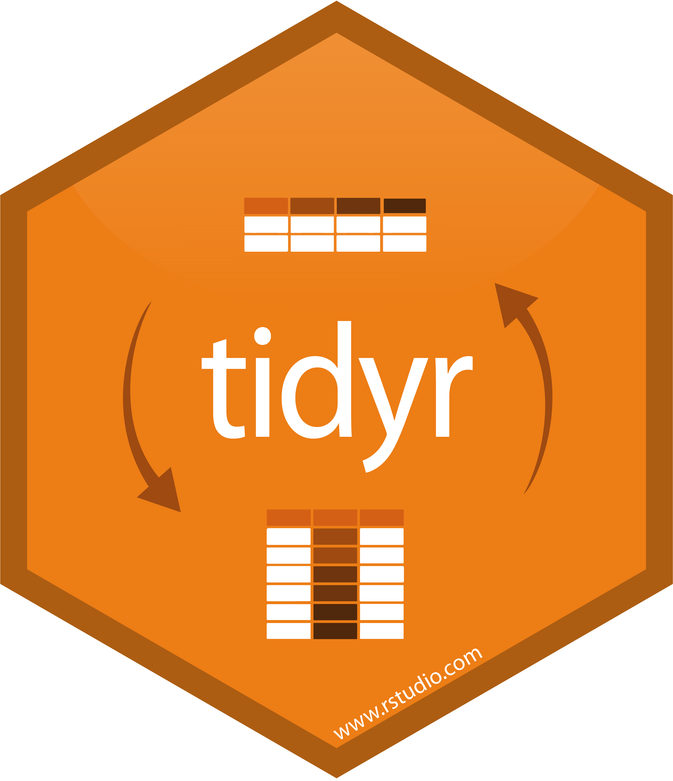






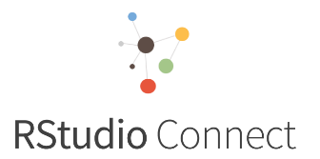
Data science workflow - enablers
Tools and packages
Data wrangling
Modelling
Data and code storage
Visualization
S3 Object Store

Slide 4
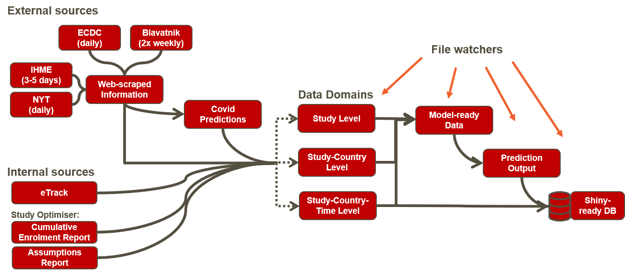



Data integration overview
Putting all the data together and improving data storage by data normalization
Advantages of data normalization
Less redundant data and fewer null values
Reduced storage size
Increased data integrity
Intuitive data schema
COVID-19 predictions
Interactive visualization
Recruitment predictions

Slide 5
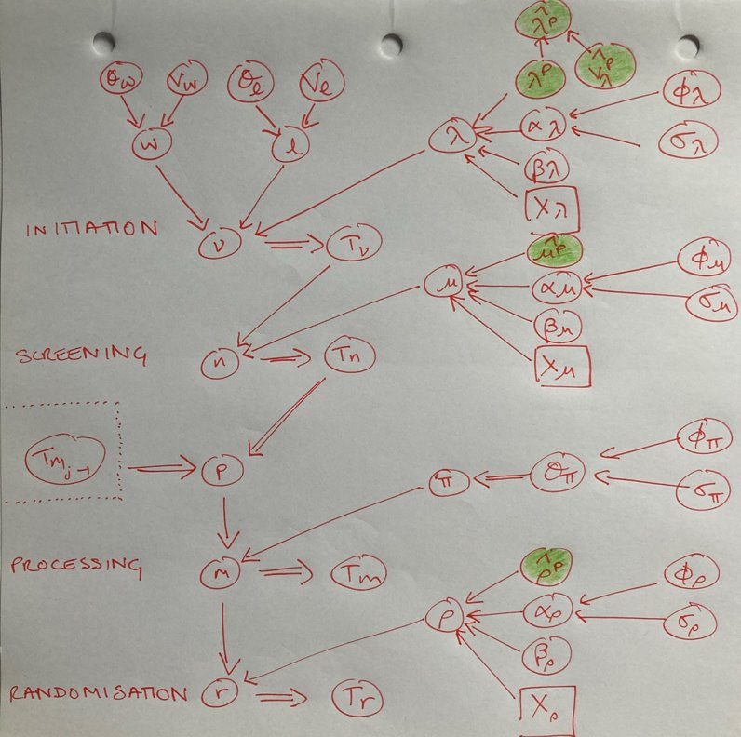
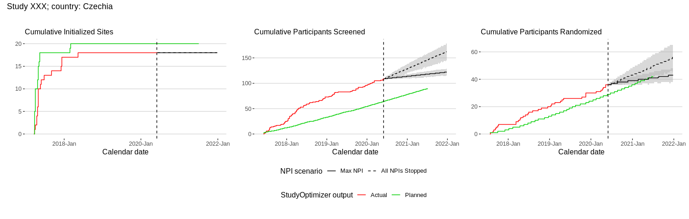
Recruitment modelling with COVID-19
Key focus: understanding the “gap” between actual and planned recruitment curves
DAG of COVID-19 impact model
Q: How much of planned/actual gap can be explained by COVID-19 impact ?
Each process measured in terms of weekly numbers, for both planned and actual recruitment
Wish to compare actual to planned recruitment but main focus on understanding the impact of COVID-19
useR! 2021

Slide 6
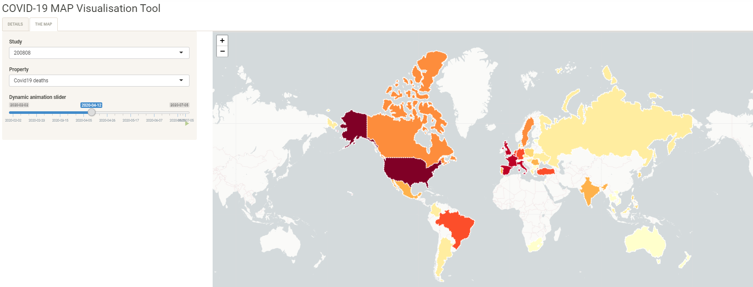
Interactive web applications based on a single database
View COVID-19 statistics and predictions on an animated map

Slide 7
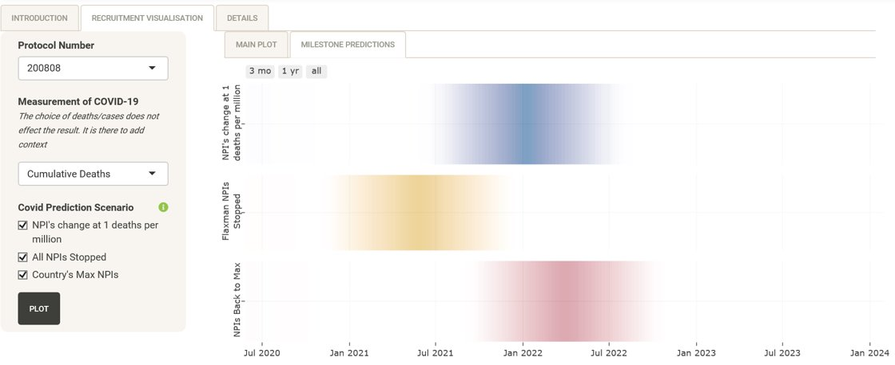
Milestone estimates in resulting Recruitment App
View probability distributions (density strips) for the LSFV visit milestone

Slide 8
Summary
We have presented work that resulted from intense collaboration within a multi-disciplinary team of statisticians, data scientists and clinical operation professionals over the course of 5 months since pandemic started
It builds on an existing well-developed stochastic Poisson-gamma model commonly used for recruitment prediction
To properly account for uncertainties in recruitment processes, the model has 3 components: site initiation, patients screening and randomization
The COVID-19 pandemic has affected all 3 sub-processes of recruitment
We have built a Bayesian hierarchical model that “explains” how the rates of all 3 processes are affected by COVID-19-related covariates such as NPI stringency index

Slide 9
Summary (cont.)
In the process, we also built a standalone COVID-19 forecaster App which can be viewed as an aggregator of publicly available COVID-19 models and GSK custom implementation of the Imperial College Flaxman model
Can be used independently of recruitment app to assist teams with planning (to plan initial footprint of studies based on COVID-19 situation)
The work is far from being done: this phase was a “pilot” for immediate impact using recruitment data from a subset of GSK studies.
Currently, study teams are test-driving the proposed solution using their own on-the-ground insight into recruitment process and COVID-19 disruptions
With more data and more insight from experts, the model is likely to be further refined
The long term goal is to embed this kind of thinking and tools into routine processes and systems within Clinical Operations

