Slide 1

An R shiny application simplifying the PK/PD review process
Kristoffer Segerstrøm Mørk, Novo Nordisk A/S
Steffen Falgreen Larsen, Novo Nordisk A/S
Notes:
Reactive PK/PD: An R shiny application simplifying the PK/PD review process.

Slide 2
Disclaimer
Views and opinions expressed are those of the speaker and not necessarily Novo Nordisk
Notes:
Disclaimer
Views and opinions expressed are those of the speaker and not necessarily Novo Nordisk

Slide 3
What is the idea?
For clinical pharmacology trials, pharmacokinetic (PK) and pharmacodynamic (PD) data is reviewed
Previously this was done by:
Creating a document containing plots of individual PK/PD profiles
Each reviewer received a copy in which they wrote comments
A review meeting was held to share and evaluate comments
Meeting minutes were created manually
Decisions were implemented in data
This was a tedious process, which we have tried to simplify
Notes:
What is the idea.
For clinical pharmacology trials, PK and PD data is reviewed on a patient level due to the limitations and uncertainties related to the procedures used to assess PK and PD.
Previously this was a manual process requiring the host of the review to produce the required plots of the individual profiles that should be reviewed. Each reviewer then received a copy of the document to which they could add their comments. A review meeting was then held to share and evaluate the different comments. After the meeting, the host manually created meeting minutes to document the review. The data was then updated accordingly.
We have tried to systematise and simplify this tedious process which resulted in the creation of Reactive PK/PD.

Slide 4


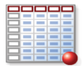





How does it work?
ADaM
Data
Minutes
Notes:
How does it work?
Reactive PK/PD is an R shiny application that automates a lot of the procedures related to a PK/PD review. This slide illustrates how a review is conducted through the application. First, the host of the review fills in a few details about the review such as trial ID and initials of the reviewers. Afterwards, the host uploads the relevant data to the application. The application automatically generates plots of the individual profiles from the uploaded data. Now the reviewers can start their review and add comments through the plots. The comments are instantly visible to all reviewers which helps them to be more prepared at the review meeting and thereby shorten the time spent at the meeting. Once the data has been reviewed, a review meeting is held evaluating the different comments. After the review meeting, the host can document the review by using the application to automatically generate minutes in Word format.
The host are also able to download the comments in a csv format which enables an automatic implementation of the comments into the relavant dataset(s).

Slide 5
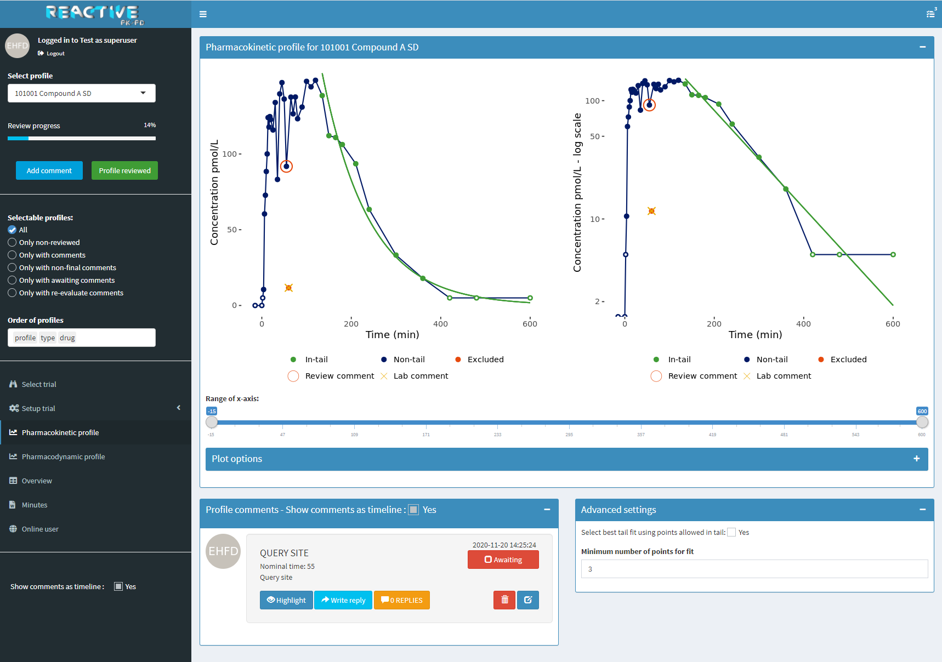
How does it look?
Notes:
How does it look?
This preview of the application will only focus on the PK part.
This is the main display for the PK part of the application.

Slide 6
How does it look?
PK profile
Left plot is in original scale
Right plot is in logarithmic scale
Review comments
Comments for the current PK profile
Notes:
How does it look?
In the blue box, two figures are shown illustrating the current selected PK profile. The left figure shows how the concentration of the drug develops over time. The figure to the right is similar to the left one except that it is in log scale. Below the figures, some labels are shown including labels for review comments and comments from the laboratory if any.
In the yellow box, comments for the selected PK profile are shown. A comment is instantly visible to all reviewers, and it includes different types of information like the initials of the comment author, the category of the comment, the time points of the related data points and the status of the comment. The initial status of a comment is ‘Awaiting’, and the status will be updated at the review meeting depending on the evaluation of the comment. It is also possible to write a reply to a comment.

Slide 7
Select and zoom
Select point(s)
By double clicking
By marking an area and then click within it
Selected points will be enlarged
Deselect by double clicking elsewhere in the plot
Zoom
By marking an area and then double-click within it
Zoom out by double clicking elsewhere in the plot
Notes:
Select and zoom
It is possible to select points and zoom in the figures.
Points can be selected by double clicking on them.

Slide 8
Select and zoom
Select point(s)
By double clicking
By marking an area and then click within it
Selected points will be enlarged
Deselect by double clicking elsewhere in the plot
Zoom
By marking an area and then double-click within it
Zoom out by double clicking elsewhere in the plot
Notes:
Select and zoom
Points can also be selected by marking an area and then click within it.

Slide 9
Select and zoom
Select point(s)
By double clicking
By marking an area and then click within it
Selected points will be enlarged
Deselect by double clicking elsewhere in the plot
Zoom
By marking an area and then double-click within it
Zoom out by double clicking elsewhere in the plot
Notes:
Select and zoom
Selected points will be enlarged.

Slide 10
Select and zoom
Select point(s)
By double clicking
By marking an area and then click within it
Selected points will be enlarged
Deselect by double clicking elsewhere in the plot
Zoom
By marking an area and then double-click within it
Zoom out by double clicking elsewhere in the plot
Notes:
Select and zoom
All points can be deselected by double clicking elsewhere in the figures.

Slide 11
Select and zoom
Select point(s)
By double clicking
By marking an area and then click within it
Selected points will be enlarged
Deselect by double clicking elsewhere in the plot
Zoom
By marking an area and then double-click within it
Zoom out by double clicking elsewhere in the plot
Notes:
Select and zoom
It is also possible to zoom by marking an area and then double-click within it.

Slide 12
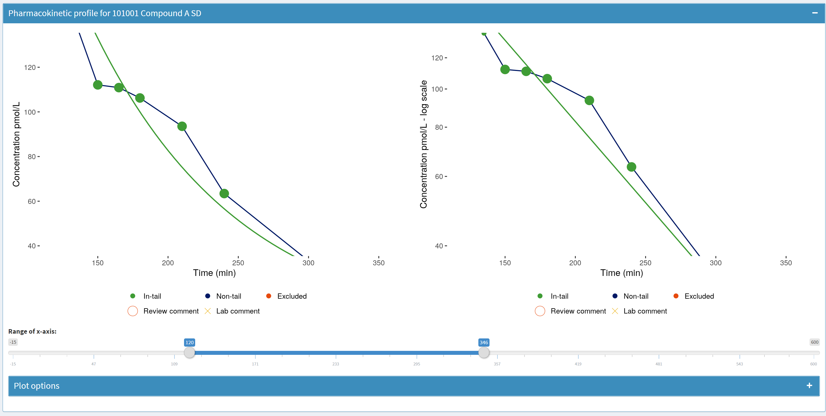
Select and zoom
Select point(s)
By double clicking
By marking an area and then click within it
Selected points will be enlarged
Deselect by double clicking elsewhere in the plot
Zoom
By marking an area and then double-click within it
Zoom out by double clicking elsewhere in the plot
Notes:
Select and zoom
The figures will then zoom in on the marked area.

Slide 13
Select and zoom
Select point(s)
By double clicking
By marking an area and then click within it
Selected points will be enlarged
Deselect by double clicking elsewhere in the plot
Zoom
By marking an area and then double-click within it
Zoom out by double clicking elsewhere in the plot
Notes:
Select and zoom
Zoom out by double clicking elsewhere in the figures.

Slide 14
Main PK display
Notes:
Main PK display
Back to the main display.
In the green pane, some different options and features are shown. In the next slide we will have a look at how some of these features should be used during a review.

Slide 15
Using the tool
Select profile
Dropdown menu used to select profiles
1
Add comment
A window will show up once this button is pressed in which the reviewer can specify their comment
2
Profile reviewed
By pressing this button the reviewer will be taken to the next profile in line and their review progress will be tracked
3
Notes:
Using the tool
The ‘Select profile’-feature is a dropdown menu that specifies the current selected PK profile.
In case a reviewer has a comment, the ‘Add comment’-button should be pressed. Then a window will show up in which the reviewer can specify their comment. Once the reviewer is done reviewing a particular profile, the ‘Profile reviewed’-button should be pressed. This button will take the reviewer to the next profile and keep track of their individual review progress. This makes it easier for the reviewers to pick up where they left off.

Slide 16
Thank you for your attention!
https://github.com/NNpackages/ReactivePKPD
Notes:
Thank you for your attention.
The source code is available on GitHub

