Slide 1

A fresh look at unit testing with tinytest
Mark van der Loo
Statistics Netherlands
useR!2021
Zürich (virtually)
@markvdloo
github.com/markvanderloo
Materials: github.com/markvanderloo/useR2021

Slide 2
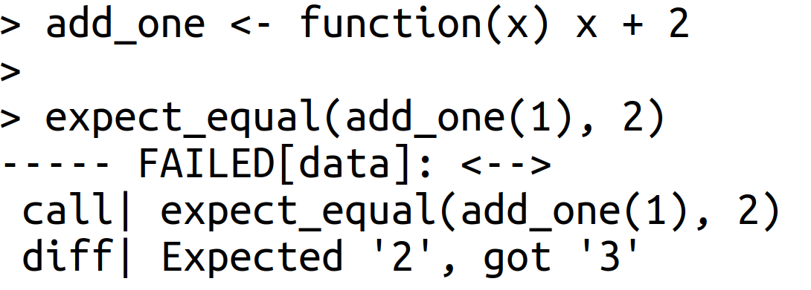
Unit testing

Slide 3
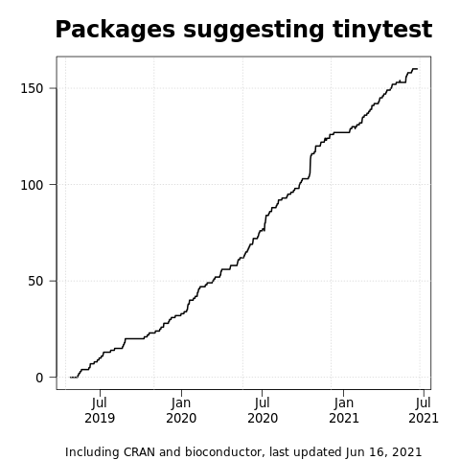
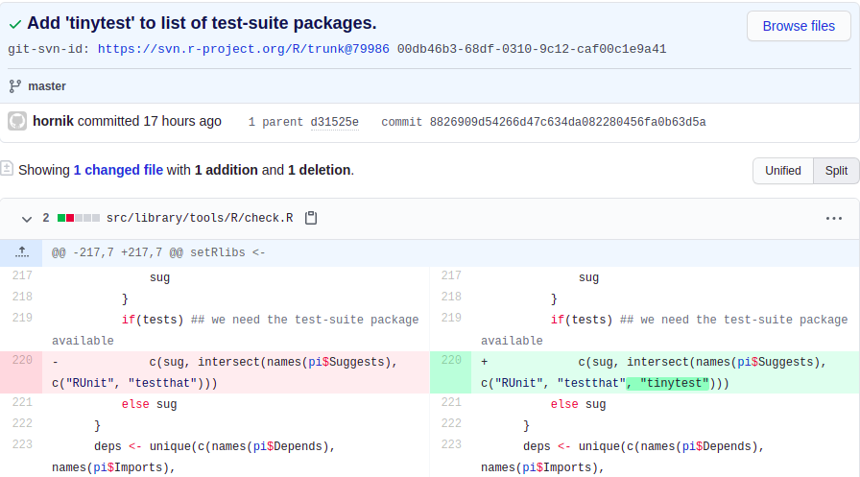
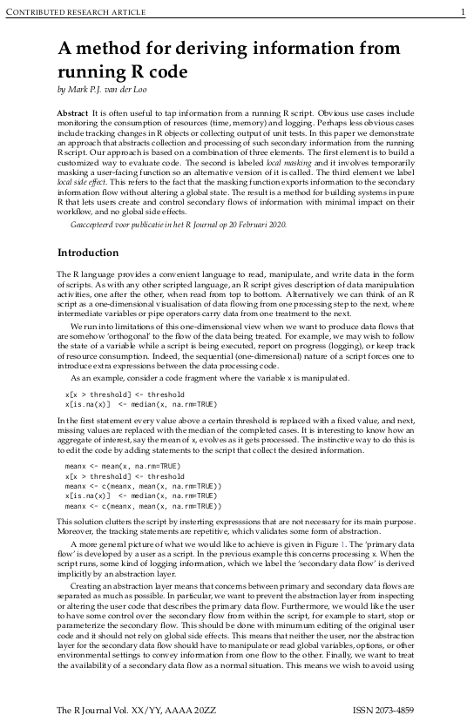
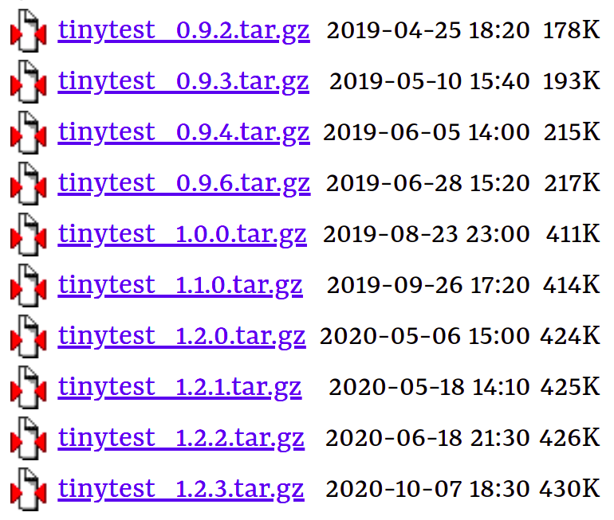
test suite package
in tools
2 vignettes
Method:
arxiv.org/abs/2002.07472
Supported by
littler
pkgKitten
11 releases since 04/2019

Slide 4


An Chu
Ott Toomet
Jon Clayden
Michel Lang
Brian Ripley
Thomas Fuchs
Jan Wijffels
Bryan Hanson
Lionel Henry
John Blischak
Jozef Hajnala
Maja Zaloznik
James Thompson
Sebastian Meyer
Patrick Breheny
GH user Billy34
Matthijs Berends
GH user salim-b
Henrik Bengtsson
Dirk Eddelbuettel
George G Vega Yon
Bart-Jan van Rossum
Jonas Kristoffer Lindeloef

Slide 5
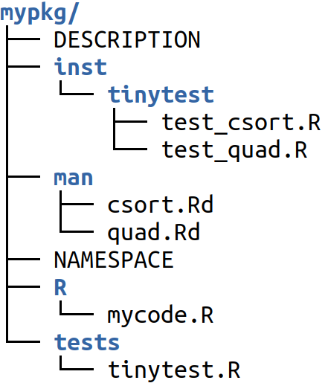
Unit tests

Slide 6

Tests travel with the package
expect_equal(1+1,2)

Slide 7
Testing in parallel
R> run_test_dir(ncpu=4)

Slide 8
Reporting side effects
R> run_test_file(side_effects=TRUE)
report_side_effects()
LC_COLLATE=”C”

Slide 9
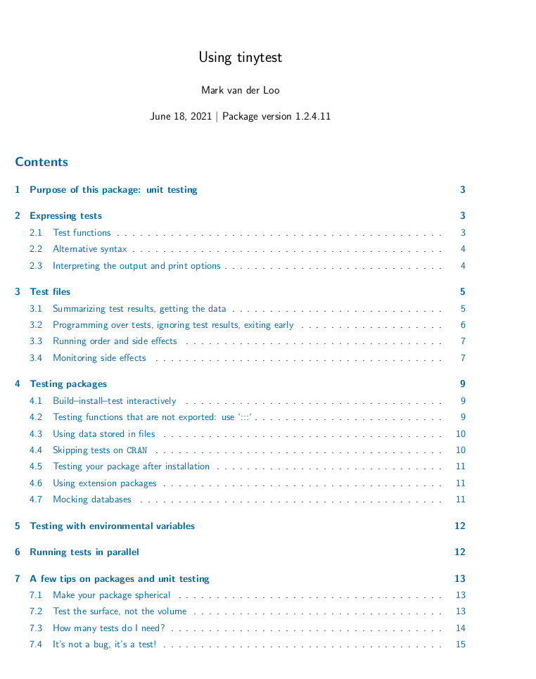
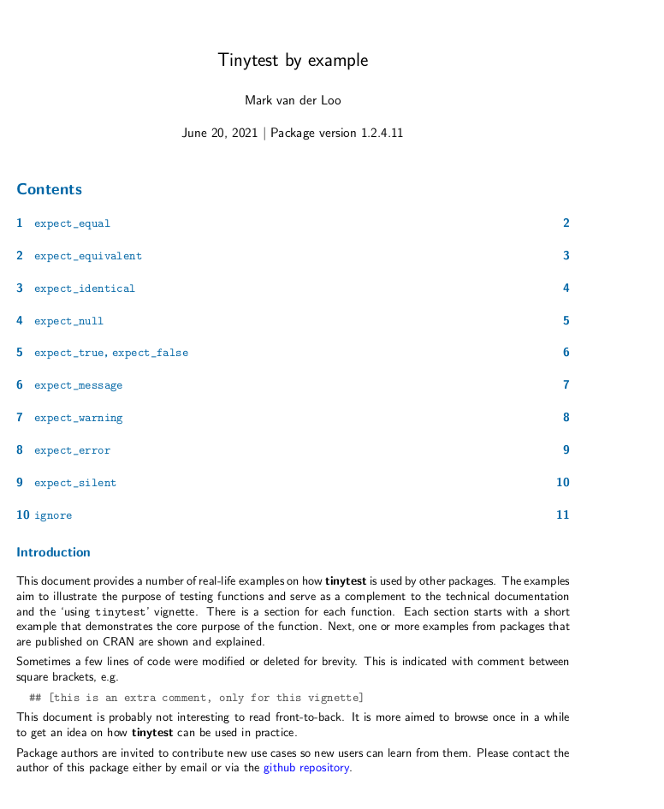
tinytest
Small, dependency-free package
Easy to set up and use
Support for pkg building cycle
Parallel testing, as easy as ncpu=n
Track side effects with ease
Tests travel with the package

