Slide 1
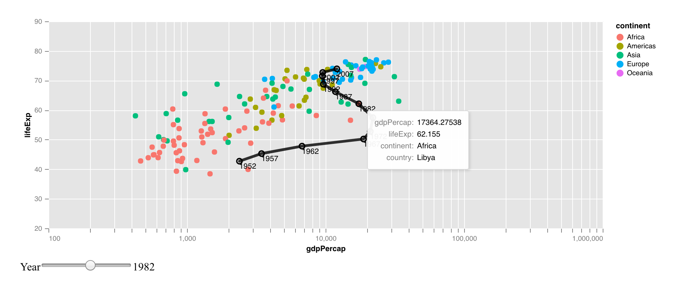
virgo
a layered grammar of interactive graphics
Stuart Lee and Earo Wang

Slide 2

Why Interactive?

Slide 3
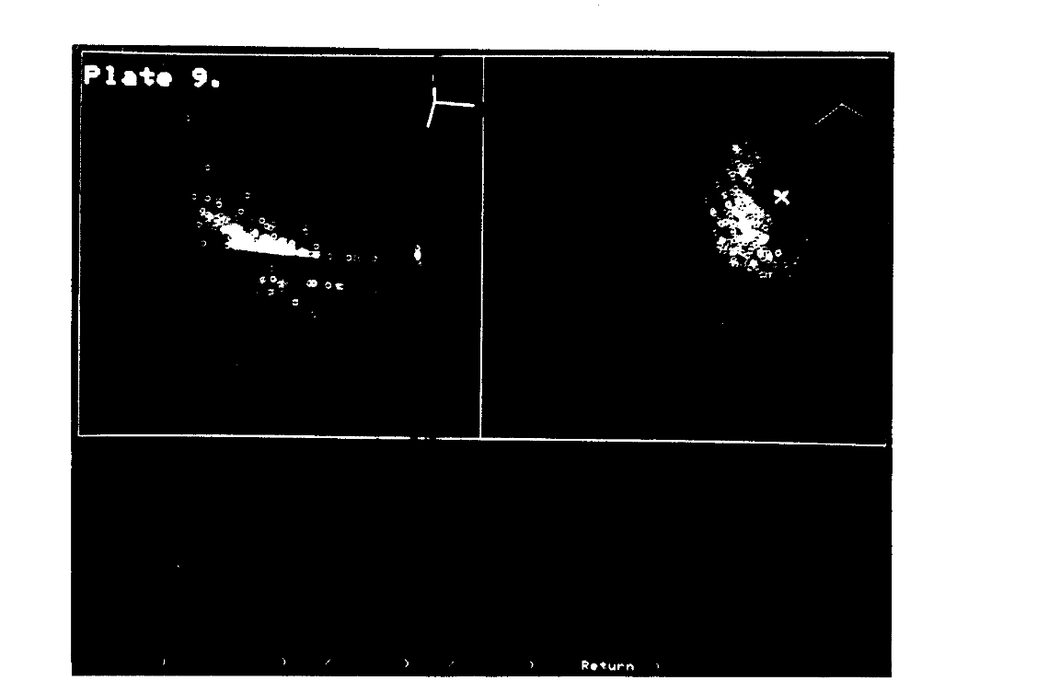
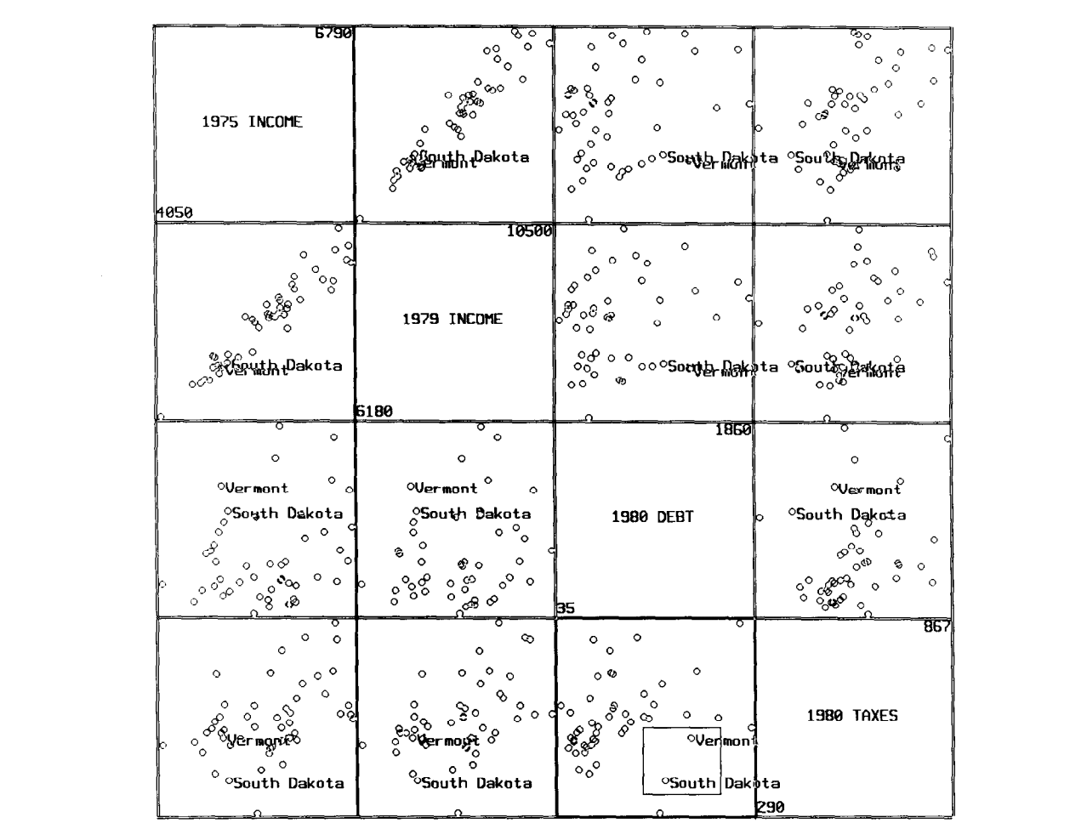
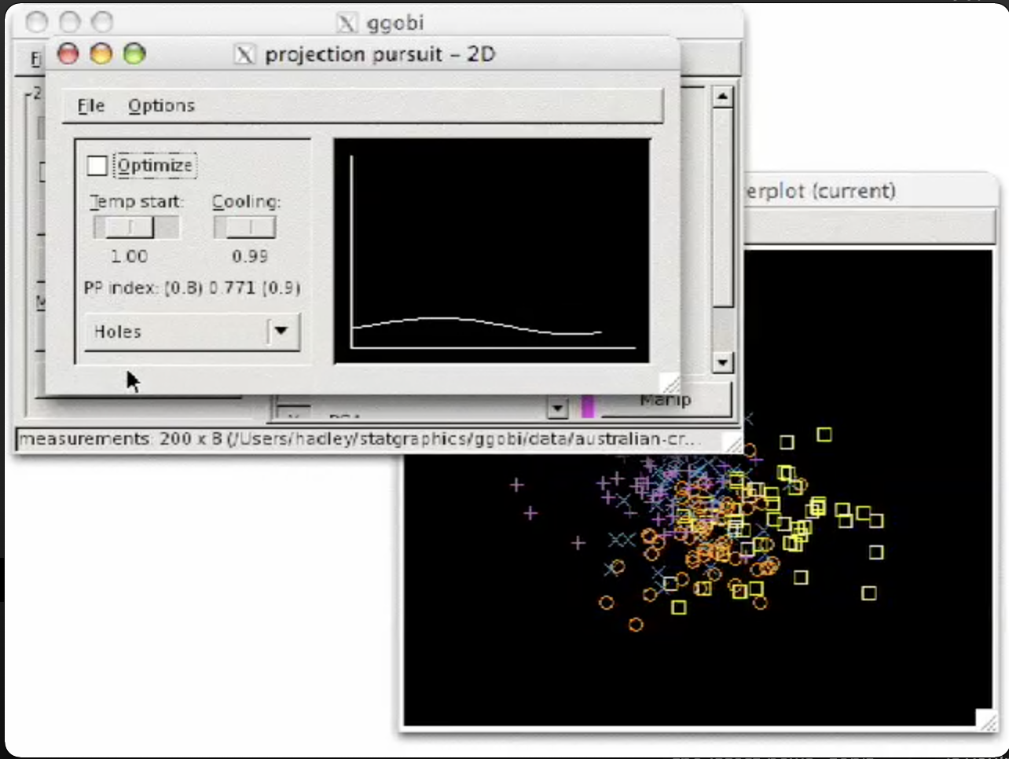

Slide 4





Grammar
virgo
vegawidget
graphics
Named
Static
Interactive

Slide 5

Grammar
virgo
vegawidget
graphics
Named
Static
Interactive

Slide 6
Demo Time

Slide 7
Learning More
https://vegawidget.github.io/virgo/
https://github.com/vegawidget/virgo
https://github.com/vegawidget/vegawidget

Slide 8
Acknowledgements
Earo Wang
Ian Lyttle
Alicia Schep
Vega/Vega-Lite Developers

