Slide 1
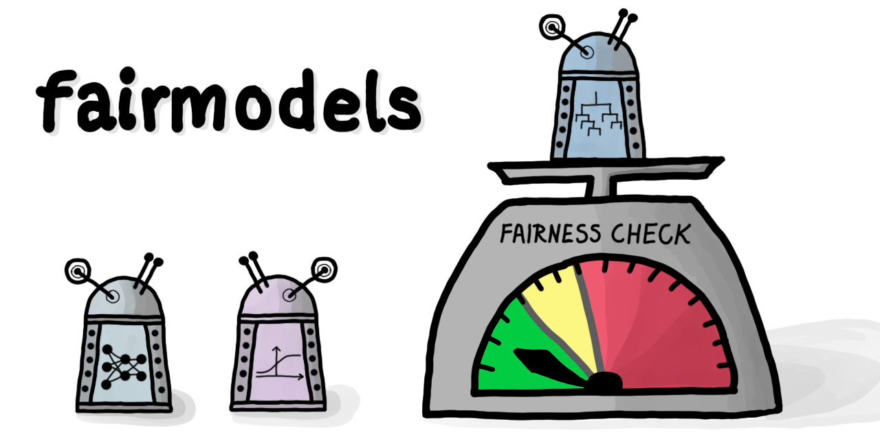


Jakub Wiśniewski
joint work with Przemysław Biecek
Notes:
Hi everybody, my name is Jacob Wiśniewski. I am research software engineer at MI2 DataLab and student at faculty of methematics and information science at warsaw university of technology and today I will be presenting my joint work with Przemysław Biecek which is R package fairmodels. Fairmodels is a flexible tool for bias detection visualization and mitigation..

Slide 2
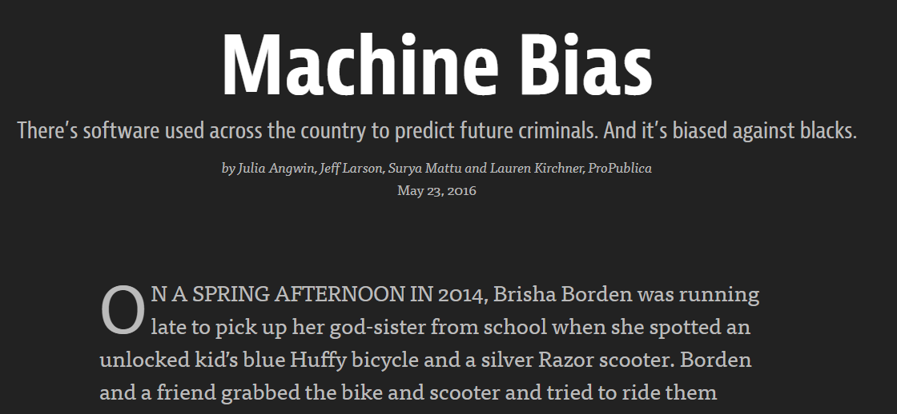
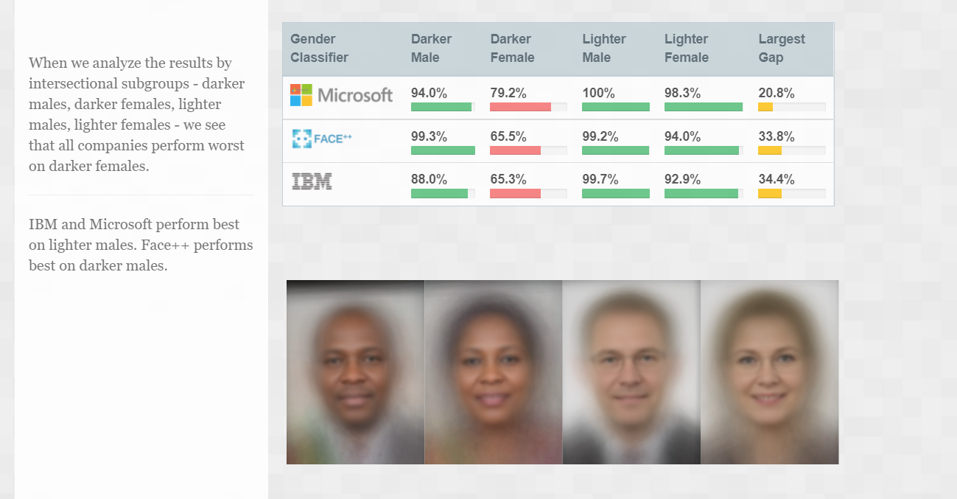
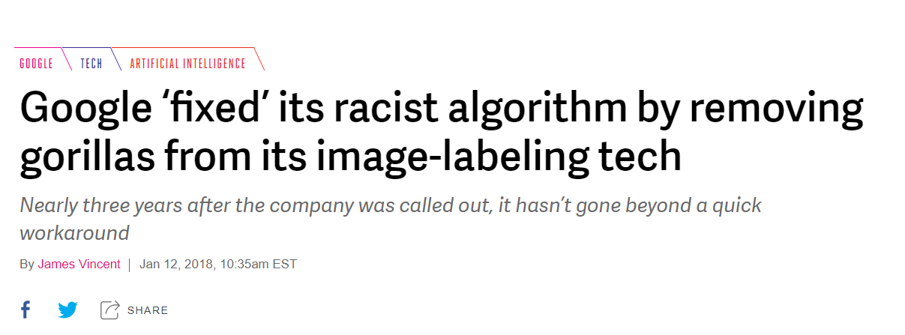
Why is It important?
propublica.org
gendershades.org
theverge.com
Notes:
- Now will answer the question why should we care about algorithmic fairness? Well decision making systems and machine learning models had a history of discrimination and somewhat shady practises. For example ProPublica found that the software used the used across the country to predict whether someone will be recidivist or not was biassed against blacks.
- In gendershades the researchers found that the popular gender classifiers where biased against darker females. The algorithm algorithms perform best on light male faces and the gap of accuracy can be as high as 30%. - As the verge reported, Google removed the gorillas from the training sets of images because the model was prone to categorise black people as gorillas.
- As you can see there are many potential harms to be made and it is necessary to test our models before we put them into production.

Slide 3
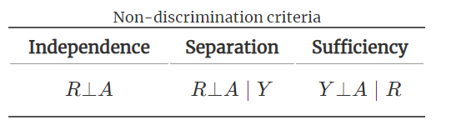
What is bias?
Bias can have many sources
Different treatment of some subgroups by model
Subgroups will be later called protected (vector)
One will be called privileged
Can be described by non-discrimination criteria
Y – binary label
R – numerical response of a model A – protected vector
Fairness and Machine Learning, Barocas et al. (2019) – fairmlbook.org
Notes:
Now we will define this bias. It can have many meanings but, in this presentation, will define it as some discrimination of some groups of people giving unfair advantage to others.
From now on I call those groups of people subgroups and one of them will be called privilege subgroup.
The vector with indicators of membership to the subgroups will be called protected vector.
Bias can be detected by some non-discrimination criteria which are independence separation and sufficiency. Essentially, they are trying to answer the question if the response of the model is independent off a protected vector or independent given some condition. But this mathematical way of measuring bias isnt convenient and we will use some relaxations and sometimes equivalents of those not discrimination criteria.

Slide 4
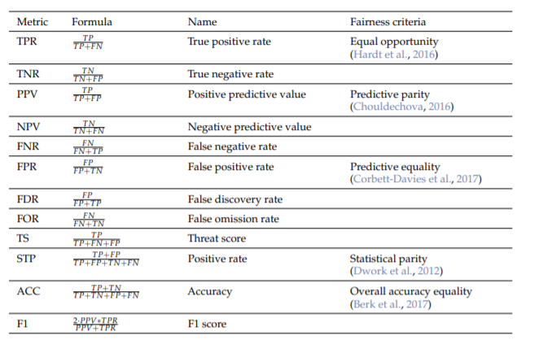
How to measure it?
With metrics
From confusion matrix for each subgroup
The metrics are either some form of relaxation or equivalents of Independence, Separation and Sufficency
Notes:
- We can do this with some fairness metrics or criteria. Those metrics can be derived from the confusion matrix metrics for each subgroup. So with well known metrics like True positive Rate, Precision, Accuracy we can now detect bias.
- For example like in ProPublica case we would like our model to have for similar False Positive Rates for both black and white defendants.

Slide 5
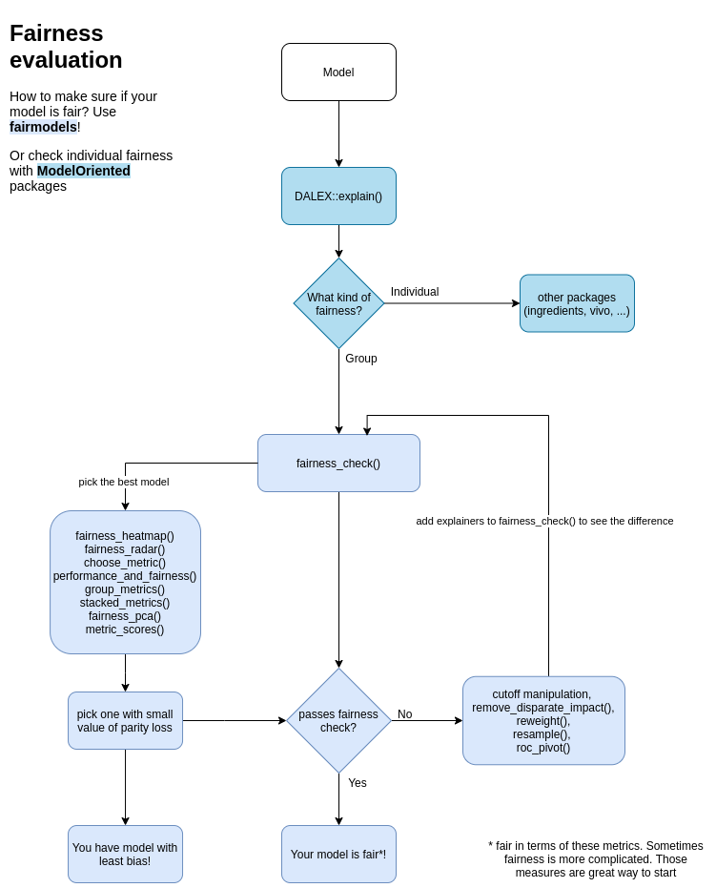
How to do it easily? With fairmodels!
With use of DALEX
Group fairness metrics
Iterative approach
fairness_check() > add model > fairness_check()
Easy for testing and prototyping
Notes:
The fairmodels backbone is DALEX package which is a wrapper around data and model and is model agnostic so it does not matter if you use xgboost, models from caret or mlr. Fairmodels focuses on group fairness metrics and it utilises this in iterative accumulative approach where after obtaining model you can make a fairness check. You then receive the answer if your model is fair or not. If your model does not pass the fairness check you have some options. - For example use different data
- use different model
- or maybe use some mitigation techniques
With fairmodels you can for example make a dozen of machine learning models then with some visualisation method you may pick the best one and check if this model passes the fairness check
As you can see this sort of pipeline or model development flow is easy for testing and prototyping your solutions.

Slide 6
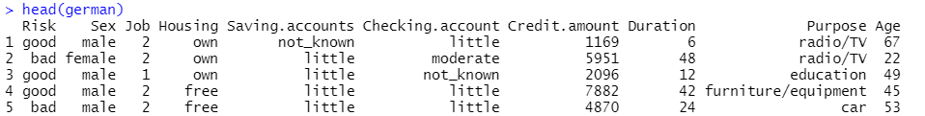

How? Let’s dive into details!
We will need some data
And some classification* model
Target (y)
Protected vector
* Regression models are partially supported (it will be discussed later)
Notes:
Now we'll dive into the details.
Let's take German Credit Data where we aim to predict whether some person will have a good or bad risk or credit. So it’s the case of binary classification.
Will be looking at bias and fairness with perspective on the gender or the sex of the person – this will be our protected vector. Let's start with a simple classification model which is logistic regression.

Slide 7

How? Let’s dive into details!
Next, we will make an DALEX explainer
And we are ready to check fairness
Notes:
The next step is to make a DALEX explainer. This can be done with a one line of code where we pass the model the data and the numerical target variable. Now we are ready to check the fairness.
The main function of fairmodels is fairness chck. It wraps around and encapsulates explainer, protected vector and privileged subgroup which describes which element of the protected vector is suspected of the most privilege.
A function returns object of type fairness object which we will assigned to a variable fobject.

Slide 8
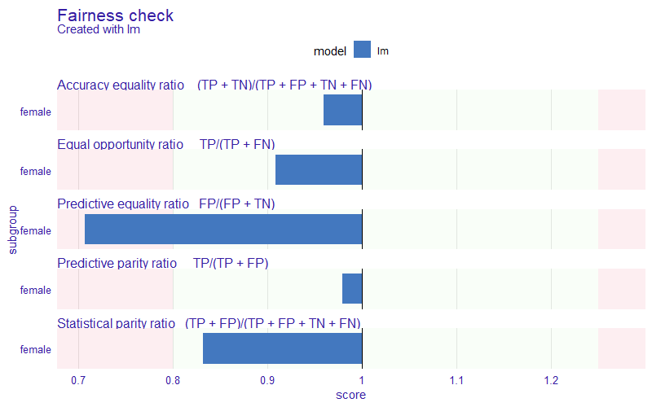

The result of fairness checking
Notes:
The fobject can be of course plotted. It includes five metric scores depicted by the bars which are on top of the red and green area. The red area symbolises the field where the bias is significant.
So intuitively when all the bars are lying within the green area then the model in terms of these metrics can be called fair. The border between red and green area can be adjusted with epsilon parameter.
On Y axis the subgroups are presented and for each subgroup the metrics are calculated. If there would be more than one subgroup there would be more bars for the metric.
So, the protected vector doesn't have to be binary it can have many, many levels or in other words, categorical values. But what are those values on the X axis? well let's dive deeper!

Slide 9
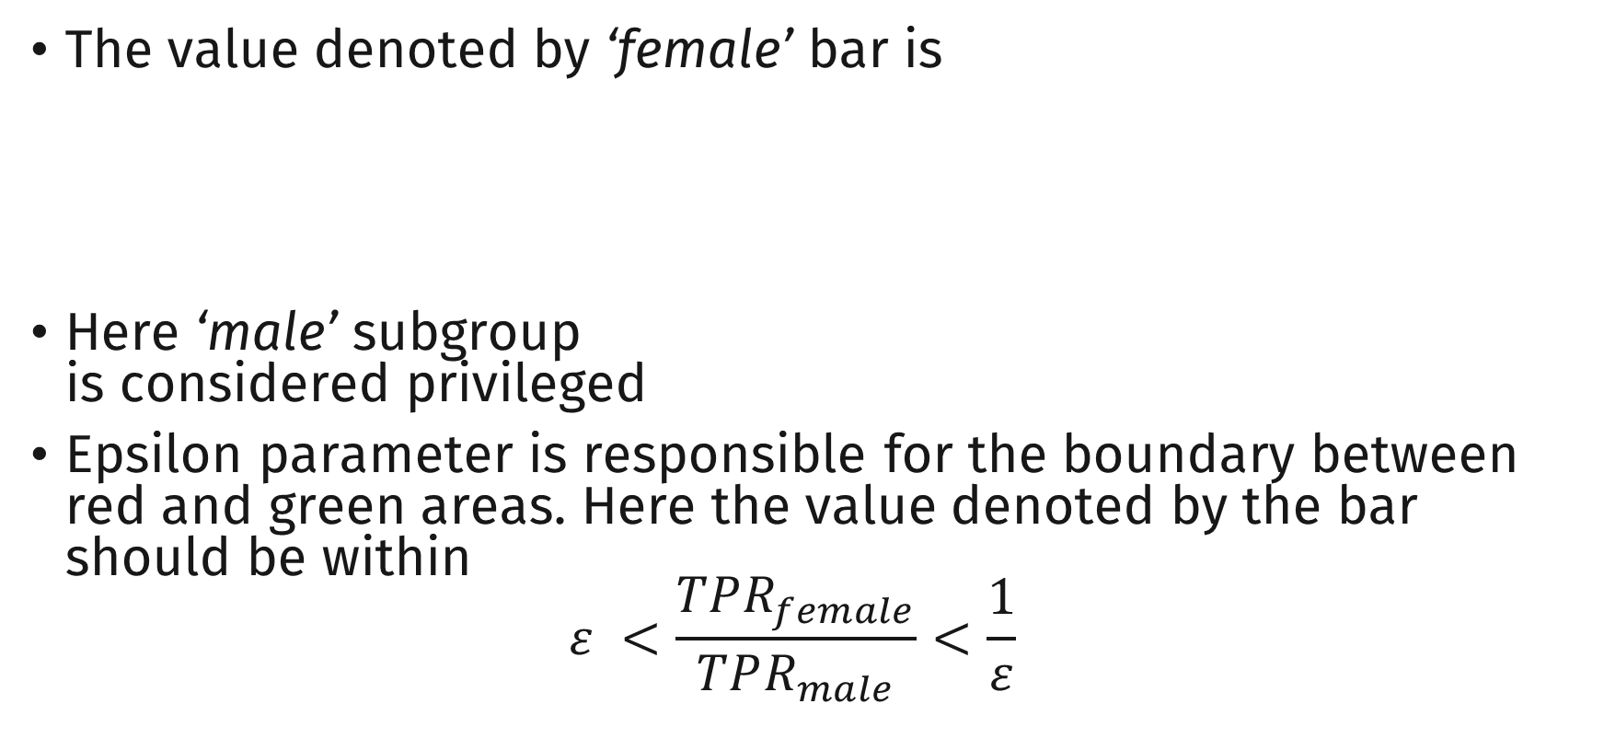

How to read it?
The value denoted by ‘female’ bar is
Here ‘male’ subgroup is considered privileged
Epsilon parameter is responsible for the boundary between red and green areas. Here the value denoted by the bar should be within $ε <\frac{TPR_{female}}{TPR_{male}}<\frac{1}{ε}$
$$\frac{TPR_{female}}{TPR_{male}}$$
Notes:
The idea behind those values is the ratio of the metrics for unprivileged subgroup which in our case is female and the privilege subgroup which is in this case male. We don’t care if the metrics are high or low as long as the ratio of them is close to 1.
For example, let's take equal opportunity ratio which can be measured by true positive rate. When those TPR scores are close to each other the division would give us something close to 1 and hence it would be within green area and we would say that there is no visible bias here.
So formally speaking we would like our ratio to be within epsilon and 1 divided by the epsilon, where epsilon is some value between zero and one which denotes the lowest possible ratio between unprivileged and privileged subgroups.

Slide 10
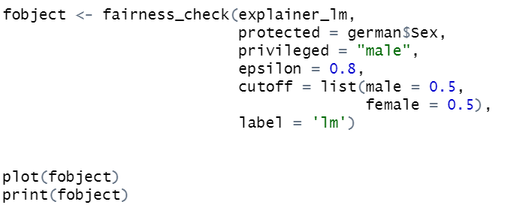
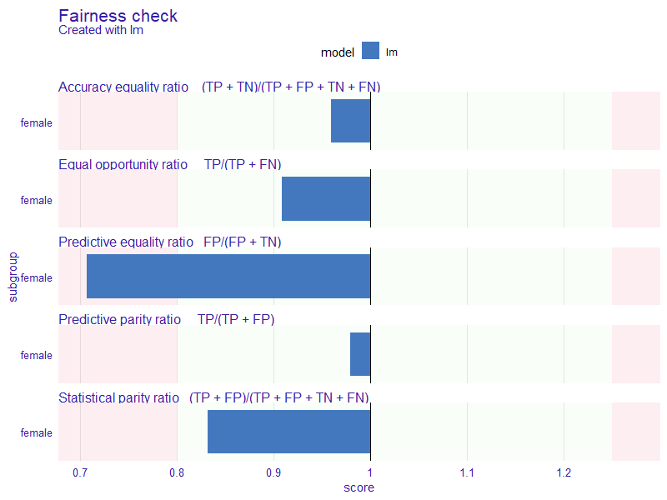
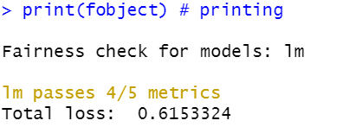
Understanding code
The epsilon parameter is set to 0.8 due to EEOC four-fifths rule
Notes:
Let's understand some more code behind this fairness object. The values after the privileged parameter are default values for this function . The epsilon parameter is on default set to 4/5 due to a guidelines set by Equal Employment Opportunity Commission. Generally any selection rate below 80% or 4/5 can be considered as adverse impact.
Cutoffs and labels can also be adjusted
Labels have to be unique for each explainer in fairness check
With such a newly creted fairness object we can of course plot it and print it. Printing is a way of summarising the plot.
Then the print method apart of showing how many metrics does the model pass, tells us what the total loss is which is summarised height of the bars.

Slide 11
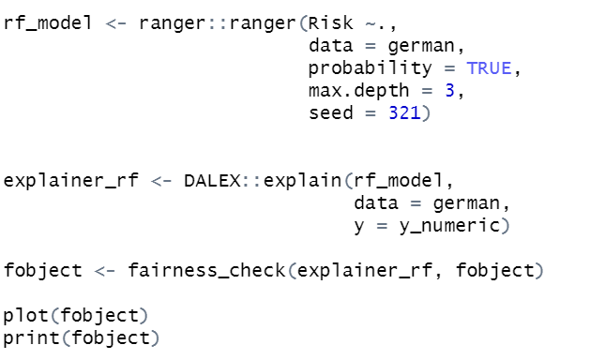
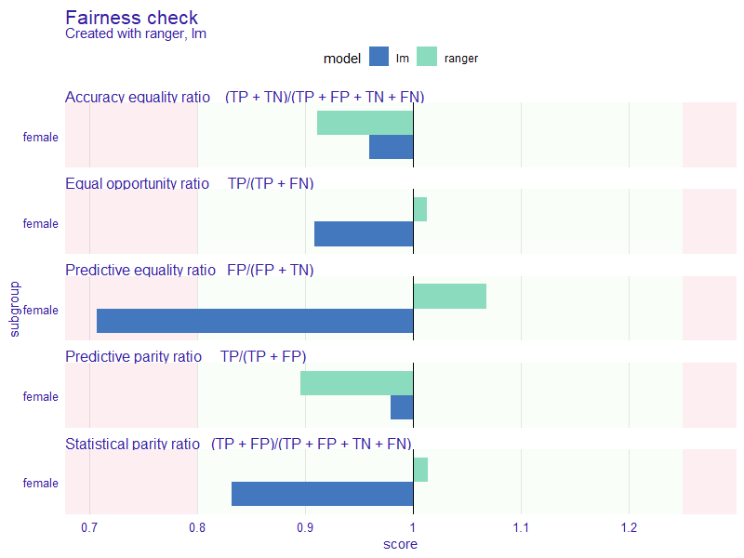
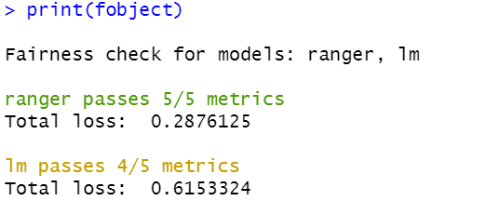
Incrementally adding explainers
Notes:
A Cool feature of fairmodels is that you can incrementally add explainer to fairness objects.
notice that when we pass the fairness object we don't have to provide any protected or privileged parameters because they are already included in the fobject.
On the fairness check plot on the right side, we can see green bars added which denote the Ranger metrics for this female subgroup.
It passes all of them so in the print method it will be printed with green colours.
If the Ranger would exceed more than one acceptable score of the metric it would being printed in red.

Slide 12
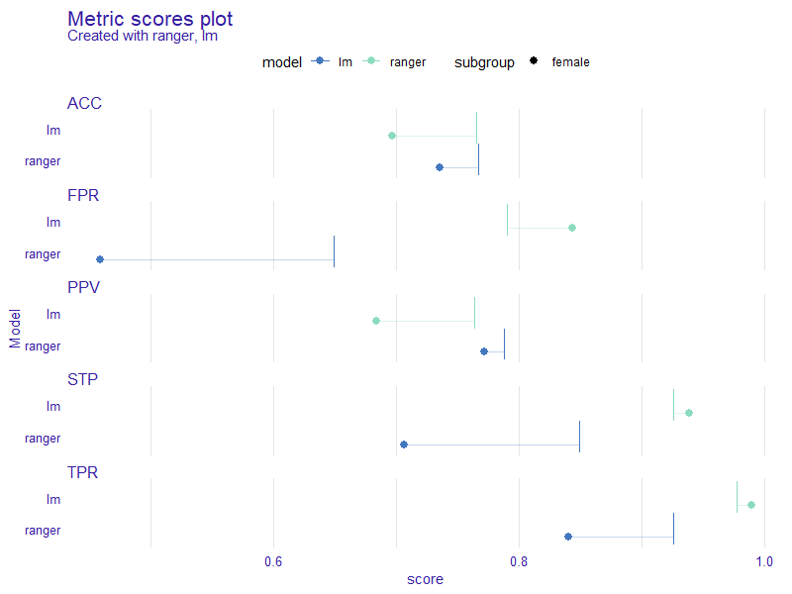
Plotting unscaled metric scores
Notes:
Sometimes there is a need to plot unscaled metric scores which aren't the ratios we have seen earlier but the raw metric scores of the models in specific subgroups
On the plot legend we have colours and shapes. each colour describes a model and each shape a certain subgroup. You might ask where is this male privileged subgroup.
Well it is represented by those vertical lines. So the intuition behind this plot is that the closer the shapes are to those vertical lines the better.

Slide 13
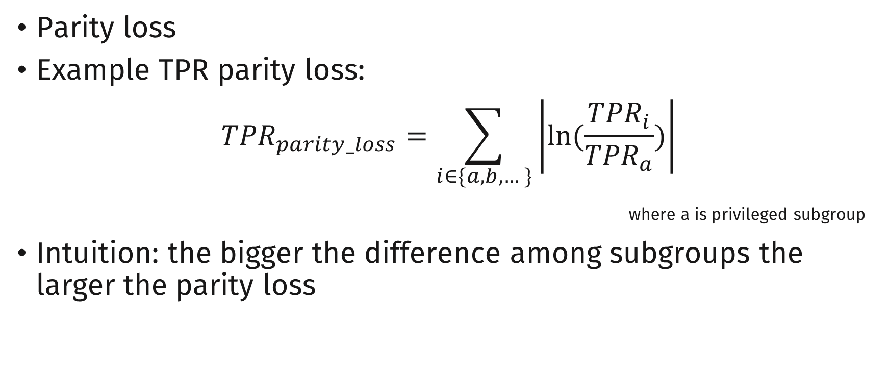
Visualization tool
Parity loss
Example TPR parity loss:
$${TPR}_{parity_loss}=\sum_{i∈\{a,b,…\}}{\left|ln⁡(\frac{{TPR}_{i}}{{TPR}_{a}})\right|}$$
where a is privileged subgroup
Intuition: the bigger the difference among subgroups the larger the parity loss
Notes:
In some visualizations parity loss is used. It is a custom function that aggregates some metric ratios over all of the subgroups. So for example let's take true positive rate and calculate its parity loss.
The intuition behind this parity loss is that the bigger the difference is in the subgroups the larger that parity loss will be.

Slide 14
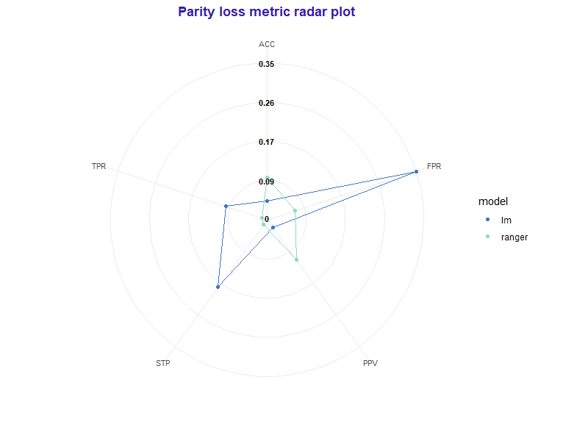
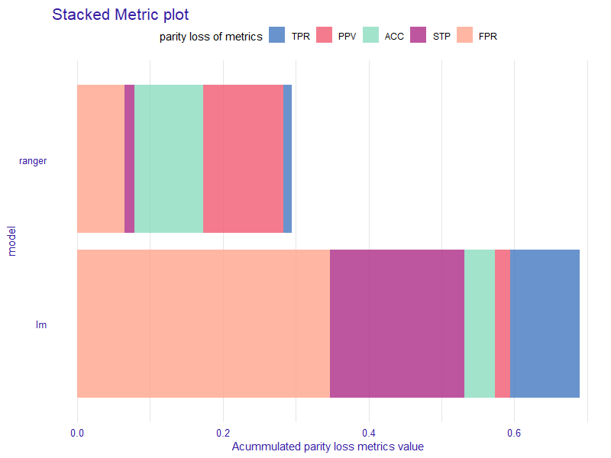
Other visualizations
Notes:
These are some other visualisations that use this parity loss they can be obtained to have a code snippets Below the plots.
Those are only two of many visualisations that can be used in fair models. On the left side there is a radar plot and on the right side there is a stacked matrix plot. they both visualise the amount of bias in many metrics at the same time.

Slide 15
Bias mitigation strategies
Data pre-processing
Disparate impact remover
Reweighting
Resampling
Explainer post-processing
Reject Option based Classification Pivot
Cutoff manipulation
Notes:
In the package there are also some simple bias mitigation strategies which can be used during a data pre-processing and after we create a model with explainer post processing.

Slide 16
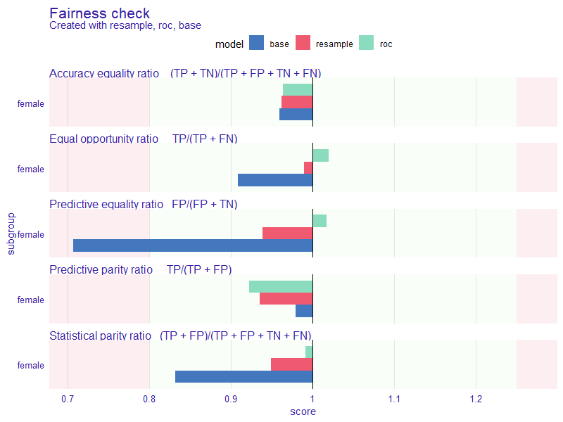
Mitigation in action
Resample – focuses on mitigating Statistical Parity
Duplicates underrepresented observations from unprivileged subgroups
Removes overrepresented observations from privileged subgroups
Reject Option based Classification Pivot
Pivots the probabilities close to cutoff to its other side.
0.4
0.5
0.6
Probabilistic response
privileged
unprivileged
Notes:
The resampling focuses on statistical parity mitigation. It duplicates or removes observations given some condition.
The Reject Option based Classification Pivot is a post-processing method that adjusts the probabilistic response of the model. When unprivileged subgroup is close to the cutoff and to the left side, it pivots to its right side. The opposite thing happens with privileged subgroup.
You can see the effects of mitigation on the plot on the right. Both methods successfully mitigated the bias in our model.

Slide 17
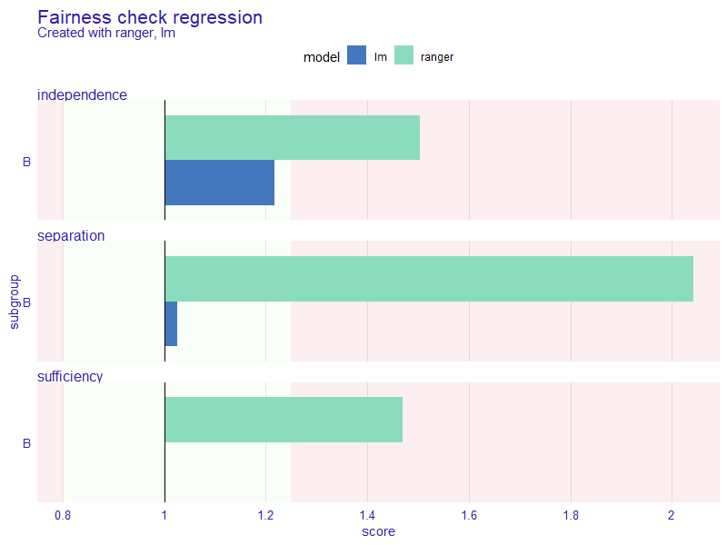
Regression module
New experimental module
Working with fairness_check_regression()
Approximating 3 non-discrimination criteria with classifiers
Notes:
Somewhat new addition to fairmodels is the support for regression type models. It works just like the one for classification but instead of using fairness check, user must use fairness_check_regression.
This experimental module is using logistic regression to approximate the fairness non-discrimination notions.
The module is relatively new, and steel awaits some feedback so if you use it, please let me know what do you think.

Slide 18
More materials
Landing page (article, blogs, documentation and tutorials) - fairmodels.drwhy.ai
ResponsibleML blog – medium.com/responsibleml
More on DALEX
fairmodels in Python as dalex module
Notes:
To dive deeper into the concepts of fairness in fairmodels I recommend visiting fairmodels page available at this link. There are many resources to choose from including the article, blogs, documentation and tutorials
You also can visit our blog that focuses on responsible machine larning, so things like explainability, new packages, Case studies and even whole series about basics of explainable ai .
If you want to explain the behaviour of your model and understand on what grounds does it make decisions, you can check out DALEX page where there is also fairmodels in Python as the python dalex fairness module.

Slide 19

Thank you for attention!
Photo by Eric Krull on Unsplash
Notes:
That would be all for me, thank you all for attention I hope that I gave you some intuition and basic understanding of fairmodels. If you have any questions, please go ahead.

