Slide 1

UseR! Conference 2021 Classifying Student’s Learning Pattern using R Sequence Analysis Packages: The Impact of Procrastination on Performance
Dr. Teck Kiang Tan
Institute for Applied Learning Sciences and Educational Technology (ALSET)
National University of Singapore

Slide 2
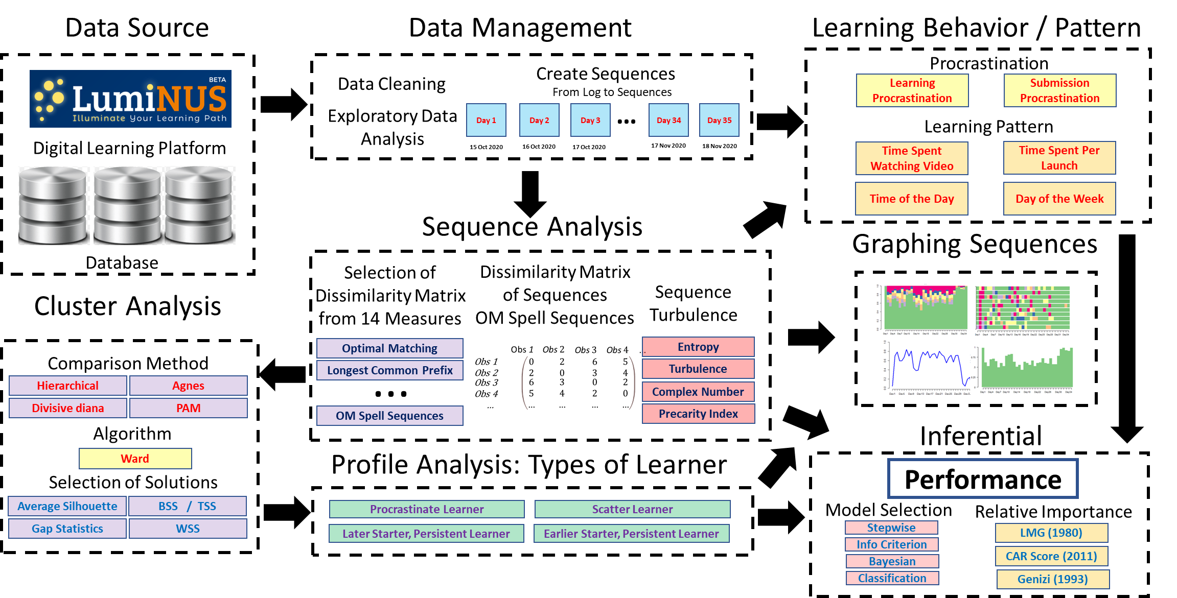
Analytical Framework

Slide 3





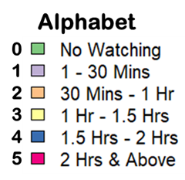



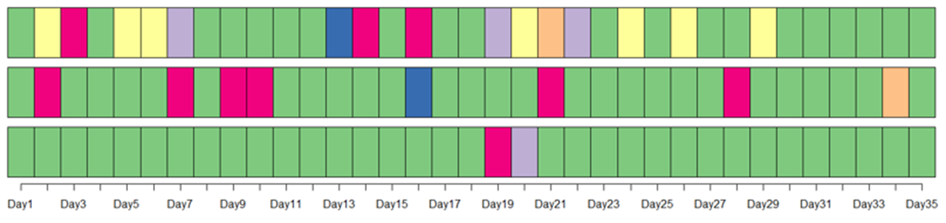
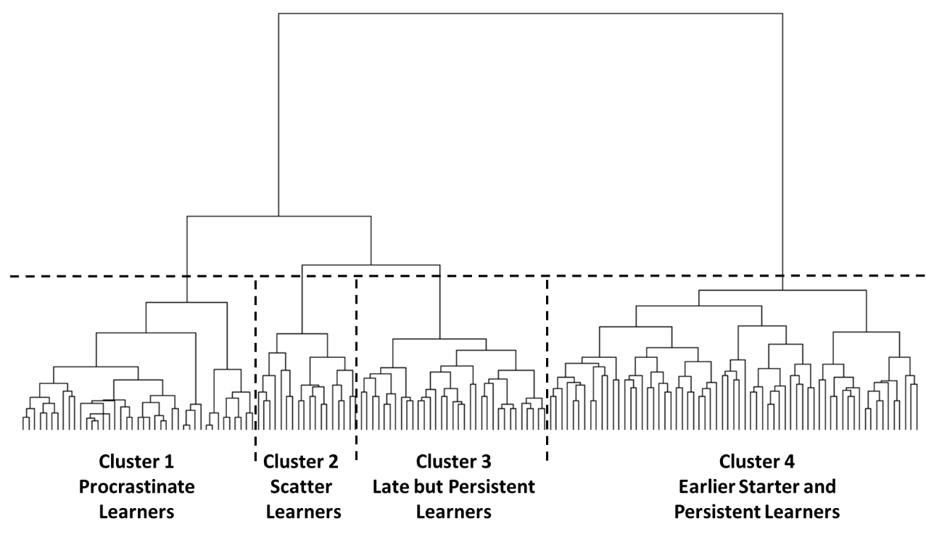
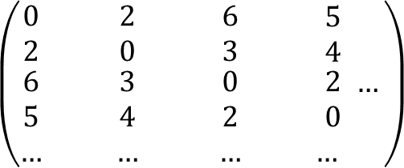
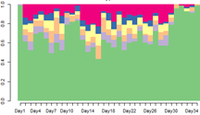
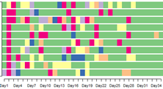
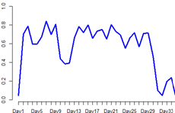

Data Management
Sequence Analysis
Profile Analysis
Cluster Analysis
Determination
No of Clusters
Function seqiplot
Relative Importance of Variables
Model Selection
Regression Analysis
Package
BayesVarSet
BeSS
Bestglm
FWDselect
MASS
Function lm and glm
Package relaimpo

Slide 4

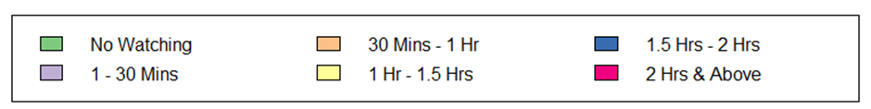
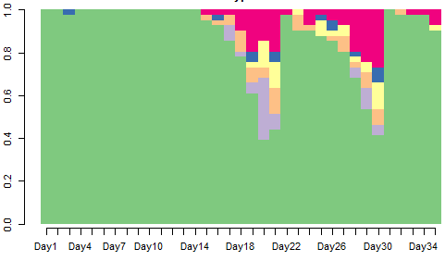
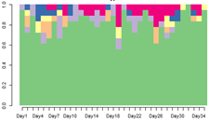
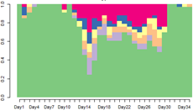
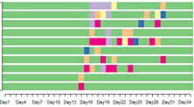
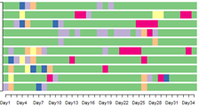
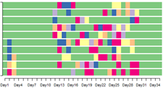
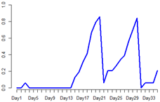
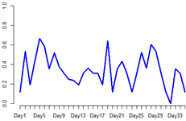
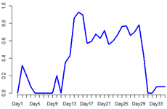
Profile Analysis - 4 Learning Clusters
Cluster 1 n=41 Procrastinate Learner | Cluster 2 n=18 Scatter Learner | Cluster 3 n=33 Late but Persistent Learner | Cluster 4 n=65 Earlier and Persistent Learner
Function seqplot (type=d)
State Distribution Plot
Late Start
Persistent Learning
No Learning
Function seqiplot
Sequence Index Plot
Function seqplot (type=Ht)
Transversal Entropy Plot
Diverse Change in Time Management

Slide 5
7 Categories
Time of the Day
7 Categories
Day of the Week
5 Categories
Time Length Per Launch
4 Sequence Turbulence
Measures
Before 10 am
10 am to 12 noon
12 noon to 3 pm
3 pm to 5 pm
5 pm to 8 pm
9 pm to 10 pm,
10 pm to 12 midnight
Sunday
Monday
Tuesday
Wednesday
Thursday
Friday
Saturday
1 - 5 Minutes
5 – 10 Minutes
10 – 15 Minutes
15 – 20 Minutes
More Than 20 Minutes
Entropy
Complexity Number
Turbulence
Precarity Index
Variable Selection
1. Akaike Information Criterion (AIC)
2. AIC Correction for finite sample size (AICC)
3. Bayesian Information Criterion (BIC)
4. Extended BIC, (BICq)
5. BIC with Bernoulli prior (BICq)
6. Leave-One-Out Cross-Validation
7. Cross-Validation
8. R²
9. Residual Variance
10. Deviance
Package MASS
Function stepAIC
Package FWDselect Function qselection
Package bestglm Function bestglm
Package BayesVarSel Function Bvs
Package BeSS Function bess.one
Model Selection

Slide 6
Variance Explained and
Relative Importance of Variables
Package relaimpo
n Lindemann, Merenda and Gold (1980)
n Zuber and Summer
CAR Score (2010)
n Genizi (1993)
Variable | Model 1 | Model 2 | Model 3 | Model 4 | Model 5 | Model 6 | Model 7
Scatter Learner | 0.12 |  |  |  |  | 0.06
Late but Persistent Learner | 0.14 |  |  |  |  | 0.06
Earlier and Persistent Learner | 0.74 |  |  |  |  | 0.34
Learning Procrastination |  | 0.84 |  |  |  |  | 0.49
Submission Procrastination 1 |  | 0.11 |  |  |  | 0.11 | 0.10
Submission Procrastination 2 |  | 0.05
Total Watching Time (Hours) |  |  | 1.00
Sequence Complexity Index |  |  |  | 1.00
Launch Time: 10pm-12pm |  |  |  |  | 0.38 | 0.17 | 0.17
Launch on Saturday |  |  |  |  | 0.42 | 0.18 | 0.17
Time Per Launch: 5 - 10 Mins |  |  |  |  | 0.20 | 0.08 | 0.08
R² | 0.19 | 0.21 | 0.05 | 0.14 | 0.14 | 0.26 | 0.26
Grömping U (2006). “Relative Importance for Linear Regression in R: The Package relaimpo.” Journal of Statistical Software, 17(1), 1–27.

Slide 7

Thank You

