Slide 1

Triplot
Model agnostic visualisations for variable importance in predictive modeling
that take into account the hierarchical correlation structure
Notes:
Hello, my name is Kasia Pękala and today with my collegue Kasia Woźnica we would like to share with you results of our work. We are part of MI Square Data Lab at Warsaw University of Technology.
Today we would like to present new R package - Triplot.
Triplot offers model agnostic approach to compute and visualise variable importance in predictive modelling. This approach takes into account correlation structure between variables in input data.

Slide 2


Intro to Triplot
Solution for some challenges with Variable Importance measures
New type of chart
Part of DALEX universe
Notes:
In a nutshell, triplot is developed as a response to the challenges faced by existing variable importance technique.
As the package name suggest, this chart is composed of three components. Together they summarise correlation structure and variable importance.
What is worth highlighting, triplot is not isolated tool, but it is part of DALEX universe. DALEX is bunch of explainable model analysis tools developed by our research group.

Slide 3
Input
Output
Notes:
Let's start with a brief reminder of what problem we are addressing. Principle of predictive modelling is simple: on the base of input data we would like to predict expected output.

Slide 4
Input
credit scoring
apartment price
disease probability
X₁
X₂
X₃
X_{n-1}
X_{n}
Notes:
This output may be different depending on the application. For instance it may be probability of customers default in credit scoring, price of apartment in considered location or many different application. his ma
On the other hand input are varaibles connected with expected output providing supplementary inforamtion. This may be information about applicant age, his income and credit history.
In classical predictive modeling input features are store in tabular data.

Slide 5
Input
X₁
X₂
X₃
X_{n-1}
X_{n}
Output
Notes:
The relationship between descriptive variables and expected output may be very complex and difficult to capture for human perception.
So we use machine learning models - black box tools. They are very effective in finding these relations but it is hard to summarise how model works and why make this decision not another.

Slide 6
XAI
Input
X₁
X₂
X₃
X_{n-1}
X_{n}
Output
Notes:
That is why in recent years bunch of explainable artificial intelligence methods have been developed. XAI methods provide insight into machine learning model stucture and try to summarise the dependency between explanatory variables and model output.The examples of XAI techniques are partial dependency profile or variable importance.

Slide 7
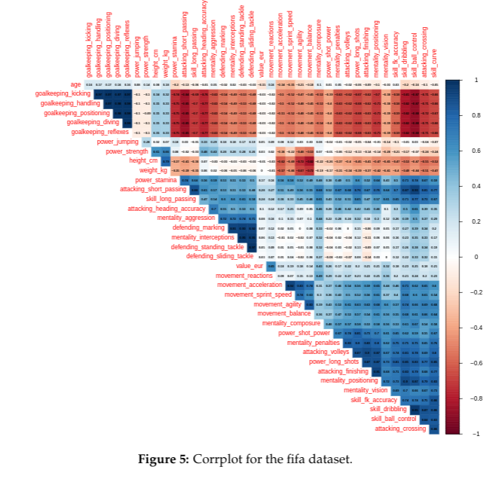
XAI
Input
X₁
X₂
X₃
X_{n-1}
X_{n}
Output
Notes:
But very important information which these techniques ignore is internal structure of input data - correlation between columns. In real world variables are not independent entities.
Often subset of them describe the same phenomena from different perspective for example how rich customer is. So it is natural that these variables are correlated.
This dependency influence model process and some XAI techniques try to eliminate bias caused by correlation modyfing definitions.

Slide 8
XAI
Input
X₁
X₂
X₃
X_{n-1}
X_{n}
Output
Notes:
In triplot package we would like to reinforce XAI interference by adding information about correlation structure as input to explanations methods.

Slide 9

Explanations - variable importance
- variable importance (VI) shows how a single variable contributes to model performance
- it is based on variable perturbations / permutations
Notes:
In this presenattion we will focus on variable importance methods. For every single variable we want to attribute how much model performance depends on this feature. To assess this we perturb input variable and create new observations in which we try to imitate excluding the impact of considered feature. After perturbation we check how model performance has changed.
The most common perturbation ist permutation - we break dependency between variable and target variable. So we permutate one selected column and check how much model performance changes. We repeat this many times to estimate expected change of model perofrmance.

Slide 10
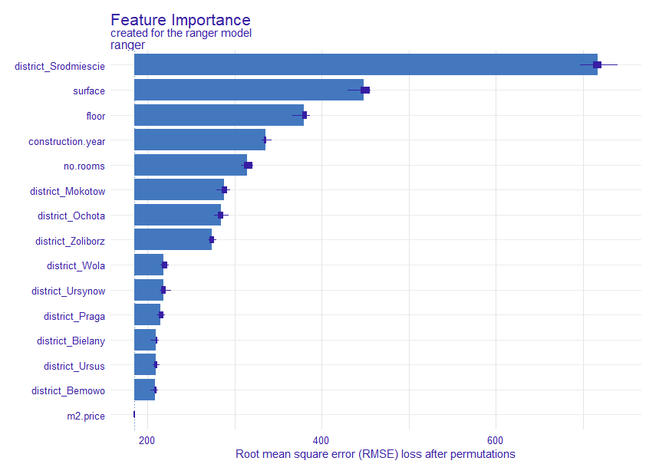
Explanations - variable importance
- variable importance (VI) shows how a single variable contributes to model performance
- it is based on variable perturbations / permutations
But there are some challenges of using VI...
Notes:
In a result we can assess the importance for every feature and summarise permutation of which feature causes the biggest disturbances in model predictions. This method is model agnostic and straightforward, but it there are some challenges.

Slide 11
Correlation & variable importance
if there are highly correlated features permuting these variables independently causes creating unlikely observations
Skill of dribbling + skill of ball control
Dribbling | Ball control
96 | 97
50 | 58
Permutation
Dribbling | Ball control
96 | 58
50 | ...
Notes:
This approach doesn't work in the case of a correlation between explanatory variables. If we treat every variable independently and permute them separately, column by column we may create very unlikely new observations - out of input data distributions.
It is easy to unerstand examaple of two skill of soccer player - dribbilng and ball control. Layman would tell that are highly correlated and if player is good at dribbling , he is also able to control ball. We can observe this also in real data. If we permute ball control column independently we could create strange player with high value of dribbiling but low value of ball control.
In this region of data model may be unstable and provide out of range preditions beacuse it has no observation durnig training model.

Slide 12
Variable importance for groups
Mitigating the challenge by calculating Variable Importance for groups
Permuting correlated variables together
Dribbling | Ball control | Sliding tackle | Interceptions
96 | 97 | 60 | 45
50 | 58 | .. | ..
48 | 55 | .. | ..
Notes:
We can mitigate the problem caused by correlated variables by using variable importance for groups. Let's look again at the football players' example:
if we permute variables dribbling and ball control together,

Slide 13
Variable importance for groups
Mitigating the challenge by calculating Variable Importance for groups
Permuting correlated variables together
Dribbling | Ball control | Sliding tackle | Interceptions
96 | 97 | 60 | 45
50 | 58 | .. | ..
48 | 55 | .. | ..
Dribbling | Ball control | Sliding tackle | Interceptions
50 | 58 | 60 | 45
96 | 97 | .. | ..
48 | 55 | .. | ..
Permutation
Notes:
we can rest assured that we won't receive a pair of data points that will be out of the distribution.
Permuting correlated features together and assessing the importance of the whole groups of variables may provide more concise explanations and more truthful picture
... but what if... we don't know the internal data structure that well?

Slide 14
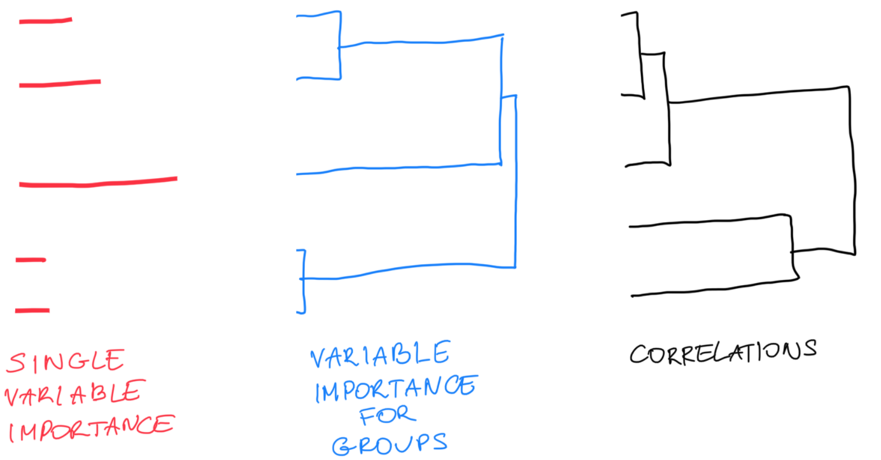
What if the correlation structure is complex?
One pair of correlated variables - easy
More complex structure - challenging
How many groups?
Use dendrogram
Notes:
Well, let's look at it this way:
it’s relatively easy to use variable importance on correlated variables when there is only pair or two pairs of of them
But what if the internal structure is much more complex? If strongly correlated features create multiple, interrelated, groups? In that case, defining such groups is not trivial. For that task we can use a dendogram, that is a diagram that shows hierarchical clustering of correlated variables. This facilitates making decisions about the number and composition of groups that will be used in Variable Importance calculations.

Slide 15
What cut off should I choose? How many groups should I use?
Notes:
But then, the question still remains, at what cut off point should we calculate this variable importance? How the Variable Importance looks like when calculated for 5 groups of strongly correlated variables and how does it look like when it is calculated for only 3 groups of little less correlated variables?
we can try to do it by trial and error, and for different cut off points calculate Variable Importance. But that creates a lot of overhead. So the triplot does it for us. It takes every cutoff point from the dendogram, that is defined by the successive nodes, and it calculates the variable importance for newly created groups. And to make the picture complete, on the left triplot show single variable importance.
In that way, in one picture, we get the information about the simple VI, then on the right we can see how the data is structured, that is how variables are correlated, and in the middle we can find out how the different groups of more or less correlated variables influence the model.

Slide 16
What cut off should I choose? How many groups should I use?
Notes:
But then, the question still remains, at what cut off point should we calculate this variable importance? How the Variable Importance looks like when calculated for 5 groups of strongly correlated variables and how does it look like when it is calculated for only 3 groups of little less correlated variables?
we can try to do it by trial and error, and for different cut off points calculate Variable Importance. But that creates a lot of overhead. So the triplot does it for us. It takes every cutoff point from the dendogram, that is defined by the successive nodes, and it calculates the variable importance for newly created groups. And to make the picture complete, on the left triplot show single variable importance.
In that way, in one picture, we get the information about the simple VI, then on the right we can see how the data is structured, that is how variables are correlated, and in the middle we can find out how the different groups of more or less correlated variables influence the model.

Slide 17
What cut off should I choose? How many groups should I use?
Notes:
But then, the question still remains, at what cut off point should we calculate this variable importance? How the Variable Importance looks like when calculated for 5 groups of strongly correlated variables and how does it look like when it is calculated for only 3 groups of little less correlated variables?
we can try to do it by trial and error, and for different cut off points calculate Variable Importance. But that creates a lot of overhead. So the triplot does it for us. It takes every cutoff point from the dendogram, that is defined by the successive nodes, and it calculates the variable importance for newly created groups. And to make the picture complete, on the left triplot show single variable importance.
In that way, in one picture, we get the information about the simple VI, then on the right we can see how the data is structured, that is how variables are correlated, and in the middle we can find out how the different groups of more or less correlated variables influence the model.

Slide 18
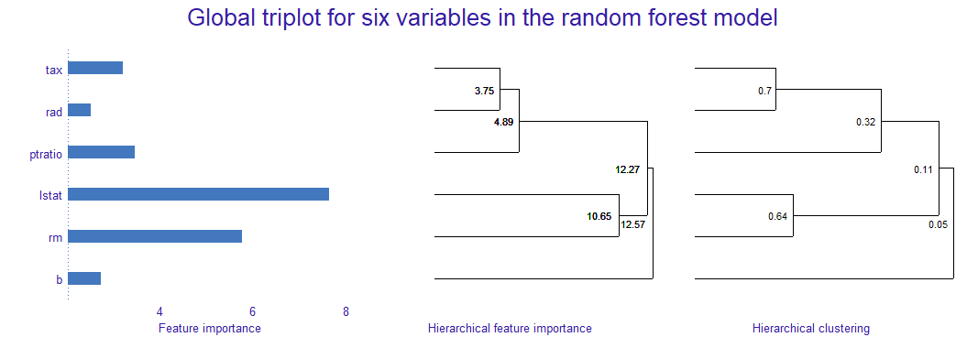
What cut off should I choose? How many groups should I use?
Notes:
This is how real example of triplot looks like for a simple model.
Again, single variable importance on the left, correlation structure on the right, and hierarchical variable importance in the middle.

Slide 19
Notes:
For the purpose of this presentation, we are using a simple model built on Boston dataset included in mlbench package. This model is built on only a few futures out of the dataset, namely 7 variables: tax rate, accessibility to highways, pupil-teacher ratio, Percentage of lower status of the population, average number of rooms and racial proportions

Slide 20
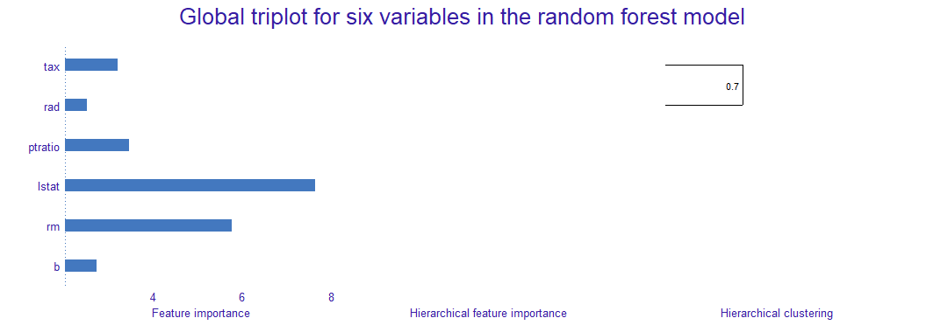
Correlation between tax and rad variables is the strongest.
Notes:
Ok. Let's understand how the triplot works by building it. On the left we see single Variable Importance for every feature. Now let's make the rest of the chart step by step. We start by looking at the variables tax and rad. Thanks to the dendogram we can see that the correlation between tax and rad is the strongest.

Slide 21
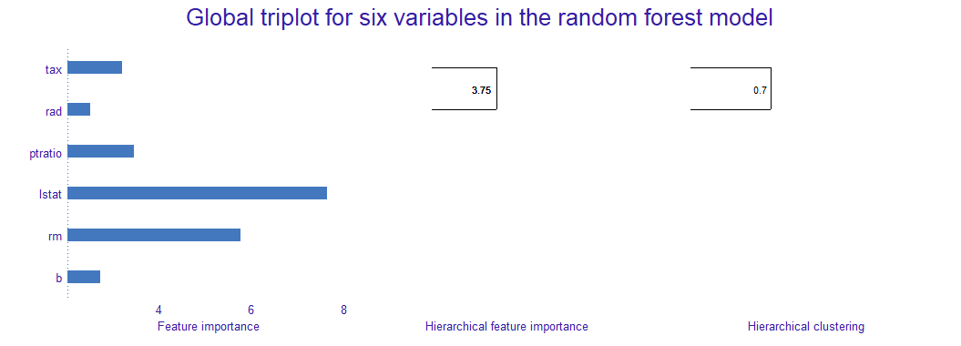
Importance of this group is equal 3.75.
Notes:
Importance of this group is equal to almost 4.

Slide 22

Correlation between rm and lstat is 0.64.
Notes:
Second pair of correlated features is lstat and rm.

Slide 23
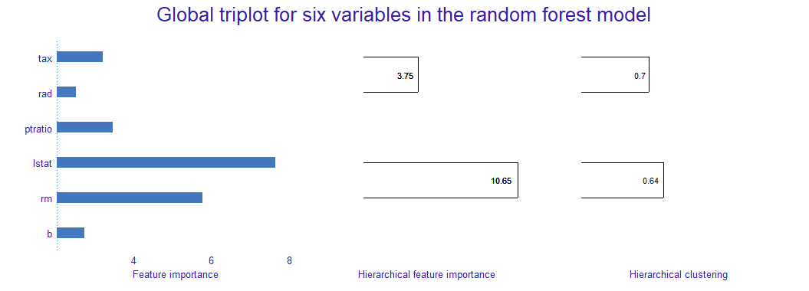
Importance of this group equal 10.65.
Notes:
Importance of group that consists of this features is equal to almost 11.

Slide 24

Correlation between ptratio and group tax+rad is 0.32.
Notes:
Next, we see that when we add ptratio to tax and rad, we get a correlation equal to 0.3.

Slide 25
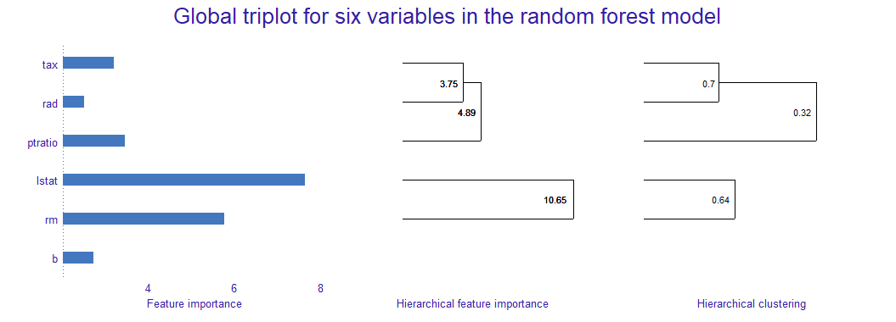
Importance of this 3-elements group is equal 4.89.
Notes:
Importance for this 3-elemnts group is equal 5.

Slide 26

Correlation between group lstat+rm and group ptratio+tax+rad is 0.11.
Notes:
Correlation between group lstat+rm and group ptratio+tax+rad is 0.11.

Slide 27

Importance of this 5 elements group is equal 12.27.
Notes:
Importance of this 5 elements group is equal 12.27.

Slide 28
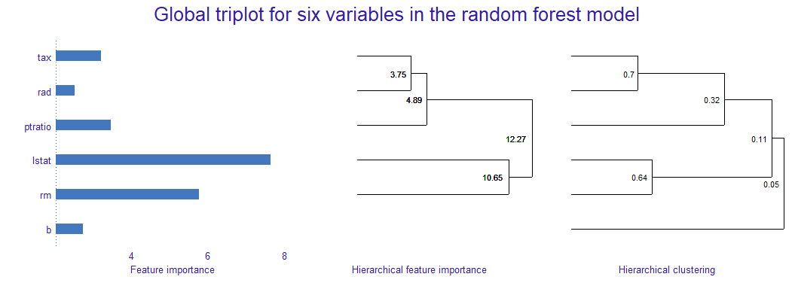
Correlation between lstat+rm+ptratio+tax+rad group and b is 0.05.
Notes:
Correlation between lstat+rm+ptratio+tax+rad group and b is 0.05.

Slide 29
Baseline for the model is 12.57.
Notes:
And finally baseline for the model is 12

Slide 30
Notes:
Finally, we can notice, or highlight, the following: even if we don't see many correlated features, we can already observe that feature importance is not additive. We can see it by looking for the most important variables - lstat and rm. Their single variable importance values are about 8 6 respectively. But importance of this group is equal to less than 11. And we can clearly see it thanks to the triplot.

Slide 31
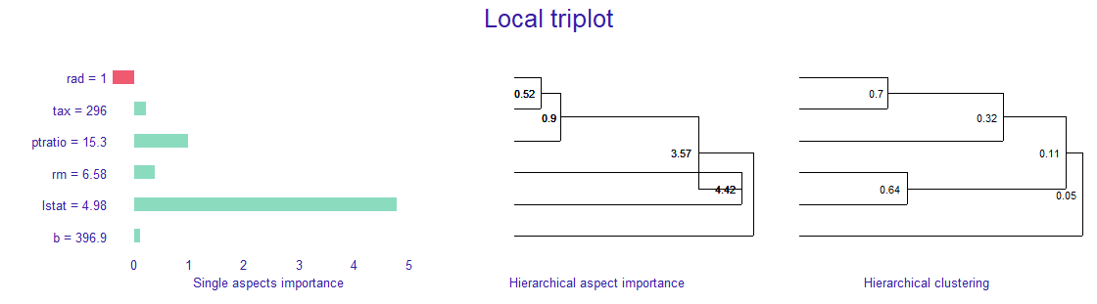
Local triplot
Notes:
Triplot package also provides a possibility to make a chart for local variable importance. It addresses a similar problem: how single variables influence the prediction of a given observation, what's the correlation between variables and how groups of variables impact the prediction. It is based on an experimental method for local variable importance called predict aspects. This method is also implemented in the triplot package.

Slide 32
Triplot code example
Boston_model <- ranger(cmedv~.,
data = Boston)
explainer <- explain(Boston_model,
Boston_no_target,
Boston$cmedv)
triplot <- model_triplot(explainer)
plot(triplot)
Notes:
At the end, we would like to show you the code that produces the triplot. You can see that after building the model, we create a DALEX explainer - an useful adapter for the machine learning explanations. It allows us to build a global and local triplots, among other methods. Afterwards, triplot object can be plotted.

Slide 33
Thank you for your attention.
Preprint about triplot:
arxiv.org/abs/2104.03403
Triplot webpage:
modeloriented.github.io/triplot/
Notes:
To summarize, we would like to highlight the necessity of taking into account the input's data correlation structure, when we are building machine learning explanations. To mitigate the problem of correlation making variable importance results misleading, we can use triplot.
More information about methods described here can be found in our preprinted paper as well as on the github.
Thank you for your attention.

