Slide 1
rSETSe
Jonathan Bourne

Slide 2
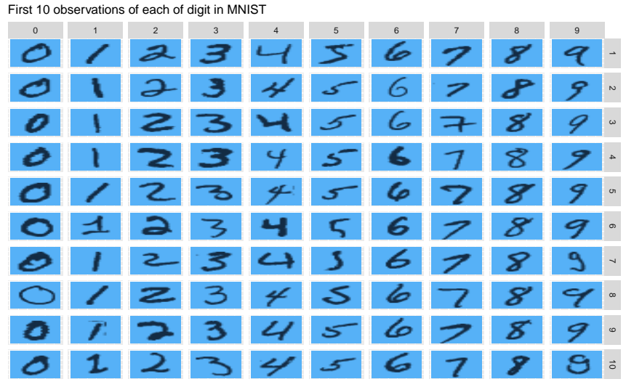
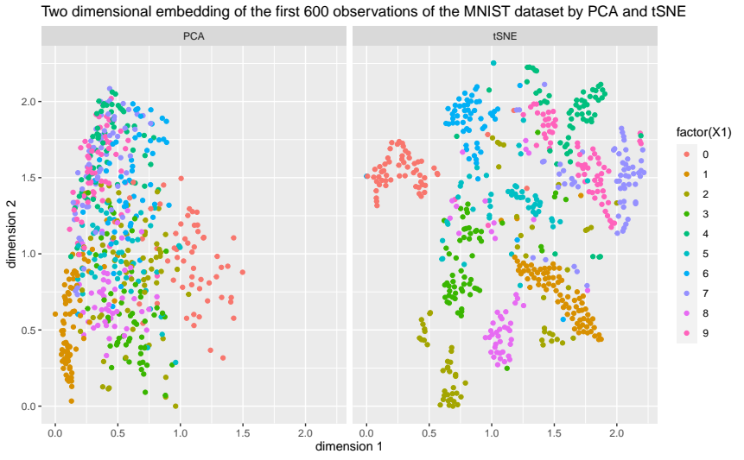
What are embeddings?

Slide 3
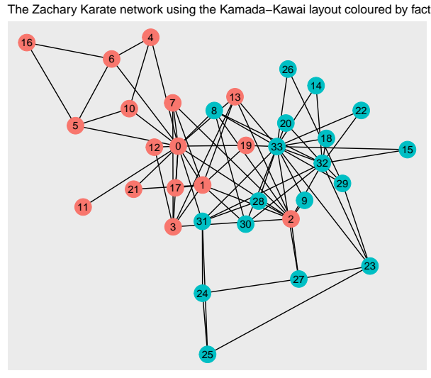
What are graph embeddings?

Slide 4
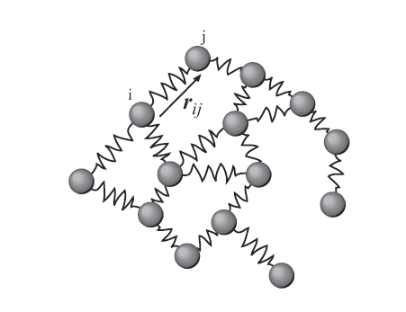
What is SETSe?
Physics based
Represents a network as a system of springs
Deterministic
Embedding and smoothing algorithm

Slide 5
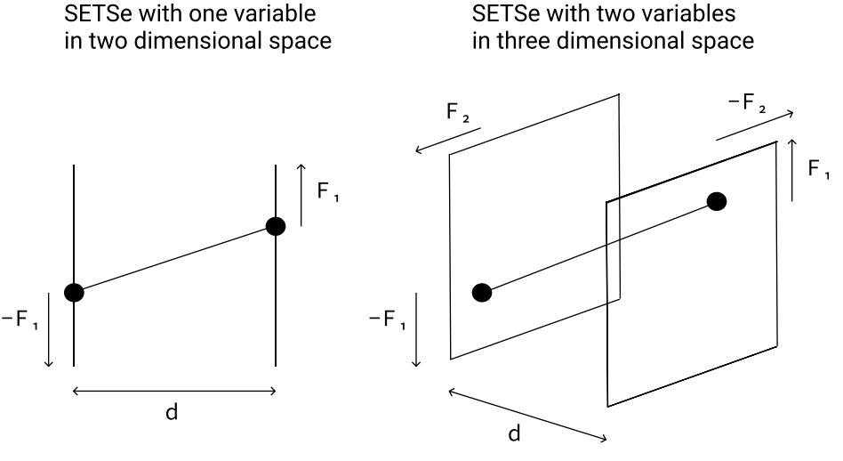
So how does SETSe work?

Slide 6
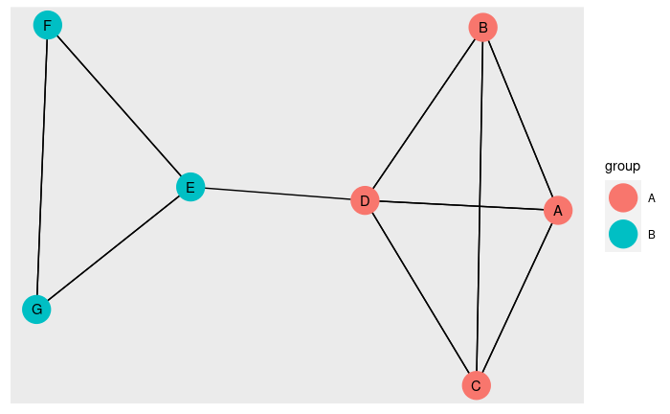
So how does SETSe work?

Slide 7
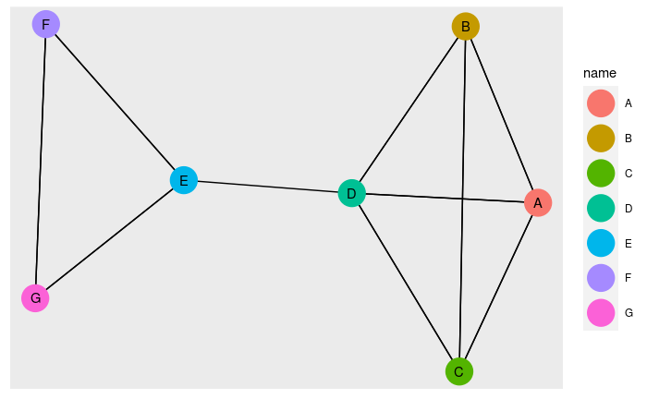
So how does SETSe work?

Slide 8
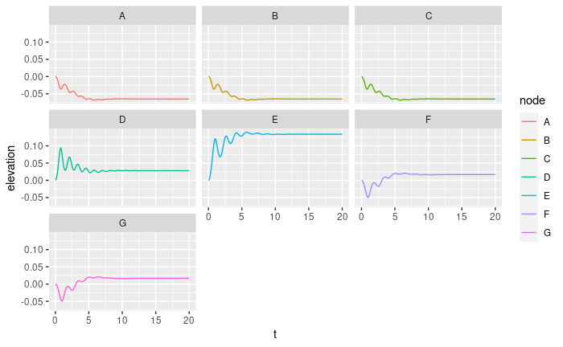
So how does SETSe work?

Slide 9
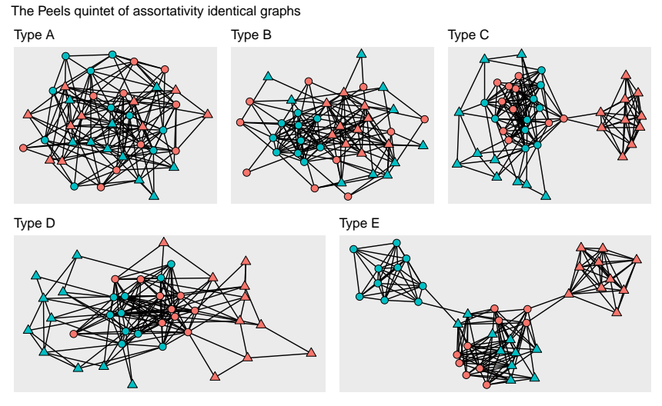
What can SETSe be used for?

Slide 10
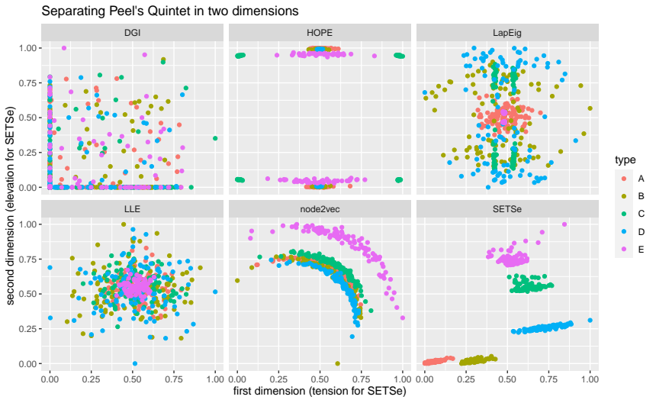
What can SETSe be used for?

Slide 11
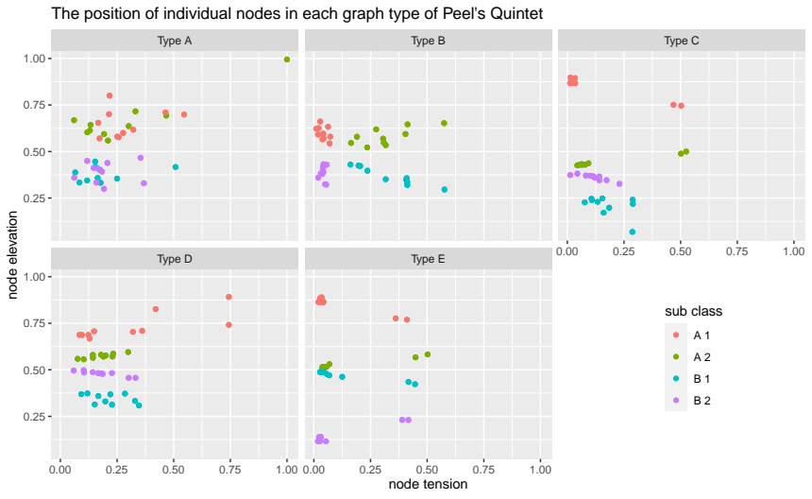
What can SETSe be used for?

Slide 12
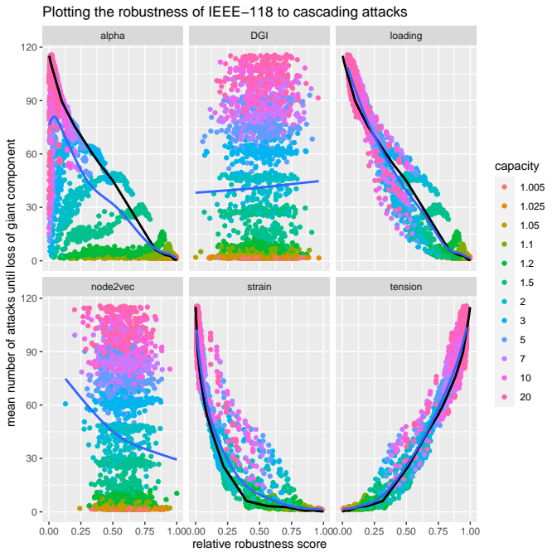
What can SETSe be used for?

Slide 13
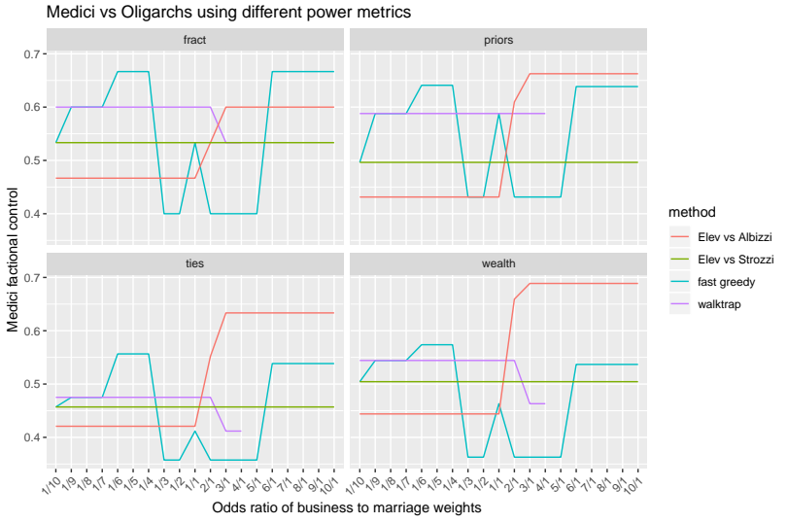
What can SETSe be used for?

Slide 14
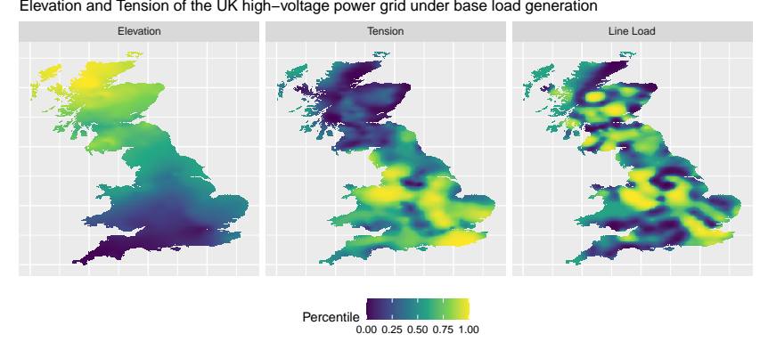
What can SETSe be used for?

Slide 15
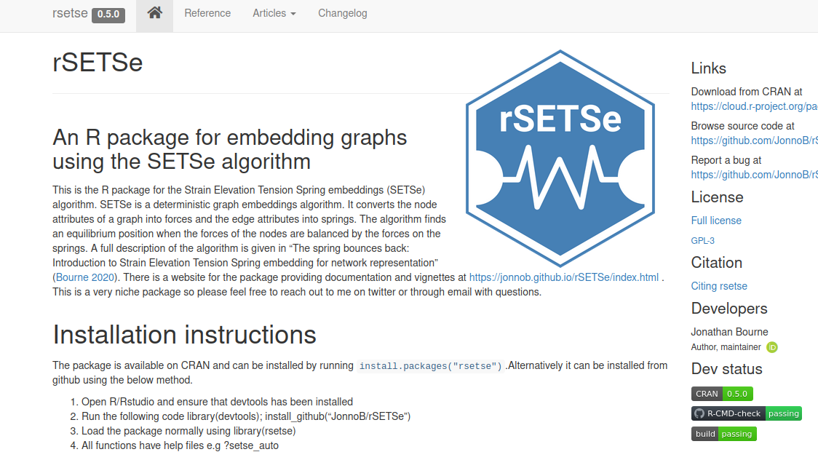
`rsetse` R implementation on CRAN

Slide 16
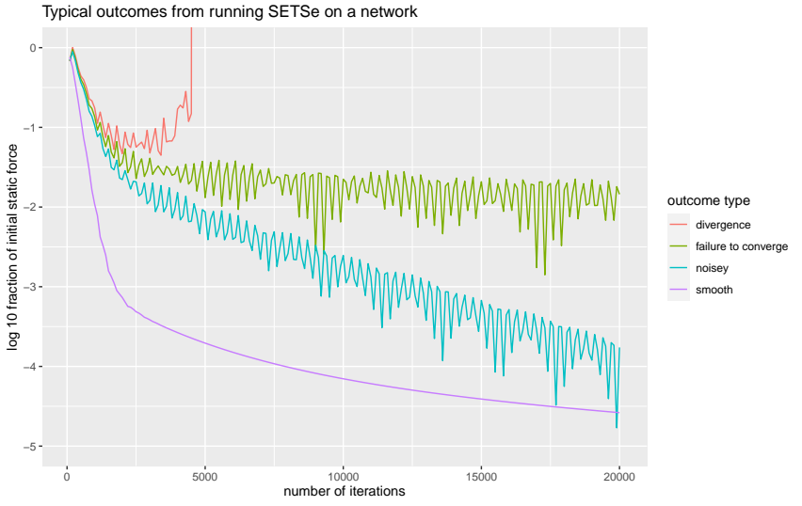
Using rsetse
Use these
setse_auto
setse_auto_hd
setse_bicomp
Or If you want to get crazy
setse
setse_extended

Slide 17
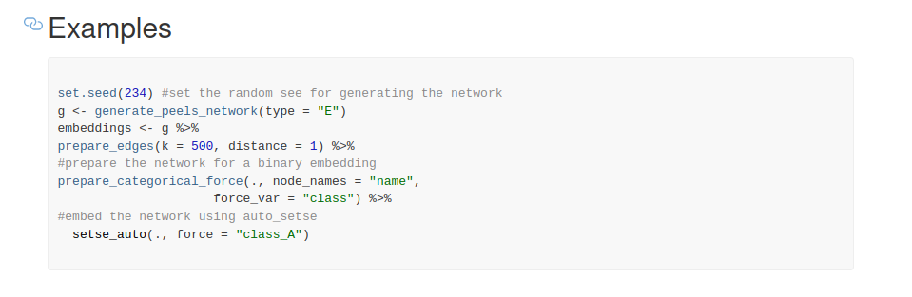
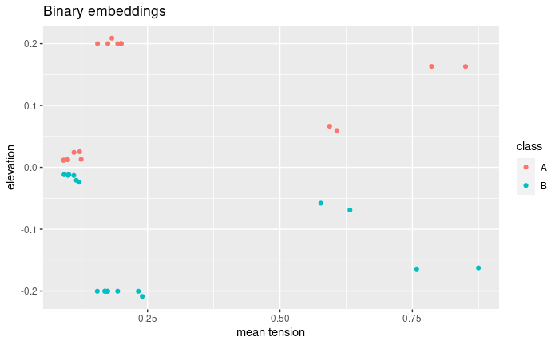
Using rsetse

Slide 18
Summary
Embeds networks using a physics model
Predicts at node and network level
Can be used on a wide range of network tasks
Acts as a networks smoothing algorithm
Works on graphs of 10k’s nodes and millions of edges
Able to create embeddings for both continuous and categorical values
Available from CRAN as `rsetse`
Documentation website available
Vignettes for deeper explanation

Slide 19
Find out more about SETSe
The Spring Bounces back: introducing the strain elevation tension spring embedding algorithm for network representation https://doi.org/10.1007/s41109-020-00329-4
High Tension Lines: Predicting robustness of high-voltage power-grids to cascading failure using network embedding
arXiv:2105.13224 [eess.SY]
rsetse website: https://jonnob.github.io/rSETSe/index.html
Use rsetse: Install.packages(“rsetse”)

Slide 20
Acknowledgements
EPSRC International Doctoral Scholars - IDS Grant (EP/N509577/1)
The UCL Myriad High Performance Computing Facility (Myriad@UCL), and associated support services

