Slide 1

shiny.fluent and shiny.react
Build beautiful Shiny apps using Microsoft's Fluent UI
Marek Rogala, CTO @ Appsilon useR! 2021

Slide 2


Introducing...
“What have you done differently this time? This looks very, very good!”
“A big game-changer for companies already using Microsoft tools on a daily basis, because everyone is already familiar and pleased by the Microsoft UI.”
Notes:
We’ve just publicly announced shiny.fluent, and its companion shiny.react, which are a new level in Shiny User Experience. Even though the packages are young, we’re received some enthusiastic feedback from early users and our clients who already got apps based on it. Today I want to show you what you can achieve with it and how to start.

Slide 3


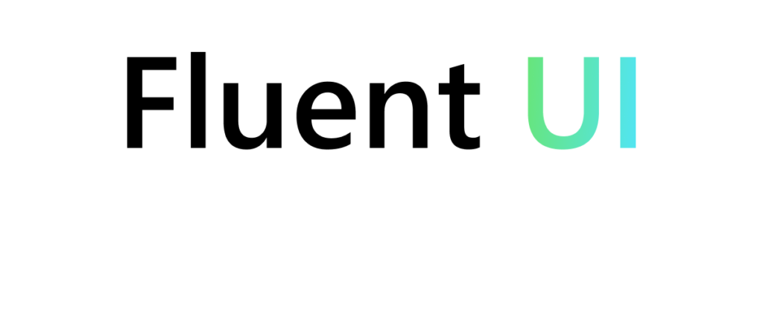
shiny.fluent brings Microsoft’s Fluent to Shiny
=
+
Notes:
Most of the big Microsoft’s apps use Fluent UI, which is their framework for building interfaces. It’s meticulously designed so that it not only looks good, but also gives great user experience. It works on desktop, mobile and web. Basically by using its web version, we can make our Shiny apps look like Microsoft Office. So very professional, perfect for enterprise apps but also for everyone who wants their app to be clean, and look good.

Slide 4

shiny.react brings React to Shiny
=
+
Notes:
All of this is possible thanks to shiny.react aims to let you easily use React libraries in Shiny. So it’s not only about Fluent UI, but all those other libraries that are designed by huge teams of UX designers and developers.

Slide 5



Build your first app!
🌐 appsilon.github.io/shiny.fluent -> “Getting started” tutorial
🕵️ Explore components demo.appsilon.ai/apps/fluentui
Participate in and send us

Slide 6
✨
Beautiful & professional
🎨
Rich
🏎
Shiny-fast development
Notes:
So how can shiny.fluent make your project stand out:
It brings professional and beautiful design styles, consistent with enterprise grade applications. Fluent layout, classes, colors, and typography are now accessible.
A rich set of components that allows for various kinds of inputs and outputs and unique functions like the People Picker, Teaching Bubble and Hover Card. Shiny fluent supports the powerful Stack() function from Fluent UI that lets users be flexible in terms of component placements in the Dashboard
And of course, Speed. shiny.fluent offers fast development speed that comes with R and Shiny by providing the same kind of interface as base shiny.

