Slide 1

Here is the anomalow-down!
Sevvandi Kandanaarachchi
RMIT University
Joint work with Rob Hyndman

Slide 2


Why anomalies?
They tell a different story
Fraudulent credit card transactions amongst billions of legitimate transactions
Computer network intrusions
Astronomical anomalies – solar flares
Weather anomalies – tsunamis
Stock market anomalies – heralding a crash?

Slide 3
Anomaly detection – why?
Take fraud and network intrusions for example
Training a model on certain fraud/intrusions/cyber attacks is not optimal, because there are new types of fraud/attacks, always!
You want to be alerted when weird things happen.
Anomaly detection is used in these applications.

Slide 4

Is everything rosy?

Slide 5
Some Current Challenges
High dimensionality of data
Finding anomalies in high dimensional data is hard
High false positives
Do not want an “alarm factory” – confidence in the system goes down
Parameters need to be defined by the user
But expert knowledge is needed
Anomalies and normal points look similar

Slide 6
Overview
dobin – a dimension reduction method for anomaly detection
Addresses the high dimensionality challenge
dobin – on CRAN
lookout – an anomaly detection method
Low false positives
User does not need to specify parameters
lookout – on CRAN

Slide 7


dobin – dimension reduction for outlier detection
Sevvandi Kandanaarachchi, Rob Hyndman
JCGS, (2021) 30:1, 204-219

Slide 8
What is it?
It is a preprocessing technique
Not an anomaly detection method
Original anomalies are still anomalies in the reduced dimensional space

Slide 9
What does it do?
Find a set of new axes (basis vectors), which preserves anomalies
First basis vector in the direction of most anomalousness (largest knn distances), second basis vector in the direction of second largest knn distances

Slide 10
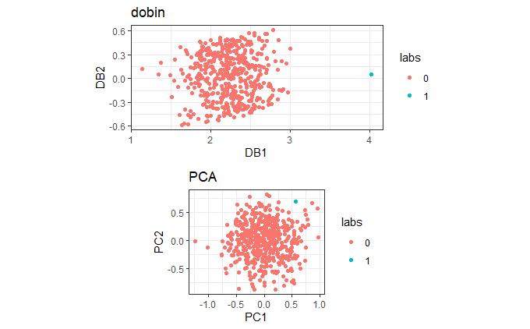
Example
Uniform distribution in 20 dimensions,
one point at (0.9, 0.9, 0.9, . . .)
This is the outlier
In R
> dobin(X)

Slide 11

lookout – leave one out kde for outlier detection
Sevvandi Kandanaarachchi, Rob Hyndman
Preprint - https://bit.ly/lookoutliers

Slide 12
lookout
Outlier detection method
Low false positives
Because of Extreme Value Theory (EVT)
EVT is used to model 100-year floods
Use a Generalized Pareto Distribution
Not an “alarm factory”

Slide 13
lookout
User does not need to specify parameters
Use Kernel Density Estimates – need a bandwidth parameter
But general bandwidth is not appropriate for anomaly detection
Select bandwidth using topological data analysis
Anomaly persistence
Which anomalies are consistently identified, with changing bandwidth?
Visual representation of anomaly persistence
bw(TDA) $→$KDE $→$ EVT $→$outliers
bw(TDA) → KDE → EVT → outliers

Slide 14
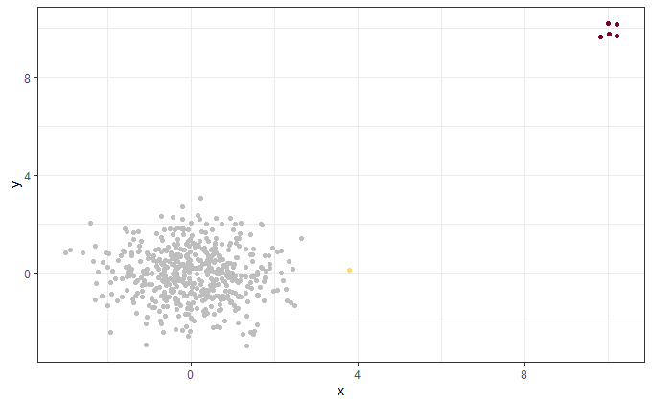
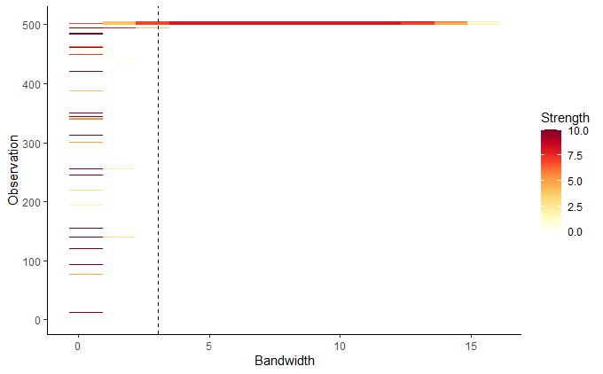
Example 1
2D normal distribution, with outliers at the far end. The outlying indices are 501 - 505
The persistence diagram. The outliers get identified
for a large range of bandwidth values.

Slide 15
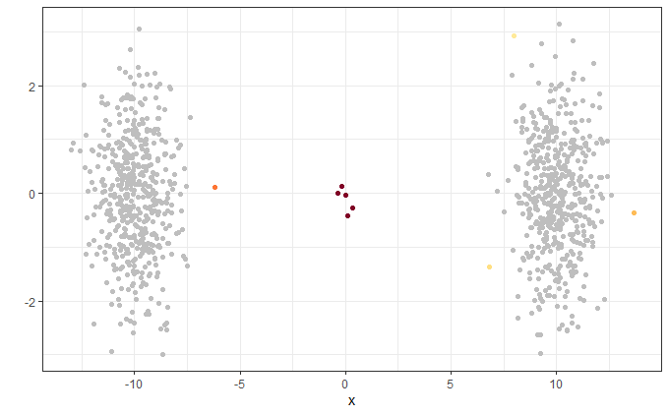
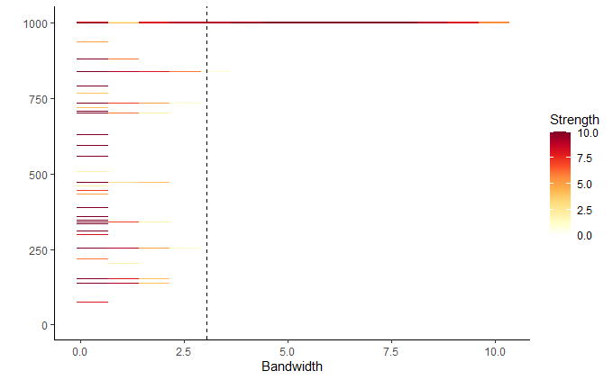
Example 2
2D bimodal distribution, with outliers in the trough. The outliers have indices 1001 - 1005
The persistence diagram. Again, the outliers
get identified for a large range of bandwidth values.

Slide 16
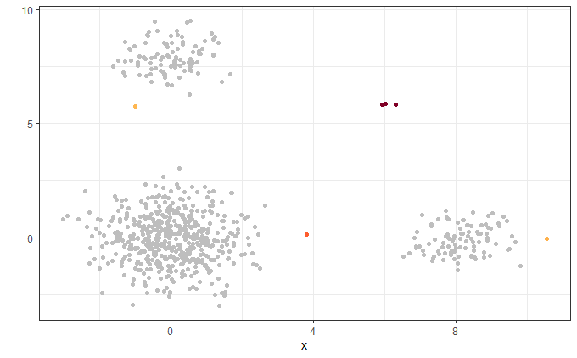
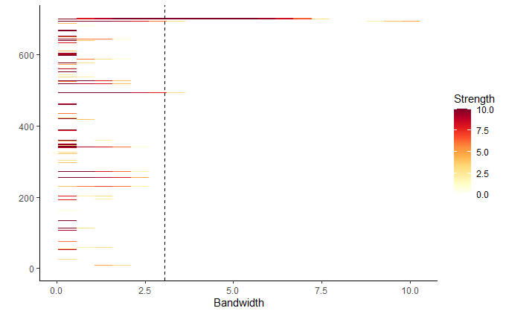
Example 3
Points in 3 normally distributed clusters, with anomalies
away from them. Anomalies have indices 701 - 703.
The persistence diagram. Anomalies get identified for a broad range of bandwidth values.

Slide 17
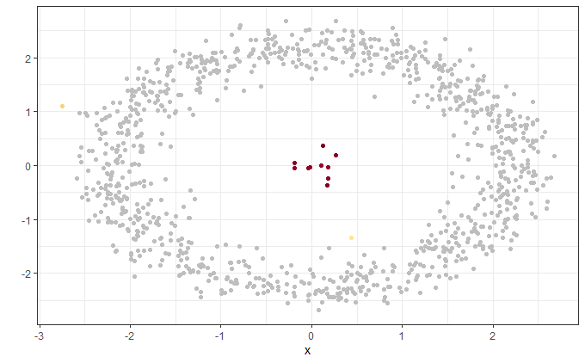
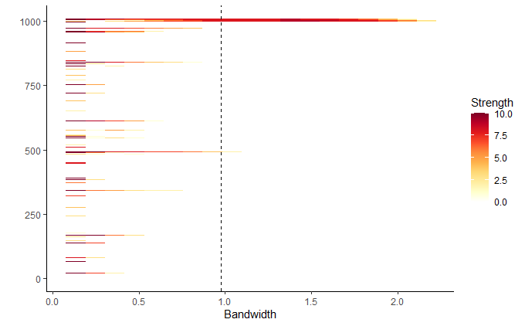
Example 4
Points in an annulus with anomalies in the middle.
Anomalies have indices 1001 - 1010
The persistence diagram.

Slide 18
Summary
dobin - a dimension reduction method for anomaly detection
lookout - a EVT based method to find anomalies
Both paper/preprint available
https://doi.org/10.1080/10618600.2020.1807353
https://bit.ly/lookoutliers
Both packages on CRAN

Slide 19

Thank you!

