Slide 1

R FOR NON-PROGRAMMERS
Creating Paradigm Shifts in Reporting for Community-Facing Organizations Using R
Mohammad Haque, Lisa Kulka, Sulagna Patra Community Connections of New York, Inc.

Slide 2
CCNY is a nonprofit organization in Western New York serving clients throughout the region in a variety of evaluation, analytics and training capacities
CCNY offers analytics support (examples include building dashboards, and providing technical support for building and maintaining databases), evaluation services (examples include report creation and visualization utilizing tools such as R), and training support (examples include QPR training for local community health providers)
WHO WE ARE

Slide 3

ENGAGING NON-PROGRAMMERS
Our techniques for engaging non-programmers in the logistics of building R schema:
Visual communication
Demonstration of outcomes from each pivotal step in the reporting process
Providing brief and easy-to-understand tutorials to supplement knowledge
Comparing deliverables with vs. without R
Notes:
within ccny it is our goal to engage folks with non programming background to use scripting methods and tools such as r. Many employee within ccny do not have a background in computer science or programming. This means that any kind of script buildings or report automation becomes instantly more difficult. hence why we decided to turn to R. R allows us to build Scripts and automate various reports even develop dashboards using fairly simple but a complex scripting language. This scripting language is best suited for those who have a mind and a process flow of an analyst/evaluator. Being able to see data being manipulated and results without the use of complex data structures and algorithms calls of a very attractive language for those who are not well versed in programming. Our director of evaluation of analytics has developed a fantastic tutorial for our evaluators and analysts to use and get the hang of R. This allows those who work at ccny to not only use R but also get engaged with R. Another form of Engagement is to take a report and automate it. Once we have completed the automation of the report we present the work to all the employees. this not only shows them what R can achieve but also allows them to get a footing and understanding what are incapable of doing for them. when you show somebody the tricks the usefulness of R instantly become engaging and fascinating.

Slide 4
HOW WE USE R AT CCNY
REPORT AUTOMATION
DATA VISUALIZATION
SUPPORT WNY ORGANIZATIONS
Create processes that allow work to be scripted
Gather reports that take time to process
Simplify process
Save time
New to this field
Allow powerful diversity to visualization
Customization and flexibility
Fast reports allows for better data delivery
Bring in more contracts
Notes:
here at ccny we utilize R in various forms and services. Each month we are tasked with building various reports from various data sources. These reports are often tedious and are linked to various Excel documents and or databases. With the help of R we are able to not only automate the report building process, but also deliver reports in a timely manner. This allows us to be competitive when given tasks for report building with various organizations. R also helps us with developing various dashboards. At the current moment we are just starting to use R for dashboard visualization, but it is worthy to note that this is an Avenue that ccny is pursuing. utilizing packages searches ggplot2 allows our visualizations to be more advanced and sophisticated then using any other pre-built software. This level customisation is what allows ccny to be versatile and advanced when comes to dashboard design and report building. with these skill sets we are able to take on various project throughout Western New York and help bring data literacy too various organizations.

Slide 5
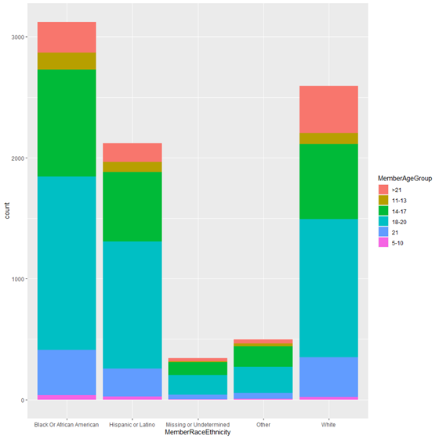
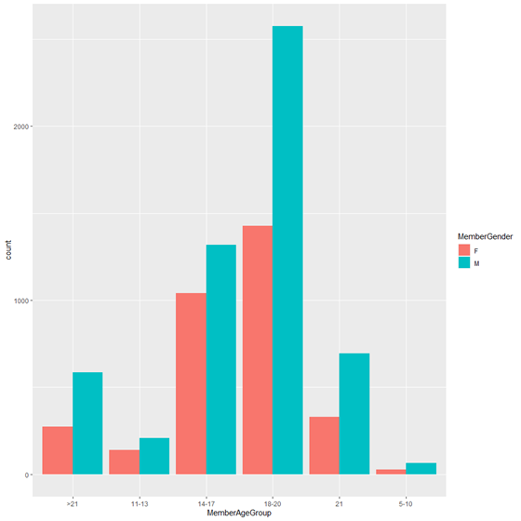
VISUALIZATION EXAMPLES

Slide 6
CSOC REPORTING
This project allowed for community health providers to have their Question, Persuade, Refer (QPR) suicide prevention training timelines automatically generated per provider:
QPR Training -> QPR Reporting -> QPR Renewal accountability
The project solved the problem of manual, time-consuming searching for QPR data that was at times erroneous
Application of R in this particular medium with non-programmers requires (1) visual communication, (2) simple explanation of the mechanics of the process, and (3) justification of each process step

Slide 7
CSOC CODE
#Renaming "Organization Name" and "Role" in Active Set
`Active Staff` <- `Active Staff` %>%
rename("Agency" = "Organization Name") %>%
rename("Trainee Job Title" = "Role")
While preprocess the data, rename Organization and role to same format in all the input data source
`Active QPR Training Set` <- plyr::join_all(list(`Active Staff`,
`Training Registration Form`,
`QPR Master`),
by=c('Trainee','Agency'),
type='left')
Joining three data sources using left join and dropping others which are not matching

Slide 8
By taking recent date calculate Due date and not Due date
CSOC CODE cont.
#Due soon interval==
soon <- interval((recent - ddays(60)), (recert))
#Not Due Date==
notduedate <- (ymd(recent) - ddays(61))
Create QPR due field Flag staff that are Overdue, and upcoming due for recert in the 60 days.
#Function for "Due Soon"==
`Active QPR Training Set`$`QPR Due` <- ifelse((Sys.Date() %within% soon),
paste("Due Soon"),
paste(`Active QPR Training Set`$`QPR Due`))
#Function for "Not Due"==
`Active QPR Training Set`$`QPR Due` <- ifelse((Sys.Date() <= notduedate),
paste("Not Due"),
paste(`Active QPR Training Set`$`QPR Due`))

Slide 9
CSOC CODE ATTRIBUTES
The code is in the simplest possible form, and easy to understand
The code reduces the redundancy of manual work, automates the process, and reduces time from several hours to a few minutes
The code’s utility was communicated (verbally and visually) to non-programmers as a quick and time-saving tool, which increased buy-in among staff

Slide 10
ADDITIONAL SAMPLE CODE
Another similar project utilizing filter commands for daily data output was automated at CCNY and shows the simplicity and generalizability of such code
#Function for "Not Due"==
`Active QPR Training Set`$`QPR Due` <- ifelse(
(Sys.Date() <= notduedate),
paste("Not Due"),
paste(`Active QPR Training Set`$`QPR Due`))
ERUS_daily<- read.csv("Y:\\Evaluation\\FMH Reporting\\ERUS\\ERUS_2021-06-17_12-27.csv ")
ERUS_daily <- as.data.frame(ERUS_daily)
Above code snippet is reading the csv file to create the data frame
Erus_data<-ERUS_daily %>%
dplyr::filter(FirstFMHReferral == Yesterday)
Above code filters the data as per yesterday
write.xlsx(Erus_data, file = paste("Y:/Evaluation/FMH Reporting/ERUS/",
"ERUS_",format(as.Date(Yesterday),"%m-%d-%Y"),".xlsx"),
sheetName = format(as.Date(Yesterday)), append = FALSE)
After that, it writes and saves the data frame in this particular location with file name

Slide 11
GENERALIZABILITY OF OUR WORK
Our approach can be applied to other similar nonprofit projects and environments in the following ways:
Short video tutorials for non-programmers to help ensure more effective project work
Simplest possible code use
Automation that incorporates the non-programmer into the process and teaches the mechanics of what is happening
Implementing their feedback into both the code writing and improvement processes

Slide 12
QUESTIONS?

