Slide 1

Generating multi-jet events with MadGraph
Yoshitaro Takaesu (Sokendai)

Slide 2
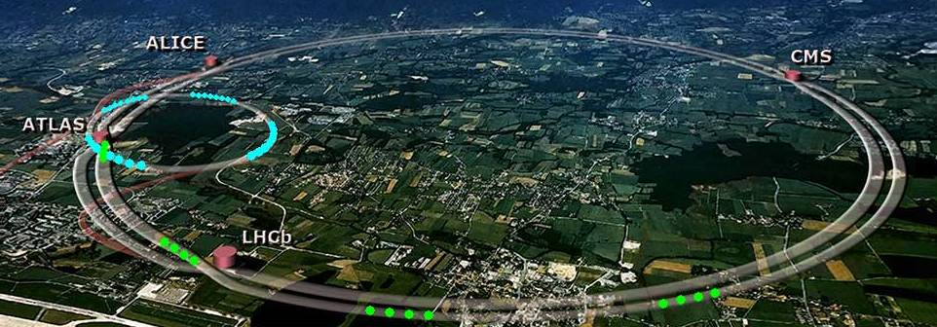
LHC is running
New Physics ?
8 TeV
5 fb^-1
Higgs ?

Slide 3
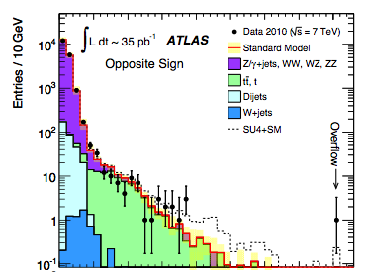
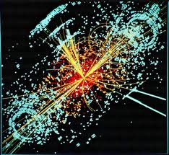


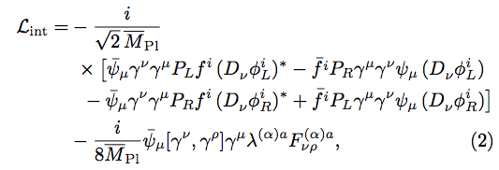
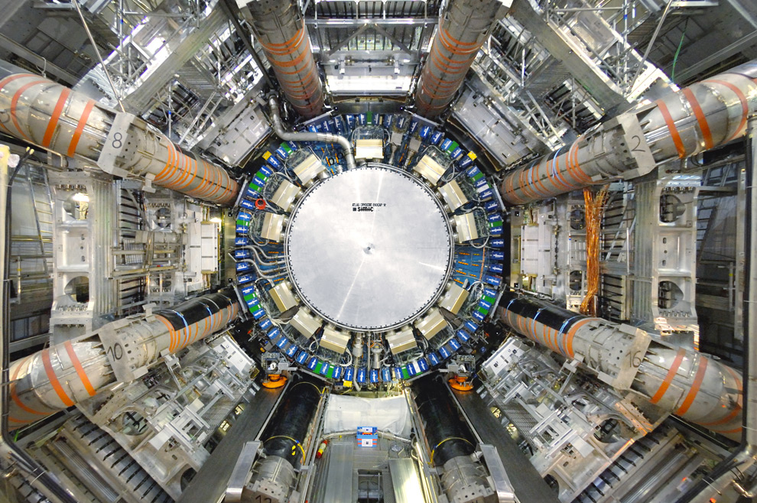
Simulation is an important tool
Simulation
Experiment
Theory

Slide 4
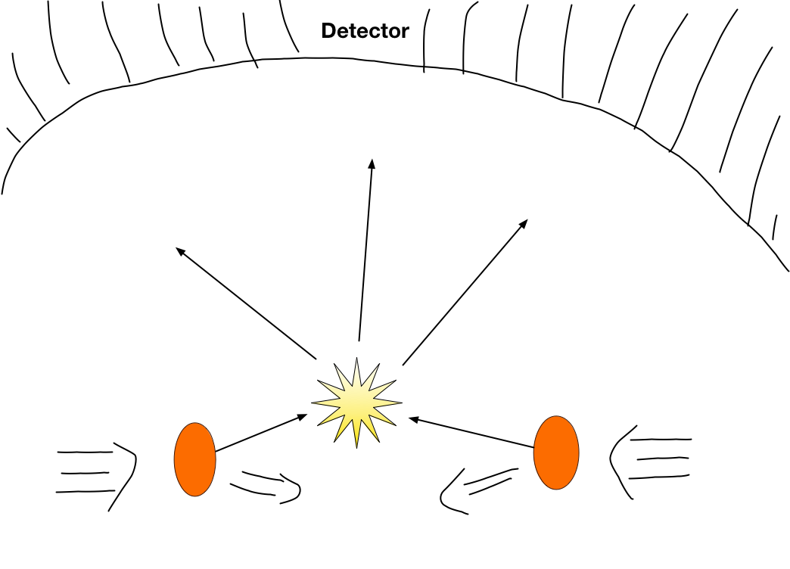
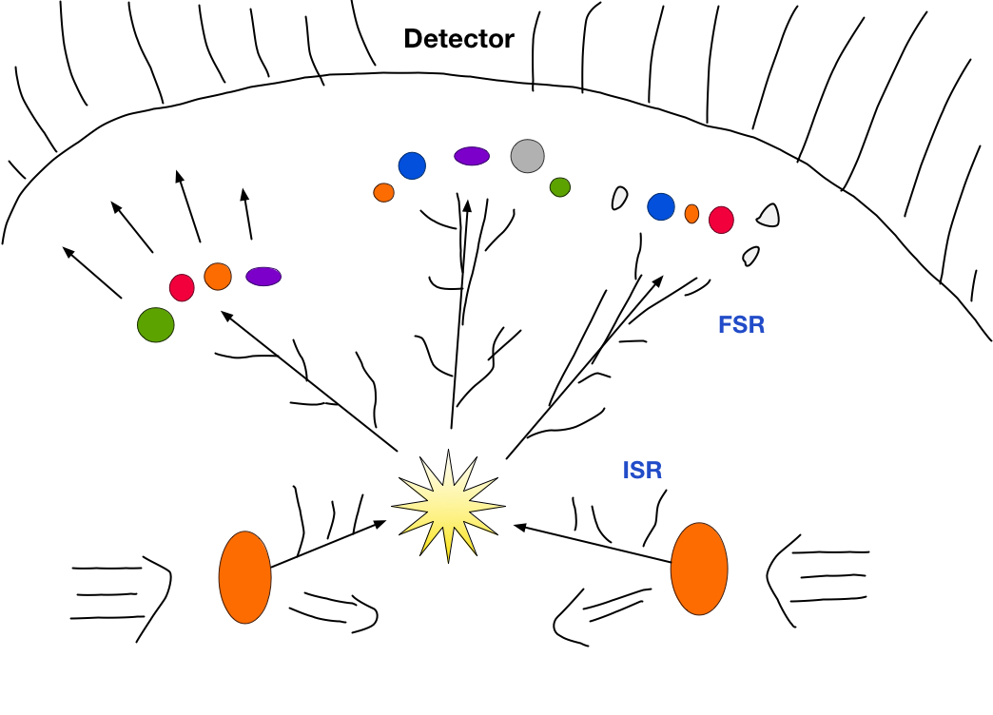
Simulation tools for HEP
Event generator
Simulate high energy collisions of elementary particles ( generating momenta and helicities )
1 Collision-Scattering = 1 Event
Matrix element generator:
Hard scattering (LO, NLO)
A few final state particles
Alpgen, HELAC, Sherpa, MadGraph
Parton shower generator:
Soft/Collinear radiations
Many particles
PYTHIA, Sherpa, Herwig

Slide 5
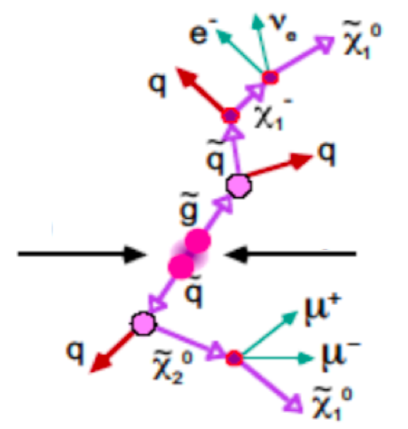
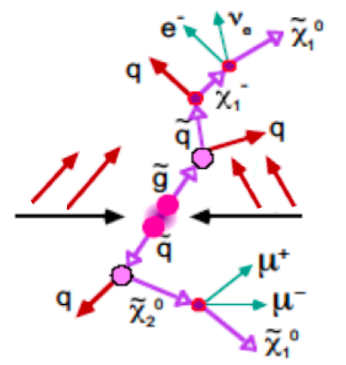
Importance of multi-jet simulation
Multi-jet signature appears in many
New Physics (BSM) models.
need to simulate more hard jets.
need to simulate more jets with
a matrix element generator.
Matrix element generator should be able to generate > 4 jets.

Slide 6
Status of ME generators
Model | Alpgen | HELAC | Sherpa | MadGraph
SM | 6 jets | 10 jets ? | 7 jets | 4 jets
MSSM | ✕ | ？ | 5 jets | 4 jets
Others | ✕ | ✕ | 5 jets | 4 jets
There is no ME generator which can simulate New Physics with > 5 jets.
We would like to extend the ability of HEP simulations
for LHC physics.

Slide 7



What is MadGraph?
Matrix Element Event Generator
Input
Model + process
Amplitude generator (“MadGraph”)
Feynman diagrams + Fortran codes for
テキスト
Event generator (MadEvent)
Output
Unweighted events in LHE format
MadGraph
7

Slide 8
Usefull features of MadGraph
Many new-physics models
MSSM, MSSM with gravitino, Randall-Sundram, ADD, 2HDM...
FeynRules/ALOHA: new physics implementation by users
Capable of dealing with n-point vertices (higher dim. operators)
Interface to
Parton Shower software (PYTHIA)
Detector simulators ( PGS, Delphes)
Data analysing tools (MadAnalysis, ROOT)
Automated NLO calculation (aMC@NLO)
Simulation of spin-3/2 and spin-2 particles
MadGraph is a powerful simulation tool
for new physics search at the LHC

Slide 9
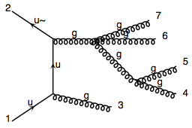



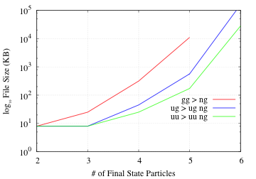
Limitation of MG
Generated Codes (> 8MB) cannot be compiled in usual PC.
The file size of codes for QCD processes
8 MB
Divide the Huge code into small pieces.

Slide 10
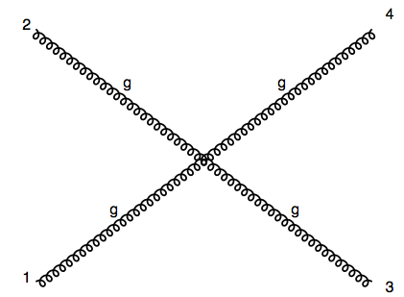
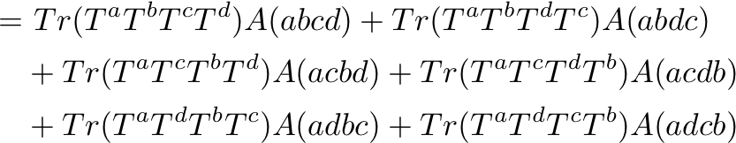
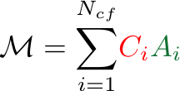




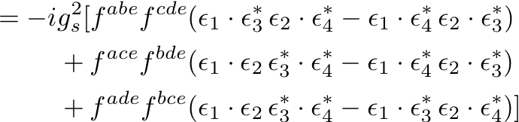
Color decomposition
color-ordered amp.
Color flow
Color Factor
i: Color flow

Slide 11
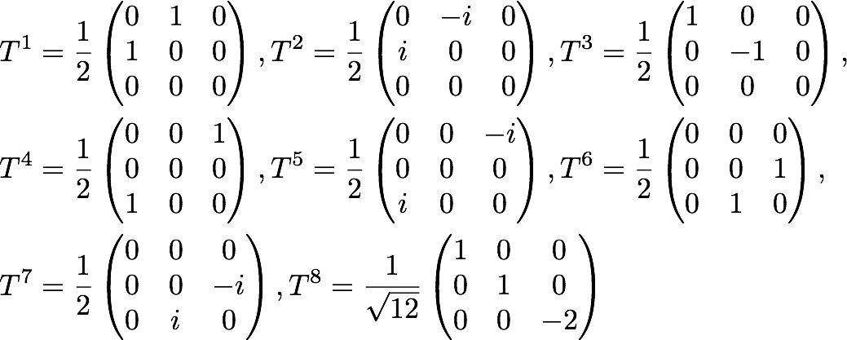
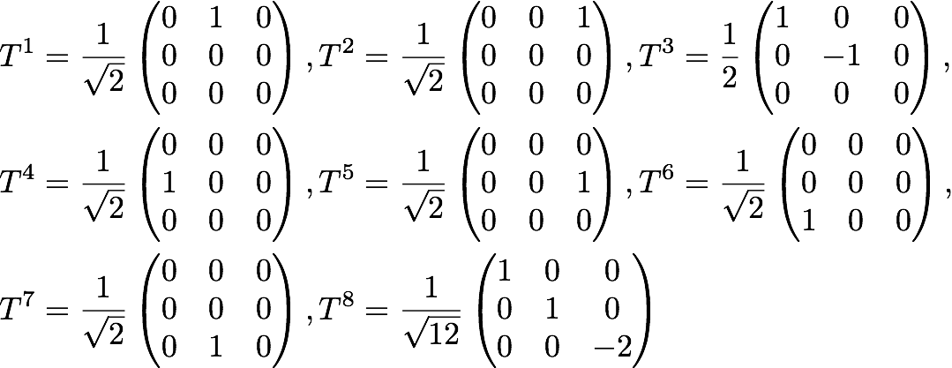
In color decomposition, we usually use Gell-Man matrices or modified matrices for .
Gell-Man:
Modified:

Slide 12
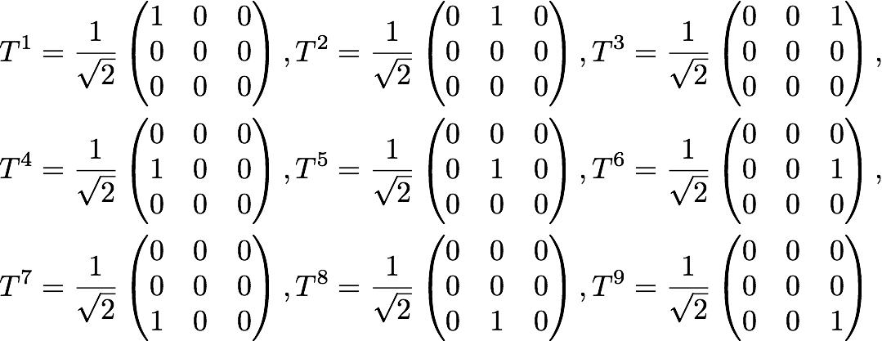

Color-Flow decomposition uses another set of matrices for .
Here are the generators of .
By using this basis, we can simplify the color factors as much as we can: 0 or 1.

Slide 13
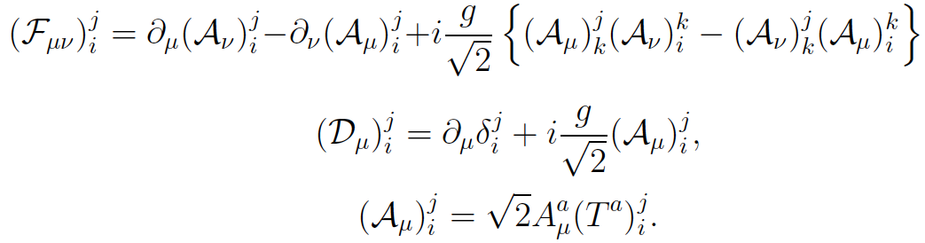
Color-Flow basis
QCD Lagrangian can be written as
13

Slide 14

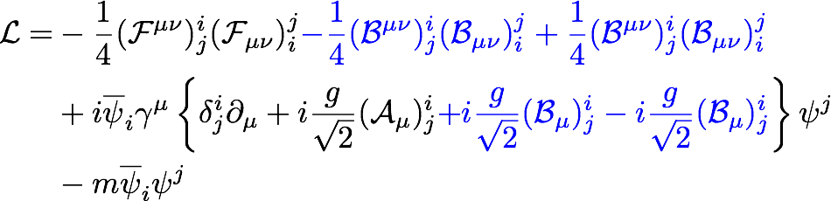

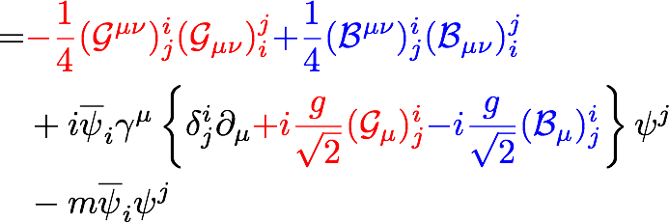

We rewrite this by introducing a U(1) gauge boson
14

Slide 15
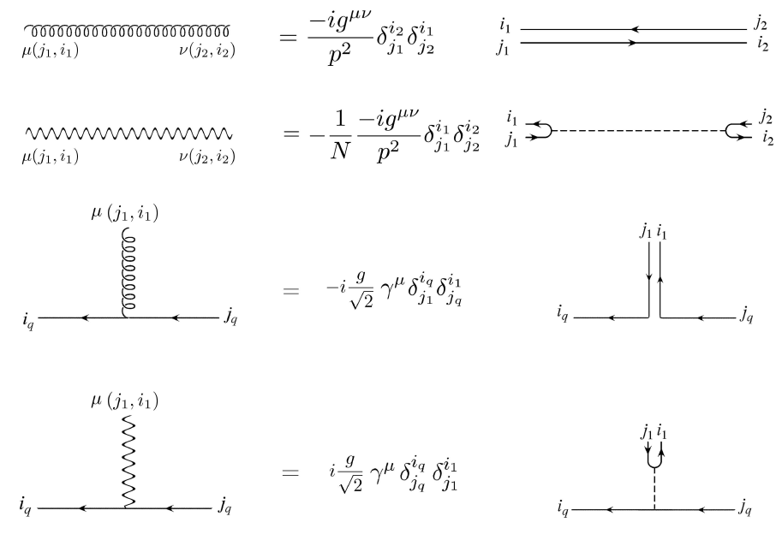
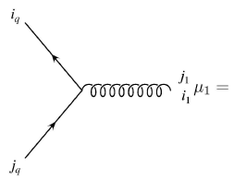
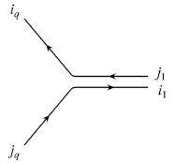

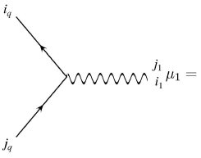
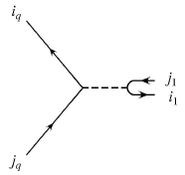

Feynman Rules 1
Color Flow diagrams
Color Flow
15

Slide 16
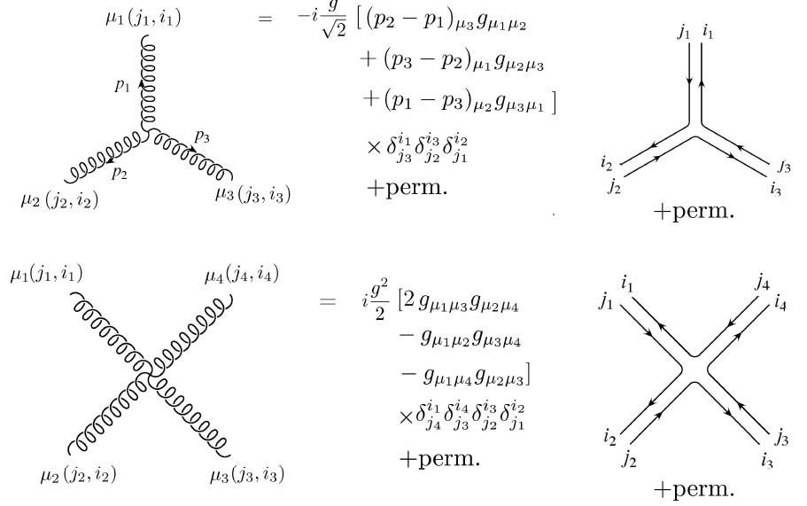
Feynman Rules 2
The abelian gluon is decoupled from U(3) gluons.
16

Slide 17


From these rules, we evaluate a color-fixed scattering amplitude.
n-gluon amplitude
color factor: 0 or1
partial amplitude
: (n-1)! non-cyclic permutaions
For n-gluon case, are the same as
the Color-Ordered ones.
This is the color-flow decomposition of a n-gluon amplitude.

Slide 18


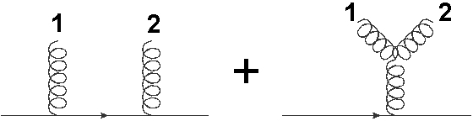

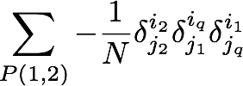
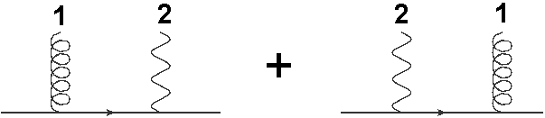

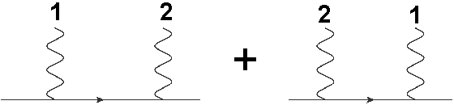
1 quark line and
amplitude
We add abelian gluon amplitudes to the U(3) gluon ones.
e.g.)

Slide 19


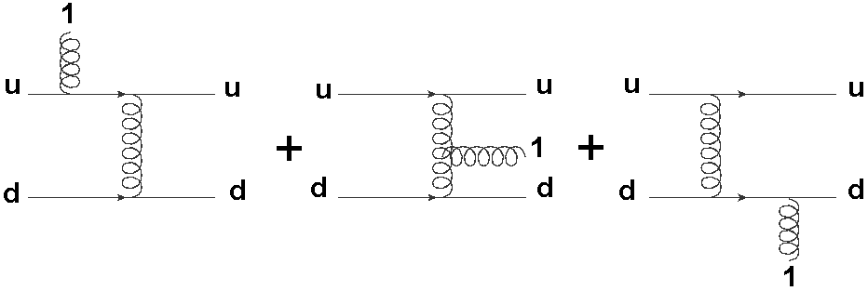

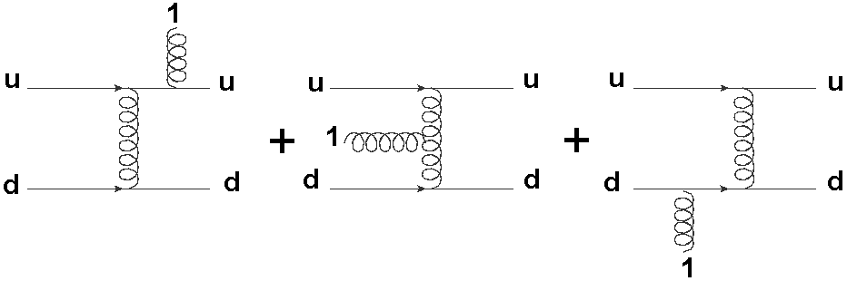


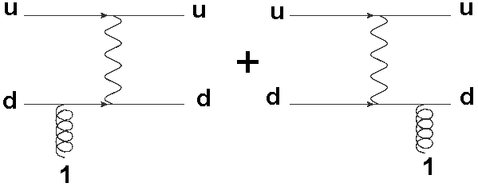

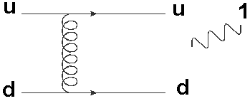

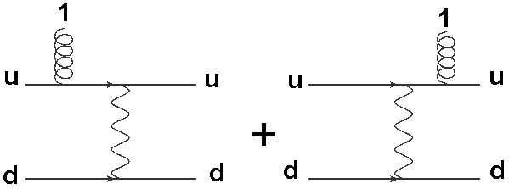

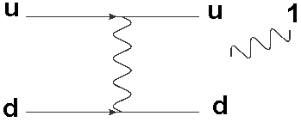
2 quark lines and
amplitude
There are other contributions from propagating abelian gluons
e.g.)

Slide 20
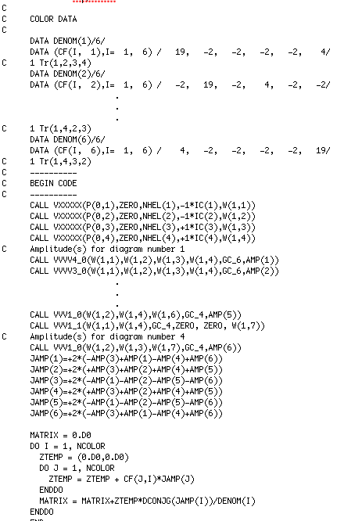

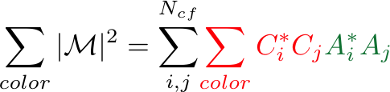

Divide MadGraph code for
Color Factor
color-ordered amp.
divide
Combine them later …

Slide 21




Advantages of dividing code by
Each code for is compilable.
are related to each other by gluon permutations.
do not have to generate all A’s.
are gauge invariant.
We can simplify color-ordered amps
Off-shell recursive relations

Slide 22
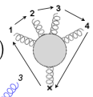
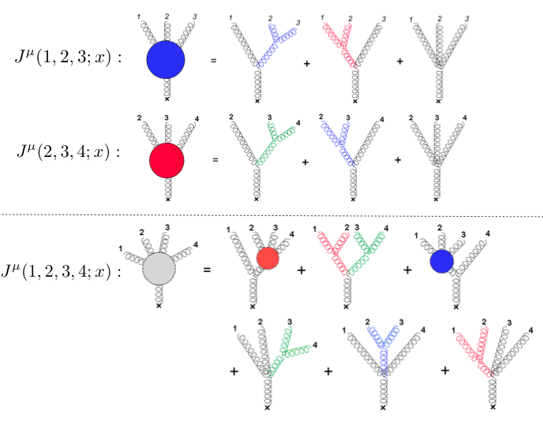
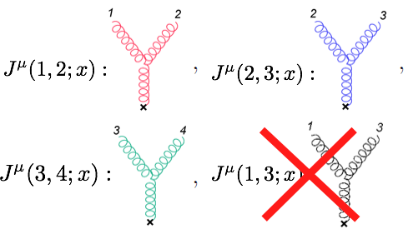
Efficient amplitude evaluation
Off-shell recursive relations in fixed color-order

Slide 23
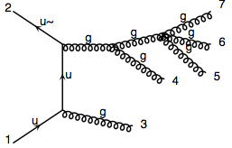
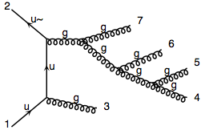
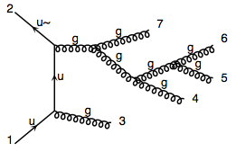
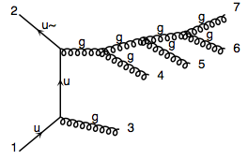
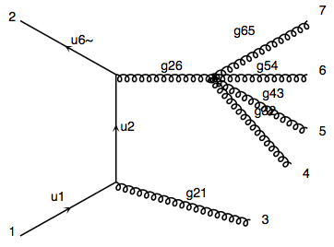
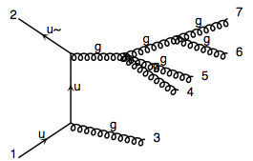
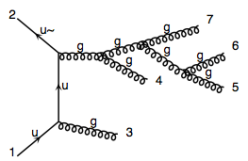
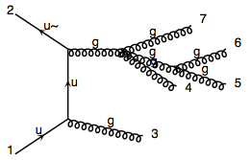


Off-shell recursive relations for gluonic subamplitude
Reduce the # of diagrams and code size
Straightforwardly applicable to New Physics processes

Slide 24

Time performance of recursively generated
color-ordered amplitudes
gg -> ng process
Average of all color-orderd amps
Recursive amp gains from 4 gluons
about 2 ~ 8 factor in execution time
So far we can generate and evaluate
color-ordered amplitudes for multi-jet processes

Slide 25




Total cross sections

Slide 26




Distributions (preliminary)

