Slide 1
ROS – serial

Slide 2
intro
ROS
Arduino
rosserial_arduino
http://wiki.ros.org/rosserial_arduino

Slide 3
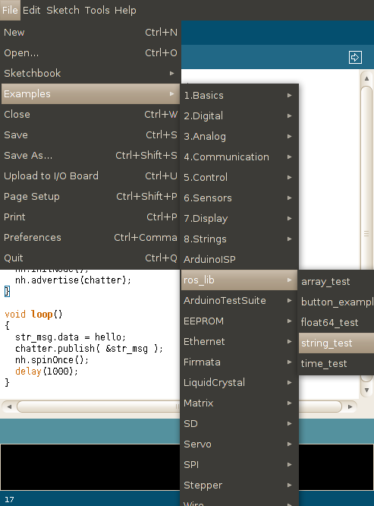
install
cd <ws>/src
git clone https://github.com/ros-drivers/rosserial.git
cd <ws>
catkin_make
catkin_make install
cd <sketchbook>/libraries
rm -rf ros_lib
rosrun rosserial_arduino make_libraries.py <sketchbook>/libraries
<sketchbook> is the directory where the Linux Arduino environment saves your sketches
view or change the location of the <sketchbook> location from with the Preferences dialog

Slide 4
HelloWorld
#include <ros.h>
#include <std_msgs/String.h>
ros::NodeHandle nh;
std_msgs::String str_msg;
ros::Publisher chatter("chatter", &str_msg);
char hello[13] = "hello world!";
void setup() {
  Serial.begin(9600); // opens serial port, sets data rate to 9600 bps
  nh.initNode();
  nh.advertise(chatter);
}
void loop() {
  str_msg.data = hello;
  chatter.publish( &str_msg );
  nh.spinOnce();
  delay(1000);
  digitalWrite(13, HIGH); // turn the LED on (HIGH is the voltage level)
  delay(1000); // wait for a second
  digitalWrite(13, LOW); // turn the LED off by making the voltage LOW
  delay(1000);
}

Slide 5
roscore
rosrun rosserial_python serial_node.py _port:=/dev/ttyACM0 _baud:=9600

Slide 6
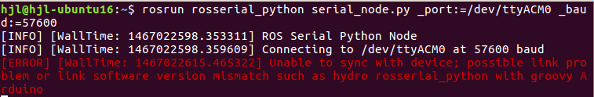
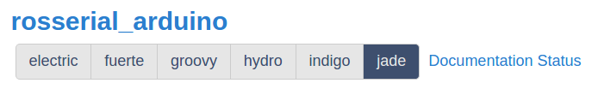
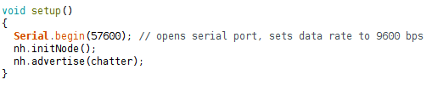
issue
check rosserial package version
check data rate
change usb cable

Slide 7
Overview
NodeHandles and Initialization
Messages
Publishers and Subscribers
Time
Logging
Limitations
Protocol

Slide 8
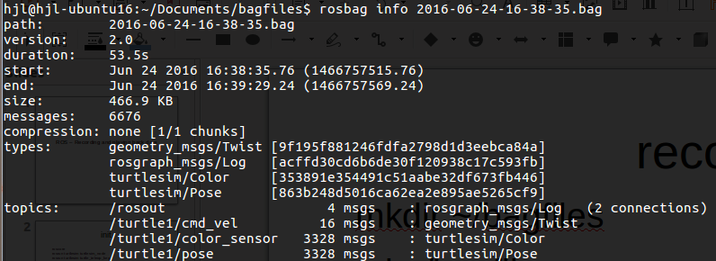
record
mkdir ~/bagfiles
cd ~/bagfiles
rosbag record -a
rosbag info <your bagfile>

Slide 9
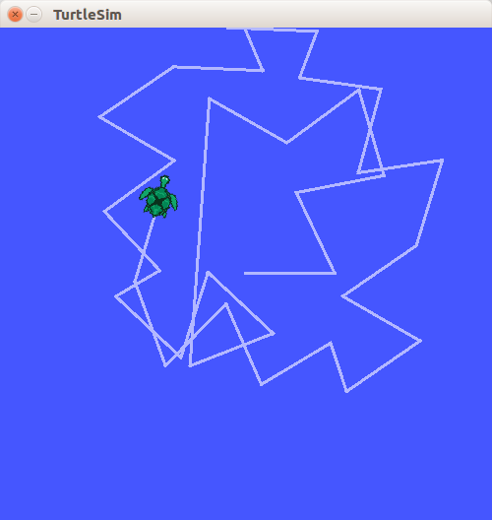
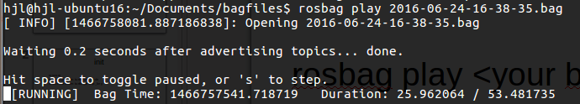
play
rosbag play <your bagfile>
rosbag play -r 4 <your bagfile>
More faster!!

Slide 10
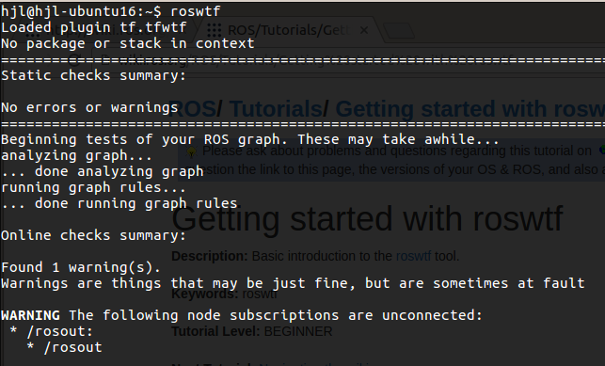
roswtf
$ roswtf

