Slide 1
ROS – Topics

Slide 2
Intro
This tutorial introduces ROS topics as well as using the rostopic and rqt_plot commandline tools.

Slide 3
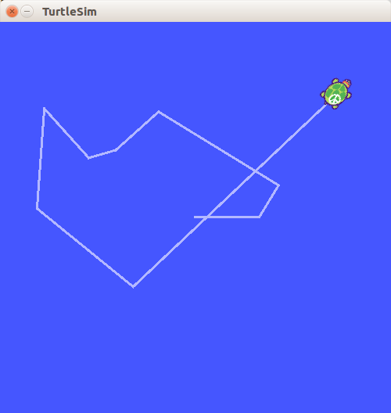
Topic
$ roscore
$ rosrun turtlesim turtlesim_node
$ rosrun turtlesim turtle_teleop_key

Slide 4
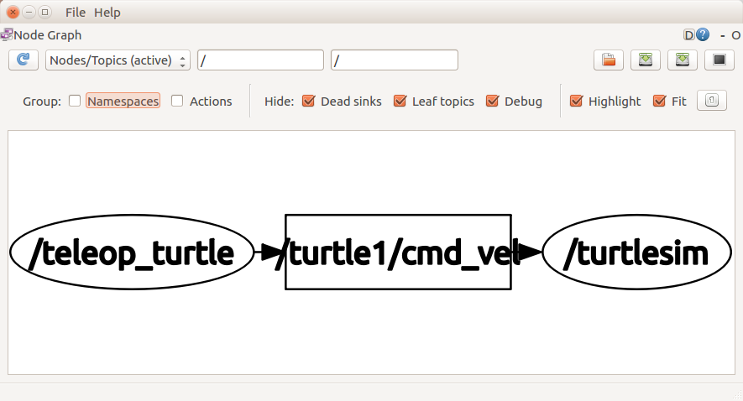
rosrun rqt_graph rqt_graph
topic
node
node
the turtlesim_node and the turtle_teleop_key nodes are communicating on the topic named /turtle1/command_velocity.

Slide 5
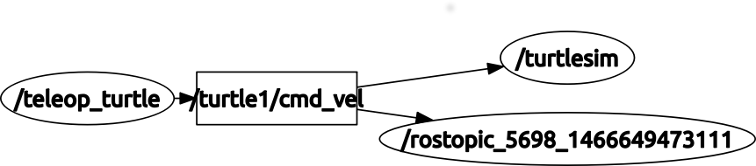
rostopic echo /turtle1/cmd_vel
linear:
x: 2.0
y: 0.0
z: 0.0
angular:
x: 0.0
y: 0.0
z: 0.0
---
linear:
x: 2.0
y: 0.0
z: 0.0
angular:
x: 0.0
y: 0.0
z: 0.0
---

Slide 6
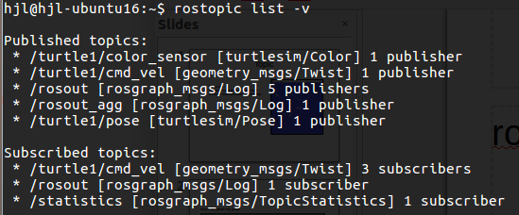
rostopic list -v
rostopic type [topic]

Slide 7
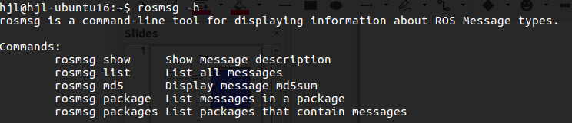
rosmsg
rosmsg -h

Slide 8
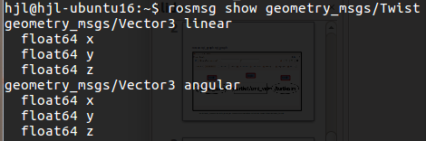
rosmsg show geometry_msgs/Twist

Slide 9

rostopic pub [topic] [msg_type] [args]
rostopic pub -1 /turtle1/cmd_vel geometry_msgs/Twist -- '[2.0, 0.0, 0.0]' '[0.0, 0.0, 1.8]'

Slide 10
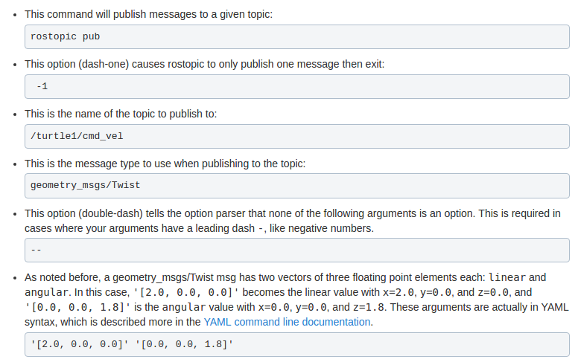

Slide 11
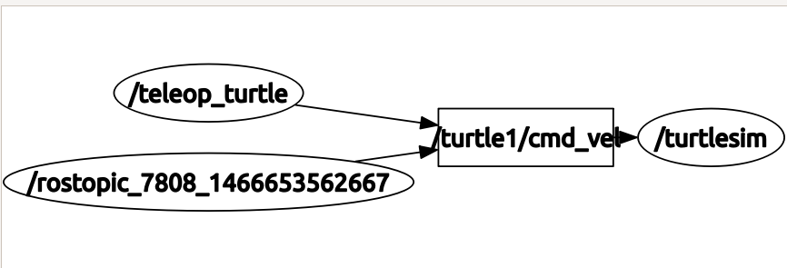

Slide 12
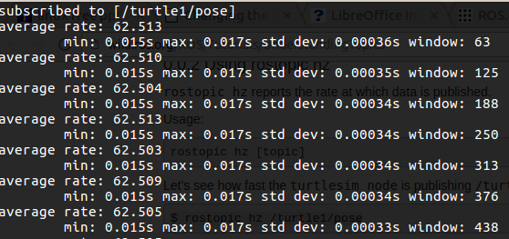

rostopic hz [topic]
$ rostopic hz /turtle1/pose

Slide 13
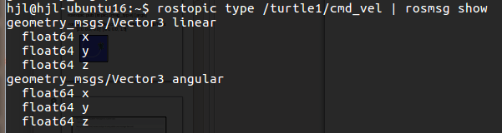
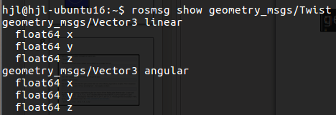
Conjunction
rostopic type /turtle1/cmd_vel

Slide 14
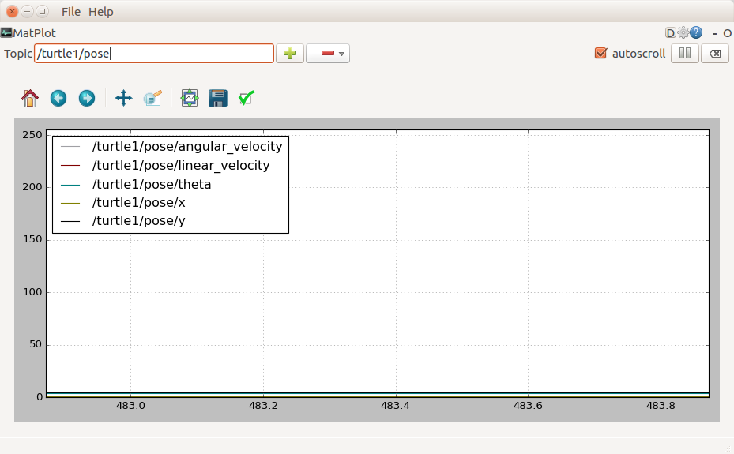
rosrun rqt_plot rqt_plot

