Slide 1
ROS – serial

Slide 2
intro
ROS
Arduino
rosserial_arduino
Arduino, especially UNO and Leonardo
http://wiki.ros.org/rosserial_arduino

Slide 3
Overview
NodeHandles and Initialization
Messages
Publishers and Subscribers
Time
Logging
Limitations
Protocol

Slide 4
Demo1
http://wiki.ros.org/rosserial_arduino/Tutorials/Hello%20World
ros_lib -> HelloWorld

Slide 5
HelloWorld
#define USE_USBCON
#include <ros.h>
#include <std_msgs/String.h>
ros::NodeHandle nh;
std_msgs::String str_msg;
ros::Publisher chatter("chatter", &str_msg);
char hello[4] = "hi\n";
void setup() {
Serial.begin(9600); // opens serial port, sets data rate to 9600 bps
nh.initNode();
nh.advertise(chatter);
delay(1000);
}
void loop() {
str_msg.data = hello;
chatter.publish(&str_msg);
nh.spinOnce();
delay(1000);
}

Slide 6

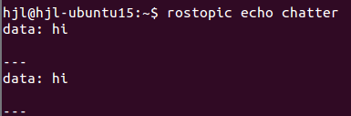
HelloWorld
roscore
rosrun rosserial_python serial_node.py _port:=/dev/ttyACM0 _baud:=9600
rostopic echo chatter

Slide 7
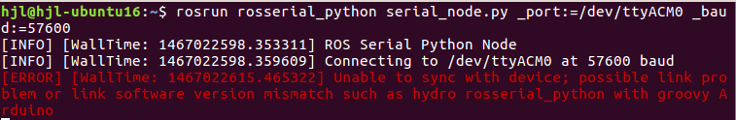
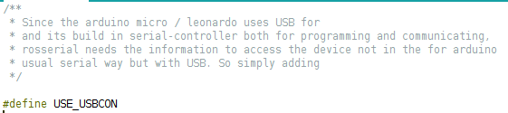
issue

Slide 8
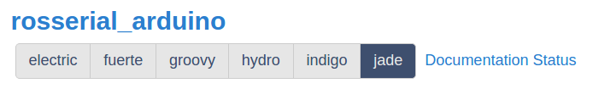
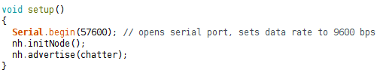
trouble shooting
check rosserial package version
check data rate
change usb cable...

Slide 9
Demo2
http://wiki.ros.org/rosserial_arduino/Tutorials/Blink
ros_lib -> Blink

