Slide 1
Datalytics Case Competition
Nadine Safwat - Nour Kasaby - Youssef Rami - Mariam ElGhobary

Slide 2
Contents
01
03
02
04
Data Analysis
Data Cleaning and Preprocessing
Machine Learning Model
Business Plan

Slide 3

Overview
We were provided with two datasets , one regarding the client and one regarding the orders. The main purpose of our project is to pre-process data, define the label, see trends and analyse data and make churn predictions. We will use these insights to propose a business plan that will help EFG determine the likelihood of a customer churning to retain them and minimise the losses that could be incurred due to customers churning.

Slide 4
Business Objectives
Find the probability that a customer will churn
Find trends or similarities between customers who churned/have high probability of churning
Focus on groups of customers who churn most and offer them incentives
Create customer loyalty through programs, messages, promotions…etc to make customers less likely to churn
Impose stricter rules and reminders to clients who have suspended accounts or limit churn trends
Overall, the main objective of predicting and analysing the customer churn is to reduce churn as customer churn negatively impacts the revenues of the company which is not ideal for any company.

Slide 5
01
Pre-processing

Slide 6
Generic Approach
In order to accumulate our data to a client level dataset multiphase aggregations were perform gradually raising our dataset level from order level to client level. The phases were the following :
Aggregated Orders DF
Full Account Level DF
Client Level Dataset
We created an account level data frame where each row captivates the aggregated order information per unique account. Aggregations include but are not limited to : total ordered quantity, total executed quantity and average price.
We then created another account level data frame which is a merge of the aggregated orders data frame and the client information.
Rates and other aggregations from the previous dataframe are then further aggregated and reprocessed into a client level dataset where each row resembles an individual client with their personal information, order information and activity trends. This is the data frame used by the machine learning model.

Slide 7
Types of Churn
Voluntary churn
Involuntary Churn
Passive Churn
Customer decides to no longer use the service/product
Company suspends the client due to payment issues or malicious activities
When customer subscription ends and is not renewed
Active Churn
Customer Churn
Revenue Churn
Customers who cancel their subscriptions
Represents loss of customers themselves rather than the lost revenue
Loss of revenue due to customer churn

Slide 8
Defining the Churn Label
Defining the label is one of if not the most fundamental cornerstone of this project and hence required very meticulous consideration of possible computations. Our main goal was to define a label that not only checks when the client was last active but also captures and emphasizes the change in each client’s ordering trends over time. Hence we conducted the following steps:
Redefine ISDormant
Define an Order Trend Metric
Create Label Conditions

Slide 9
Redefining IsDormant
The IsDormant column we had to begin with had some ambiguity and inconsistency as we noticed some rows that have the IsDormant value as -1 despite not meeting the dormant criteria. Thus we took the initiative of recomputing this column by checking whether or not each client’s most recent order across all accounts was more than 1 year ago to the current date. If it was more than a Year IsDormant is set to 1 else set to 0.

Slide 10
2. Defining Order Trend Metric
In order to emphasize order trends per client we decided to first compute order rates at account level and then aggregate it to client level accordingly. We started off by creating two “time windows” per order where the time between opening the account till today is split into two to get start and end order rates. After doing this at account level we computed the average start rate and average end rate per client across all accounts and computed the rate change. Thus a negative change indicates reduced activity in the recent window and the positive change indicates the opposite and 0 simply resembles unchanged activity trends.

Slide 11
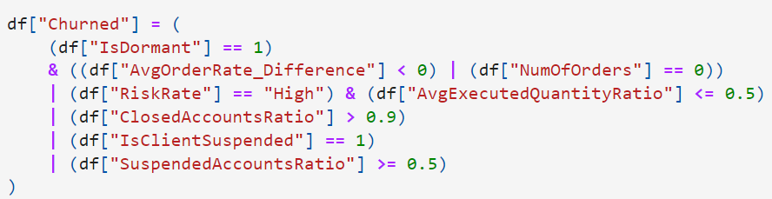
3. Creating Label Conditions

Slide 12
02
Data Analysis

Slide 13
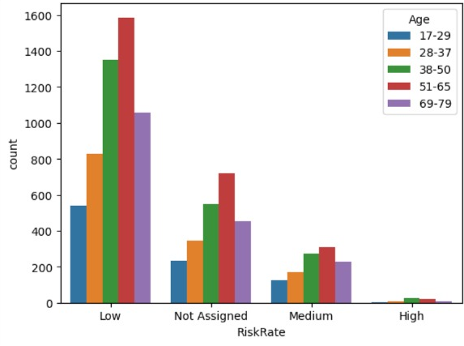
Risk Rate Per Age

Slide 14
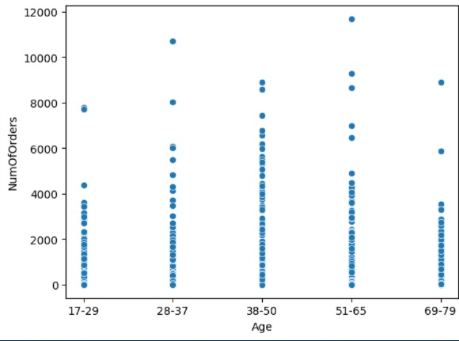
Number of Orders vs Age

Slide 15
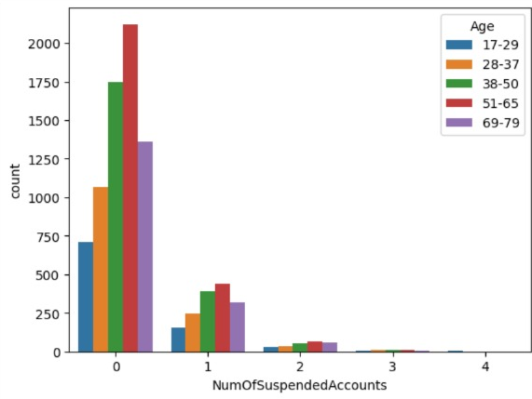
Number of Suspended Accounts Per Age

Slide 16
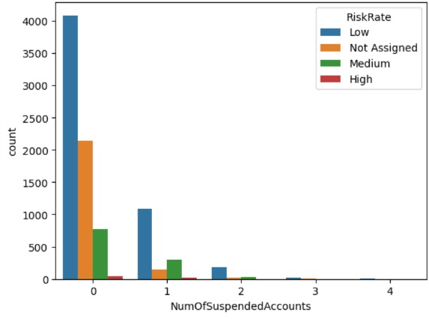
Number of Suspended Accounts Per Risk Rate
Notes:
KYC system isnt good

Slide 17
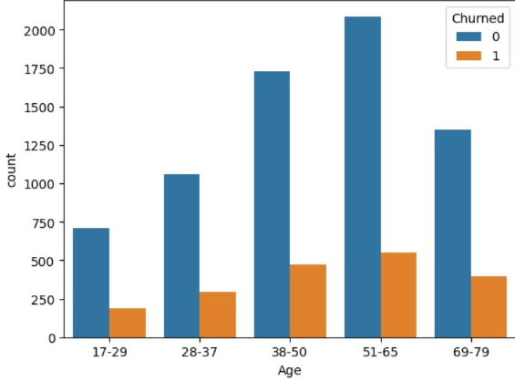
Churned vs Not Churned per Age
Notes:
KYC system isnt good

Slide 18
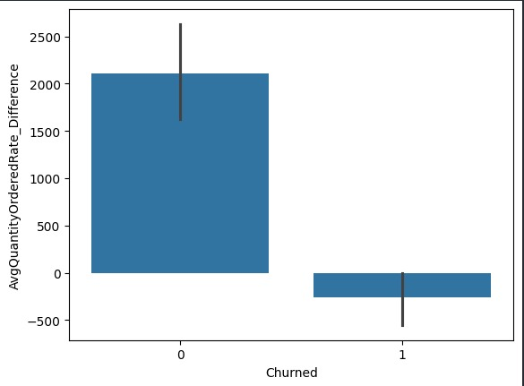
Churned vs Not Churned Avg Q Ordered Difference
Notes:
KYC system isnt good

Slide 19
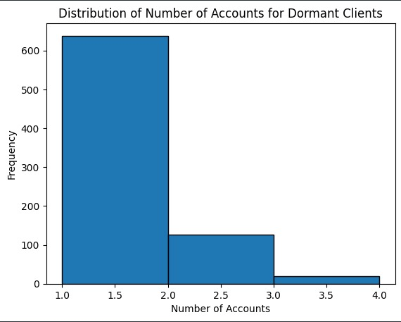
Distribution of Number of Accounts for Dormant Clients
Notes:
KYC system isnt good

Slide 20
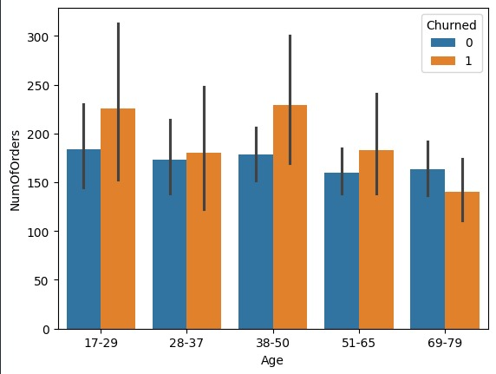
Number of orders per Age with Churn Hue
Notes:
KYC system isnt good

Slide 21
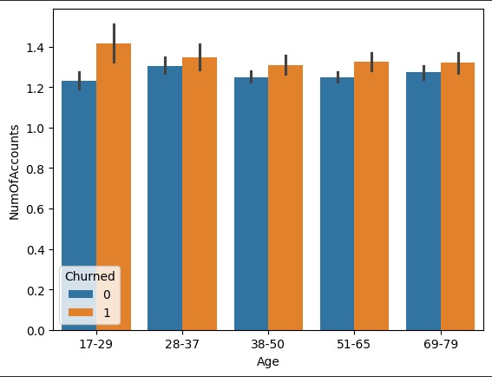
Number of Accounts per Age with Churn Hue
Notes:
KYC system isnt good

Slide 22
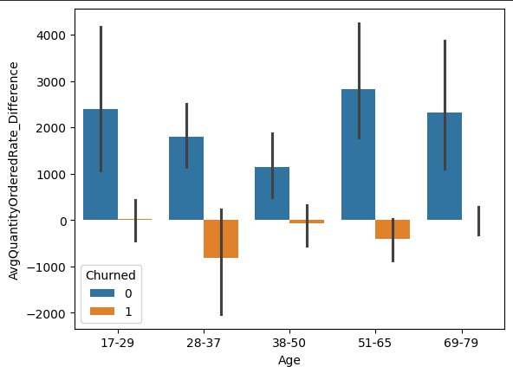
Avg Q Ordered Difference per Age with Churn Hue
Notes:
KYC system isnt good

Slide 23
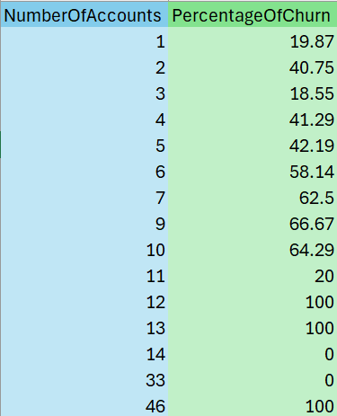
Percentage Of Churn per Number of Account

Slide 24
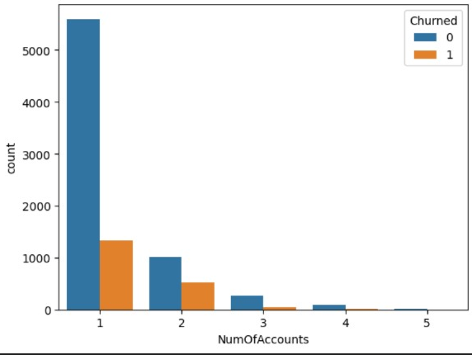
Number of Accounts with Churn Hue

Slide 25
03
Machine Learning Model

Slide 26
Preparing Data for Models
We did further data cleaning and feature engineering to train our data using machine learning models.
Categorical Data
Some features such as Gender, AccountOpenDate_Year, Risk_Rate, Order_Month…etc were one hot encoded
Other features such as Security_ID and Sector Name were encoded using frequency encoding to give weights to most influential securty_Id’s and sector names
Numerical Data
We saw the distribution of each numerical value and scaled accordingly.
Uniform distribution -> Min-Max Scaling
Normal distribution -> Z-Scaling
Cauchy distribution -> Quantile Scaling
Exponential distribution -> Log Scaling
Rayleigh distribution -> Log Scaling
Note: Since there was a great imbalance in the dataset (almost 25% churned vs 75% not churned), we oversampled the churned class.

Slide 27
Models Trained
We trained our classification model on 7 supervised machine learning models which are:
KNN
Naive Bayes
Decision Trees (CART implementation)
Random Forest
Logistic Regression
SVM
Neural Networks
We also performed GridSearch on each model to find the best parameters and through that we decided to go with Random Forest using 300 trees and a max_depth of 30.

Slide 28
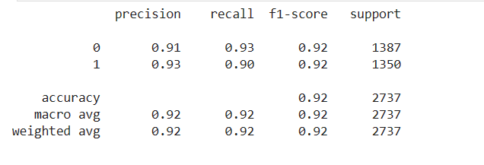
Model’s Metrics
Model’s Prediction Scores:
As can be seen from the above scores the model yielded a very high accuracy of 93%. Notice that since a customer churning has a direct effect on the company’s revenue we need to take the recall’s scores for the churned class into great consideration. The model’s churn recall’s score is 91% which indicates that it is really efficient in correctly predicting the churned customers within a pool of churned customers.

Slide 29
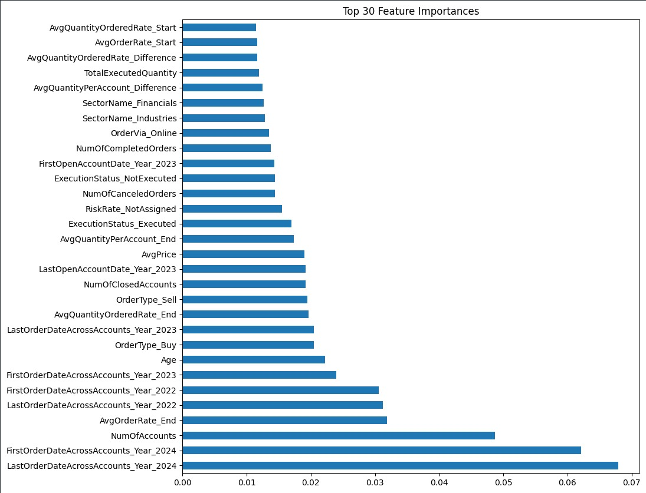
Feature Importance

Slide 30
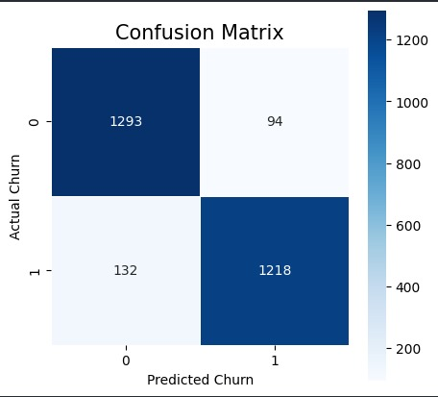
Confusion Matrix

Slide 31
04
Business Plan

Slide 32
Improvements to be made
Give benefits to people who are close to being dormant or send them notifications that its been awhile since they've ordered
Try and gather feedback from clients
Improve KYC system to better identify high risk customers
Show clients their order rate history so that they have more interaction and knowledge on their orders
Limit the number of accounts a single client can make or add a premium fee if someone wants to open more accounts
Give benefits to less active age ranges to reduce their probability to churn

