Slide 1
Classification of Wines based on their
Chemical and Physical Attributes
Anh Nguyen
s3616128@rmit.edu.vn
Assignment II
COSC 2789 - Practical Data Science

Slide 2
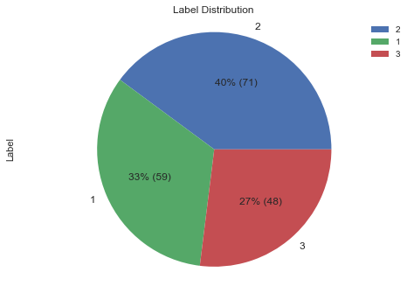
Goal & Dataset
Goal: to see if it is possible to reliably differentiate three different types of wine from the same region in Italy based on their chemical and physical attributes.
Dataset:
The dataset was obtained from the UCI ML Repository.
Contains 178 wine samples from the same region in Italy, produced by 3 different winemakers.
14 attributes: 1 categorial & 13 numerical attributes.
Notable attributes: Label, Alcohol, Total Phenols, Hue, Color Intensity and so on.

Slide 3
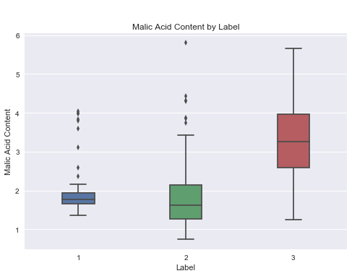
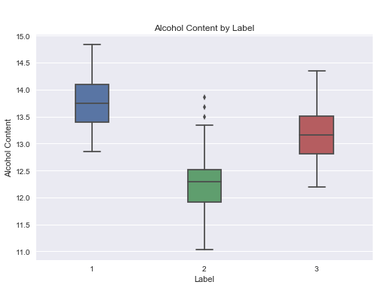
Data Preparation
The dataset underwent several checks:
NaN value check
Impossible value check (every attribute has to be a non-zero non-negative number)
=> The dataset does not contain any missing or impossible values.
Outliers were found by observing analytical plots
Decided to not delete/replace the outliers:
Sample size is too small
Outliers are expected.

Slide 4
Data Modelling
Two models were chosen from the sklearn package: K Nearest Neighbors(kNN) and Decision Tree.
The dataset was split in 3 different ways:
50% training, 50% testing
60% training, 40% testing
80% training, 20% testing
The performance of a model is measured by 4 metrics:
Recall Score, F1 Score, Precision Score (the higher the better)
Classification Error Rate (the lower the better)
Hypotheses:
For kNN classifier, with the value of k from 1 to 10, how does the parameter weights affect the outcome of the model? Two possible values for weights are ‘uniform’ and ‘distance’.
For decision tree classifier, how does limiting the number of features to be used would affect the outcome of the
model?

Slide 5
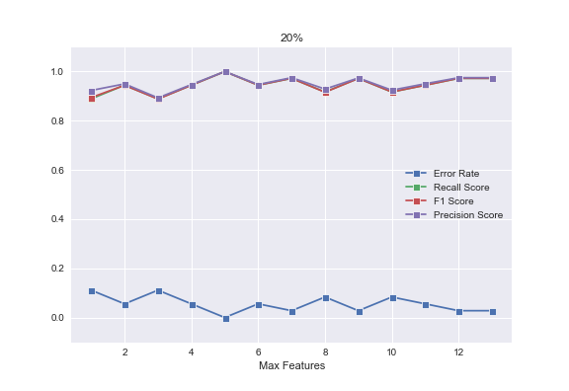
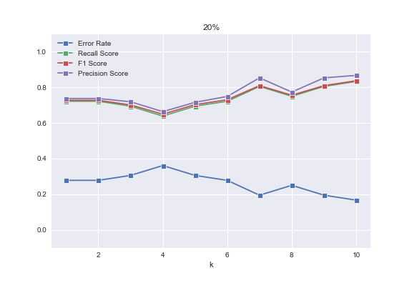
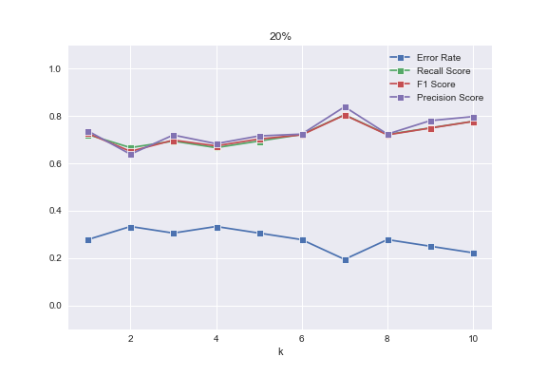
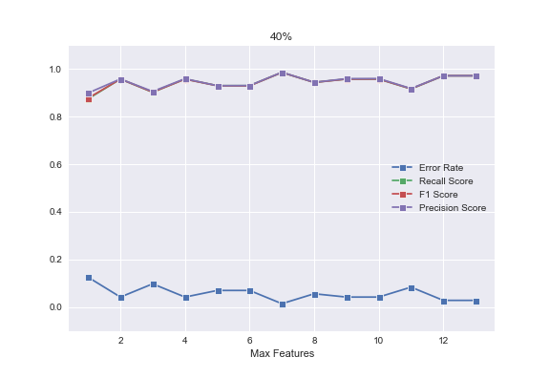
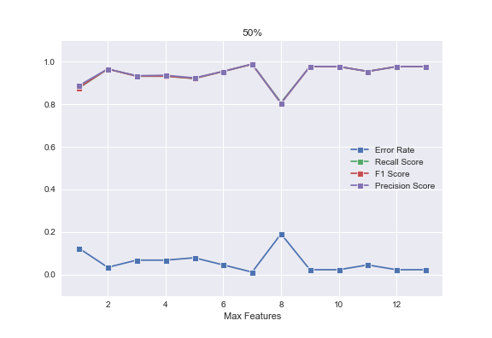
Data Modelling - kNN
Data Modelling - DT
Uniform Distance
k=7 is the best value for uniform. k = 10 for distance.
The weights parameter makes little difference in this dataset.
Overall, the best number of features is 7 which has a close to 0 error rate.
In the 20% testing set, at max_features = 5, error rate is equal to 0!

Slide 6
Conclusion and Recommendation
Both models - kNN and Decision Tree - were able to reliably predict the wine type from the chemical and physical attributes of the target.
To improve the kNN model for 20% testing dataset, change the weights parameter to ‘distance’. At k = 10, error rate is equal to 0.17.
To improve the kNN model overall, the weights parameter should be set to ‘uniform’, and k=7.
The best setting for the decision tree model is when max_features is set to 7, the average error rate is equal 0.018.
I recommend using the Decision Tree model to identify the wine type in the future since it has a much lower error rate compared to kNN.

Slide 7
THE END

