Slide 1
Building an SLA-First Observability Platform with ClickHouse

Slide 2
Advantages
Requires NO CHANGES to applications
Puts NO LOAD on MongoDB
Allows tracking Business Relevent metrics

Slide 3
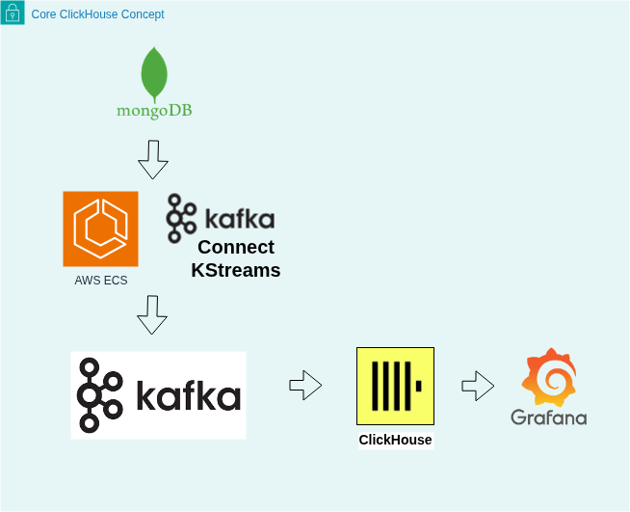

Slide 4
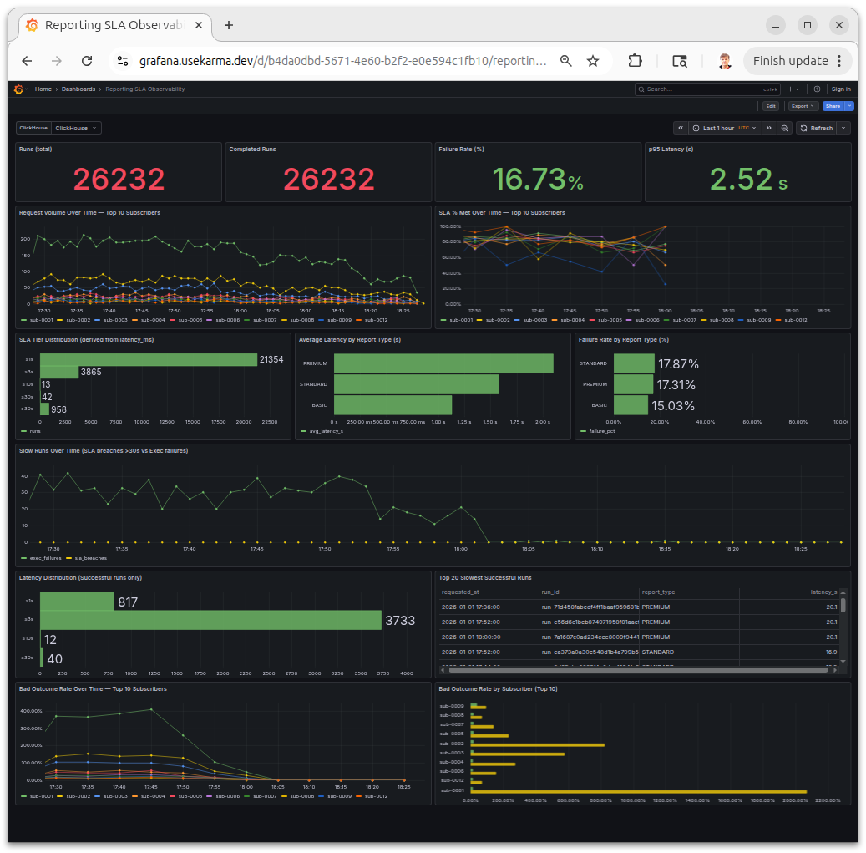

Slide 5
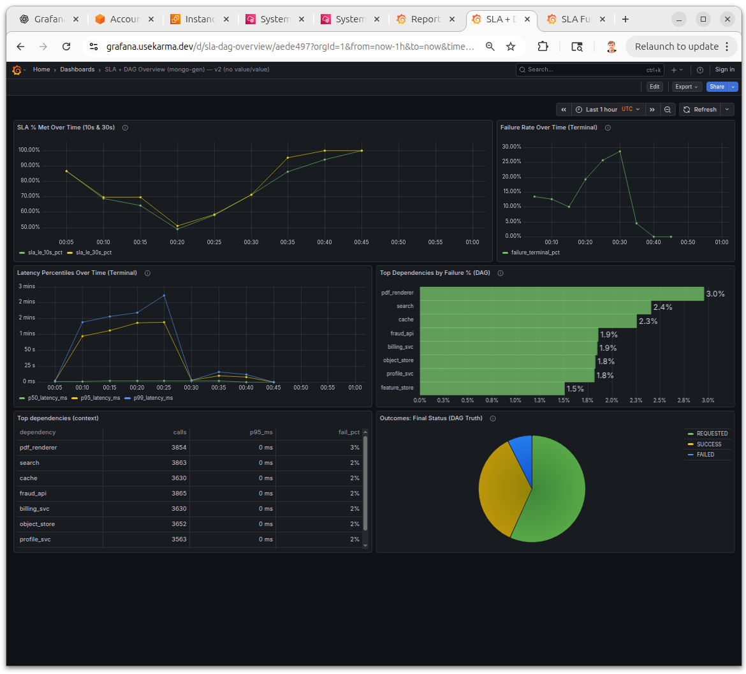

Slide 6
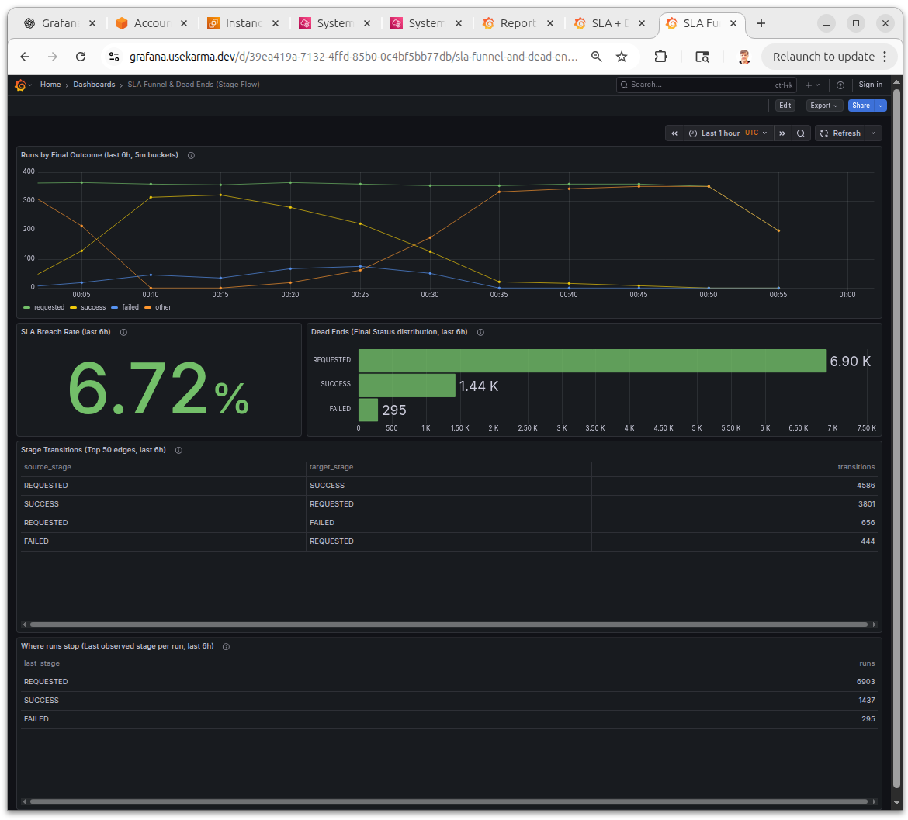

Slide 7
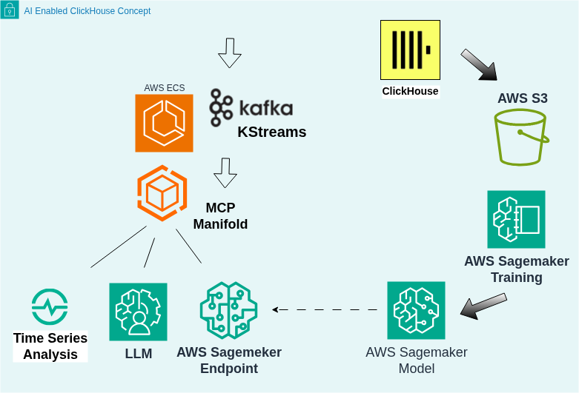

Slide 8
