Slide 1
Unit-3 : Developing Contributor Personality
Contributor Personality Development
(HS 134 A-H)
HSS, I2IM, CHARUSAT

Slide 2
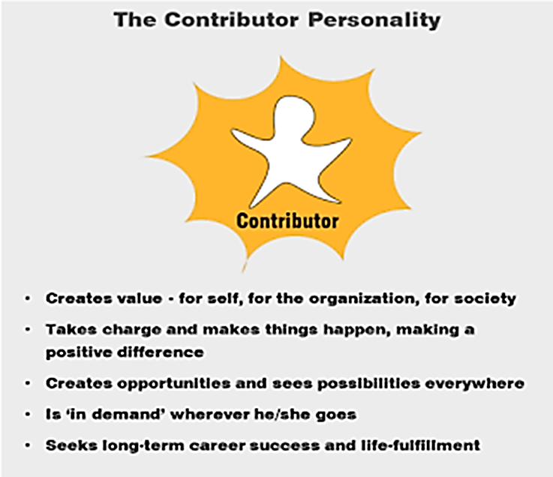
Concept of Contributor
Creates Value – For self, Organization, Society
Takes initiative and make a positive difference in outcome
Creator of opportunity and possibility
Long term career success and satisfied with life

Slide 3
Characteristics of Contributor
Visionary
Goal Setter
Work for excellence
Positive Thinker
Assertive
Demonstrates Human Concern
Revolutionary
Creative
Ethical
Social Worker

Slide 4
Vision of Career
Contributor’s
Non-contributors
Flexible (Contributive career)
Generates opportunities for all
Recognizes contribution of group
Inclusive democratic leadership
Work to contribute to society
Win-win situation
Rigid (Acquisitive Career)
Generates opportunities for self
Recognizes individual contribution
Self-centered – no/less consideration to colleagues
Work to earn money
Win-lose situation

Slide 5
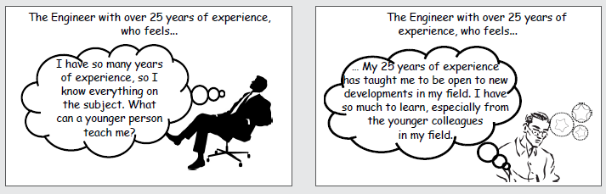

Slide 6
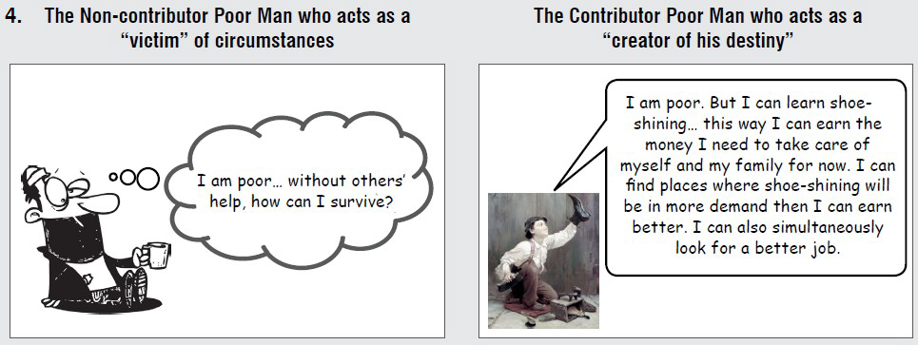

Slide 7
Vision of Success
Non-Contributor
Non-Contributor
External Success
Good Relationship with people
Beating competition
Respect of People around them
Financial incentives
Promotions
Inner success
The excitement for a challenge
Feeling confident
Proud of innovation/inventions
Self satisfaction of building capabilities among others
Contribution to society

Slide 8
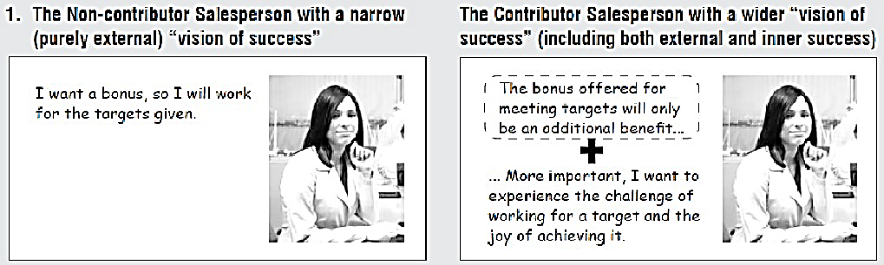

Slide 9

Scope of Contribution
Contributor personality
Personal/ Self
Organizational/
Professional
Social

Slide 10
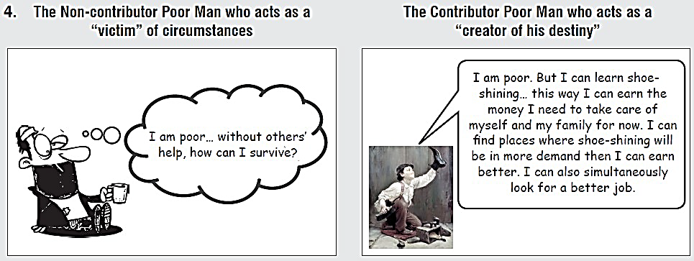

Slide 11
References
i-become active guide.
Soft Skills: A Textbook for Undergraduates

