Slide 1
Personality: Meaning, Concept & Type
Ishan Vinay Pandya

Slide 2
Line of Presentation
“
Introduction
Meaning / Definition
Theories of Personality
Personality Factors
Characteristics of personality
The things that we Love …
Tell us what we are!!!
”

Slide 3

Introduction
Perception Capacity
Emotional Maturity
Responsiveness
Sociability
Originality
Neutrality
Latin word “Persona”
The mask worn by actors in drama
Thoughts
Feelings
Behaviour
Leadership Feeling
Integrated
Tendency
Young (Thinking)
Appearance (External)
It’s Beauty that Captures your attention;
Personality which captures your heart.

Slide 4
Meaning: Personality
Personality is the dynamic organization within the individual that determine his unique adjustment to the environment.
- Gordon Allport
A combination of long lasting and distinctive behaviours, thoughts, motives, and emotions that typify how to react and adapt with people and situations
- Plotnik

Slide 5
“Personality is a Patterned body of habits, traits, attitudes and ideas of an individual, as these are organized externally into roles and statuses, and as they relate internally to motivation, goals, and various aspects of selfhood.”
- K. Young

Slide 6
Theories of Personality
Trait Theory
Lasts longer
Focus on Measuring, identifying, describing individual differences
Psychodynamic
Behavior caused by unconscious factors
ID – Pleasure Principle- Instinctive (Birth)
Humanistic
Abraham Maslow and Carl Rogers…
Individuals has free will
Integrative
What is Different???
MBTI test
EGO – Reality Principle – sub-conscious mind – decision making
SUPER-EGO – Conscious mind – Values and Morals of Society
Self-Actualized personality
Emotionally and socially mature individual
Well adjusted personality
Sigmund Freud and others
Self development (Potential Self)
Attainment of Self-Actualization
Physiological needs
Safety needs
Belongingness and love need
Self-Esteem needs
Self Actualization
Myers & Briggs
Indian Scriptures
Veda
Upanishad
Patanjali Yogasutra
Extraversion & Introversion
Sensing & Intuitions
Thinking & Feeling
Judging & Perceiving
16 types of personality
Hans J. Eysenck

Slide 7
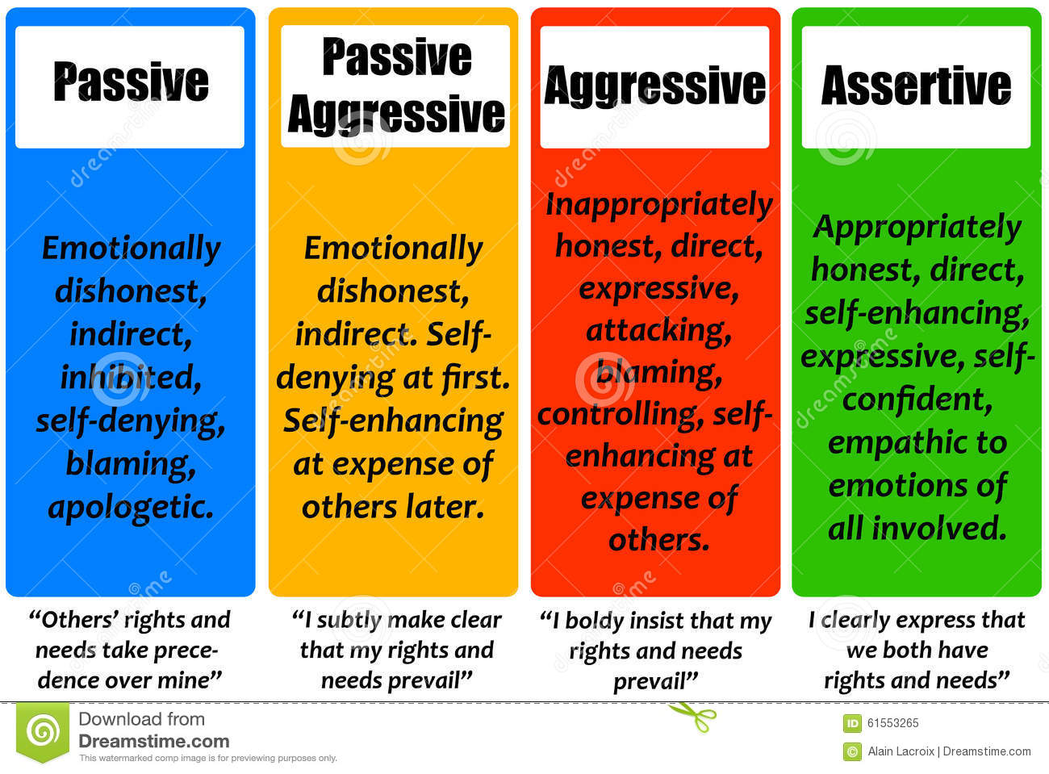

Slide 8
THREE DOSHA

Slide 9
Personality Characteristics: Vata, Pitta, Kapha
Vata Personality
Lean Body
Active
Pitta Personality
Short Tempered
Cheerful nature
Kapha Personality
Calm and Composed
Lack of Sleep
Easily Agitated
Poor Appetite
Digestion Issues
Intolerant to Cold
Indecisive by Nature
Social
Quick Digestion
Intolerant to Hunger
Intolerant to Heat
Public recognition
Complacent Nature
Firm Judgements
Slow paced
Slow Digestion
Sleeps Deeply
Large Body frame

Slide 10
Vata | Pitta | Kapha
Dry | Oily | Oily
Cold | Hot | Cold
Light | Light | Heavy
Irregular | Intense | Stable
Mobile | Fluid | Sticky
Rough | Liquid | Smooth

Slide 11
Personality Factors
Biological Factors
Physique
Nervous System
Sociological Factors
Home
School
Language
Culture
Psychological Factors
Intelligence
Motivation
Emotion
Attitude
Interest
Sentiments

Slide 12
What affects our personality???
Psychological Factors
Motives
Interests
Sociological Factors
Physical Environment
Social Environment
Biological Factors
Attitudes
Will & Character
Intellectual Capacity
Perception & Reasoning
Educational Environment
Language
Self Concept
Identification
Heredity
Intelligence
Gender Differences
Nervous System

Slide 13

Concept of Contributor
Create Value
For Yourself
For the Organization
For Society and World
Take charge and Make things happen
Bring Positive Difference
Create Opportunities and Possibilities
Long term Career Success and life fulfilment
‘We’ not ‘I’

Slide 14
Contributor: Vision, Career & Success
Vision
Capacity Expansion Vision
Volunteer for tasks
Career
Contributive Career
Concern for Human Nature
Success
Personal Fulfilment
Self-Development
Learn New Thing
Take on New Tasks
External + Internal Success
Involved with tasks
I am doing to bring positive difference

Slide 15
Non-Contributor: Vision, Career & Success
Vision
Comfort Vision
Stick to job
Career
Acquisitive Career
Concern for Self Achievements
Success
Material Success
Achievements
External Success
Disengaged with tasks
I am doing because it has been given to ME
Nothing out of Comfort Zone
No Initiatives
“I” not “WE”

Slide 16
Characteristics of Contributor
Visionary
Goal Setter
Work for excellence
Positive Thinker
Assertive
Characteristics of Contributor
Humanistic
Revolutionary
Creative
Ethical
Social Worker

Slide 19
2020
2021
2022
2023
2024
My Aspiration:

Slide 20

Thank You !!!

