Slide 1
Paycheck protection program(ppp): Tracking and analyzing private loans distribution Among small businesses in nyc
PAI 789 – Advanced Policy Analysis Ulises Sepulveda
Prof. Wilcoxen 04/27/2022

Slide 2
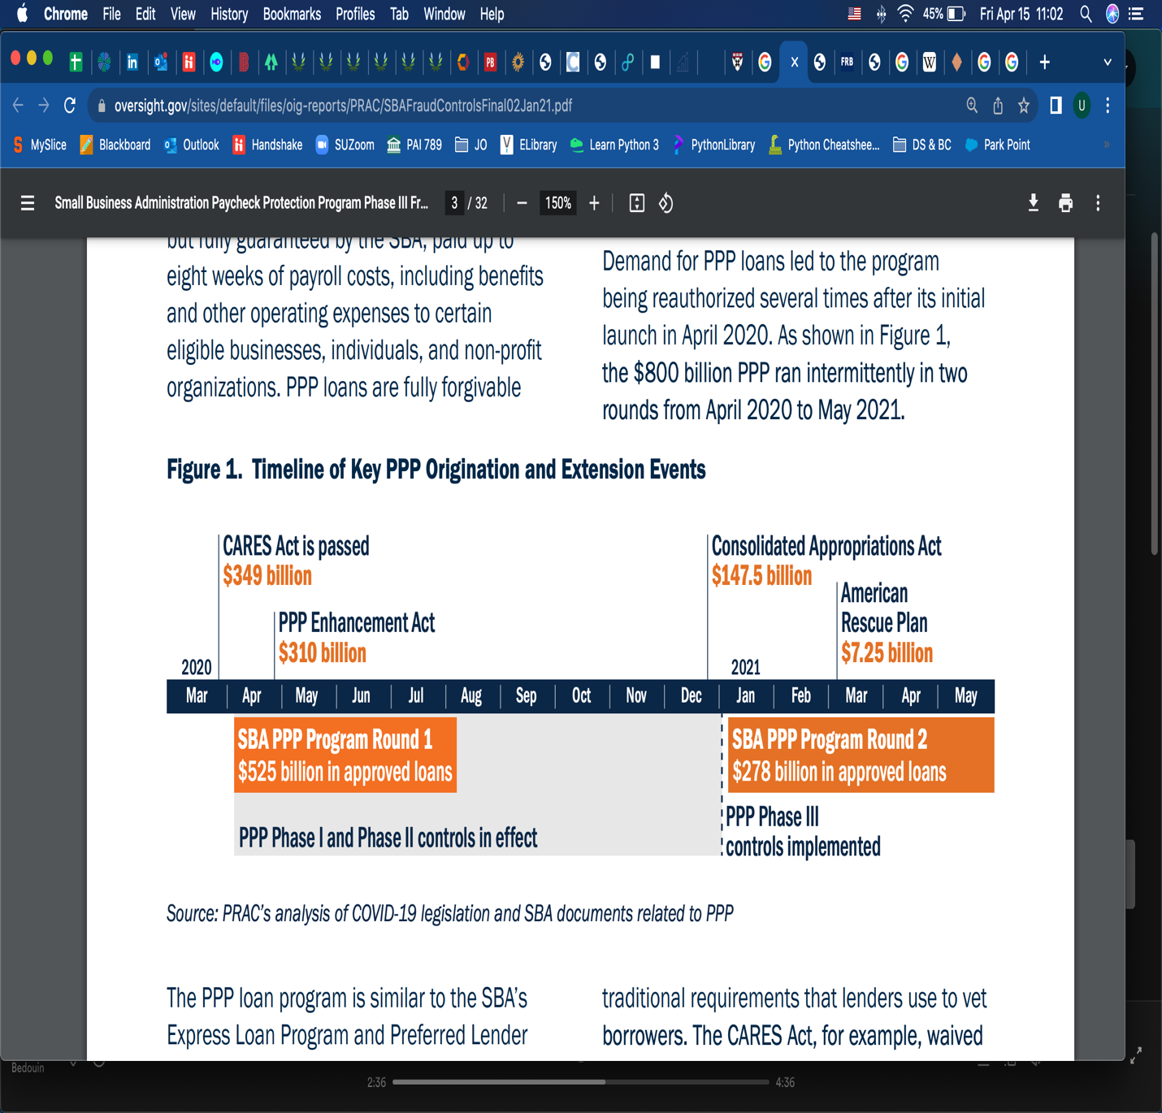
Background and scope of PPP Timeline of ppp’s milestones
PPP: Tracking and analyzing private loans distribution to small businesses in NYC
Notes:
Overview of the Paycheck Protection Program (PPP)
To tackle the unprecedented economic disruptions caused by the COVID-19 pandemic crisis, the Paycheck Protection Program (PPP) was established by the Coronavirus Aid, Relief, and Economic Security (CARES) Act in April 2020.
PPP’s goal is to provide small businesses with the necessary resources to maintain payroll, hire back employees who may have been laid off and cover applicable overhead through Small Business Association(SBA)-guaranteed private loans from commercial banks.
As a result, PPP enables small businesses continuity, fewer jobs lost and more small business staying afloat while contributing to overall economic recovery.
Considering there is limited data on the impact and effectiveness of PPP as a policy, this analysis focuses on private loans' distribution among small businesses in New York City covering the 5 boroughs that make up NYC..
NY State received = 38.5B and out of those loans NYC accounted for $4.7B in the first phase.
Although New York City was an initial epicenter of the pandemic, only 45.6 percent of firms in the City received loans through the PPP, below the national average of 50.9 percent.3
*The U.S. Small Business Administration primarily defines a small business as one with fewer than 500 employees.

Slide 3
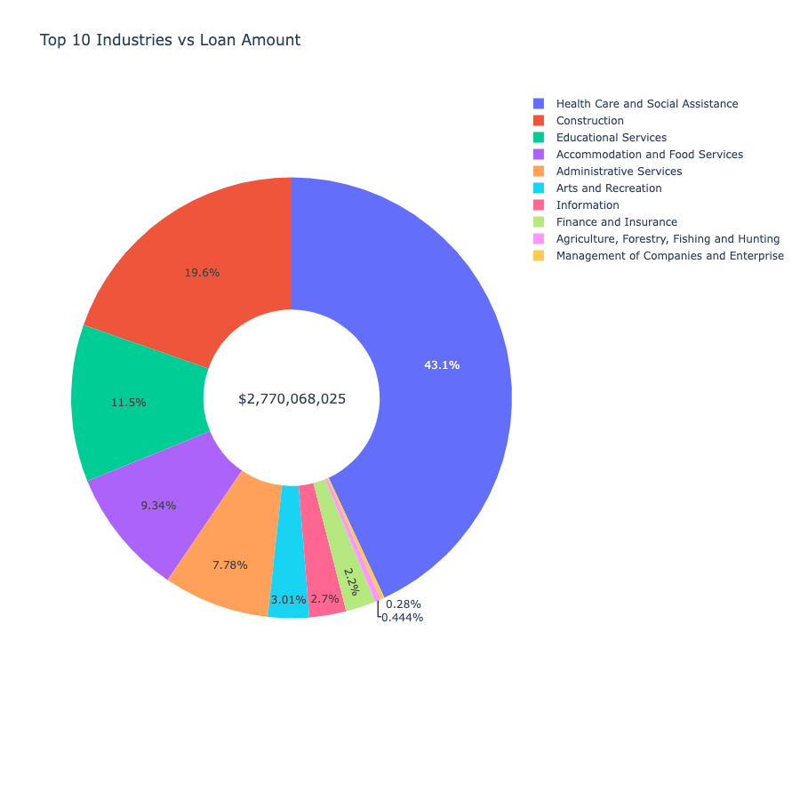
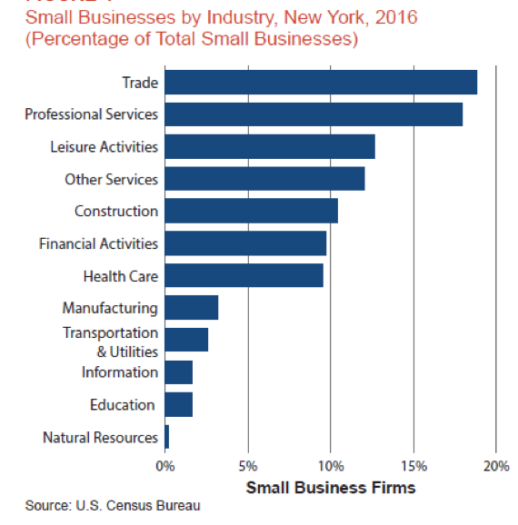
PPP: Tracking and analyzing private loans distribution to small businesses in NYC
Notes:
A total of $2,77B with an avg. loan amount of $129,780 distributed among 21,345 small businesses to cover a total of 266,554 jobs
while the total private loan funds for NY State were $38.5b distributed among 344,758 small businesses with an avg loan amount of $111,858 for the 3.2mm jobs reported
Census total jobs in NY State 2,266,451 (2018)

Slide 4
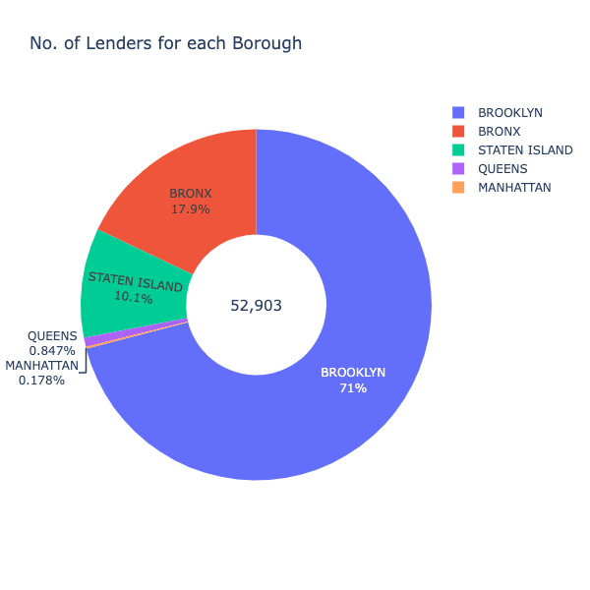

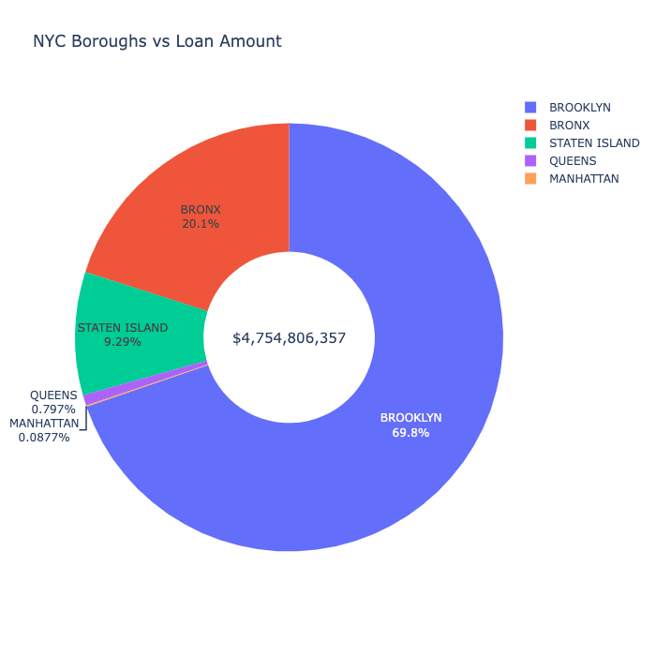
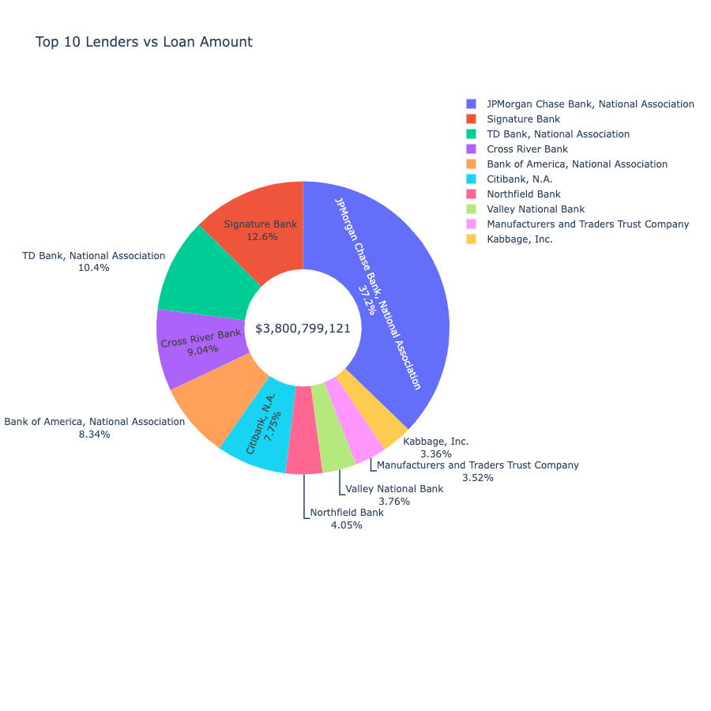
PPP: Tracking and analyzing private loans distribution to small businesses in NYC
Notes:
The total amount for the top 10 lenders was 3.8B, which covers around 81% of the total loan portfolio ($4.7B) leaving all of the other banks with just 19%, of the pie, the average amount ~80,283k, distributed among 35,182 small businesses to cover roughly 261,883 jobs

Slide 5
PPP: Tracking and analyzing private loans distribution to small businesses in NYC

Slide 6
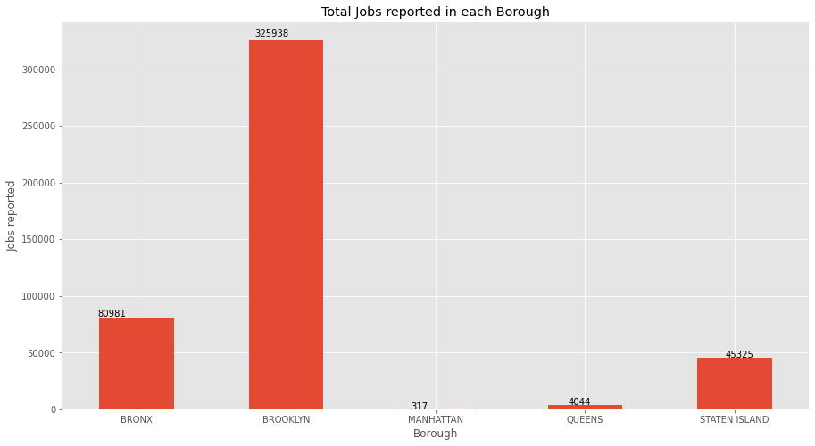
PPP: Tracking and analyzing private loans distribution to small businesses in NYC
Notes:
A total of $4.7 billions with an avg. loan amount of $89,877 distributed among 52,905 small businesses in the 5 boroughs covering a total 465,605 jobs

Slide 7
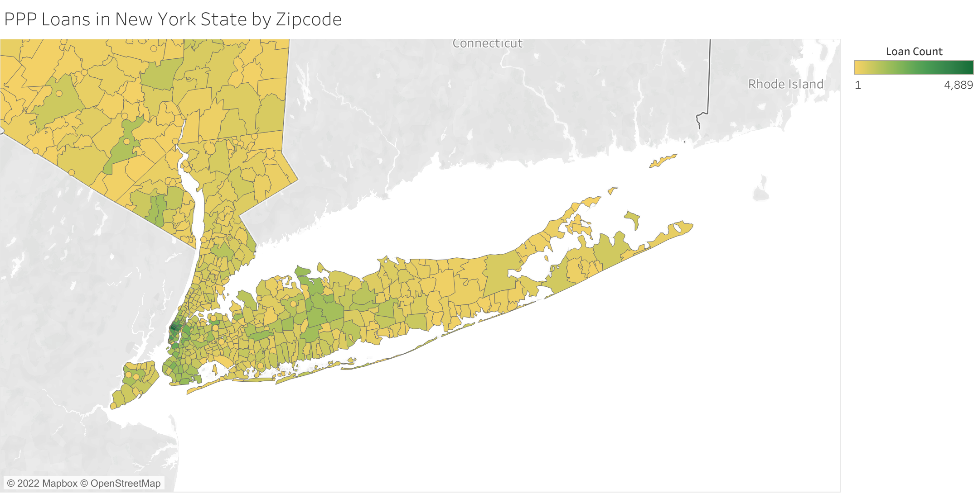
PPP: Tracking and analyzing private loans distribution to small businesses in NYC
Notes:
New York City small businesses account for approximately 220,000 small businesses generating of over 3 million jobs as up today.
A total of $4.7 billions was lent to small businesses with an avg. loan amount of $89,877 distributed among 52,905 small businesses covering a total 465,605 jobs.
Brooklyn Demographics
At the 2010 Census, the racial and ethnic breakdown of Brooklyn was:
White: 49.5% (non-Hispanic: 35.8%)
African American: 35.8%
Asian: 11.3%
Native American: 1.0%
Native Hawaiian and Pacific Islander: 0.1%
Two or more races: 2.2%
Other races: 8.9%
Hispanic or Latino of any race: 19.8%

Slide 8
PPP: Tracking and analyzing private loans distribution to small businesses in NYC
Conclusion and lessons learned
1
Demographic data
2
Focus on underserved borrowers and lenders
3
Provide TA for SBs
4
Assess PPP's impact on SBs and economy recovery
Notes:
1. A simple but critical improvement is the requirement that lenders request additional data already required for other SBA loans, including gender, race, ethnicity and veteran status for equity purposes
2. Earmarks of funds may lead to greater diversity among borrowers, and to an increase in the level at which smaller businesses participate.
3. Given small businesses don’t have accounting departments or government liaisons in place, it is important that efforts be made to reach out to these businesses to help them understand not only that the PPP exists, but also how to navigate its application process and the requirements for loan forgiveness.
4. It is imperative assess SBA's impact on SBs and economic recovery to measure how effective PPP was as a policy.

Slide 9
Paycheck protection program(ppp): Tracking and analyzing private loans distribution Among small businesses in nyc
PAI 789 – Advanced Policy Analysis Ulises Sepulveda
Prof. Wilcoxen 04/27/2022
Q & A?
Thank you!

