Slide 1
大模型结构图

Slide 2
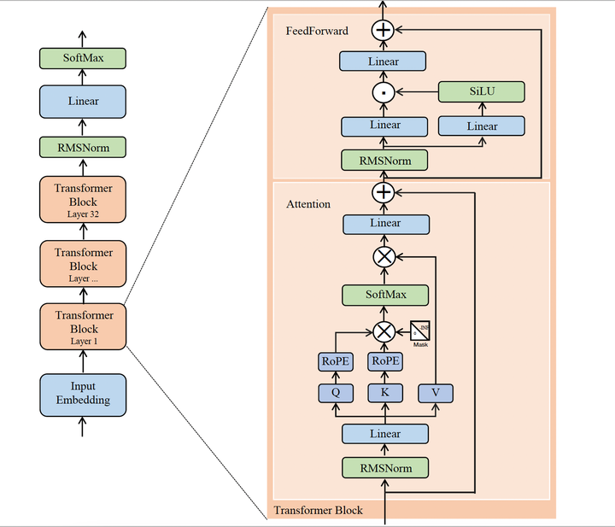
llama

Slide 3
baichuan13B
FeedForward
Linear
ACT2FN
Linear
Linear
Linear
RMSNorm
RMSNorm
Attention
Linear
32 x
Decoder
Block
softmax
Input
Embeding
alibi mask
KV_cache
Q
K
V
Linear
RMSNorm

Slide 4
Chatglm2
FeedForward
Linear
RMSNorm
Linear
Attention
RMSNorm
Linear
32 x
Decoder
Block
softmax
mask
Input
Embeding
RoPE
RoPE
KV_cache
Q
K
V
Linear
RMSNorm

