Slide 1
Digital domain (L1 or L2)
Client mapping/mux/switch
Out of scope
digital section layer? (OTUk, OTUCn, ODUCn)
In scope
Inverse multiplexing
FEC
FEC
line-coding
Digital domain (L0.5)
OTSi
OTSi
Optical domain (L0)

Slide 2
10x10GE
…
MXP
3R
MXP
…
10x10GE
OTSiG/MCG
OTSiG/MCG
Optical Tunnel
Client Signal
100G
100G

Slide 3
Transponders @100G

Slide 4
Transponder @200G

Slide 5
Muxponder @200G

Slide 6
Open ZR+ Muxponder
Is it based on OTN: NO, multiplexing is based on direct time division with alignment marker that follow 802.3 100G specification (Clause 91.5.2 Figure 91-4)
Open ZR+ MSA: https://www.openzrplus.org/site/assets/files/1096/openzrplus_rev3p0_final2.pdf
Framing definition at section 3: Directly derived from OIF 400ZR frame
Payload Mapping at section 4: using GMP mapping for the Ethernet client
Multiplexing at section 5: “Multiplexing of 100G and 200G clients into the ZR400 frame, illustrated in Figure 5-1, is performed using simple time division multiplexing of the 257-bit blocks in the ZR payload. A ZR400 frame has four sets of overhead (OH) available in the first row to support multiplexing of GMP for up to four clients. There are 10220 257-bit blocks in a ZR400 frame. This number is divisible by both 4 and 2. Row 1 has 20 blocks, while all other rows have 40 blocks. The ZR400 stuffing location uses some number of consecutive 257-bit blocks based upon ZR400 rate as shown in Table 4-1. The ZR400 frame has 4 unique OH chunks of 40 bytes. The GMP six justification control bytes are distributed inside the OH using four consecutive frames. There are two GMP values processed during the 8-frame ZR400 multi-frame”
The multiplexing should be compatible with Flex-O-xe defined in G.709.1 and used in oif2017.490.05 (OIF 400ZR Frame Definition)

Slide 7
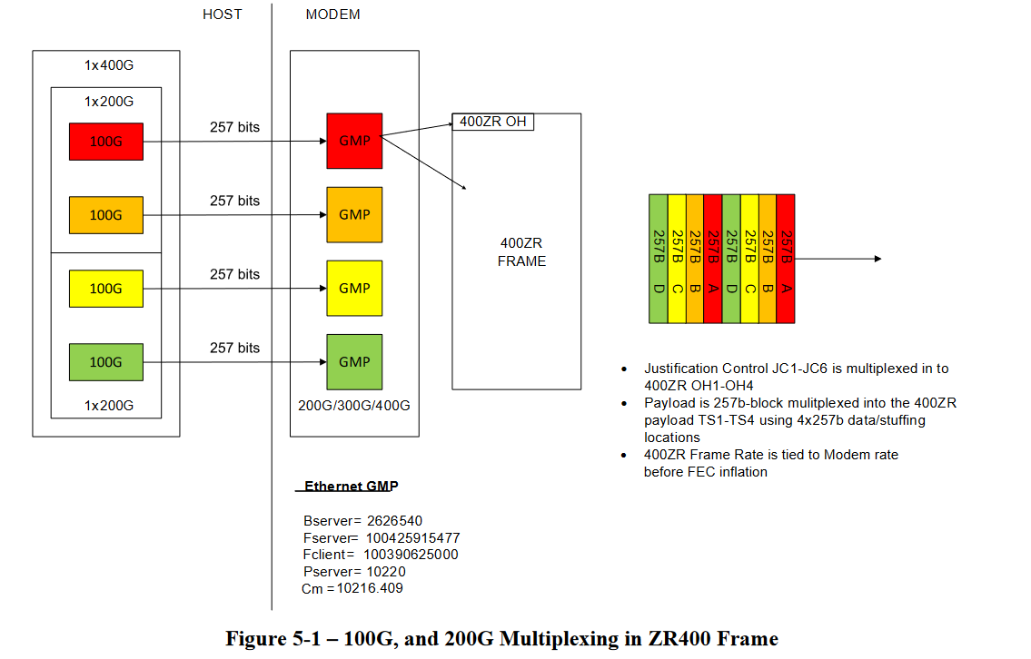
Open ZR+ Multiplexing example (from MSA)

Slide 8
ZR/ZR+ Transponders @400G FEC type: CFEC for ZR, OFEC for ZR+
(
Optical Specification
A
)
or
(
B
(
)
F
)
(
D
)
(
C
)
(
Application Code
)
λ
@
400
G
(
1
400
GE
)
GMP
FlexO-4-e
FEC
Pol. split
OTSi

Slide 9
ZR+ Transponders @100G
(
Optical Specification
A
)
or
(
B
(
)
F
)
(
D
)
(
C
)
(
Application Code
)
λ
@
100
G
(
1
100
GE
)
GMP
FlexO-1-e
OFEC
Pol. split
OTSi

Slide 10
ZR/ZR+ 4x100GE Muxponders @400G
(
Optical Specification
A
)
or
(
B
(
)
F
)
(
D
)
(
C
)
(
Application Code
)
100
GE
GMP
FlexO-1
100
GE
GMP
FlexO-1
λ
@
400
G
(
1
Interliver Multiplexing
)
OFEC
Pol. split
OTSi
100
GE
GMP
FlexO-1
100
GE
GMP
FlexO-1

