Slide 1
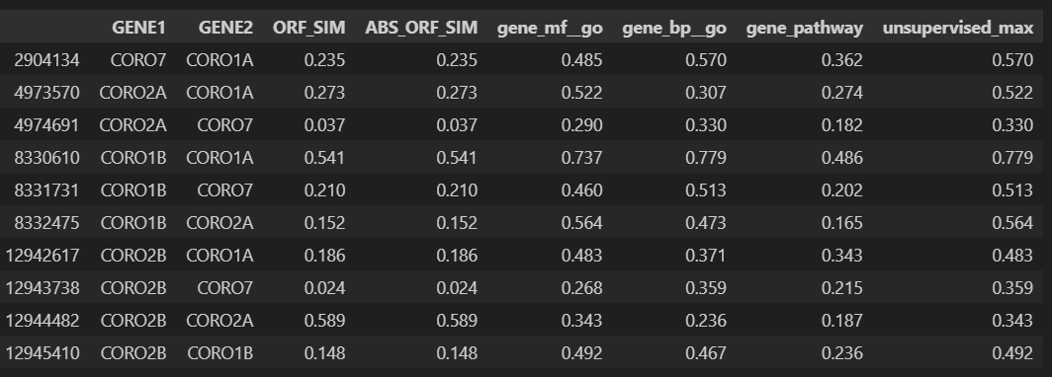
KG scores
For all studied pairs
CORO2A/B, VGLL3/4, CNN1/2
despite possible structural similarity, the genes are not involved in common pathways or specific GOs, and do not interact in STRING DB, have weak co-citation, especially before 2020 (see slides below). Their functions are either badly studies or they have significant specialization within the common family in terms of gene function.
Eg: Both CORO2A and CORO2B can bind to actin, a key component of the cytoskeleton, and are involved in actin filament dynamics. This is a common feature of coronin family proteins. Apart from its cytoskeletal role, CORO2A is known to be involved in transcriptional regulation. CORO2B does not have a well-established role in transcriptional regulation. Its functions are more restricted to cytoskeletal dynamics. CORO2A is expressed in various tissues, while CORO2B has a more limited expression pattern, primarily in neurons. CORO2A and CORO2B share only ‘actin binding’ GO MF which is not very specific (contains>500 members)

Slide 2
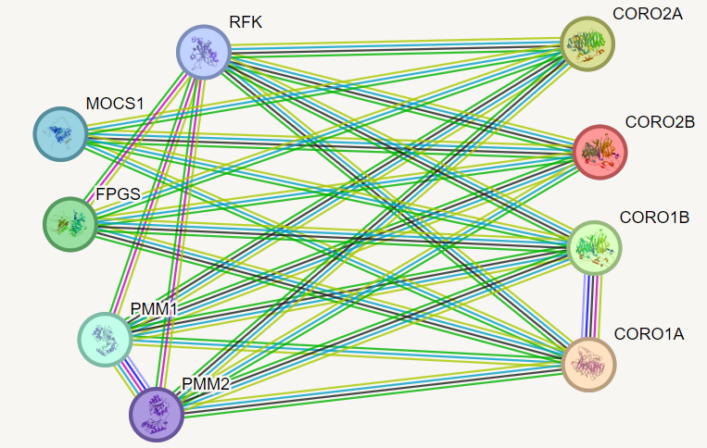
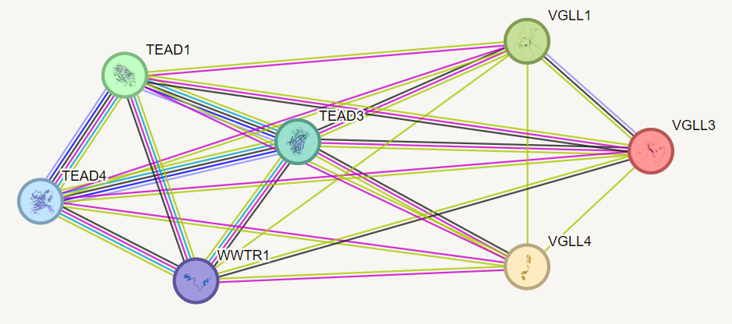
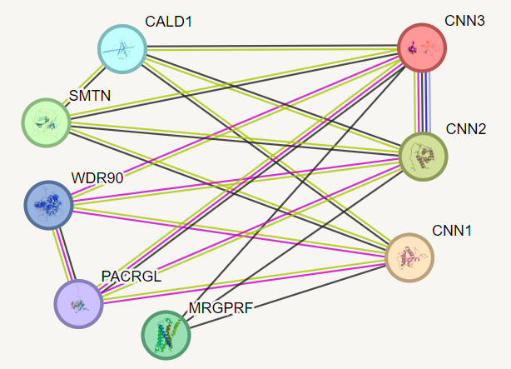
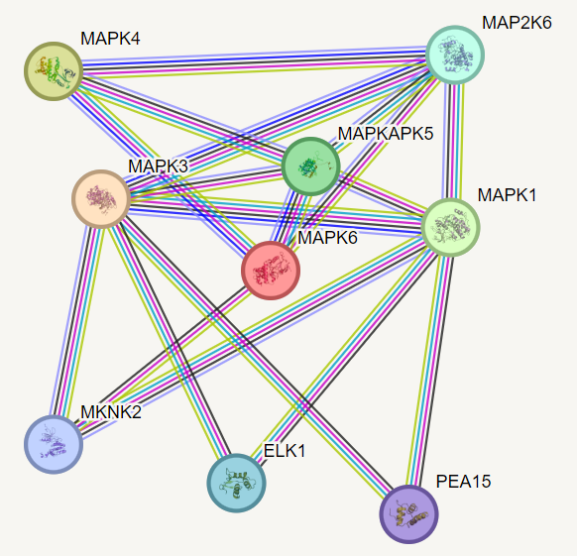
String DB
For example, contrast with

Slide 3
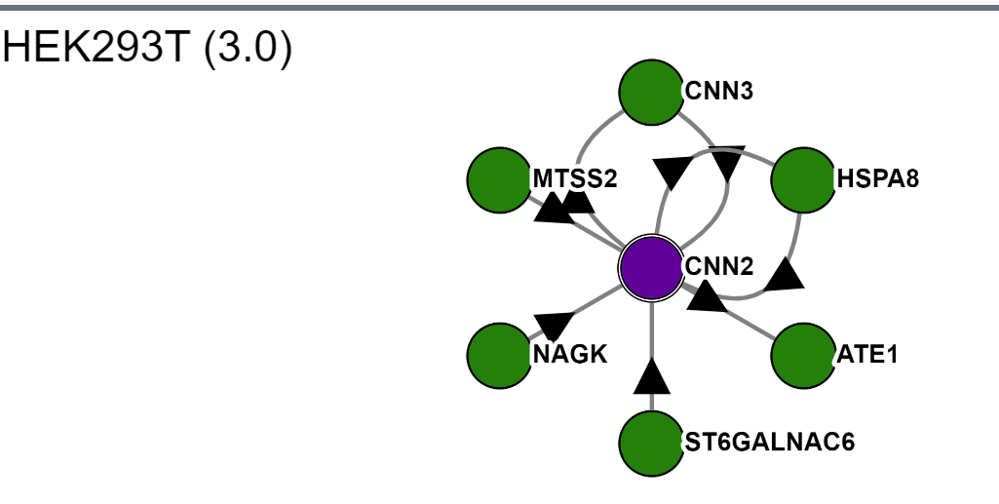
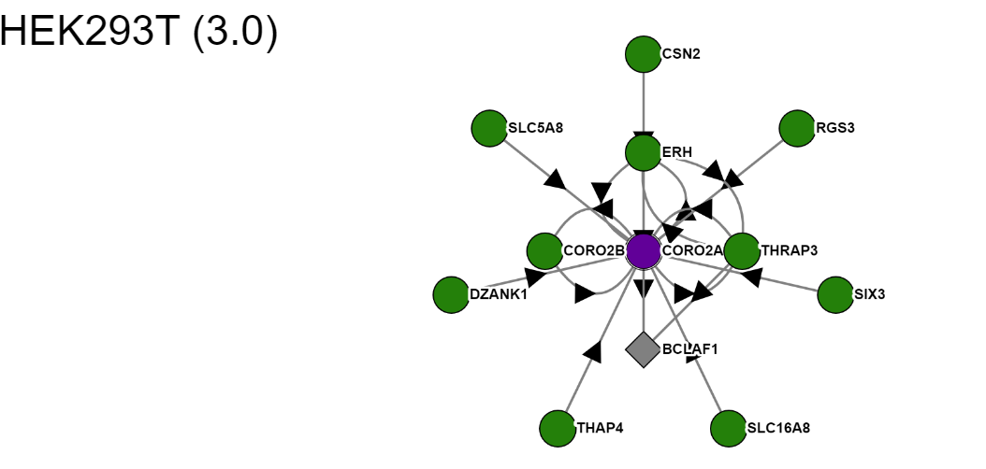
Bioplex 2.0 interaction data
https://bioplex.hms.harvard.edu/explorer/network.php

Slide 4
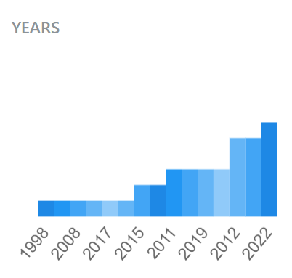
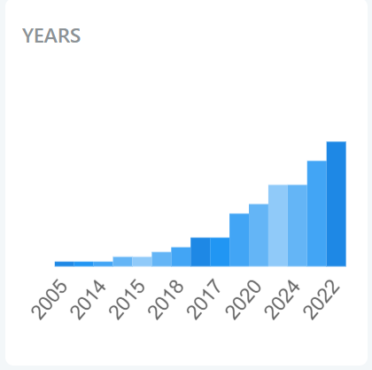
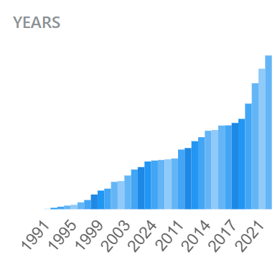
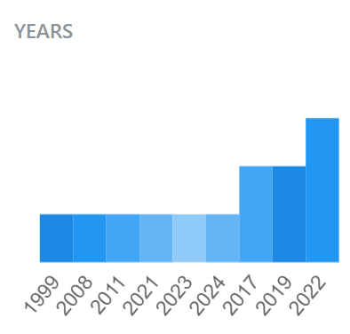
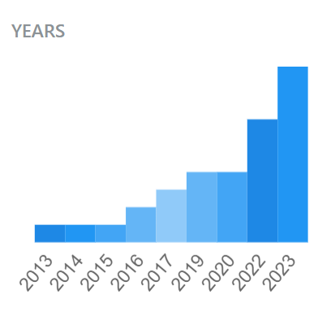
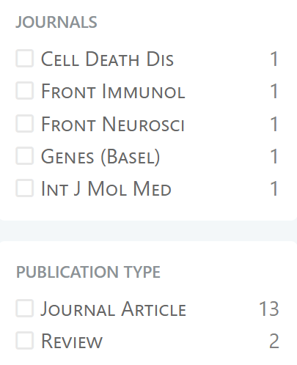
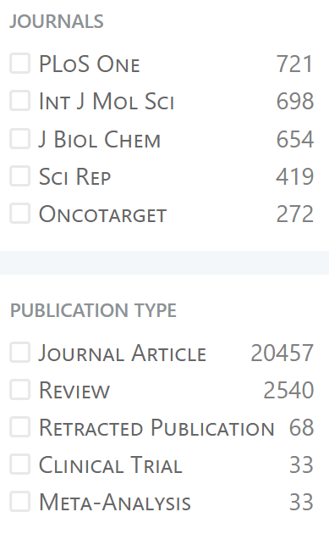
Pubtator
https://www.ncbi.nlm.nih.gov/research/pubtator3/docsum?text=@GENE_CNN1%20@GENE_CNN2%20
https://www.ncbi.nlm.nih.gov/research/pubtator3/docsum?text=@GENE_VGLL3%20@GENE_VGLL4%20
https://www.ncbi.nlm.nih.gov/research/pubtator3/docsum?text=@GENE_CORO2A%20@GENE_CORO2B%20
CNN1/2
CORO2A/CORO2B
VGLL3/4
MAPK1/3
CORO1A/CORO1B
132 publications
13 publications
33 publications
38 publications
20582 publications
Heavily confounded with CNN abbreviation

Slide 5
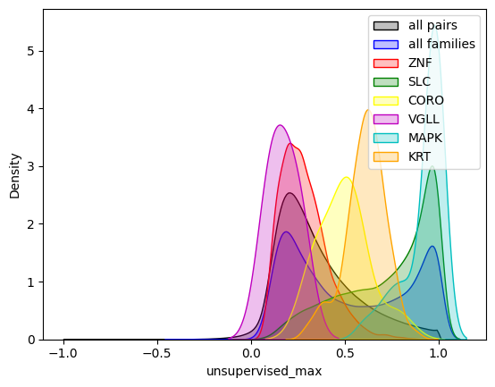
Global family analysis
To define pairs of genes belonging to the same family, we used the following rule
Two genes must have at least first three first letters identical
Those ending letters that are different must be either numerical or A,B,C,D,E,F,G,H
38102 pairs have been identified in the merged scores table based on ORF_SIM scores (denoted as ‘all families’ in the plot)
The label on the plot denotes the common prefix for a gene family
CNN1/2 is not shown (only one pair of genes in the table, the score is 0.31)

