Slide 1
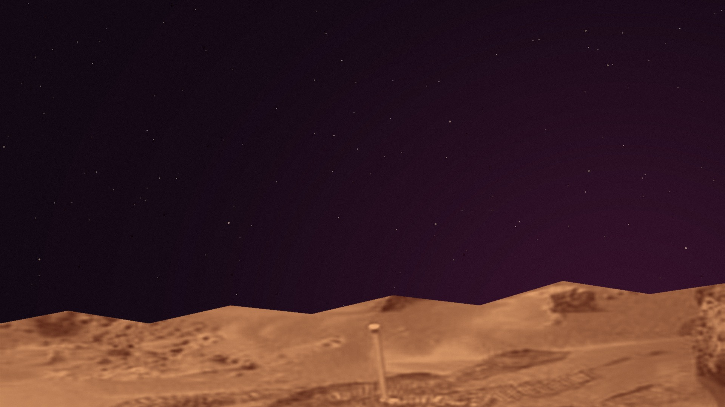
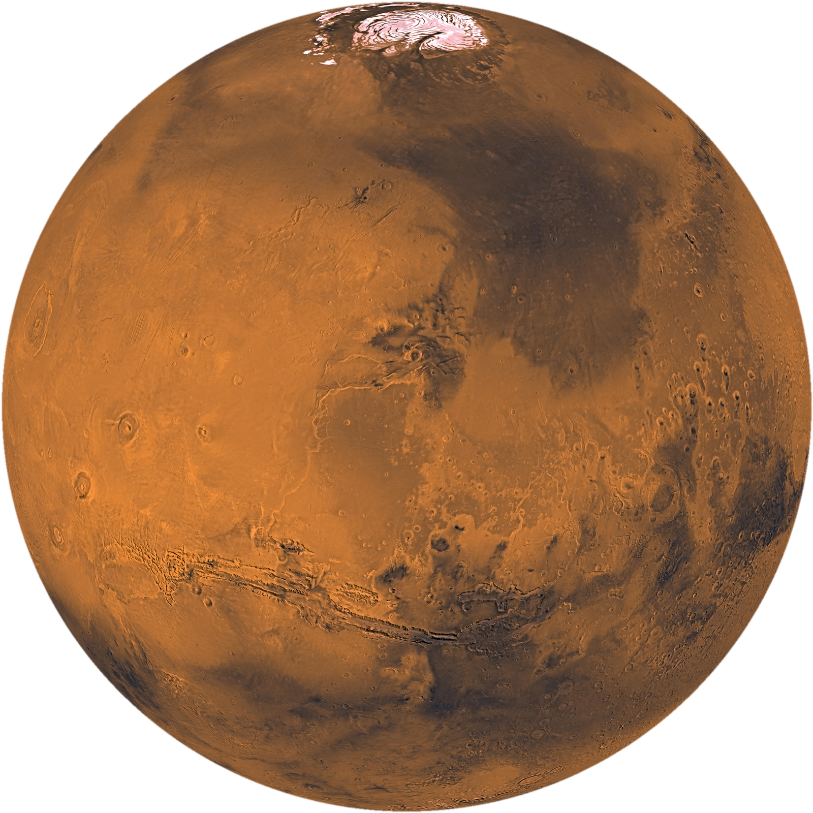

A JOURNEY TO MARS
BLUE
IMPULSE
SOJOURNER
Notes:
VISUAL STRUCTURE ONLY — follow stage2-slide-outline.md.
Opening title. The rocket is an original illustration; the planets are NASA photographs.
Keep all slide text at 28 pt or larger. Titles: Horizon. Body: Quicksand.
NASA sources and the artwork process are listed in stage2-sojourner/README.md.

Slide 2

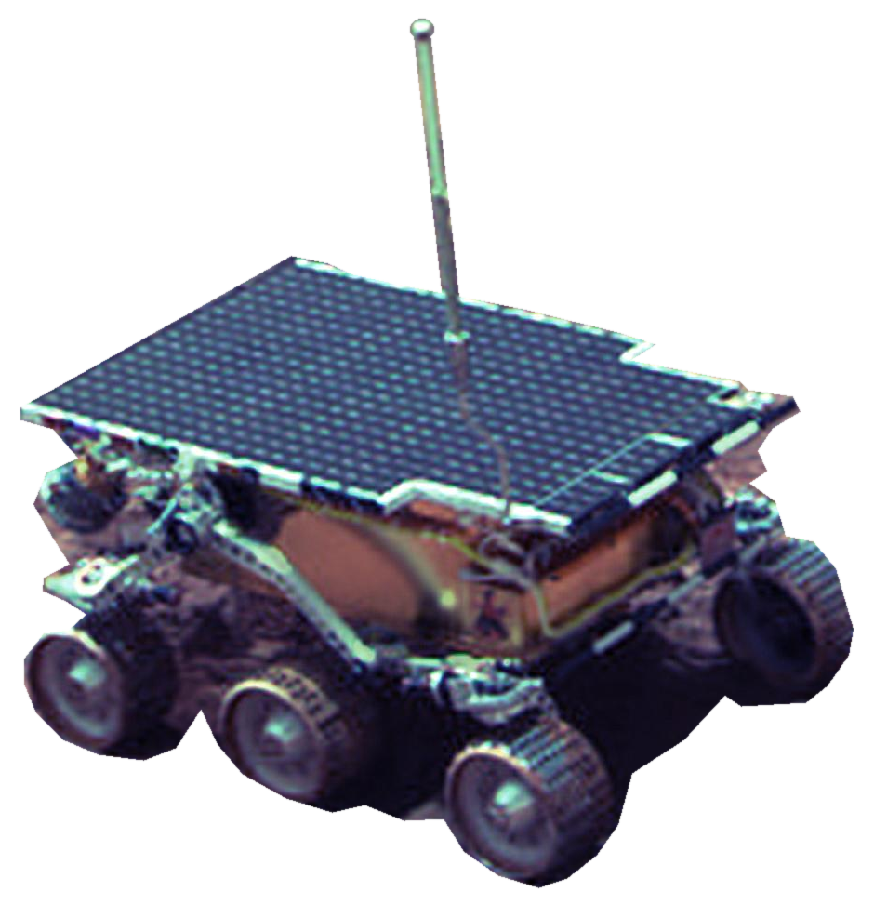
OUR MISSION
MEET
SOJOURNER
Hardware
Networks
Behaviorist AI
02
Notes:
VISUAL STRUCTURE ONLY — follow stage2-slide-outline.md.
Introduce Sojourner and its connection to the three chapter topics. Leave detailed claims for the next content pass.
Keep all slide text at 28 pt or larger. Titles: Horizon. Body: Quicksand.
NASA sources and the artwork process are listed in stage2-sojourner/README.md.

Slide 3
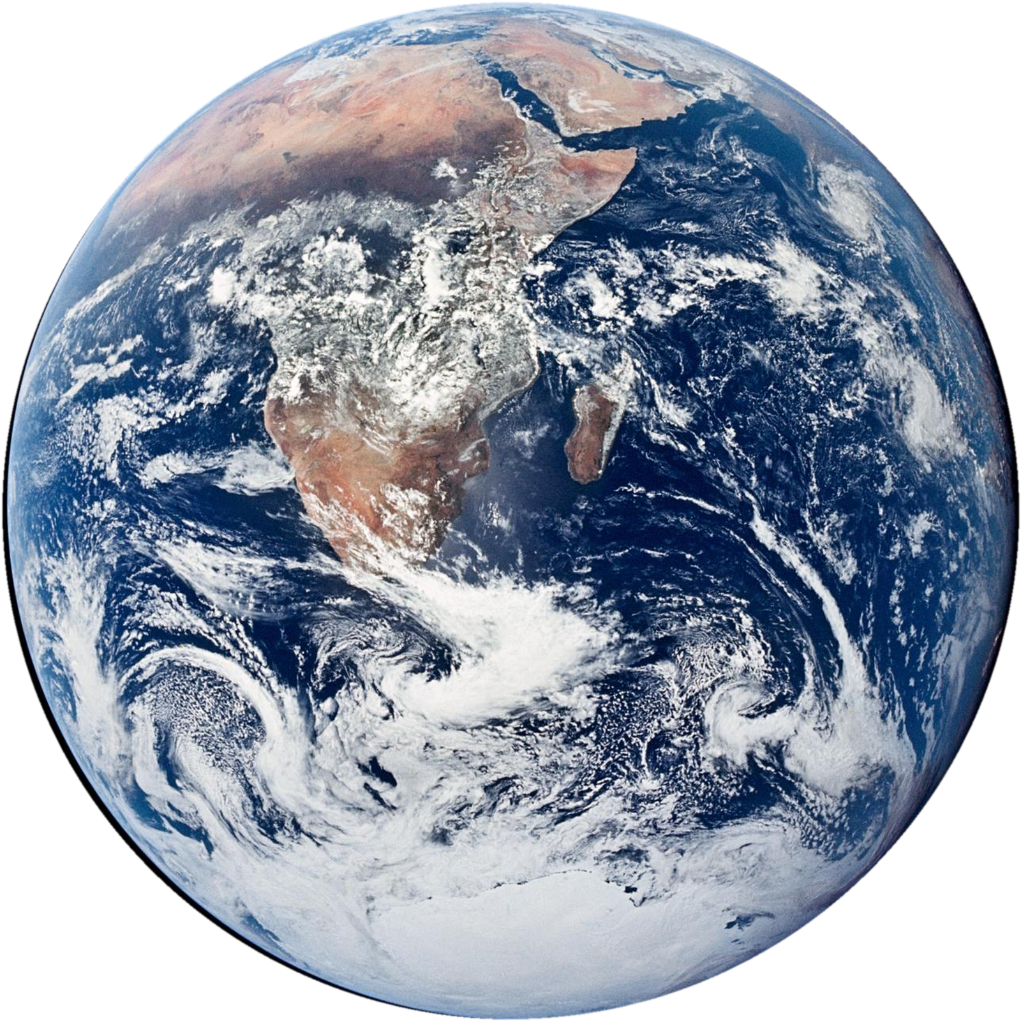
MISSION / OUTBOUND
LEAVING EARTH
EARTH
MARS
03
Notes:
VISUAL STRUCTURE ONLY — follow stage2-slide-outline.md.
Symbolic rocket journey, not a historical reconstruction of Pathfinder. Sojourner did not return to Earth. Advance through the adjacent slides in desktop PowerPoint to play the matched-object Morph movement.
Keep all slide text at 28 pt or larger. Titles: Horizon. Body: Quicksand.
NASA sources and the artwork process are listed in stage2-sojourner/README.md.

Slide 4
MISSION / OUTBOUND
NEXT STOP: MARS
EARTH
MARS
04
Notes:
VISUAL STRUCTURE ONLY — follow stage2-slide-outline.md.
Symbolic rocket journey, not a historical reconstruction of Pathfinder. Sojourner did not return to Earth. Advance through the adjacent slides in desktop PowerPoint to play the matched-object Morph movement.
Keep all slide text at 28 pt or larger. Titles: Horizon. Body: Quicksand.
NASA sources and the artwork process are listed in stage2-sojourner/README.md.

Slide 5
MISSION / OUTBOUND
TOUCHDOWN
EARTH
MARS
05
Notes:
VISUAL STRUCTURE ONLY — follow stage2-slide-outline.md.
Symbolic rocket journey, not a historical reconstruction of Pathfinder. Sojourner did not return to Earth. Advance through the adjacent slides in desktop PowerPoint to play the matched-object Morph movement.
Keep all slide text at 28 pt or larger. Titles: Horizon. Body: Quicksand.
NASA sources and the artwork process are listed in stage2-sojourner/README.md.

Slide 6

01 / HARDWARE
WHAT MAKES
SOJOURNER
01
WORK?
06
Notes:
VISUAL STRUCTURE ONLY — follow stage2-slide-outline.md.
Chapter divider. No explanatory content is included.
Keep all slide text at 28 pt or larger. Titles: Horizon. Body: Quicksand.
NASA sources and the artwork process are listed in stage2-sojourner/README.md.

Slide 7
01 / HARDWARE
THE
ROVER
SOJOURNER’S OVERALL BODY
07
Notes:
VISUAL STRUCTURE ONLY — follow stage2-slide-outline.md.
Leave the lower-left text area empty for the team to add content.
Keep all slide text at 28 pt or larger. Titles: Horizon. Body: Quicksand.
NASA sources and the artwork process are listed in stage2-sojourner/README.md.

Slide 8
01 / HARDWARE
COLLECTING
INFORMATION
08
Notes:
VISUAL STRUCTURE ONLY — follow stage2-slide-outline.md.
Leave the lower-left text area empty for the team to add content.
Keep all slide text at 28 pt or larger. Titles: Horizon. Body: Quicksand.
NASA sources and the artwork process are listed in stage2-sojourner/README.md.

Slide 9
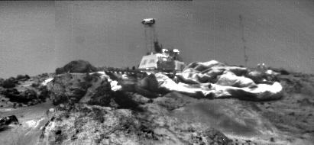
01 / HARDWARE
MEET THE
LANDER
09
Notes:
VISUAL STRUCTURE ONLY — follow stage2-slide-outline.md.
Leave the lower-left text area empty for the team to add content.
Keep all slide text at 28 pt or larger. Titles: Horizon. Body: Quicksand.
NASA sources and the artwork process are listed in stage2-sojourner/README.md.

Slide 10
01 / HARDWARE
LANDER
HARDWARE
Stereoscopic camera
IMP filters
ASI / MET
10
Notes:
VISUAL STRUCTURE ONLY — follow stage2-slide-outline.md.
The three instrument headings come directly from the outline. Do not add specifications yet.
Keep all slide text at 28 pt or larger. Titles: Horizon. Body: Quicksand.
NASA sources and the artwork process are listed in stage2-sojourner/README.md.

Slide 11
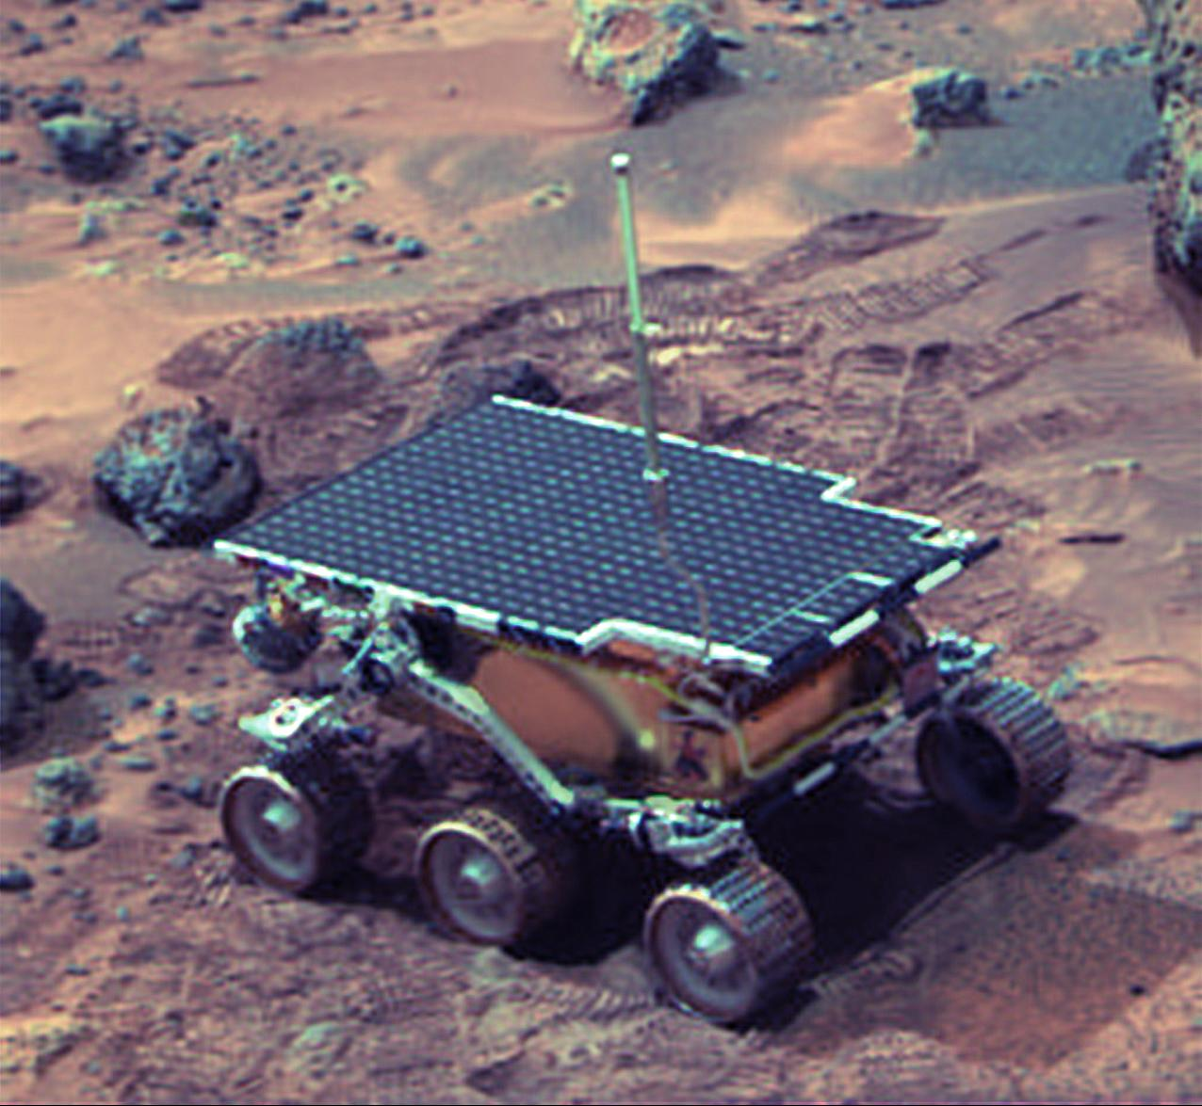
01 / HARDWARE
CAMERAS
11
Notes:
VISUAL STRUCTURE ONLY — follow stage2-slide-outline.md.
Leave the lower-left text area empty for the team to add content.
Keep all slide text at 28 pt or larger. Titles: Horizon. Body: Quicksand.
NASA sources and the artwork process are listed in stage2-sojourner/README.md.

Slide 12
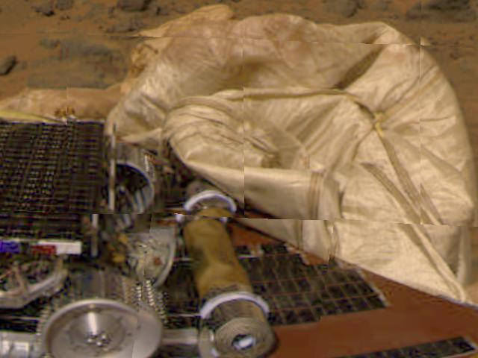
01 / HARDWARE
AT THE
REAR
APXS
12
Notes:
VISUAL STRUCTURE ONLY — follow stage2-slide-outline.md.
Leave the lower-left text area empty for the team to add content.
Keep all slide text at 28 pt or larger. Titles: Horizon. Body: Quicksand.
NASA sources and the artwork process are listed in stage2-sojourner/README.md.

Slide 13
01 / HARDWARE
WHEELS
AT WORK
WHEEL ABRASION EXPERIMENT
13
Notes:
VISUAL STRUCTURE ONLY — follow stage2-slide-outline.md.
Leave the lower-left text area empty for the team to add content.
Keep all slide text at 28 pt or larger. Titles: Horizon. Body: Quicksand.
NASA sources and the artwork process are listed in stage2-sojourner/README.md.

Slide 14
01 / HARDWARE
ANTENNA
+ UHF RADIO
14
Notes:
VISUAL STRUCTURE ONLY — follow stage2-slide-outline.md.
Leave the lower-left text area empty for the team to add content.
Keep all slide text at 28 pt or larger. Titles: Horizon. Body: Quicksand.
NASA sources and the artwork process are listed in stage2-sojourner/README.md.

Slide 15
02 / NETWORKS
HOW DOES
SOJOURNER
02
COMMUNICATE?
15
Notes:
VISUAL STRUCTURE ONLY — follow stage2-slide-outline.md.
Chapter divider. No explanatory content is included.
Keep all slide text at 28 pt or larger. Titles: Horizon. Body: Quicksand.
NASA sources and the artwork process are listed in stage2-sojourner/README.md.

Slide 16
02 / NETWORKS
THE CONNECTION
EARTH
LANDER
SOJOURNER
16
Notes:
VISUAL STRUCTURE ONLY — follow stage2-slide-outline.md.
Communication-path structure only. Future explanatory text belongs in the notes or the blank area, at 28 pt or larger.
Keep all slide text at 28 pt or larger. Titles: Horizon. Body: Quicksand.
NASA sources and the artwork process are listed in stage2-sojourner/README.md.

Slide 17
02 / NETWORKS
EARTH TO
1 / 2
SOJOURNER
EARTH
LANDER
SOJOURNER
17
Notes:
VISUAL STRUCTURE ONLY — follow stage2-slide-outline.md.
Part 1 of a two-slide communication sequence. The moving point is a visual cue only; add transmission details later.
Keep all slide text at 28 pt or larger. Titles: Horizon. Body: Quicksand.
NASA sources and the artwork process are listed in stage2-sojourner/README.md.

Slide 18
02 / NETWORKS
EARTH TO
2 / 2
SOJOURNER
EARTH
LANDER
SOJOURNER
18
Notes:
VISUAL STRUCTURE ONLY — follow stage2-slide-outline.md.
Part 2 of a two-slide communication sequence. The moving point is a visual cue only; add transmission details later.
Keep all slide text at 28 pt or larger. Titles: Horizon. Body: Quicksand.
NASA sources and the artwork process are listed in stage2-sojourner/README.md.

Slide 19
02 / NETWORKS
SOJOURNER TO
1 / 2
EARTH
EARTH
LANDER
SOJOURNER
19
Notes:
VISUAL STRUCTURE ONLY — follow stage2-slide-outline.md.
Part 1 of a two-slide communication sequence. The moving point is a visual cue only; add transmission details later.
Keep all slide text at 28 pt or larger. Titles: Horizon. Body: Quicksand.
NASA sources and the artwork process are listed in stage2-sojourner/README.md.

Slide 20
02 / NETWORKS
SOJOURNER TO
2 / 2
EARTH
EARTH
LANDER
SOJOURNER
20
Notes:
VISUAL STRUCTURE ONLY — follow stage2-slide-outline.md.
Part 2 of a two-slide communication sequence. The moving point is a visual cue only; add transmission details later.
Keep all slide text at 28 pt or larger. Titles: Horizon. Body: Quicksand.
NASA sources and the artwork process are listed in stage2-sojourner/README.md.

Slide 21
02 / NETWORKS
THE
UHF LINK
21
Notes:
VISUAL STRUCTURE ONLY — follow stage2-slide-outline.md.
Leave the lower-left text area empty for the team to add content.
Keep all slide text at 28 pt or larger. Titles: Horizon. Body: Quicksand.
NASA sources and the artwork process are listed in stage2-sojourner/README.md.

Slide 22
02 / NETWORKS
HALF-
DUPLEX
22
Notes:
VISUAL STRUCTURE ONLY — follow stage2-slide-outline.md.
Two directional visual lanes. Leave detailed explanation blank.
Keep all slide text at 28 pt or larger. Titles: Horizon. Body: Quicksand.
NASA sources and the artwork process are listed in stage2-sojourner/README.md.

Slide 23
02 / NETWORKS
STILL
CONNECTED?
HEARTBEAT & COMMUNICATION CHECKS
23
Notes:
VISUAL STRUCTURE ONLY — follow stage2-slide-outline.md.
Heartbeat motif only. The intended checks and details remain to be added.
Keep all slide text at 28 pt or larger. Titles: Horizon. Body: Quicksand.
NASA sources and the artwork process are listed in stage2-sojourner/README.md.

Slide 24
02 / NETWORKS
WORKING
WITH LIMITS
MEMORY / COMMUNICATION
24
Notes:
VISUAL STRUCTURE ONLY — follow stage2-slide-outline.md.
Leave the lower-left text area empty for the team to add content.
Keep all slide text at 28 pt or larger. Titles: Horizon. Body: Quicksand.
NASA sources and the artwork process are listed in stage2-sojourner/README.md.

Slide 25
02 / NETWORKS
WHEN TO
DECIDE
25
Notes:
VISUAL STRUCTURE ONLY — follow stage2-slide-outline.md.
Transition into the behaviorist-AI discussion. Do not assert that Sojourner used reinforcement learning.
Keep all slide text at 28 pt or larger. Titles: Horizon. Body: Quicksand.
NASA sources and the artwork process are listed in stage2-sojourner/README.md.

Slide 26
03 / BEHAVIORIST AI
HOW
SOJOURNER
03
DECIDES
26
Notes:
VISUAL STRUCTURE ONLY — follow stage2-slide-outline.md.
Chapter divider. No explanatory content is included.
Keep all slide text at 28 pt or larger. Titles: Horizon. Body: Quicksand.
NASA sources and the artwork process are listed in stage2-sojourner/README.md.

Slide 27
03 / BEHAVIORIST AI
CAN SOJOURNER BE AN EXAMPLE?
BEHAVIORIST
AI?
27
Notes:
VISUAL STRUCTURE ONLY — follow stage2-slide-outline.md.
This is deliberately a question, not an assertion that Sojourner learned using reinforcement learning.
Keep all slide text at 28 pt or larger. Titles: Horizon. Body: Quicksand.
NASA sources and the artwork process are listed in stage2-sojourner/README.md.

Slide 28
THE ARGUMENT
SAFA
NAZIF
vs
28
Notes:
VISUAL STRUCTURE ONLY — follow stage2-slide-outline.md.
Introduce Safa and Nazif’s argument, points and claims. The two text areas are intentionally empty. No position has been invented for either person.
Keep all slide text at 28 pt or larger. Titles: Horizon. Body: Quicksand.
NASA sources and the artwork process are listed in stage2-sojourner/README.md.

Slide 29
03 / BEHAVIORIST AI
STIMULUS
1 / 2
RESPONSE
29
Notes:
VISUAL STRUCTURE ONLY — follow stage2-slide-outline.md.
Leave the stimulus and response examples blank for the content pass.
Keep all slide text at 28 pt or larger. Titles: Horizon. Body: Quicksand.
NASA sources and the artwork process are listed in stage2-sojourner/README.md.

Slide 30
03 / BEHAVIORIST AI
STIMULUS
2 / 2
RESPONSE
30
Notes:
VISUAL STRUCTURE ONLY — follow stage2-slide-outline.md.
Leave the stimulus and response examples blank for the content pass.
Keep all slide text at 28 pt or larger. Titles: Horizon. Body: Quicksand.
NASA sources and the artwork process are listed in stage2-sojourner/README.md.

Slide 31
03 / BEHAVIORIST AI
WATCH IT HAPPEN
31
Notes:
VISUAL STRUCTURE ONLY — follow stage2-slide-outline.md.
Video placeholder only. No video has been fabricated or embedded. Replace the empty video frame with the selected real rover clip.
Keep all slide text at 28 pt or larger. Titles: Horizon. Body: Quicksand.
NASA sources and the artwork process are listed in stage2-sojourner/README.md.

Slide 32
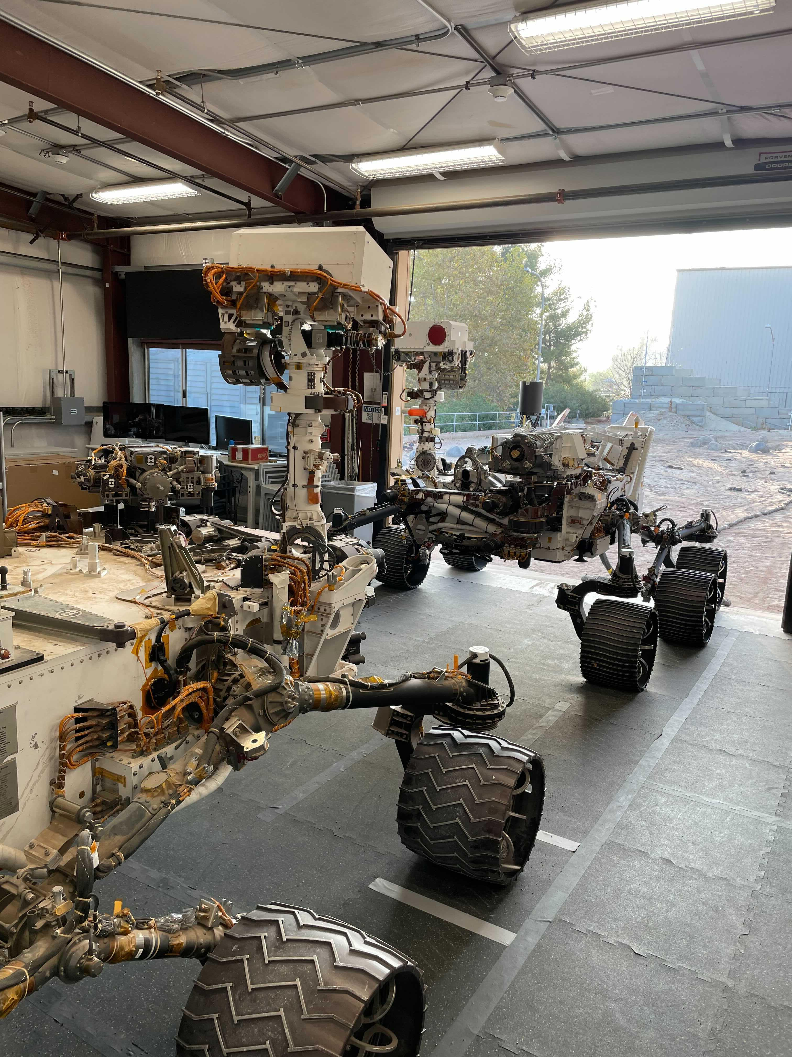
03 / BEHAVIORIST AI
WHY
SOJOURNER?
Curiosity
Perseverance
32
Notes:
VISUAL STRUCTURE ONLY — follow stage2-slide-outline.md.
Comparison headings only. The right-side NASA photo shows engineering models of Curiosity and Perseverance, not Sojourner. Do not add comparative claims yet.
Keep all slide text at 28 pt or larger. Titles: Horizon. Body: Quicksand.
NASA sources and the artwork process are listed in stage2-sojourner/README.md.

Slide 33
CONCLUSION
ONE CONNECTED
SYSTEM
INPUT
PROCESS
OUTPUT
NETWORKING
DECISION MAKING
33
Notes:
VISUAL STRUCTURE ONLY — follow stage2-slide-outline.md.
Structural integration diagram: Input → Process → Output, with Networking and Decision Making. The arrows are organisational scaffolding, not a detailed architecture.
Keep all slide text at 28 pt or larger. Titles: Horizon. Body: Quicksand.
NASA sources and the artwork process are listed in stage2-sojourner/README.md.

Slide 34
YOUR TURN
GAME
34
Notes:
VISUAL STRUCTURE ONLY — follow stage2-slide-outline.md.
Intentionally blank game slide. Add the game only after its content is agreed.
Keep all slide text at 28 pt or larger. Titles: Horizon. Body: Quicksand.
NASA sources and the artwork process are listed in stage2-sojourner/README.md.

Slide 35
MISSION / RETURN
HOMEWARD BOUND
MARS
EARTH
35
Notes:
VISUAL STRUCTURE ONLY — follow stage2-slide-outline.md.
Symbolic rocket journey, not a historical reconstruction of Pathfinder. Sojourner did not return to Earth. Advance through the adjacent slides in desktop PowerPoint to play the matched-object Morph movement.
Keep all slide text at 28 pt or larger. Titles: Horizon. Body: Quicksand.
NASA sources and the artwork process are listed in stage2-sojourner/README.md.

Slide 36
MISSION / RETURN
BACK TO EARTH
MARS
EARTH
36
Notes:
VISUAL STRUCTURE ONLY — follow stage2-slide-outline.md.
Symbolic rocket journey, not a historical reconstruction of Pathfinder. Sojourner did not return to Earth. Advance through the adjacent slides in desktop PowerPoint to play the matched-object Morph movement.
Keep all slide text at 28 pt or larger. Titles: Horizon. Body: Quicksand.
NASA sources and the artwork process are listed in stage2-sojourner/README.md.

Slide 37
THANK
YOU
BLUE IMPULSE
Notes:
VISUAL STRUCTURE ONLY — follow stage2-slide-outline.md.
Closing slide. The return rocket is a storytelling device; Sojourner remained on Mars.
Keep all slide text at 28 pt or larger. Titles: Horizon. Body: Quicksand.
NASA sources and the artwork process are listed in stage2-sojourner/README.md.

