Slide 1
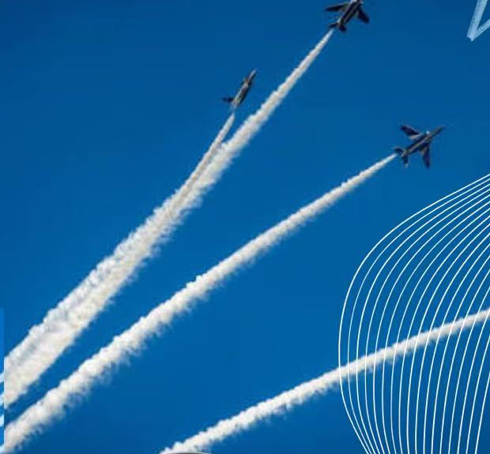
STAGE 1 · LIVE STATUS REPORT · 30 OCT 2026
BLUE
IMPULSE
I = FΔt = Δp — small pushes, real momentum
HOOK QUESTION
[One surprising question your module answers — e.g. “Why do we remember the first and last items of a list best?”]
Module: [Module name] · For: [Intended learners]
Notes:
[0:00–0:20] CUT TO THE CHASE — no greetings, no member roll-call.
Open with the hook question straight away. Pause 2 seconds.
"We're Blue Impulse. Our module, [Module name], answers exactly that question for [learners]. In the next four minutes we'll show you what we've built, the proof on GitHub, what's still broken — and we'll end with the example we're proudest of."

Slide 2



What we're building — and for whom
Module
Intended learners
Learning goals
[Module name]
[One-line description of the topic it covers]
[e.g. first-year students with no prior background in the topic]
[Goal 1 — learners can explain …]
[Goal 2 — learners can apply …]
[Goal 3 — learners can recognise …]
Notes:
[0:20–0:45] ~25 seconds. Don't read the cards — point at them.
"Our module is [name]. It's for [learners] — people who've never met this topic. By the end, they should be able to do three things: [goal 1], [goal 2], [goal 3]."

Slide 3
Where we are today
CONTENT STRUCTURE
[4] / [7]
1
[Section 1 — Introduction & key question]
Completed
2
[Section 2 — Core concept explained]
Completed
3
[Section 3 — Diagram / visual model]
Completed
sections drafted in Markdown Content V1.0
4
[Section 4 — Worked example]
Completed
[N] commits
[N] Markdown files
5
[Section 5 — Learner activity]
In progress
6
[Section 6 — Common misconceptions]
In progress
7
[Section 7 — Quiz & summary]
Planned
Notes:
[0:45–1:25] ~40 seconds. SHOW the status, be honest about what is unfinished.
"Here's our whole module on one slide. Green is finished and in the repo, coral we're writing right now, grey is still a plan. [4] of [7] sections are drafted. The activity and misconceptions sections are half-done — we'll come back to why."
Rule: never call a 'Planned' item finished.

Slide 4




Proof on GitHub, not promises
github.com/[org]/[repo]
Clear structure
[/modules/ /images/ /exercises/ — one file per section]
A change that mattered
[Commit “…”: replaced a wall of text with a diagram + step list]
Paste screenshot here:
repository tree + one commit diff
(zoom in so it is readable from the back row)
Shared work
[N] commits · [N] contributors · [N] pull requests reviewed
Notes:
[1:25–2:05] ~40 seconds. Use a real screenshot of YOUR repo (offline — no live browser!).
Point to ONE meaningful commit and say WHY it improved the work:
"This commit is where Section 3 went from a paragraph nobody finished to a diagram plus three steps. That's the kind of change we're making across the repo."

Slide 5

Markdown V1.0: how one page got better
Before
V1.0
## [Concept]
[Concept] is a process in which
the ... and therefore ... which
means that ... (one long
paragraph, no example, no
picture)
## [Concept] in 30 seconds
> **Key idea:** [one sentence]
![diagram](images/[x].png)
1. [Step one]
2. [Step two]
3. [Step three]
**Try it:** [mini question]
What changed: one key sentence first, a picture before the details, numbered steps, and a question the learner answers immediately.
Notes:
[2:05–2:35] ~30 seconds. Replace both panels with REAL text from your repo (first draft vs. V1.0).
"Left is our first draft. Right is V1.0 of the same page. We moved the key idea to the top, added a diagram, broke the explanation into steps, and ended with a question. That's 'show, don't tell' applied to our own materials."

Slide 6

Our biggest problem — and the plan for Nov 7
STAGE 2 PRIORITIES · DUE 7 NOV
1
[By Nov 2]
[Fix the problem: rewrite Section 2 with a beginner test reader]
THE PROBLEM
[e.g. Our explanations assume too much — a test reader with no background got lost in Section 2.]
2
[By Nov 5]
[Finish Sections 5–6: learner activity + misconceptions]
Why it matters: [beginners stop reading before they reach the example].
3
[By Nov 7]
[Add quiz, peer-review every page, tag release V2.0]
Notes:
[2:35–3:05] ~30 seconds. Name ONE real weakness honestly, then show the realistic plan.
"Our biggest problem: [problem]. We know because [evidence — e.g. a test reader got lost]. So priority one for Stage 2 is fixing that, then finishing the activity and misconceptions sections, then review and release by November 7."

Slide 7

Best for last: [concept] in three moves
01
02
03
Hook
Model
Check
[A familiar everyday situation the learner already knows]
[The diagram / analogy that explains what is really happening]
[A quick question the learner answers — and the common wrong answer]
Remember this: [the one-sentence insight a beginner walks away with]
Notes:
[3:05–3:45] ~40 seconds. YOUR STRONGEST MOMENT — walk the class through the example as if they were beginners.
1. Ask the hook from slide 1 again. 2. Show the diagram / model. 3. Ask the class the check question — let them answer in their heads for 2 seconds.
End on the banner sentence, then simply: "That's Blue Impulse. Thank you." Stop by 3:50 — the hard cut is 4:00.

