Slide 1


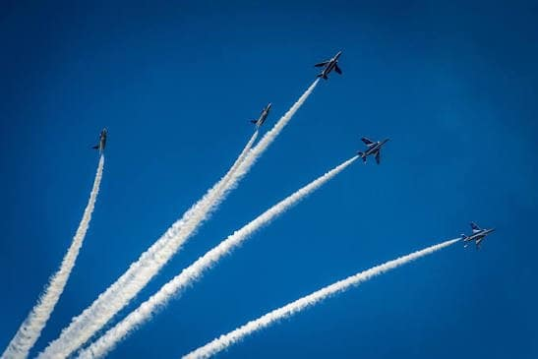

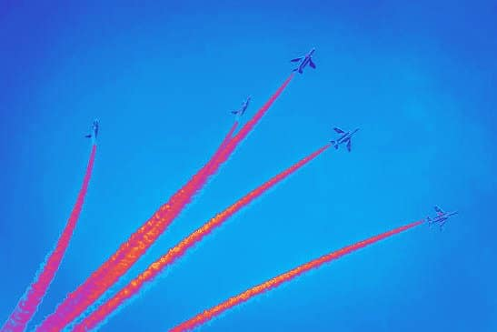



IMPULSE
STAGE 1 · LIVE STATUS REPORT · 30 OCT 2026
BLUE
impulse
impulse
impulse
HARDWARE, NETWORK & BEHAVIORIST AI
Safa - Submission lead+Researcher
Tian - Visual design lead
Nazif - Visual design
Danial - Researcher
Edzel - Researcher
I = FΔt = Δp — small pushes, real momentum
1
Notes:
[0:00–0:20] CUT TO THE CHASE — no greetings, no member roll-call.
Open with the hook question straight away. Pause 2 seconds.
"We're Blue Impulse. Our module, [Module name], answers exactly that question for [learners]. In the next four minutes we'll show you what we've built, the proof on GitHub, what's still broken — and we'll end with the example we're proudest of."
1

Slide 2




What we're building — and for whom
Module
Intended learners
Learning goals
2
Notes:
[0:20–0:45] ~25 seconds. Don't read the cards — point at them.
"Our module is [name]. It's for [learners] — people who've never met this topic. By the end, they should be able to do three things: [goal 1], [goal 2], [goal 3]."
2

Slide 3

What we're building — and for whom
Module
Hardware, Networking and Behaviorist AI
3
Notes:
[0:20–0:45] ~25 seconds. Don't read the cards — point at them.
"Our module is [name]. It's for [learners] — people who've never met this topic. By the end, they should be able to do three things: [goal 1], [goal 2], [goal 3]."
2

Slide 4
What we're building — and for whom
Module
Intended learners
Learning goals
4
Notes:
[0:20–0:45] ~25 seconds. Don't read the cards — point at them.
"Our module is [name]. It's for [learners] — people who've never met this topic. By the end, they should be able to do three things: [goal 1], [goal 2], [goal 3]."
2

Slide 5
What we're building — and for whom
Intended learners
  High schoolers or University freshmen
  Familiar with basic computer hardware
  Understand the concept of stimulus response
  Know the basic definition of AI
  Has an idea of “networking”
5
Notes:
[0:20–0:45] ~25 seconds. Don't read the cards — point at them.
"Our module is [name]. It's for [learners] — people who've never met this topic. By the end, they should be able to do three things: [goal 1], [goal 2], [goal 3]."
2

Slide 6
What we're building — and for whom
Module
Intended learners
Learning goals
6
Notes:
[0:20–0:45] ~25 seconds. Don't read the cards — point at them.
"Our module is [name]. It's for [learners] — people who've never met this topic. By the end, they should be able to do three things: [goal 1], [goal 2], [goal 3]."
2

Slide 7
What we're building — and for whom
Learning goals
  Identify fundamental computer hardware components and functions
  Explain basic networking concepts
  Apply their knowledge to everyday technology scenarios
  Demonstrate improvement through practices
7
Notes:
[0:20–0:45] ~25 seconds. Don't read the cards — point at them.
"Our module is [name]. It's for [learners] — people who've never met this topic. By the end, they should be able to do three things: [goal 1], [goal 2], [goal 3]."
2

Slide 8


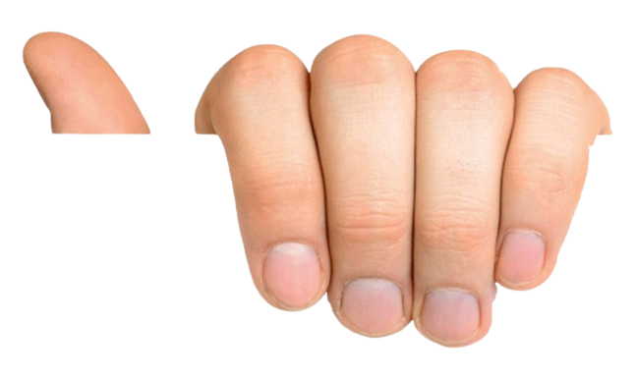

Content Structure
BRIEF OUTLINE
1
What Behaviorism Is
Markdown Content V1.0
2
Definition of Behaviorism AI
3
Core Hardware Requirement
4
How Hardware Enables AI
5
Networking Fundamentals
6
Networking for Behaviorist AI
7
Real-World Examples & Swarm Robotics
8
Strength & Limitations
8
Notes:
[0:45–1:25] ~40 seconds. SHOW the status, be honest about what is unfinished.
"Here's our whole module on one slide. Green is finished and in the repo, coral we're writing right now, grey is still a plan. [4] of [7] sections are drafted. The activity and misconceptions sections are half-done — we'll come back to why."
Rule: never call a 'Planned' item finished.
3

Slide 9

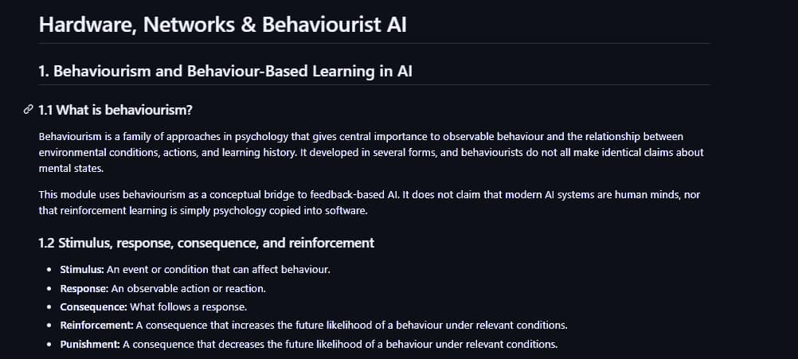
Markdown Content V1.0
CHAPTER 1
9
Notes:
[0:45–1:25] ~40 seconds. SHOW the status, be honest about what is unfinished.
"Here's our whole module on one slide. Green is finished and in the repo, coral we're writing right now, grey is still a plan. [4] of [7] sections are drafted. The activity and misconceptions sections are half-done — we'll come back to why."
Rule: never call a 'Planned' item finished.
3

Slide 10
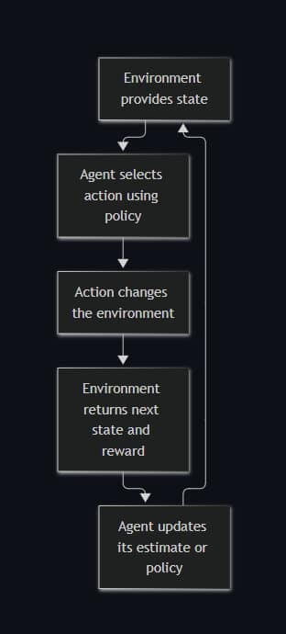
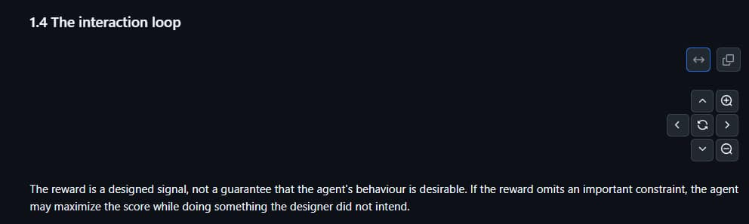
Markdown Content V1.0
CHAPTER 1
(use of diagram)
when click this space
It shows a flowchart
10
Notes:
[0:45–1:25] ~40 seconds. SHOW the status, be honest about what is unfinished.
"Here's our whole module on one slide. Green is finished and in the repo, coral we're writing right now, grey is still a plan. [4] of [7] sections are drafted. The activity and misconceptions sections are half-done — we'll come back to why."
Rule: never call a 'Planned' item finished.
3

Slide 11


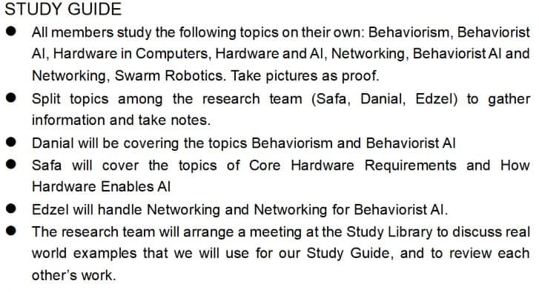
Progress
COMPLETED
IN PROGRESS
## Task
-List contents, chapters, topics, and lessons of the study material
-Write down purpose and learning goals of this project and the target audience
-Create GitHub repository and manage tasks
-Outline of Chapter 1
-Planned meetings
-Learning methods
## Task
# Pursue stage 2:
-task list for stage 2 and 3
-dividing detailed responsibility among the research team and visual team
11
Notes:
[2:05–2:35] ~30 seconds. Replace both panels with REAL text from your repo (first draft vs. V1.0).
"Left is our first draft. Right is V1.0 of the same page. We moved the key idea to the top, added a diagram, broke the explanation into steps, and ended with a question. That's 'show, don't tell' applied to our own materials."
5

Slide 12
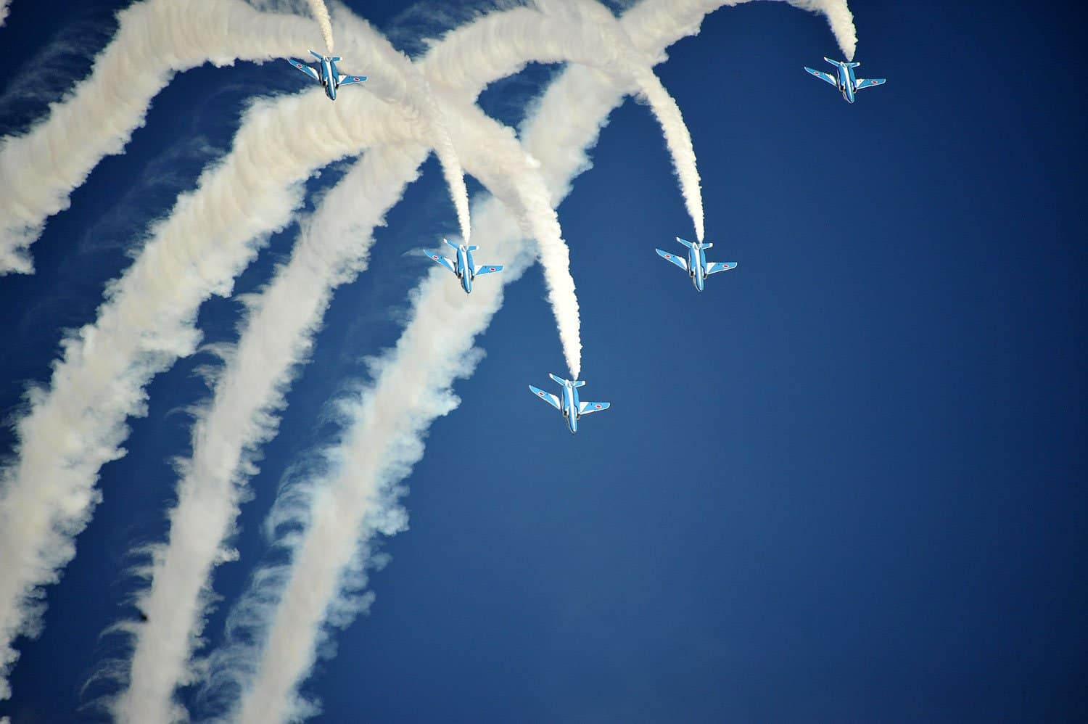
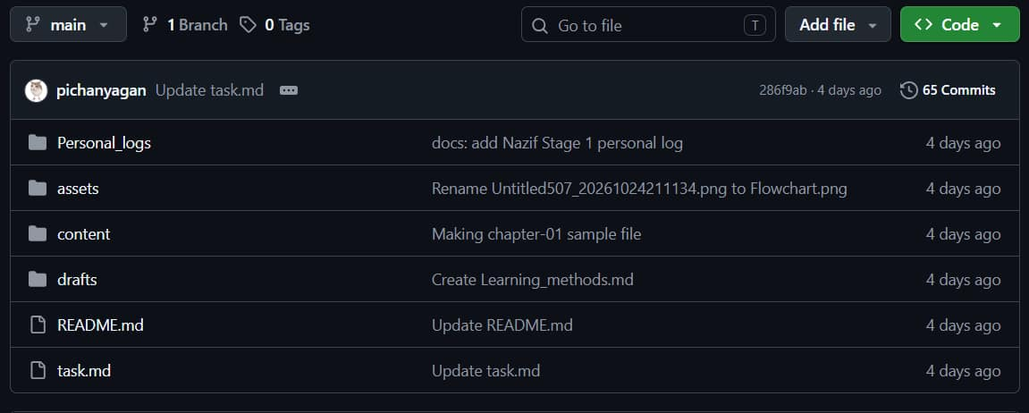

GitHub Repository
github.com/[org]/[repo]
12
Notes:
[1:25–2:05] ~40 seconds. Use a real screenshot of YOUR repo (offline — no live browser!).
Point to ONE meaningful commit and say WHY it improved the work:
"This commit is where Section 3 went from a paragraph nobody finished to a diagram plus three steps. That's the kind of change we're making across the repo."
4

Slide 13
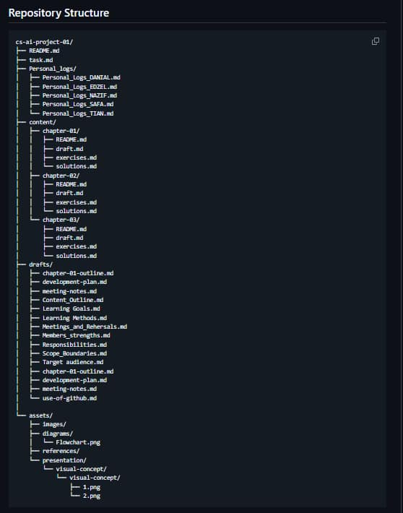
GitHub Repository
github.com/[org]/[repo]
13
Notes:
[1:25–2:05] ~40 seconds. Use a real screenshot of YOUR repo (offline — no live browser!).
Point to ONE meaningful commit and say WHY it improved the work:
"This commit is where Section 3 went from a paragraph nobody finished to a diagram plus three steps. That's the kind of change we're making across the repo."
4

Slide 14
GitHub Repository
github.com/[org]/[repo]
14
Notes:
[1:25–2:05] ~40 seconds. Use a real screenshot of YOUR repo (offline — no live browser!).
Point to ONE meaningful commit and say WHY it improved the work:
"This commit is where Section 3 went from a paragraph nobody finished to a diagram plus three steps. That's the kind of change we're making across the repo."
4

Slide 15

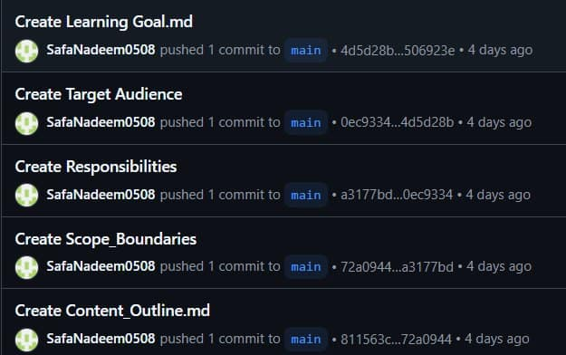
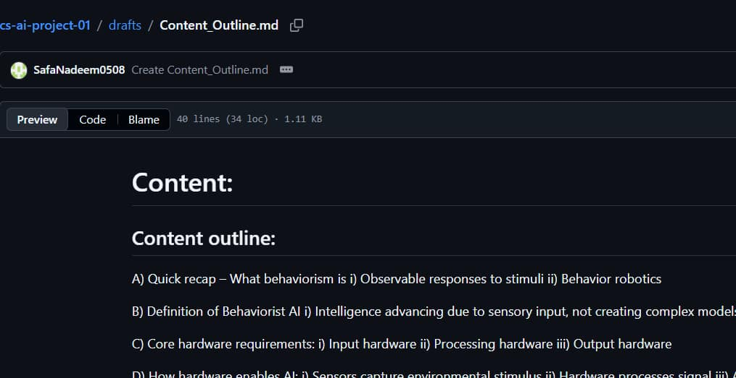


Main Commit: Safa
Content
Name and research on contents of the study guide
github.com/[org]/[repo]
Project Plan
Wrote majority of the project plan: scope boundary, Target audience etc.
Submission
Handles the submission on Lexue
15
Notes:
[1:25–2:05] ~40 seconds. Use a real screenshot of YOUR repo (offline — no live browser!).
Point to ONE meaningful commit and say WHY it improved the work:
"This commit is where Section 3 went from a paragraph nobody finished to a diagram plus three steps. That's the kind of change we're making across the repo."
4

Slide 16
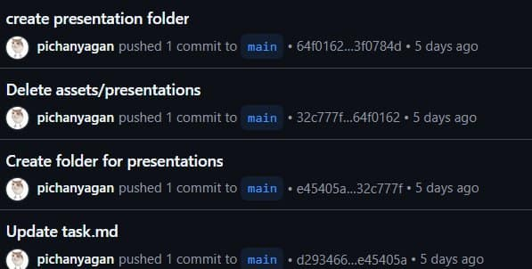
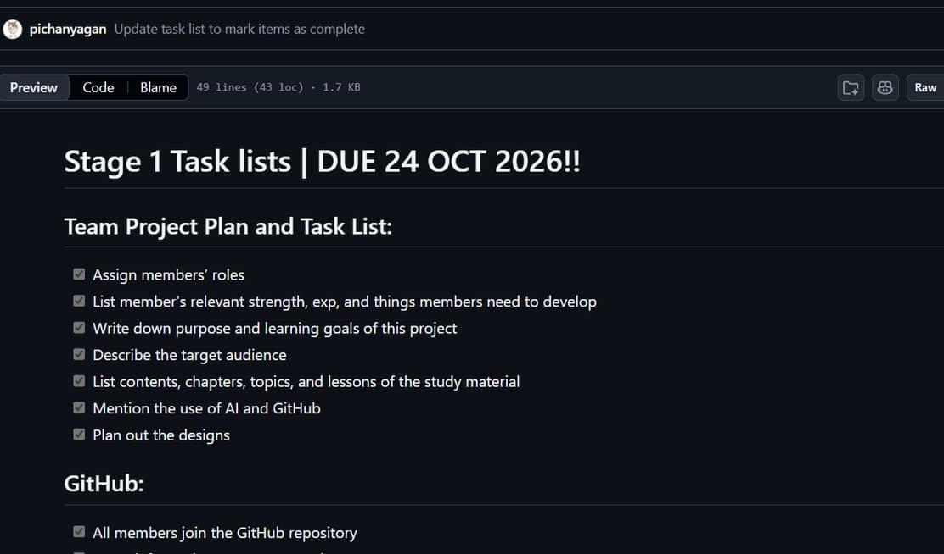
Main Commit: Tian
Task.md
Wrote tasks, plan out meeting spots. Contributed to learning goals
github.com/[org]/[repo]
Use of GitHub
Wrote use of github, indicating significance of it
Slides
Polishes this slide
16
Notes:
[1:25–2:05] ~40 seconds. Use a real screenshot of YOUR repo (offline — no live browser!).
Point to ONE meaningful commit and say WHY it improved the work:
"This commit is where Section 3 went from a paragraph nobody finished to a diagram plus three steps. That's the kind of change we're making across the repo."
4

Slide 17
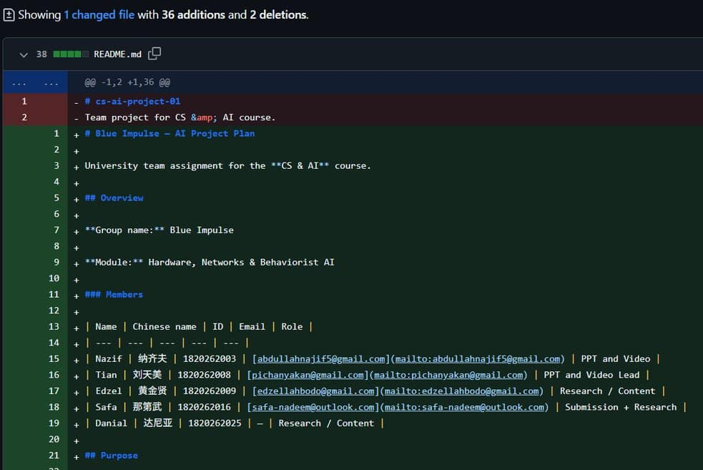
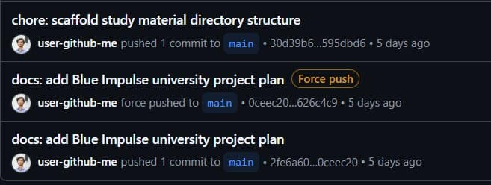
Main Commit: Nazif
Creating repository
github.com/[org]/[repo]
Familiar with GitHub, so he was assigned to initiate the repository
README.md
Majority of README.md was wrote by Nazif
Slides
This slide was made by Nazif before passing on to Tian for polishing
17
Notes:
[1:25–2:05] ~40 seconds. Use a real screenshot of YOUR repo (offline — no live browser!).
Point to ONE meaningful commit and say WHY it improved the work:
"This commit is where Section 3 went from a paragraph nobody finished to a diagram plus three steps. That's the kind of change we're making across the repo."
4

Slide 18
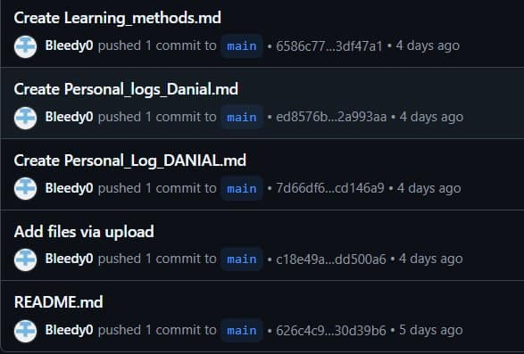
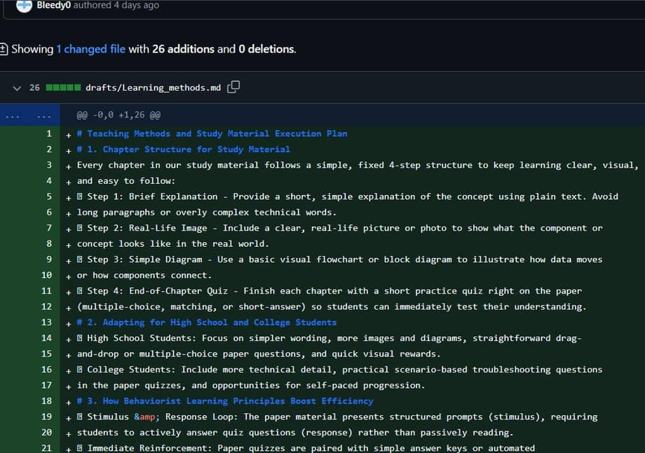
Main Commit: Danial
github.com/[org]/[repo]
Learning Methods
Wrote all learning method that will apply later to the study guide
Research Content
Mainly research on contents of specific chapters
18
Notes:
[1:25–2:05] ~40 seconds. Use a real screenshot of YOUR repo (offline — no live browser!).
Point to ONE meaningful commit and say WHY it improved the work:
"This commit is where Section 3 went from a paragraph nobody finished to a diagram plus three steps. That's the kind of change we're making across the repo."
4

Slide 19
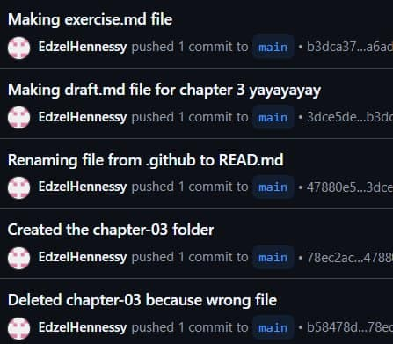
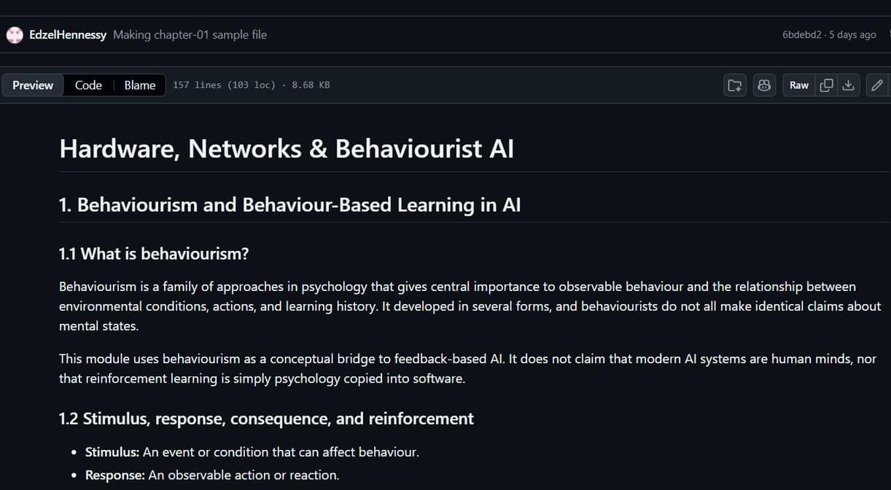
Main Commit: Edzel
Project Log and Meeting
Wrote the “Project Log and Meeting Summaries” document
github.com/[org]/[repo]
Chapter 1 Outline
Created an excerpt of the first chapter of our study guide.
Research
Mainly research on contents of specific chapters
19
Notes:
[1:25–2:05] ~40 seconds. Use a real screenshot of YOUR repo (offline — no live browser!).
Point to ONE meaningful commit and say WHY it improved the work:
"This commit is where Section 3 went from a paragraph nobody finished to a diagram plus three steps. That's the kind of change we're making across the repo."
4

Slide 20




Problems We Faced
A very detailed instructions confuses majority of the team member about what exactly we have to do
THE PROBLEM
  Interpreting the given instructions
  Settle for a meeting
Everybody has a different schedule and timing, it’s hard to have a meeting with all 5 members are present
20
Notes:
[2:35–3:05] ~30 seconds. Name ONE real weakness honestly, then show the realistic plan.
"Our biggest problem: [problem]. We know because [evidence — e.g. a test reader got lost]. So priority one for Stage 2 is fixing that, then finishing the activity and misconceptions sections, then review and release by November 7."
6

Slide 21

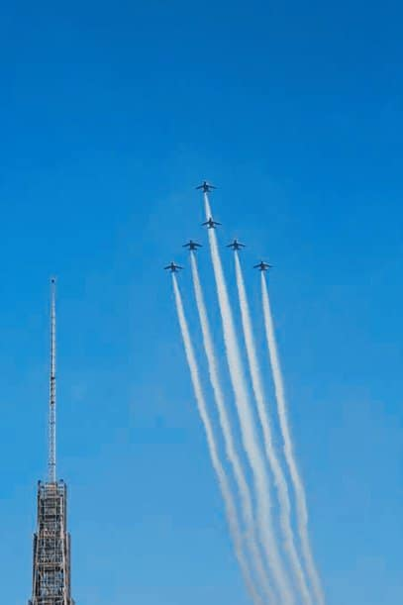
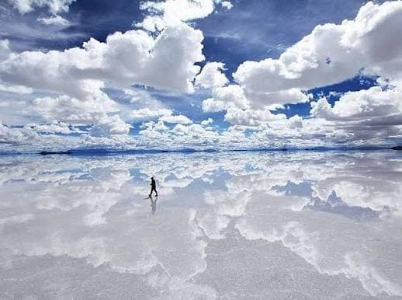
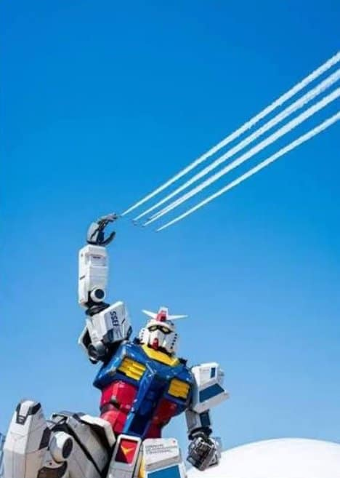
Future Plan
STAGE 2 PRIORITIES · DUE 7 NOV
01
02
03
Study Guide
+Research
Video
Slides
blue
blue
blue
blue
blue
blue
Write scripts, and come to an agreement of how we want the video to be
After every chapter ‘s content compilation is finished, the visual team will begin on doing slides
Complete investigating on each topic of the chapter, then execute a study plan.
Markdown V2.0
I = FΔt = Δp — small pushes, real momentum
21
Notes:
[3:05–3:45] ~40 seconds. YOUR STRONGEST MOMENT — walk the class through the example as if they were beginners.
1. Ask the hook from slide 1 again. 2. Show the diagram / model. 3. Ask the class the check question — let them answer in their heads for 2 seconds.
End on the banner sentence, then simply: "That's Blue Impulse. Thank you." Stop by 3:50 — the hard cut is 4:00.
7

Slide 22
Thank you

