Slide 1
Introduction to the JIRA system for QA Analysts
in Agile Scrum framework environment
By Olga Voronova
July 2021

Slide 2

What is JIRA
Jira is software for issue tracking, bug tracking, and project management. Jira helps all teams manage their work. When Jira was first released in 2002, it was purely for software development.
The #1 software development tool used by agile teams.

Slide 3
Which Application Type Do you Have?
Jira is offered in four packages:
Jira Work Management (Core) is intended as generic project management/business teams.
Jira Software includes the base software, including agile project management features (previously a separate product: Jira Agile).
Jira Service Management (Service Desk) is intended for use by IT operations or business service desks.
Jira Align is intended for strategic product and portfolio management

Slide 4
Which JIRA deployment type do you have?
Cloud
Server
Data center

Slide 5
JIRA Software
Jira Software is an agile project management tool that supports any agile methodology: scrum, kanban, or your own unique flavor. From agile boards, backlogs, roadmaps, reports, to integrations and add-ons you can plan,track,and manage all your agile software development projects from a single tool.
Notes:
I walk you through how to use JIRA to create/manage a Project management workflow for a Software Project.

Slide 6
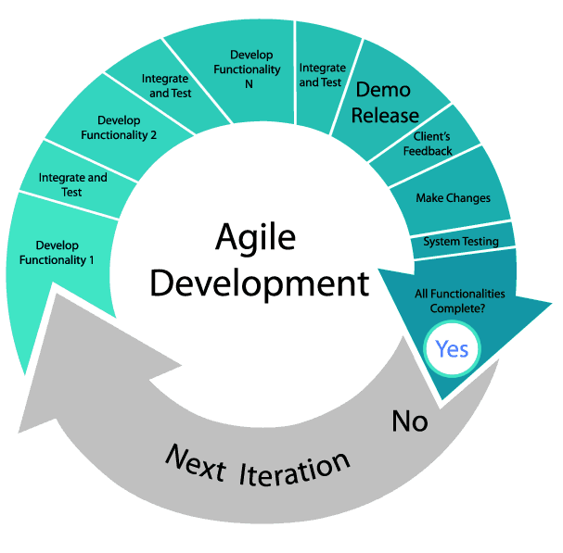
AGILE
Notes:
In software development, agile practices involve discovering requirements and developing solutions through the collaborative effort of self-organizing and cross-functional teams and their customer/end use. The whole idea of Software Dev steams from creating an Agile process that can be broken to Functionality, Planning, Implementation, Testing and Review. Scrum is a framework that helps teams work together.

Slide 7
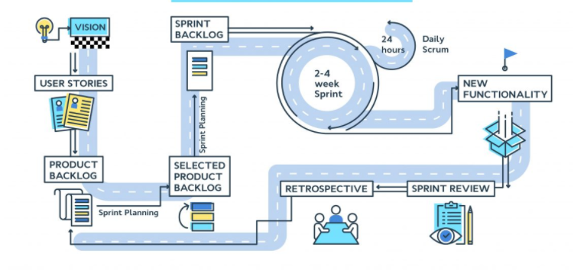
SCRUM Flow
Notes:
Scrum is a process framework that has been used to manage product development. The Scrum framework consists of Scrum Teams and their associated roles[?], events, artifacts, and rules. Each component within the framework serves a specific purpose and is essential to Scrum's success and usage.

Slide 8
SCRUM Roles
Project owner: responsible for an entire project
Scrum master: manager of the project flow between project owner and dev/ops teams
Scrum team: employees that are hands on and completing tasks

Slide 9
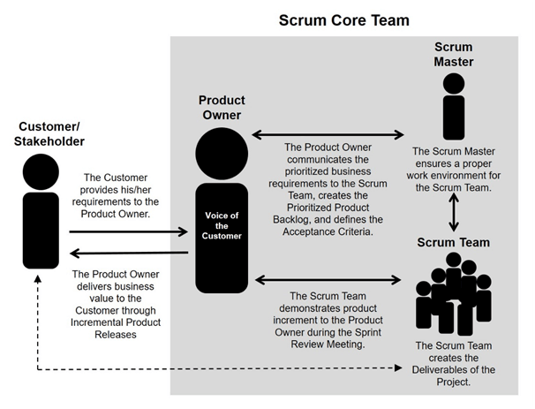

Slide 10
Examples of an Interview Q&A I
What is deploy?
Answer: encompasses all the processes involved in getting new software or hardware up and running properly in its environment, including installation, configuration, running, testing, and making necessary changes. The word implementation is sometimes used to mean the same thing.

Slide 11
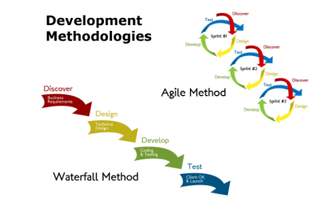
Examples of an Interview Q&A. II
What is Agile Testing?
Answer: Agile testing is a practice based on the principles of agile software development. It includes all members of an agile team with specific skills and a certain expertise to ensure the timely delivery of a product with the release of additional features at frequent intervals.
2. How is Agile Methodology different than Traditional Waterfall process?
Answer: In agile methodology, features of the software are delivered frequently, so that the testing activity is done simultaneously with the development activity. Testing time is shortened as only small features are need be tasted at once, while,
in the waterfall model, testing activities take place at the end of the entire development process. Testing time, in this case, is as long as the entire product is to be tested in one go. Waterfall methodology is a closed process where all stakeholders are not involved in the development process whereas agile methodology requires the involvement of various stakeholders including customers.
3. What are the different types of Agile Methodologies?
Answer: There are several types of agile development methodology. Scrum is one of the most popular and widely used agile methods. Other types of agile development methodology are; development like Crystal Methodology, DSDM(Dynamic Software Development Method), Feature-driven development(FDD), Lean software development and Extreme Programming(XP).

Slide 12
Examples of an Interview Q&A. III
4. State some major principles of Agile testing.
Answer: Some major principles of Agile testing are
Customer satisfaction
Face to face communication
Sustainable development
Quick respond to changes
Continuous feedback
Successive improvement
Self-organized
Error-free
Collective work
5. What are the skills of a good Agile Tester?
Answer: An agile tester is one who implements agile software development principles for software testing. Followings are the skills of a good agile tester –
Required to be familiar with the concepts and principles of Agile
Should have an excellent communication to communicate with the team and the clients
Ability to set priority for the tasks according to the requirements
Should be able to understand the requirements properly
Understanding of the risks involved with a project due to changing requirements
Notes:
We are going exercise some of these principals, and get a idea who is consider as a good agile tester )

Slide 13
Examples of an Interview Q&A IV
1. Differentiate between Agile and Scrum.
Answer: Agile and Scrum have their fair share of similarities and differences. Since Scrum is a part of the Agile Methodology, both of them promote the completion of projects incrementally in small fragments. Also, both methodologies are iterative in nature.
However, the main difference between Agile and Scrum is that the former has a broader spectrum. While Agile Methodology is used for project management, Scrum is ideal for projects where the requirements change rapidly. In the Agile Methodology, leadership holds the most pivotal position, whereas Scrum encourages the creation of a self-organizing and cross-functional team.
How long were your sprints for the projects you have worked on?
Answer: Generally, the duration of a scrum sprint (scrum cycle) depends upon the size of project and team working on it. The team size may vary from 3-9 members. In general, a scrum script complete in 3-4 weeks. Thus, on an average, the duration of a scrum sprint (scrum cycle) is 4 weeks.
What kind of project management tools were used for your project?
Answer: Slack, JIRA, Redmine
Have you used automated test tools earlier? How was your experience?
Answer: Yes, [<tool>]. I see the advantages of automation testing, and aware of its impact a company. For instance, results of automation can lead to lowering company costs, freeing up team members to fill other roles and delegating resources to other departments. I am confident in my ability to fully use these advantages for this position.

Slide 14
Examples of an Interview Q&A V
1. What is Velocity?
Answer: Velocity question is generally posed to understand if you have done some real work and familiar with the term. Its definition “Velocity is the rate at which team progresses print by sprint” should be enough. You can also add saying the important feature of velocity that it can’t be compared to two different scrum teams.
2. What do you understand by Daily Stand-Up?
Answer: The daily stand-up is an everyday meeting (most preferably held in the morning) in which the whole team meets for almost 15 minutes to find answer to the following three questions –
What was done yesterday?
What is your plan for today?
Is there any impediment or block that restricts you from completing your task?
The daily stand-up is an effective way to motivate the team and make them set a goal for the day.

Slide 15
JIRA Project [Review] [Scrum Master or JIRA admin Role]
Create Project
Create users
Create Version
Version - Functionalities we are targeting in multiple sprints go as production release
4. Create EPIC and Stories
Epic - abstract view of what we are creating
Story - what is required to archive your Epic. A user story is the smallest unit of work in an agile framework.
5. Start the SPRINT
Sprint - Project workflow of tasks to be completed in a specific timeframe
6. Story points update for each and every story.
A story point - the unit for the estimation of total efforts that are required to perform
or complete a particular task.
Notes:
Epic: What Customer needs/wants: Ex. Name: Verify GMAIL Functionalities/Description: Verify all Gmail Functionalities; Story: diff features: Ex. Verify Login functionality. Diff teams use it for diff purposes/tasks.

Slide 16
BREAK
10 MIN

Slide 17
JIRA Project [SCRUM Teams [QA] Role]
Tasks Creation for each and every story
Add attachment/Links
Assign sub tasks to teams /self
Burn the hours in JIRA
Sprint life cycle
Status Update
Creating the bugs
Notes:
Tasks testing cycle: create sub-task for a Story QA: Ex. Prepare Test Cases; Review Test Cases; Execute Test cases; Analyze results; Bug Tracking; Perform Retesting and Regression testing
Tasks dev cycle: Ex. design; Develop Code; Perform Unit Testing

Slide 18
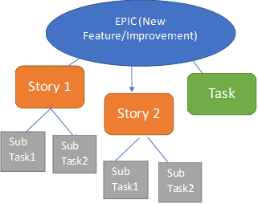
Hierarchy of JIRA Issues

Slide 19
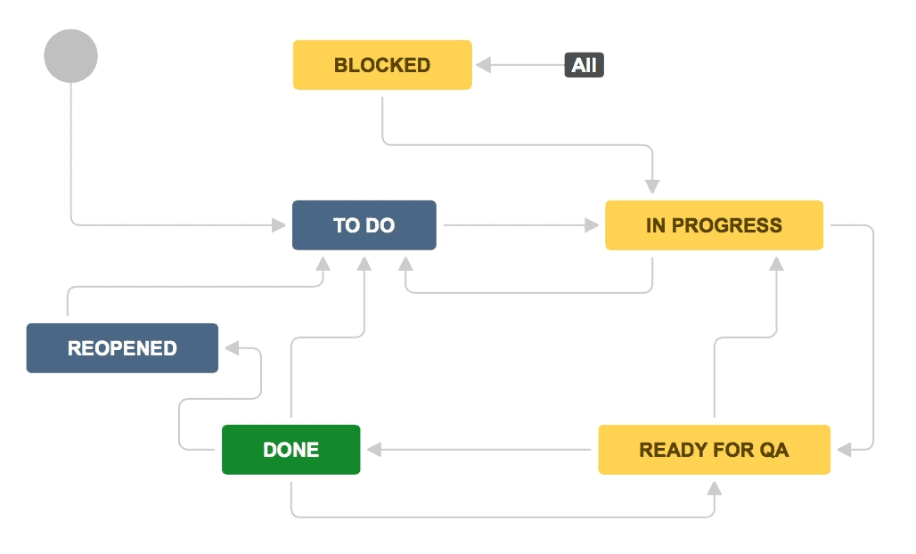
JIRA workflow for SCRUM
Notes:
In Real time more is available: Ex. To Do; Dev; In Progress Dev; Done; QA ; In Progress QA; Done; UAT; In progress UAT; Done; Ready to Release; Done.

Slide 20
HOMEWORK – DAY 1
Create JIRA User Avatar
Create an Issue “Subtask” for a Story; assign it to your self. Note: You can pick any of the created during the class Stories
Create a Filter; Give it a Name; Share it
Create a Test case relative to the Subtask that you’ve created
[test id, test case name, test description, test data, test steps, expected results]
https://docs.google.com/spreadsheets/d/1ftdpS1A5KfOHT2MSaKLJfQEzzWgK5IlTuGzT_v_tB5o/edit?usp=sharing

Slide 21
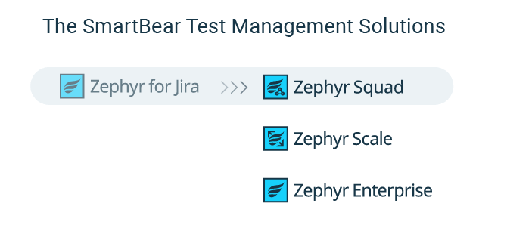
Zephyr plug-in Intro
By default JIRA does not support test management.
Organizations need a tool to manage testing activities.
Zephyr for Jira [Zephyr Squad] is the No. 1 installed Agile test management app in the Atlassian Marketplace; a flexible test management solution inside Jira, perfect for Agile teams focusing on Test Design, Execution, and Test Automation.
Notes:
Product family; Very Flexible

Slide 22
Zephyr Installation
Zephyr for Jira Cloud
Search Zephyr Jira Add-on in Atlassian Marketplace:
With administrator login, click on ‘Add-ons’ link. This will show up the Add-ons menu.
Click ‘Find new add-ons’ link.
Enter ‘Zephyr for JIRA’ in the ‘Search for Marketplace’ box.
Select ‘Zephyr for JIRA – Test Management’, from the search results.
Click on either ‘Buy Now’ or ‘Free Trial’ button.
This will navigate to the Atlassian home page. One can enter the username/password or create a new account.
This will give a 30-day trial version or a proper license can be bought.
Add-on will be installed and now be ready for use.

Slide 23
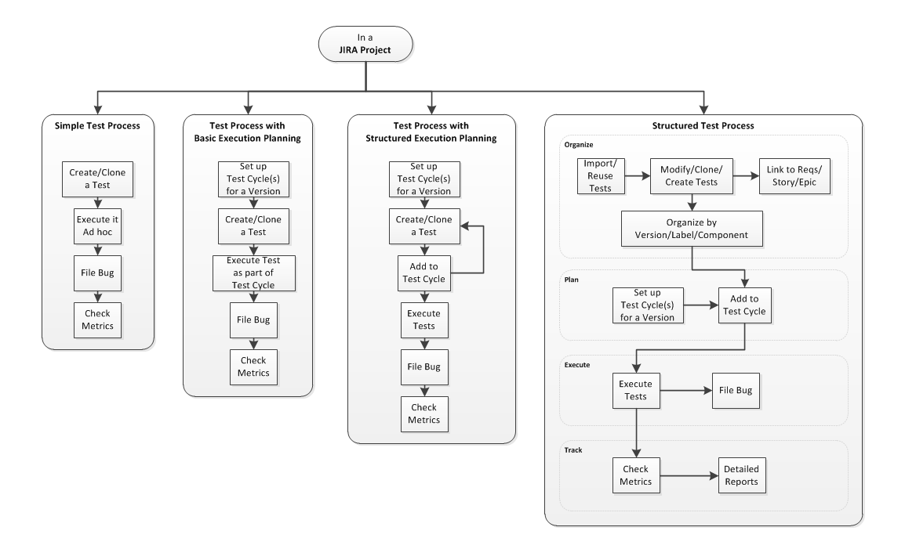
ZEPHYR: JIRA Test process Overview

Slide 24
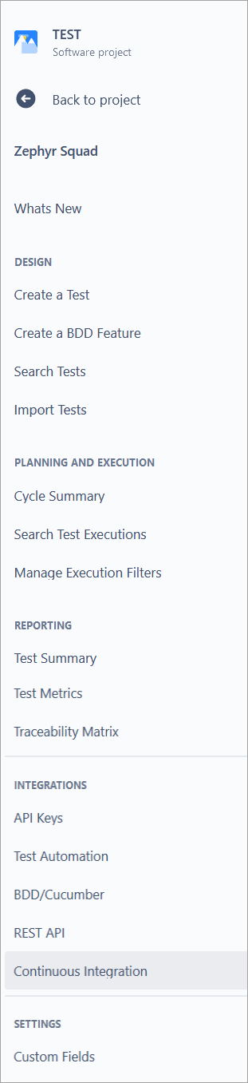
ZEPHYR: UI Overview I
Design
Create a Test - Create a brand new test under the current project. The issue type is "Test" and is indicated by this icon:
Create a BDD Feature - Create a BDD feature with accompanying steps.
Search Tests -This opens the Issue Navigator to allow searching for tests.
Import Tests - Import your existing tests from Excel or XML files.
Planning and Execution
Cycle Summary - Create and view various test cycles based on version.
Search Test Executions - Search for executions in a project using ZQL.
Manage Execution Filters - Manage filters saved using the test execution search functionality.

Slide 25
ZEPHYR: UI Overview II
Reporting
Test Metrics - Opens the Test Dashboard with testing metrics gadgets displayed.
Test Summary - Summary of all testing activity in a project.
Traceability Matrix - A report that can generate a trace of testing from a story through tests, cycles, executions, and defects.
Integrations
API Keys - Get API keys required to call Zephyr Squad REST API.
Test Automation - Imports test results from test automation frameworks directly into Zephyr test execution cycles.
BDD/Cucumber - Learn how to create and use behavior-driven development (BDD) testing with Zephyr Squad.
REST API - Learn more about Zephyr Squad REST API.
Continuous Integration - Learn how to integrate your CI/CD workflows with Zephyr Squad.
Settings
Zephyr Custom Fields - Select the custom fields to add to test steps and test executions.
About (this menu appears only when Zephyr is opened from global context)
Welcome - This page educates and provides access to a variety of resources such as Support, Buying/Upgrading etc.
Documentation - Link to the online documentation.
Zephyr Status - Opens the status page where you can see the current status of Zephyr Squad Cloud and subscribe to updates on planned maintenance.
Support - Link to Zephyr's support page.
Feedback - Give feedback directly to the plugin developers regarding your Zephyr Squad experience.
About Zephyr - Version and license information.

Slide 26
Zephyr Squad - Features
Create, view, edit, clone and execute tests (test cases).
Testing directly inside/through Jira.
Link test cases to user stories, tasks, requirements, bugs, etc.
Logical grouping of test cases, with proper folder structure within the test cycles.
Plan test execution cycles, like system test, etc.
Link Sprint to folders and test cycles to have increased traceability.
Searching test executions which were carried out earlier, with execution navigator.
Pre-defined/saved filters for executive search.
Export test execution data to the CSV file.
Configure and track Quality metrics. Streamlined tracking capabilities.
Inline editing capabilities.
High flexibility.
Real-time reporting.
Integration of agile boards with test boards.
Advanced searching using Zephyr Query language (ZQL).
Provision for Test Dashboards.
Supports many languages.
Navigation is more of project-centric.
Integration with test automation tools.
Integration with CI/CD tools – Collaborative capabilities.

Slide 27
ZEPHYR:
Associate ZEPHYR with JIRA Project/EPIC
Create the Test case
Create the Test Cycle
Execute the Test cases
Create Cycle/Add Tests to Test Cycle
Assign Test Execution
Track Test Progress

Slide 28
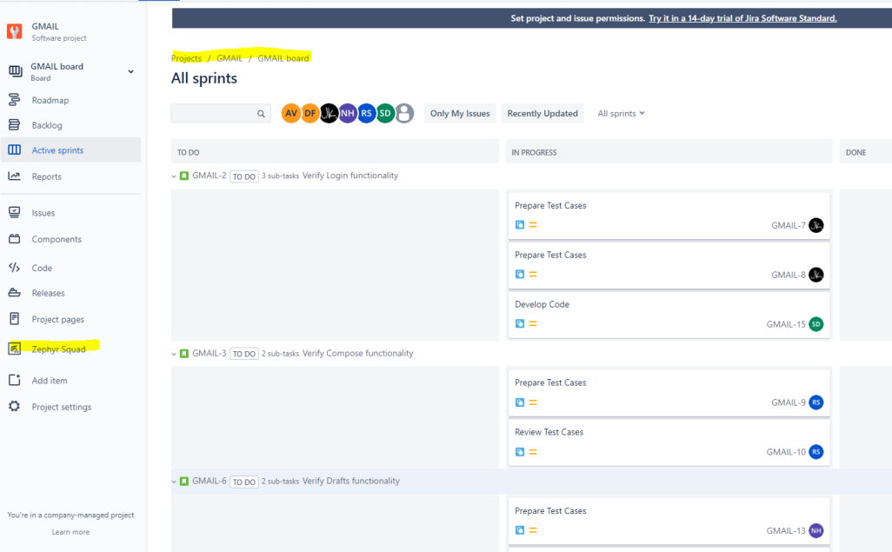
ZEPHYR: How to Associate ZEPHYR with JIRA Project
1. Browse for the desired project, for which the tests are to be created. Use JIRA Software Console Project Board
2. Click Zephyr Squad Option

Slide 29
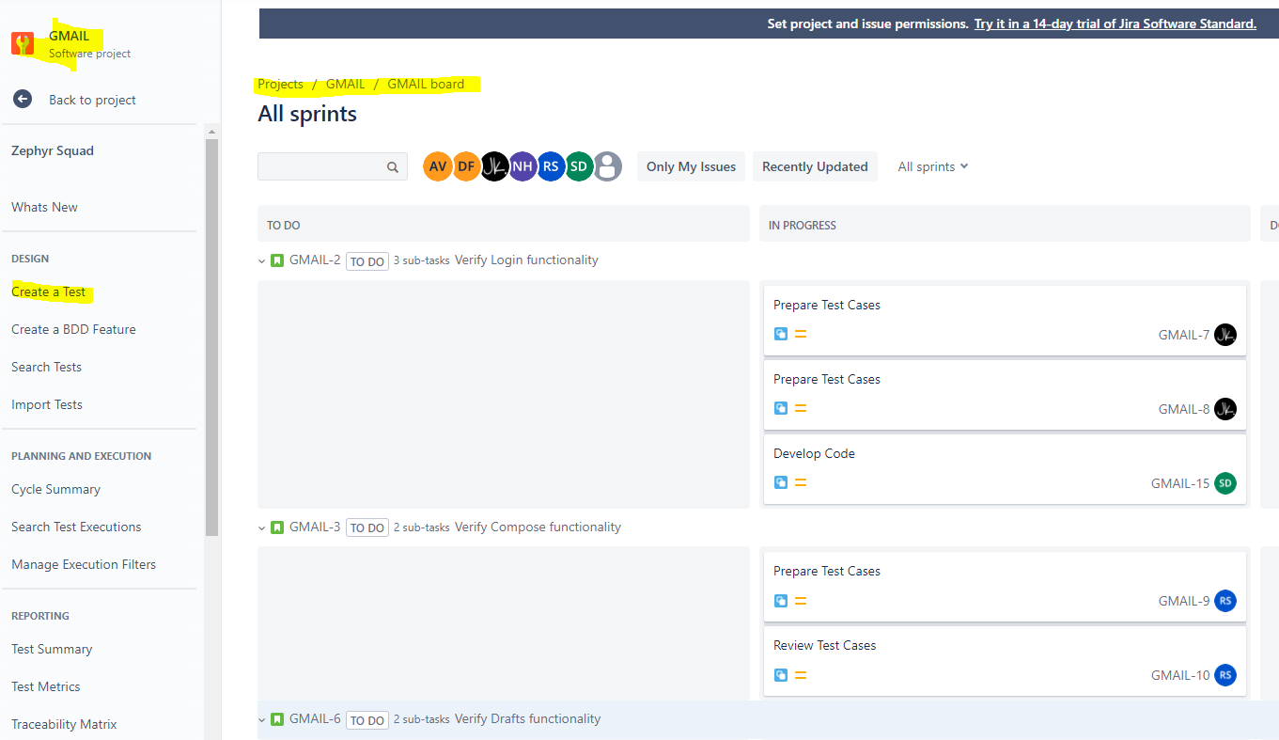
ZEPHYR: How to Create a Test I
1. Click ‘Create issue’ (+) link.
2. Make sure that the desired project, for which the tests are to be created, is selected in the ‘Project’ Drop-down box.

Slide 30
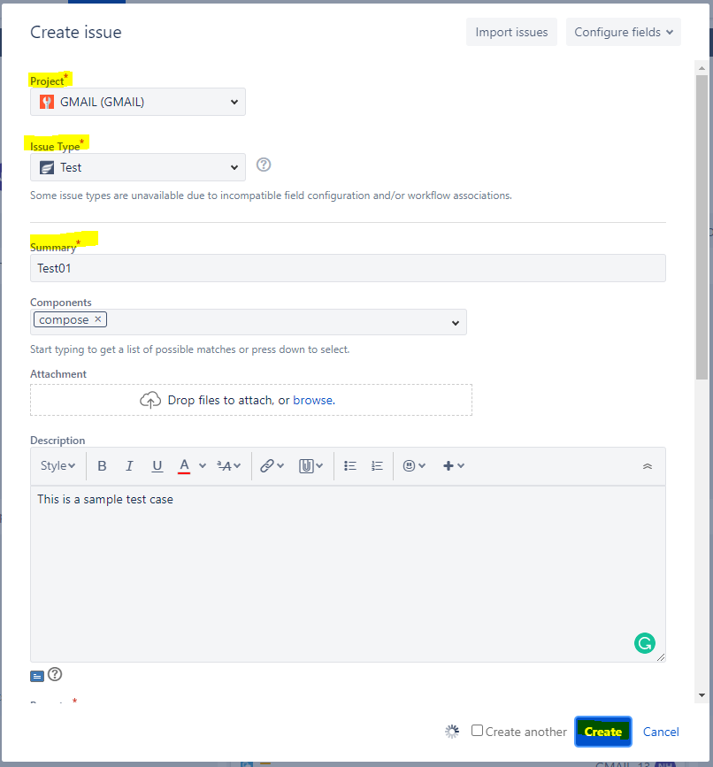
ZEPHYR: How to Create a Test II
3. Select ‘Test’ as the issue type in the ‘Issue Type’ drop-down box.
4. Enter the required details and other required additional information in the respective fields.
Note: Creating an issue of type ‘Test’ is similar to that of any other issue types like Bug, Task, etc.
5. Click the ‘Create’ button.
→This will create a new test, which is an issue of type ‘Test’.
.

Slide 31

ZEPHYR: How to Create a Test III
➔ To add test steps and their details Test issue needs to be modified: click on Test Details of the created Test case
6. Add/Edit/Clone/Delete Test Steps
a. Open the test to edit, preferably open the issue in a new browser tab.
b. Go to ‘Test Details’ section and start adding details in ‘Test Step’, ‘Test Data’ and ‘Expected Result’ columns.
c. After adding the required details click on ‘Add Steps’ (button with icon available under the ‘Actions’ column.) button.
d. This will add Step1 for the test [see next presentation’s slide]
e. Continue adding more steps, as required

Slide 32
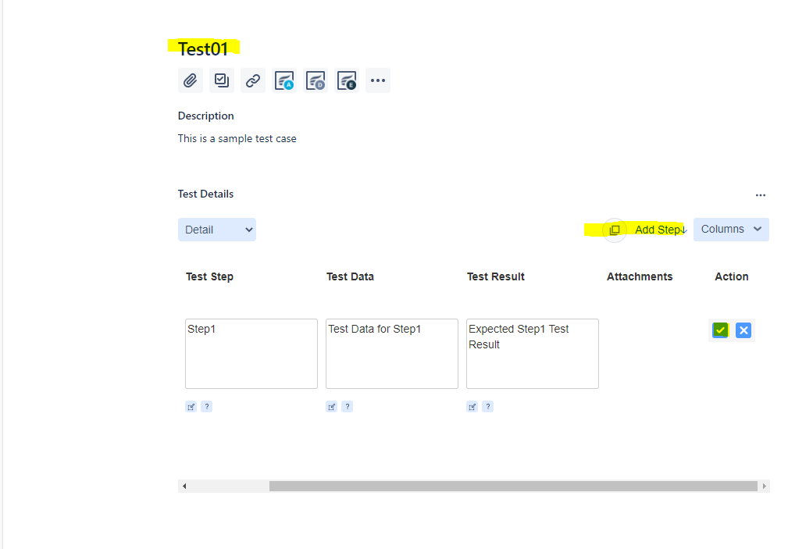
ZEPHYR: How to Create a Test IV

Slide 33
10 Min Break

Slide 34
To Do:
Create your first Test Case

Slide 35
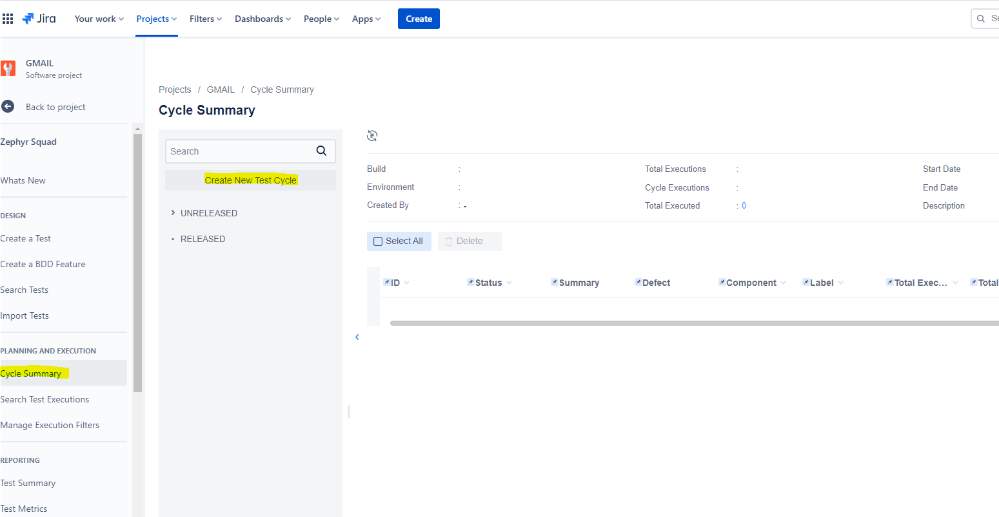
ZEPHYR: Plan/Create Test Cycle I
To run tests, the user needs to create a test plan. => Click on ‘Cycle Summary’ link available under ‘PLANNING AND EXECUTION’, from the menu items that are seen in the left pane => Click on ‘Create the Test Cycle’
=> Provide Test Cycle Name [Ex. see image on the next slide]
=> Click Save
→This will create a new test cycle

Slide 36
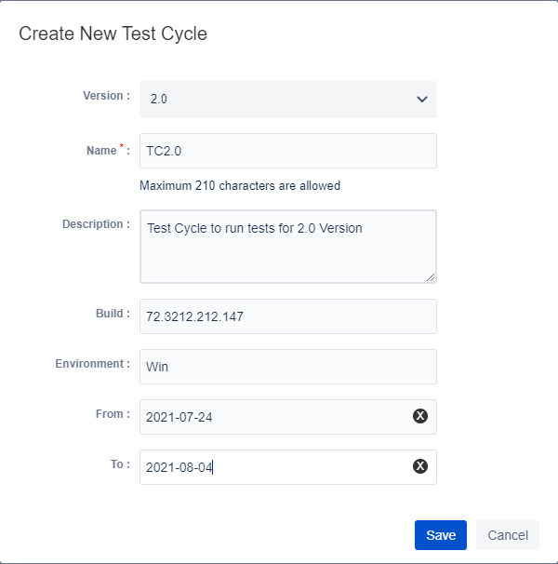
ZEPHYR: Plan/Create Test Cycle II

Slide 37
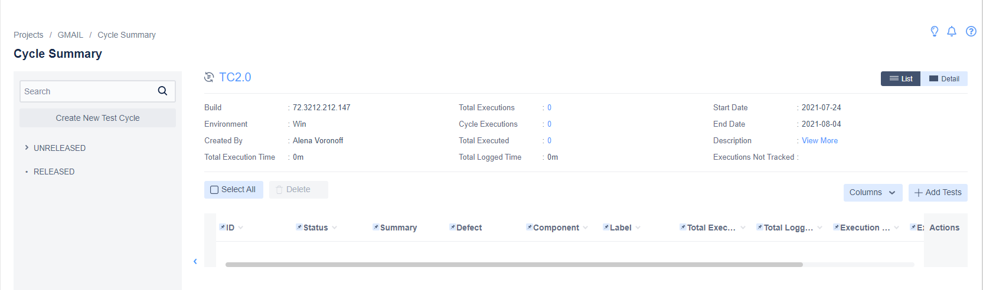
ZEPHYR: Plan/Create Test Cycle III

Slide 38

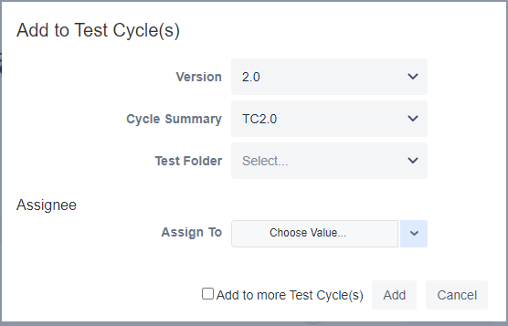
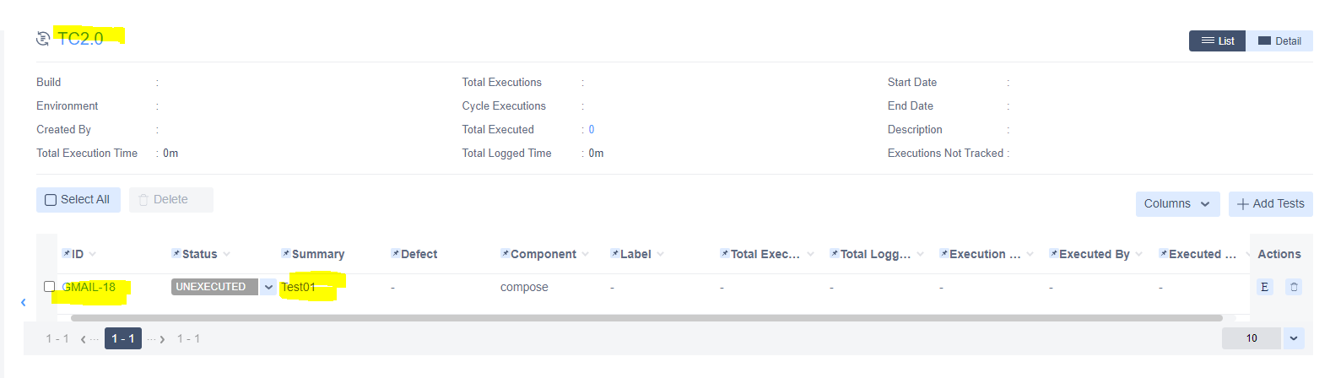
ZEPHYR: Add Tests to Test Cycle
1. Click on the ‘Add Tests’ button (available at the right-hand edge of the page. This will display the page named ‘Add Tests to Cycle :< Name of the cycle>’.
2. On the above page, select the appropriate Test, then assigned the test to the concerned user by selecting the user in ’Assign To’ drop-down. Click on the ‘Add’ button.
=> Added tests should now be seen in the grid.
Note: Before starting test execution, make sure that all the tests are assigned to the concerned users.

Slide 39

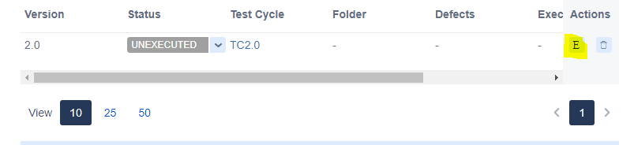
ZEPHYR: Test Cycle Execution I
Execute from ‘Test Cycle Summary’ page: Test cycle summary page displays a list of test cycles. Click on the desired test cycle to see the list of tests included in that cycle.
=> Click on the ‘E’ button on the respective test row. (This button is available under the ‘Actions’ column).
=> This will open up the Test Execution page for the respective test, wherein the user needs to fill in the mandatory details and the other details as applicable.
Note:
If a test step fails, either create an issue using ‘Create New Issue’ button or select issue number (in case it is an already known issue) in the ‘select defects’ dropdown.
It is important to note that, the overall ‘Execution Status’ of a test will not be updated automatically when there are multiple steps and if the status is different for steps. Overall test execution status is to be updated manually too.

Slide 40

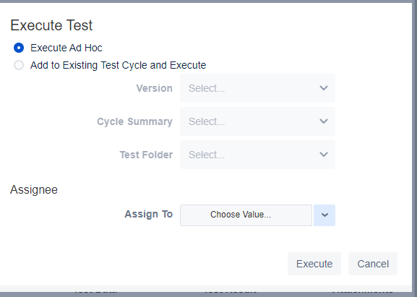
ZEPHYR: Test Cycle Execution II
2. Clicking on the ‘Execute’ button while viewing the test:
=> Open the test to see its details.
Click on the ‘Execute’ button (Refer above image). This will display ‘Execute Test’ popup dialog. Appropriate details
are to be selected on this dialog.
=> Select relevant radio button from
the ‘Execute Ad Hoc’ and ‘Add to
Existing Test Cycle and Execute’.
=> Select Version, Test Cycle and Test Folder.
=> Select the user in ‘Assign To’ drop-down.
Now click on the ‘Execute’ button. This will open up the Test Execution page for the respective test. For details about filling data on this page, refer to option 1.

Slide 41
To Do:
Add Test Case to the Created Cycle
Execute Test Case
View Execution Results
Update Test Case with Additional steps/Assign a Defect report to the Test Case
View/Analyze Test Cycle Execution Results

Slide 42
ZEPHYR: Organizing Tests
Tests can be organized by Project or by Version (Fix version) or by Component or by Label.
By Project: As the tests are created for a specific project(s), they can be sorted/organized based on the Project.
By Fix-Version: Test issues can be further organized by their Fix-version.
By Component: If components are added to different tests, then tests can be organized based on the components.
Tests can also be organized by user-defined labels if the labels are mentioned on the tests.

Slide 43
QA Planning Documents
Company - Test Policy
Project - Quality Management Plan
Product - Test Strategy
Release/sprint – Test plan: test items, test approach, pass-fail criteria, features to be tested, deliverables, schedule, risks, responsibilities
Feature - Test case: id, description, steps, data, excepted results, actual results, status.

Slide 44
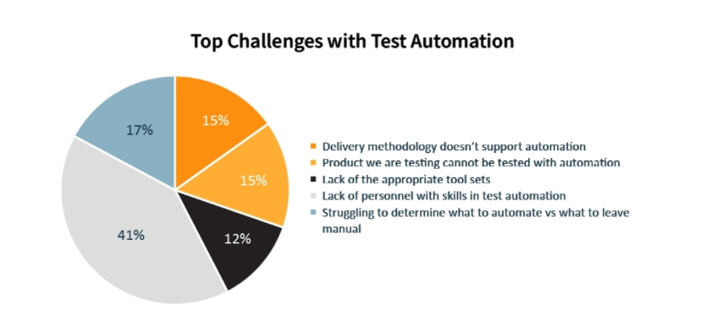

Slide 45
Resources I
Documentation
Jira Software Support
https://support.atlassian.com/jira-software-cloud/resources/
Cloud Support
https://support.atlassian.com/jira-software-cloud/

Slide 46
Resources II
Learn scrum with Jira Software
https://www.atlassian.com/agile/tutorials/how-to-do-scrum-with-jira-software
JIRA Epic https://www.atlassian.com/agile/tutorials/epics
ZEPHYR
https://support.smartbear.com/zephyr-squad-cloud/docs/test-cycles/index.html

