Slide 1
Pos performance test

Slide 2
Changed parameters
Change genesis gasLimit to 126000000
Enlarge Txpool length
Change K to 2400

Slide 3
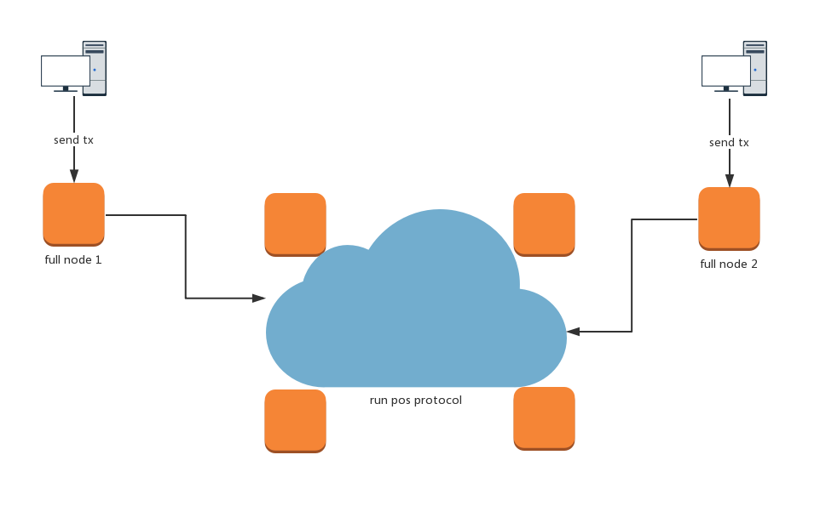
Test topo

Slide 4
Test description
There are 6 pos docker instance
4 instance run pos protocol
2 run as full node and accept txs from PC
Scan the blocks to check how many txs in a block.

