Slide 1
Ensemble Models & Random Forests

Slide 2
Contents

Slide 3
Contents
Introduction
Ensemble Learning
How ensemble learning works
Bagging
Building models using Bagging
Random Forest algorithm
Random Forest model building

Slide 4
The Wisdom of Crowds

Slide 5
The wisdom of crowds
“One should not expend energy trying to identify an expert within a group but instead rely on the group’s collective wisdom, however make sure that opinions must be independent and some knowledge of the truth must reside with some group members” – Surowiecki
-So instead of trying to build one great model, its better to build some independent moderate models and take their average as final prediction

Slide 6
The wisdom of crowds
Problem Statement: What is the estimated monthly expense of a family in our city.
An Eminent Professor built a model Vs.
100 Assessment Professors built 100 models
M1 M2 M3 ……
M1
M100
One Single Prediction
Average of all 100 predictions
$6500
$7200

Slide 7
What is Ensemble Learning

Slide 8

What is Ensemble Learning
Imagine a classifier problem, there are two classes +1 & -1 in the target
Imagine that we built a best possible decision tree, it has 91% accuracy
Let x be the new data point and our decision tree predicts it to be +1. Is there a way we can do better than 91% by using the same data
Lets build 3 more models on the same data. And see we can improve the performance
Data
New data(x)
Decision Trees
Decision Trees
9%
9%
+1

Slide 9
What is Ensemble Learning
We have four models on the same dataset, Each of them have different accuracy. But unfortunately there seem to be no real improvement in the accuracy.
Data
Logistic
Regression
Neural nets
Model
Decision Trees
RF
10%
9%
9%
8%

Slide 10



What is Ensemble Learning
What about prediction of the data point x?
Except the decision tree, the rest all algorithms are predicting the class of x as -1
Intuitively we would like to believe that the class of x is -1
The combined voting model seem to be having less error than each of the individual models.
This is the actual philosophy of ensemble learning
new data(x)
Logistic
Regression
Neural nets
Model
Decision Trees
SVM
10%
9%
9%
8%
-1
-1
+1
-1

Slide 11
Ensemble Models

Slide 12
Ensemble Models
Obtaining a better predictions using multiple
models on the same dataset
Not every time it is possible to find single best fit model for our data, ensemble model combines multiple models to come up with one consolidated model
Ensemble models work on the principle that multiple moderately accurate models can give us a highly accurate model
Understandably, the Building and Evaluating the
ensemble models is computationally expensive
Build one really good model is the usual statistical approach. Build many models and average the results is the philosophy of Ensemble learning
Data
M1
M2
M3
…..
Mk
Combined
model

Slide 13
Why Ensemble technique works?
Imagine three models
M1 with an error rate of 10%
M2 with an error rate of 10%
M3 with an error rate of 10%
The three models have to be independent, we can’t build the same model three times and expect the error to reduce. Any changes to the modeling technique in model -1 should not impact model-2
In this scenario, the worst ensemble model will have 10% error rate
The best ensemble model will have an error rate of 2.8%
2 out of 3 models predicted wrong + all models predicted wrong
(3C2)*(0.1)(0.1)(0.9) + (0.1)(0.1)(0.1)
2.8%
The best ensemble model will have an error rate of 2.8%

Slide 14
Types of Ensemble Models
The above example is a very primitive type of ensemble model. There are better and statistically stronger ensemble methods that will yield better results
Two most popular ensemble methodologies are
Bagging
Boosting

Slide 15
Bagging

Slide 16
Bagging
Take multiple boot strap samples from the population and build classifiers on each of the samples. For prediction take mean or mode of all the individual model predictions.
Bagging has two major parts 1) Boot strap sampling 2) Aggregation of learners
Bagging = Bootstrap Aggregating
In Bagging we combine many unstable models to produce a stable model. Hence the predictors will be very reliable(less variance in the final model).
Note : In statistics, Bootstrap Sampling is a method that involves drawing of sample data repeatedly with replacement from a data source to estimate a population parameter

Slide 17
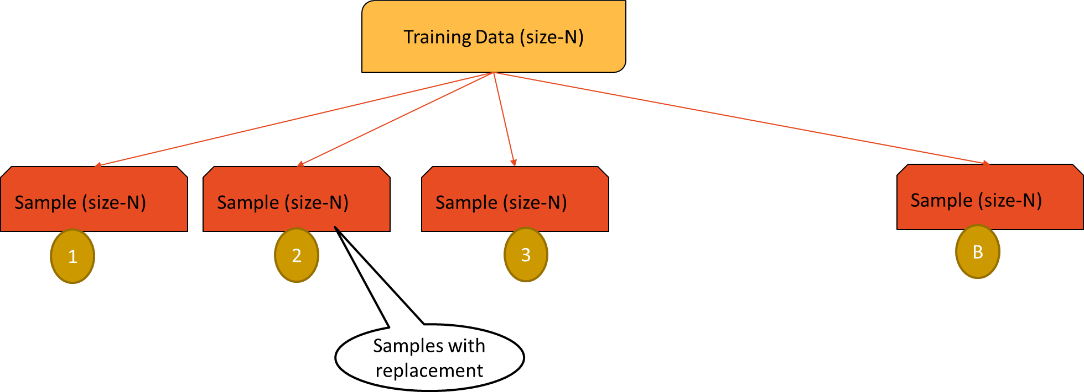
Boot strapping
We have a training data is of size N
Draw random sample with replacement of size N – This gives a new dataset, it might have repeated observations, some observations might not have even appeared once.
We are selecting records one-at–a-time, returning each selected record back in the population, giving it
a chance to be selected again
Create B such new datasets. These are called boot strap datasets

Slide 18
The Bagging Algorithm

Slide 19
The Bagging Algorithm
The training dataset D
Draw k boot strap sample sets from dataset D
For each boot strap sample i
Build a classifier model M_{i}
We will have total of k classifiers M_{1 ,} M₂
,….. M_{k}
Vote over for the final classifier output and take the average for regression output
Data
B1
B2
B3
…..
Bk
M1
M2
M3
…..
Mk
Bagged
model

Slide 20
Why Bagging works
We are selecting records one-at–a-time, returning each selected record back
in the population, giving it a chance to be selected again
Note that the variance in the consolidated prediction is reduced, if we have independent samples. That way we can reduce the unavoidable errors made by the single model.
In a given boot strap sample, some observations have chance to select
multiple times and some observations might not have selected at all.
There a proven theory that boot strap samples have only 63% of overall population and rest 37% is not present.

Slide 21
Why Bagging works
So the data used in each of these models is not exactly same, This makes our learning models independent. This helps our predictors have the uncorrelated errors.
Finally the errors from the individual models cancel out and give us a better ensemble model with higher accuracy
Bagging is really useful when there is lot of variance in our data

Slide 22
Random Forest

Slide 23
Random Forest
Random forest is a specific case of bagging methodology. Bagging on
decision trees is random forest
Like many trees form a forest, many decision tree model together form a Random Forest model

Slide 24
Random Forest
In random forest we induce two types of randomness
Firstly, we take the boot strap samples of the population and build decision trees on each of the sample.
While building the individual trees on boot strap samples, we take a subset of the
features randomly
Random forests are very stable they are as good as NN and SVMs sometimes better

Slide 25
Random Forest algorithm
The training dataset D with t number of
features
Draw k boot strap sample sets from dataset D
For each boot strap sample i
Build a decision tree model M_{i} using only p number of features (where p<<t)
Each tree has maximal strength they are fully grown and not pruned.
We will have total of k decision treed M_{1 ,} M₂
,….. M_{k}; Each of these trees are built on reactively different training data and different set of features
Vote over for the final classifier output and
take the average for regression output
Data
B1
B2
B3
…..
Bk
p1
p2
p3
..
pk
D1
D2
D3
…..
Dk
RF
model

Slide 26
The Random Factors in Random Forest
We need to note the most important aspect of random forest, i.e inducing randomness into the bagging of trees. There are two major sources of randomness
Randomness in data: Boot strapping, this will make sure that any two samples data
is somewhat different
Randomness in features: While building the decision trees on boot strapped samples we consider only a random subset of features.

Slide 27
Why to induce the randomness?
The major trick of ensemble models is the independence of models.
If we take the same data and build same model for 100 times, we will not see any improvement
To make all our decision trees independent, we take independent samples set and independent features set
As a rule of thumb we can consider square root of the number
features, if ‘t’ is very large else p=t/3

Slide 28
Why Random Forest Works
For a training data with 20 features we are building 100 decision trees
with 5 features each, instated of single great decision.
The individual trees may be weak classifiers.
Its like building weak classifiers on subsets of data. The grouping of large sets of random trees generally produces accurate models.

Slide 29


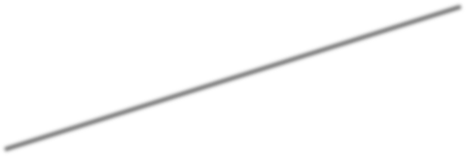
Why Random Forest Works
In this example we have three simple classifiers.
m1 classifies anything above the line as +1 and below as -1
m2 classifies all the points above the line
as -1 and below as +1
m3 classifies everything on the left as -1 and right as +1
Each of these models have fair amount of
misclassification error.
All these three weak models together make a strong model.
m2
m1
m3

Slide 30
LAB: Random Forest

Slide 31
LAB: Random Forest
Dataset: /Car Accidents IOT/Train.csv
Build a decision tree model to predict the fatality of accident
Build a decision tree model on the training data.
On the test data, calculate the classification error and accuracy.
Build a random forest model on the training data.
On the test data, calculate the classification error and accuracy.
What is the improvement of the Random Forest model when compared with the single tree?

Slide 32
Code: Random Forest
import pandas as pd import sklearn as sk import numpy as np import scipy as sp
#Importing dataset
car_train=pd.read_csv("D:\\Google Drive\\Training\\Datasets\\Car Accidents IOT\\train.csv") car_test=pd.read_csv("D:\\Google Drive\\Training\\Datasets\\Car Accidents IOT\\test.csv")
from sklearn import tree
var=list(car_train.columns[1:22]) c=car_train[var] d=car_train['Fatal']
Import data and build a
decision tree
###building Decision tree on the training data #### clf = tree.DecisionTreeClassifier()
clf.fit(c,d)

Slide 33

Code: Random Forest
#####predicting on test data #### tree_predict=clf.predict(car_test[var])
from sklearn.metrics import confusion_matrix###for using confusion matrix###
cm1 = confusion_matrix(car_test[['Fatal']],tree_predict) print(cm1)
Accuracy of the tree
#####from confusion matrix calculate accuracy total1=sum(sum(cm1)) accuracy_tree=(cm1[0,0]+cm1[1,1])/total1 accuracy_tree

Slide 34

Code: Random Forest
####Building Random Forest Model
from sklearn.ensemble import RandomForestClassifier
forest=RandomForestClassifier(n_estimators=10, min_samples_split=2, min_samples_leaf=1)
forest.fit(c,d)
forestpredict_test=forest.predict(car_test[var]) e=car_test['Fatal']
Random forest model and
its accuracy
###check the accuracy on test data
from sklearn.metrics import confusion_matrix###for using confusion matrix### cm2 = confusion_matrix(car_test[['Fatal']],forestpredict_test)
print(cm2)
total2=sum(sum(cm2))
#####from confusion matrix calculate accuracy accuracy_forest=(cm2[0,0]+cm2[1,1])/total2 accuracy_forest

Slide 35
Boosting

Slide 36
Contents
What is boosting
Boasting algorithm
Building models using boosting

Slide 37
Boosting
Boosting is one more famous ensemble method
Boosting uses a slightly different techniques to that of bagging.
Boosting is a well proven theory that works really well on many of the machine learning problems like speech recognition
If bagging is wisdom of crowds then boosting is wisdom of crowds where each individual is given some weight based on their expertise

Slide 38
Boosting
Boosting in general decreases the bias error and builds strong
predictive models.
Boosting is an iterative technique. We adjust the weight of the observation based on the previous classification.
If an observation was classified incorrectly, it tries to increase the weight of this observation and vice versa.

Slide 39







Boosting Main idea
Take a weighted sample
This time give more weight to misclassified records from previous model
Update the weight w accordingly to pick the misclassified records
Build a new classifier on the reweighted sample
Since we picked many previously misclassified records, we expect this model to build a better model for those records
Take a random sample from population of size N
Each record has 1/N Chance of picking
Let 1/N be the weight w
Check the error and resample
Does this classifier still has some misclassifications
If yes, then re- sample
Build a classifier Note down the accuracy
The Classifier may misclassify some of the records.
Note them down
Final Weighted Classifier C = ∑𝛼_{𝑖}𝑐_{𝑖}

Slide 40


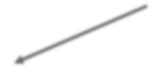

Boosting Main idea
Initial weight(1/N)
Sample
C1
Error
ε1
Accuracy factor
α1
Update weight
Weighted Sample
C2
Error
ε1
Accuracy factor
α2
…..
…
…
…..

Slide 41
How weighted samples are taken
Data | 1 | 2 | 3 | 4 | 5 | 6 | 7 | 8 | 9 | 10
Class | - | - | + | + | - | + | - | - | + | +
Predicted Class M1 | - | - | - | - | - | - | - | - | + | +
M1 Result |  |  | ❒ | ❒ |  | ❒ |  |  |  | 
Weighted Sample1 | 1 | 2 | 3 | 4 | 5 | 6 | 7 | 4 | 3 | 6
Class | - | - | + | + | - | + | - | + | + | +
Predicted Class M2 | - | - | + | + | + | + | + | + | + | +
M2 Result |  |  |  |  | ❒ |  | ❒ |  |  | 
Weighted Sample2 | 6 | 5 | 3 | 4 | 5 | 6 | 7 | 7 | 5 | 7
Class | + | - | + | + | - | + | - | - | - | -
Predicted Class M3 | + | - | + | + | - | + | - | - | - | -
M3 Result |  |  |  |  |  |  |  |  |  | 

Slide 42
Boosting illustration

Slide 43
Boosting illustration
Below is the training data and their class
We need to take a note of record numbers, they will help us in weighted sampling later
Data Points | 1 | 2 | 3 | 4 | 5 | 6 | 7 | 8 | 9 | 10
Class | - | - | + | + | - | + | - | - | + | +
1
2
4
5
3
6
7
8
9
10

Slide 44
Boosting illustration
Model M1 is built, anything above the line is – and below the line is +
3 out of 10 are misclassified by the
model M1
These data points will be given more weight in the re-sampling step
We may miss out on some of the correctly classified records
Data | 1 | 2 | 3 | 4 | 5 | 6 | 7 | 8 | 9 | 10
Class | - | - | + | + | - | + | - | - | + | +
Predicted Class M1 | - | - | - | - | - | - | - | - | + | +
M1 Result |  |  | ❒ | ❒ |  | ❒ |  |  |  | 

Slide 45
Boosting illustration
The misclassified points 3,4,& 6 have appeared more often than others in this weighted sample.
The sample points 9,10 didn’t appear
M2 is built on this data. Anything above
the line is – and below the line is +
M2 is classifying the points 5 & 7 incorrectly.
They will be given more weight in the next sample
Weighted Sample1 | 1 | 2 | 3 | 4 | 5 | 6 | 7 | 4 | 3 | 6
Class | - | - | + | + | - | + | - | + | + | +
Predicted Class M2 | - | - | + | + | + | + | + | + | + | +
M2 Result |  |  |  |  | ❒ |  | ❒ |  |  | 

Slide 46
Boosting illustration
The misclassified points 5 & 7 have appeared more often than others in this weighted sample.
M3 is built on this data. Anything above the line is – and below the line is +
M3 is now classifying everything correctly
Weighted Sample2 | 6 | 5 | 3 | 4 | 5 | 6 | 7 | 7 | 5 | 7
Class | + | - | + | + | - | + | - | - | - | -
Predicted Class M3 | + | - | + | + | - | + | - | - | - | -
M3 Result |  |  |  |  |  |  |  |  |  | 

Slide 47
Boosting illustration
1
2
-
4
5
3
₊ 6
7
8
9
10
The final model now will be picked on weighted Votes.
For a given data point more than 2 models seam to be indicating the right class.
For example take point 6, it is classified as – by M1, + by M2 and + by M3, final result will be +
Similarly take a point 2, it will be classified as –by M1, -by M2 and + by M3, final result will be -
So the final weighted combination of three models predictions will yield in accurate
perdition.

Slide 48
Theory behind Boosting Algorithm

Slide 49
Theory behind Boosting Algorithm
Take the dataset Build a classifier C_{m} and find the error
Calculate error rate of the classifier
Error rate of ε_{m}
• = ∑𝑤_{𝑖}𝐼(𝑦_{𝑖} ≠ 𝐶_{𝑚} 𝑥 ) / ∑𝑤_{𝑖}
• =Sum of misclassification weight / sum of sample weights
Calculate an intermediate factor called α. It analogous to accuracy rate of the model. It will be later used in weight updating. It is derived from error
α_{m}= log((1−ε_{m})/ε_{m})

Slide 50

Theory behind Boosting Algorithm..contd
Update weights of each record in the sample using the α factor. The indicator
function will make sure that the misclassifications are given more weight
For i=1,2….N
_{𝑤𝑖+1 = 𝑤𝑖𝑒}α_{m}𝐼(𝑦_{𝑖}≠𝐶_{𝑚} 𝑥 )
Renormalize so that sum of weights is 1
Repeat this model building and weight update process until we have no misclassification
Final collation is done by voting from all the models. While taking the votes, each model is weighted by the accuracy factor α
C = 𝑠𝑖𝑔𝑛(∑𝛼_{𝑖} 𝐶_{𝑖} (𝑥))

Slide 51
Gradient Boosting
Ada boosting
Adaptive Boosting
Till now we discussed Ada boosting technique. Here we give high weight to misclassified records.
Gradient Boosting
Similar to Ada boosting algorithm.
The approach is same but there are slight modifications during re-weighted sampling.
We update the weights based on misclassification rate and gradient
Gradient boosting serves better for some class of problems like regression.

Slide 52
LAB: Boosting
Ecom products classification. Rightly categorizing the items based on their detailed feature specifications. More than 100 specifications have been collected.
Data: Ecom_Products_Menu/train.csv
Build a decision tree model and check the training and testing accuracy
Build a boosted decision tree.
Is there any improvement from the earlier decision tree

Slide 53
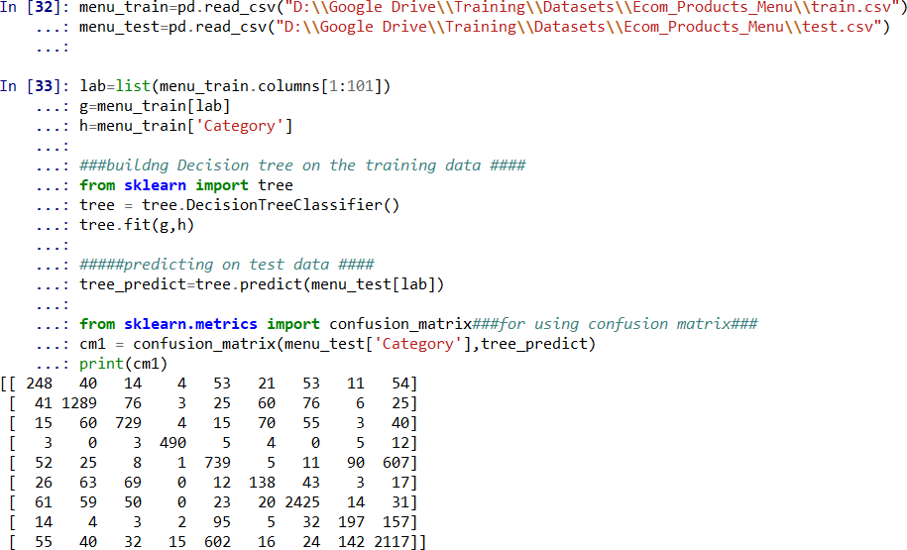
Code: Boosting
Import data and build basic decision tree model
Accuracy

Slide 54
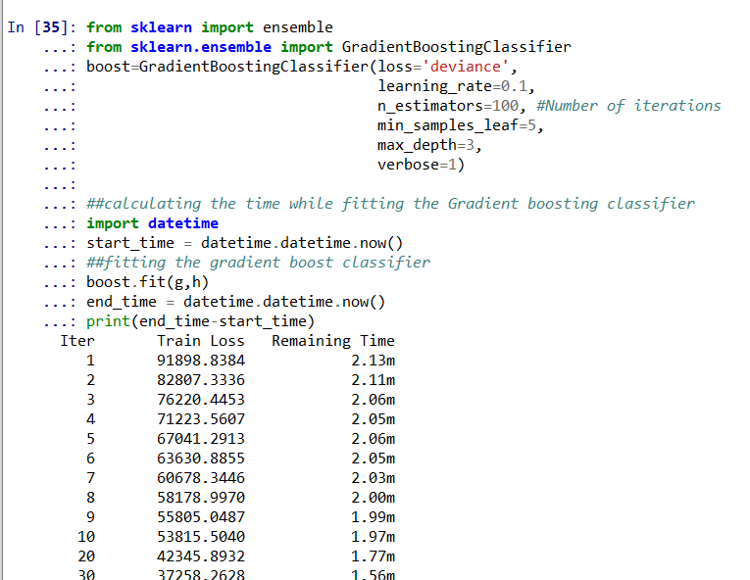

Code: Boosting
GBM Model and iterations

Slide 55
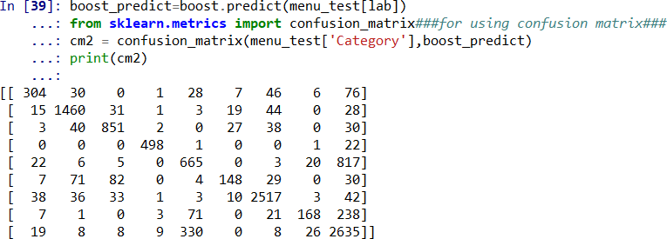
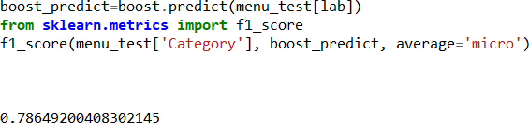
Code: Boosting
Boosted tree accuracy

Slide 56
When Ensemble doesn’t
work?

Slide 57
When Ensemble doesn’t work?
The models have to be independent, we can’t build the same model
multiple times and expect the error to reduce.
We may have to bring in the independence by choosing subsets of data, or subset of features while building the individual models
Ensemble may backfire if we use dependent models that are already less accurate. The final ensemble might turn out to be even worse model.

Slide 58
When Ensemble doesn’t work?
Yes, there is a small disclaimer in “Wisdom of Crowd” theory. We need
good independent individuals.
If we collate any dependent individuals with poor knowledge, then we might end up with an even worse ensemble.
For example, we built three models, model-1 , model-2 are bad, model-3 is good. Most of the times ensemble will result the combined output of model-1 and model-2, based on voting

Slide 59
Conclusion

Slide 60
Conclusion
Ensemble methods are most widely used methods these days. With advanced machines, its not really a huge task to build multiple models.
Random forests are relatively fast, since we are building many small
trees, it doesn’t put lot of pressure on the computing machine
Random forest can also give the variable importance. We need to be careful with categorical features, random forests trend to give higher importance to variables with higher number of levels.
Ensemble models are the final effort of a data scientist, while building the most suitable predictive model for the data

