Slide 1

EC 327 Project:
Registration Magic
Contributors: Sadman Kabir, Nathan Clark, Cynthia Young, Oluwaseun Angelo Soyannwo, Peter West

Slide 2
Project Idea
Course Registration Tool
An application which allows you to register for all of your courses at once rather than having to do one at a time

Slide 3
Backend Deliverables
A Http server which can send a HTTP request to the BU server in order to automats course registration.
Features
A method to store what courses the student plans to register in.
The student link SelectIt ID for each course
Store user credentials or re-ask every time / Authentication (?)
API for the Duo app
A method to send the requests at a scheduled time

Slide 4
Backend Technologies and other Details
Python for processing and sending Http requests
Run on user’s device
Dataset of every course ID (CAS CS 111) and the associated SelectIt ID (######)
This Python script going through every course code on the planner and getting the associated SelectIt
Limitations: no

Slide 5
Frontend Deliverables
A pretty user interface which has the ability to interact with the backend
Features:
Selection of courses
A chrome extension that saves the SelectIt and other course info from every course added to the planner
Or a prettier interface that does the dirty work of dealing with student link
via selenium to get the SelectIt IDs
via a server hosting all the SelectIt IDs stored on a server or packaged with the app
Asks for credentials in a way that appears secure to the user
Easy scheduling that makes it clear that course registration is set to automatically send out at the given time

Slide 6
Frontend Technical tools and Frameworks
Flutter Framework (front end development)
Google Dart programming language (General purpose programming language that flutter uses).

Slide 7





Application Architecture
Local user database
User Interface
Course database (coursedb.py, takes info from Student Link and caches in Course_Info.xlsx)
database.dart
Login Page
Flask API and Python Backend
Home Page
Http request
Student link (registration)

Slide 8
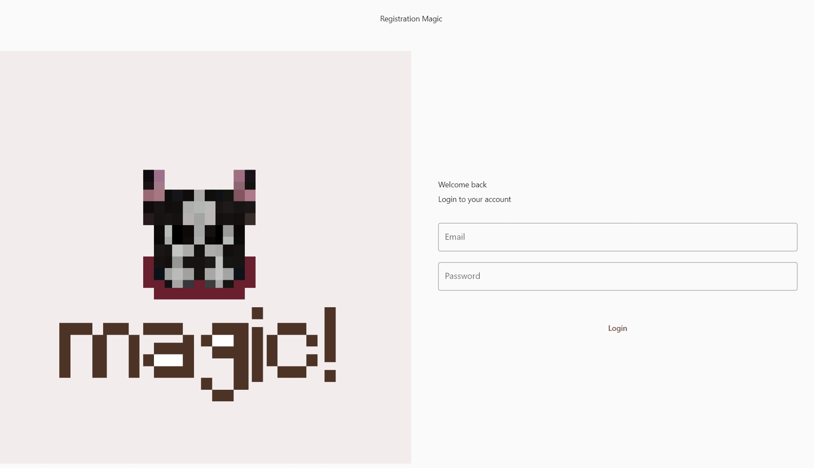
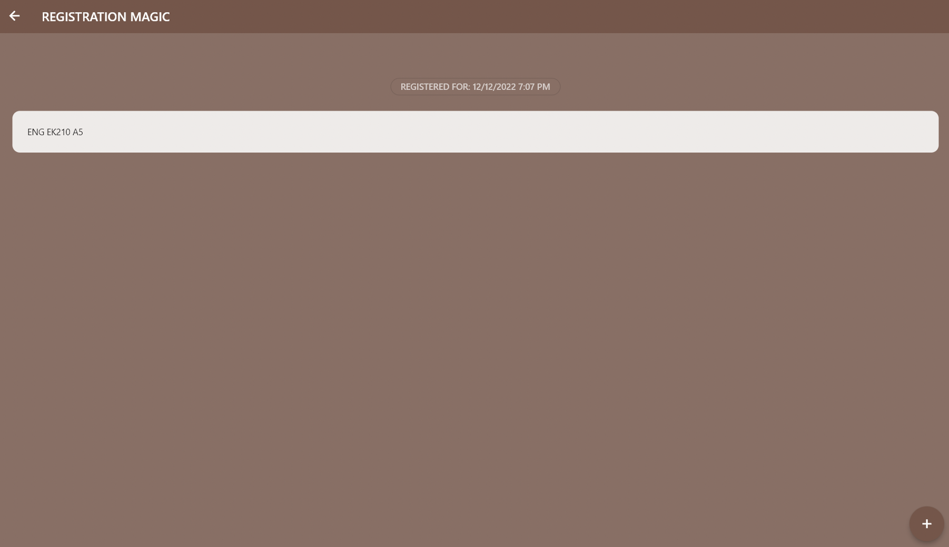
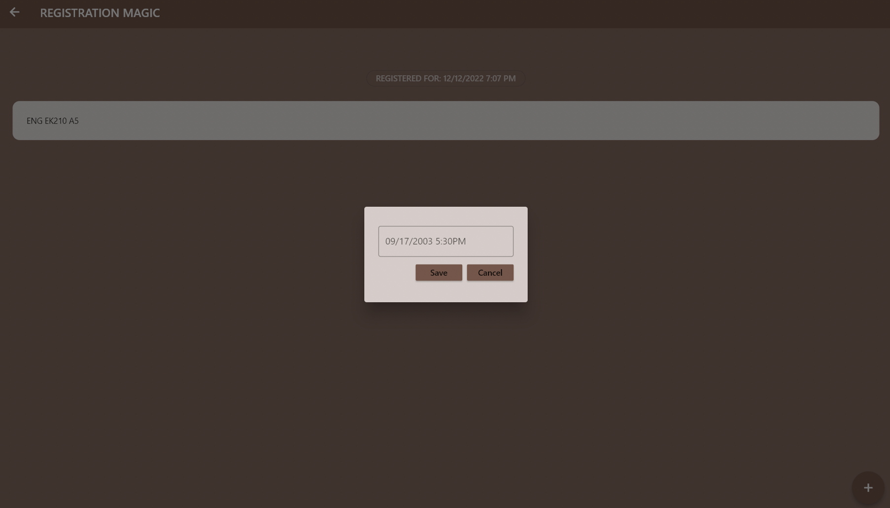
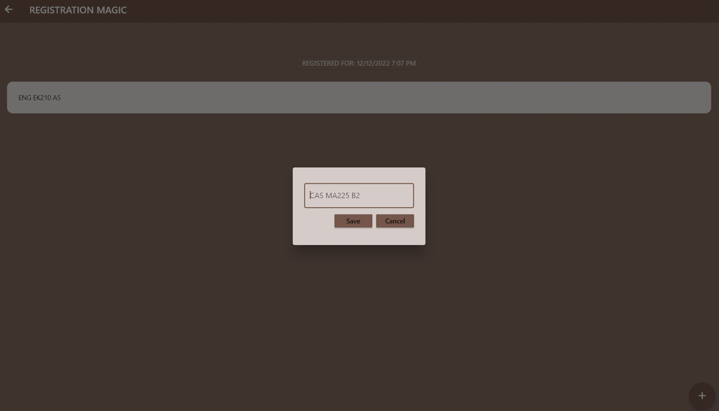
Registration Magic In action

