Slide 1
Kaggle Project – Santander Product Recommendation
Itay Alfia

Slide 2
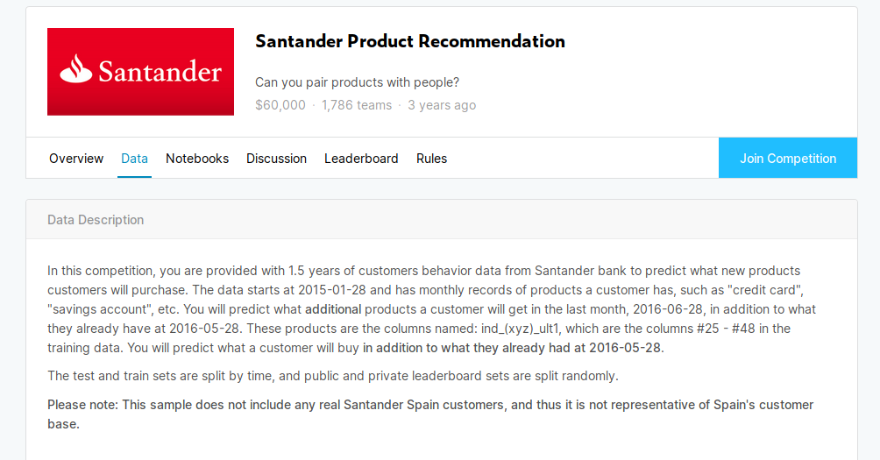
Project Definition
900K Customers, row per month (spanning 1.5 years), each row contains
24 context features (ex. Gross Income, Age…) and 24 binary (have/don’t have)
product features.
Goal: predict positive changes in the product features in the the next month,
for each customer.

Slide 3
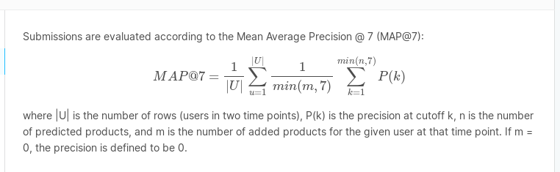
Evaluation Metric
Metrics library contains code for computing the MAP@K metric.
Computed max possible score on dataset – 0.0355 MAP.
Best score on Kaggle Leaderboard – 0.0314 (around 88%)

Slide 4
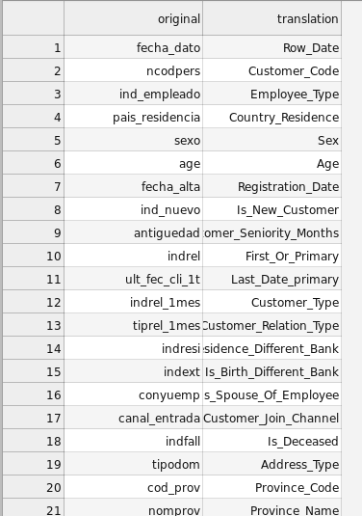
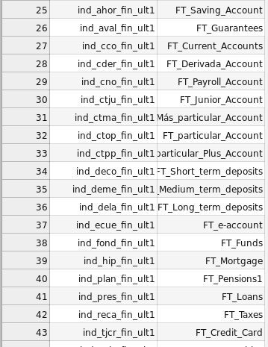
Feature Translation
Unfortunately, dataset is in Spanish.
First step was rough English translation:

Slide 5
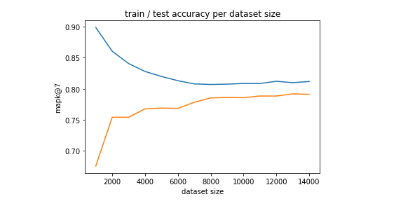
Data Cardinality
900K customers * 18 months * 48 features = Too much data to fit in memory
with Pandas.
+ Slow…
Solution – Use Dask library to load Dataframe in chunks + cleaning + pickling
smaller subsets of the data.
Later, found that model accuracy reaches saturation around 10K~ rows (when chosen carefully):

Slide 6
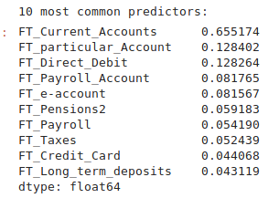
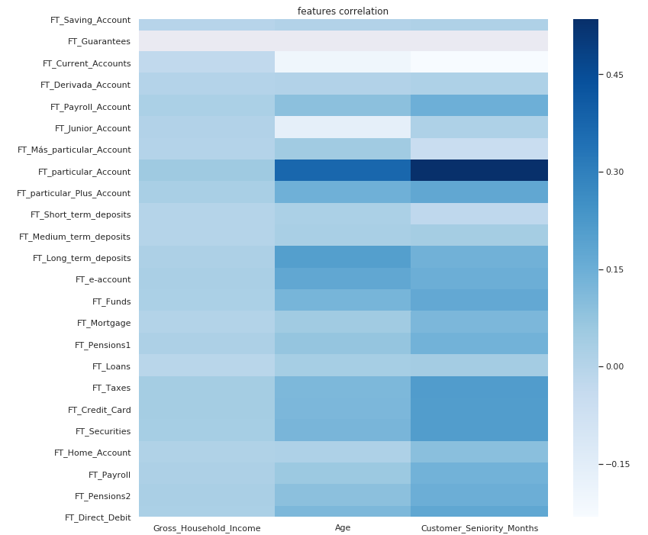
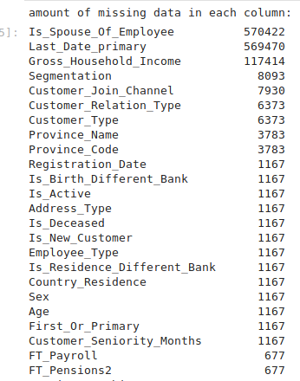
Exploration

Slide 7
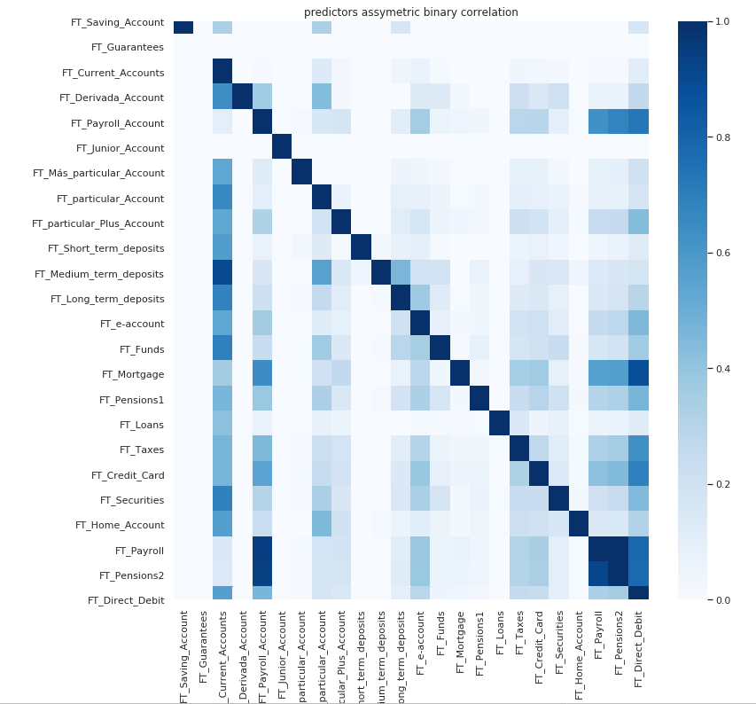
asym_corr(a,b) = P(b | a)
Possible baseline – recommend products connected with high probability
to current possessions.

Slide 8
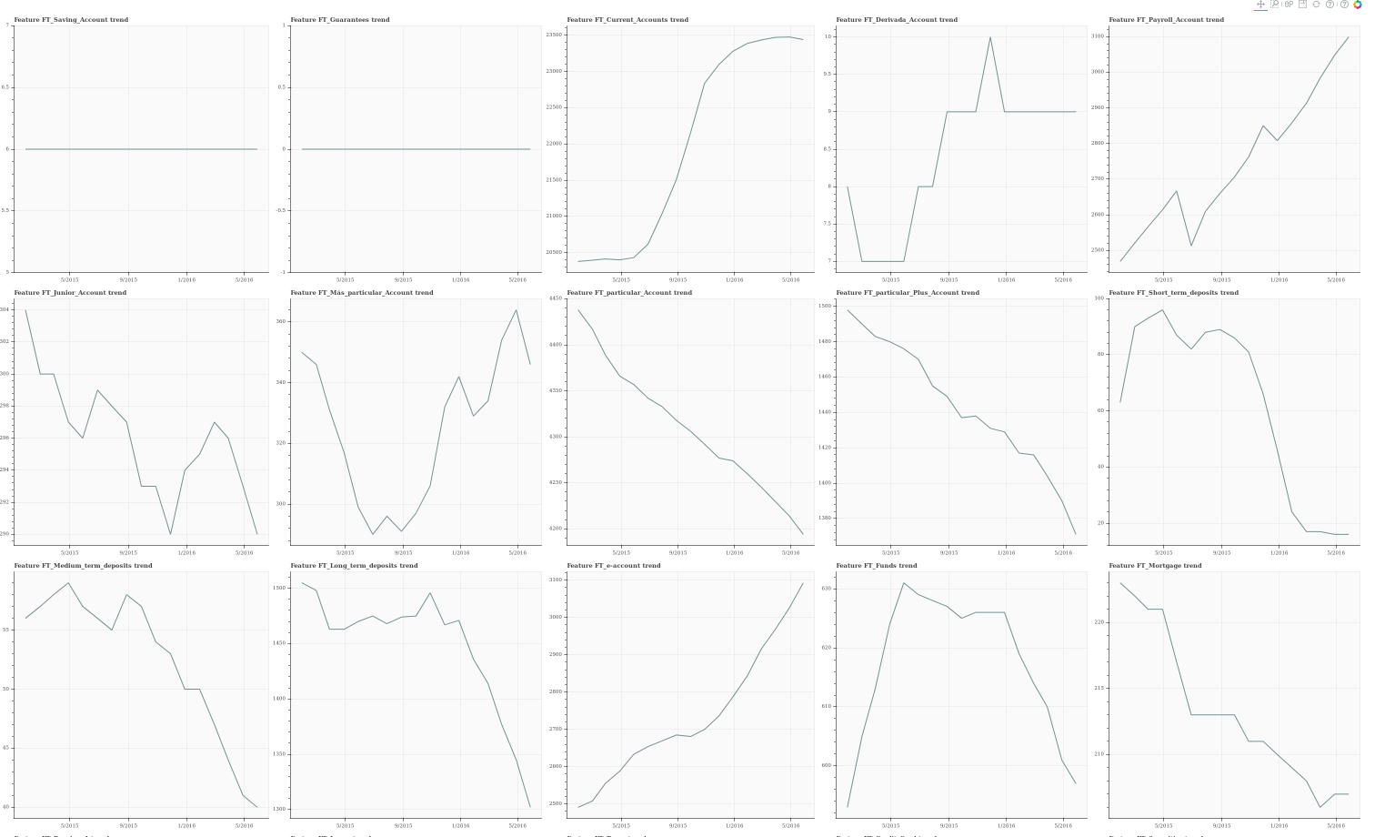
Visualized global trend of possession count, for each product:
Possible baseline – recommend only products with large, positive trend.
Possible problem – trend of some of the products has large variance.

Slide 9
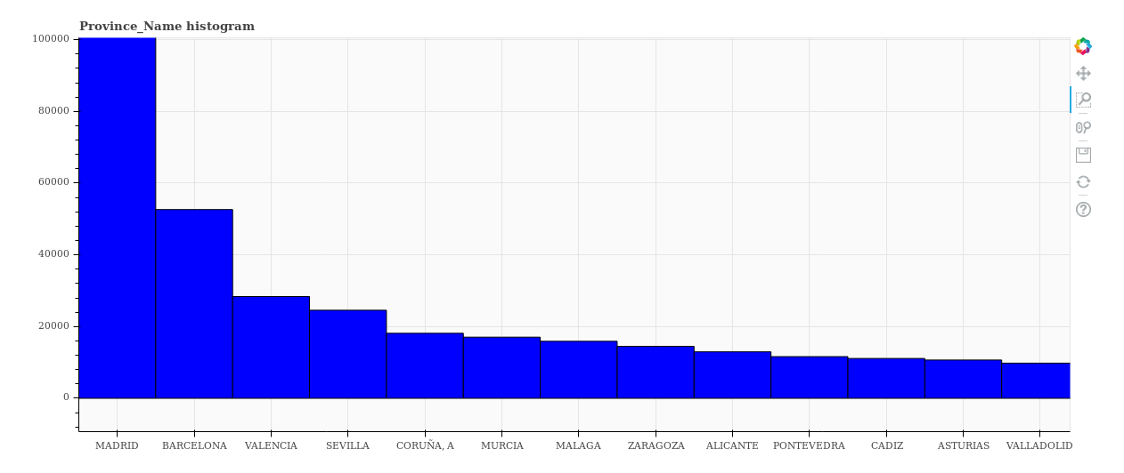
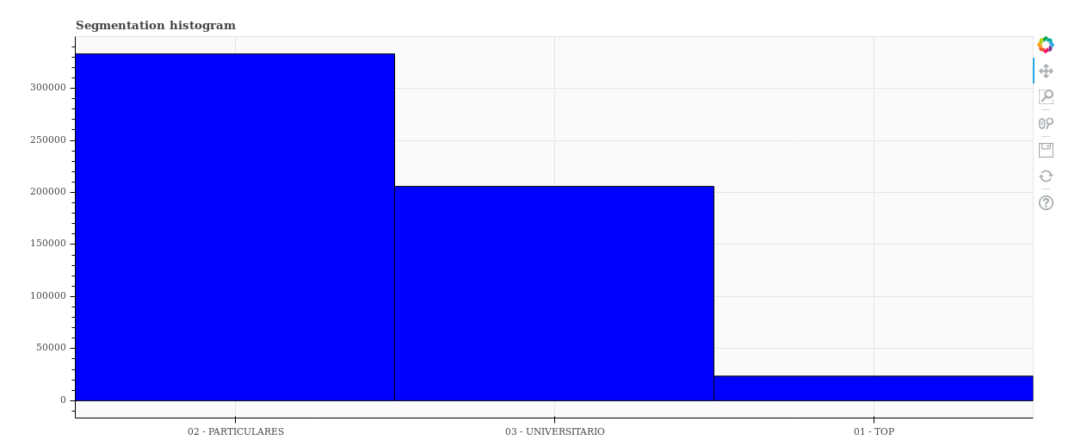

Slide 10
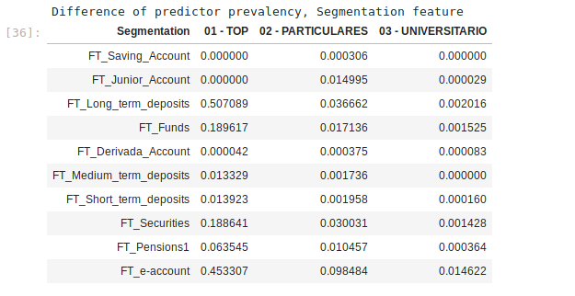
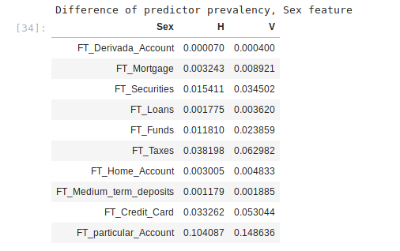
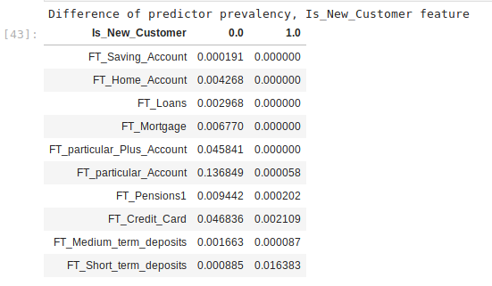
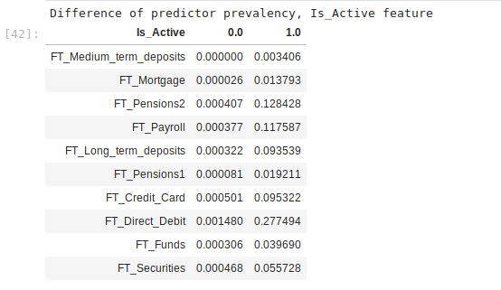

Slide 11
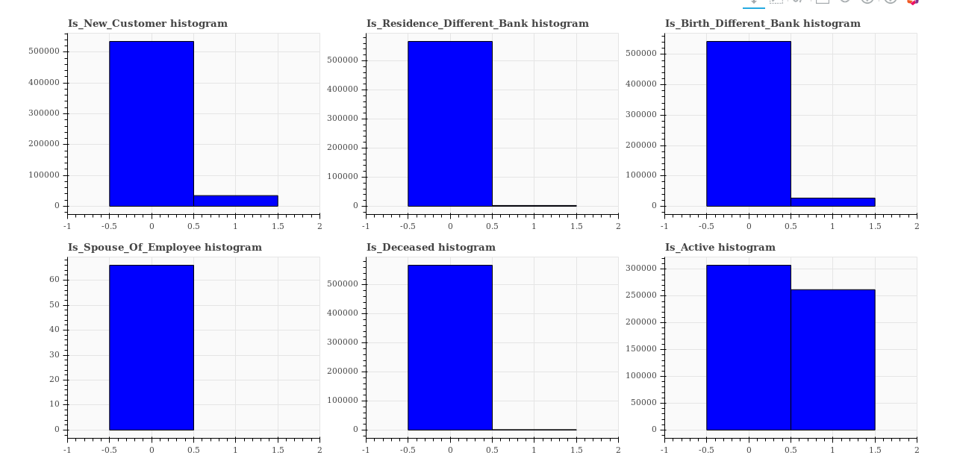
Useless features?

Slide 12
Data Cleaning
1. Keep only the significant context features:
Row_Date, Sex, Age, Customer_Seniority_Months, Province_Name,
Is_Active, Gross_Household_Income, Segmentation
2. Conditional fill_na (mean / most common value / 0)
3. Remove all data rows when no change occurred (keep only 3.5% of data).
4. Handling of categoricals – label encoding / one hot vectorizing / binarize
(most common vs rest)

Slide 13
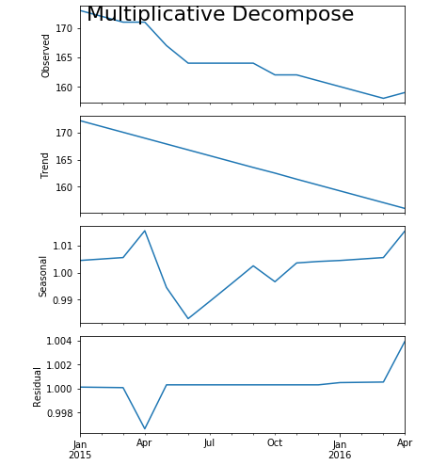
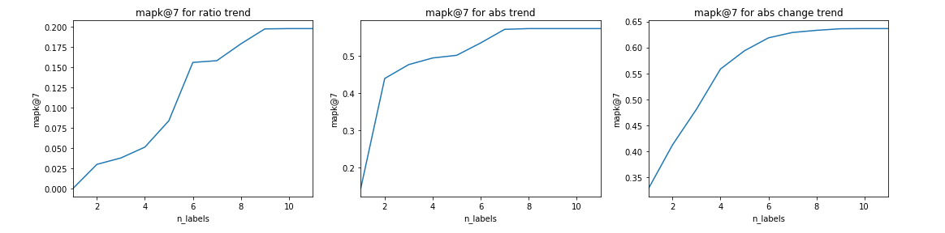
Trend Baseline
Trend decomposition of product:
First baseline – recommend products with an high trend, that the customer
does not already have. Tried various trend types:
Best is recommend top k by “mean absolute change” metric, 63.6% MAP@7

Slide 14
Correlation Baseline
Baseline 2 – recommend to customer, by mean probability predicted
by assymetric correlations matrix.
Weaker than trend baseline.
Best baseline (combination) – interleave recommendations from both
trend, corr baselines - 64.6% MAP

Slide 15
Possible Approaches
Model as a:
1. Multilabel classification problem.
2. Timeseries prediction problem.
3. Collaborative filtering recommendation problem.
4. “Learn To Rank” problem (included in XGBoost!)
5. Label ranking problem (small, low maintenance libraries)
6. Ensemble of other models (Rank Aggregation algorithms)
Collaborative filtering was thrown out – strength of model primarily in cases of open set
Of labels, and when feature space is naturally embedable in a metric space
(distances between points are significant).
Simplest approach, explored first, is to reduce the problem to multilabel binary classification.
Output is the sorting of product labels by their probabilities.
Making use of timeseries information is possible, through engineering of historical
features (would be explored later).
Main con of this method (compared to specialized ranking algorithms) – output probabilities
are possibly uncalibrated, it is not obvious that sorting would work as expected.

Slide 16
Multilabel Classification Models

