Slide 1
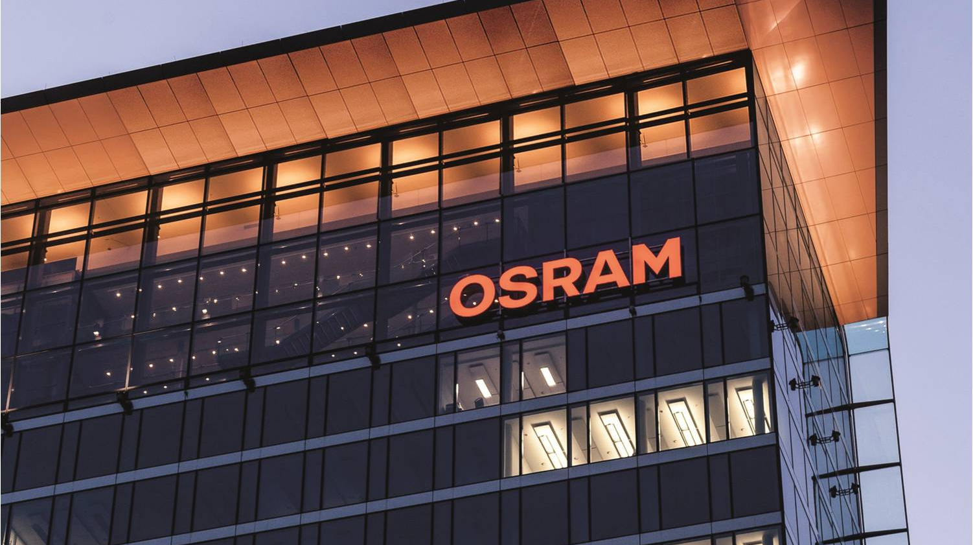



Pac-Lite Packets
Automotive
Devlin Paddock | 06/28/2019
Light is OSRAM

Slide 2
Current Architecture
Service Interface
Service for interfacing with many different Protocols.
Easily change the communication methods for all Pac-Lite machines at one location
One Universal interface for Pac-Lite to support.
Documented Packet structure for importing information to Camstar, Engineering Database etc.
Communicates to service through ActiveMQ in order to buffer data safely.
ENG_DB
ActiveMQ
Camstar
gRPC
Pac-Lite Service
ActiveMQ
TCP/IP
SQL Queries
MQTT
Pac-Lite
Pac-Lite
gRPC Calls
Pac-Lite
Pac-Lite
Pac-Lite
Pac-Lite
Pac-Lite
Pac-Lite

Slide 3
Pac-Lite Packets
Packet Structure
Packet contains all information needed for further routing by the service
Current Packet types are Throughput, Downtime, Index Summary.
Max Packet Size of 254 Bytes, Max Payload of 246 bytes (~4% packet overhead)
Packet type differentiates how it is procccessed
1 Byte
1 Byte
1 Byte
5 Bytes
Up to 246 bytes
StringLength
Packet Header
Packet Type
Pac-Lite_ID
Reserved
JSON Pair/Values
String Null

Slide 4
Pac-Lite Packets
Packets setup
TestActiveMQ
1 252 1 32 32 32 32 32 (json data{Machine Line Good bad index NAED UOM })
Just copies to output que
Camstar Throughput
1 253 1 32 32 32 32 32 (json data{Machine Line Good NAED UOM })
Reports Machine throughput to Camstar
TestSQL
1 254 1 32 32 32 32 32 (json data{Machine Line Good bad index NAED UOM })
Places data in the Pac-Lite SQL database under the machine table.

Slide 5
Outputs supported
ActiveMQ
Consuming applications would subscribe to a topic and configure what type of packets they would receive.
Naming Convention set per Topic.
Camstar
TCP/IP connection to Camstar.
Configure what packets it wants to receive and what packet format if applicable
SQL
Specify which Database and Naming Convention.
Auto Fills with data from packet.
gRPC
Will be capable of calling gRPC procedures with packets setup and defined in the service.

Slide 6
Thank you.
Automotive

