Slide 1
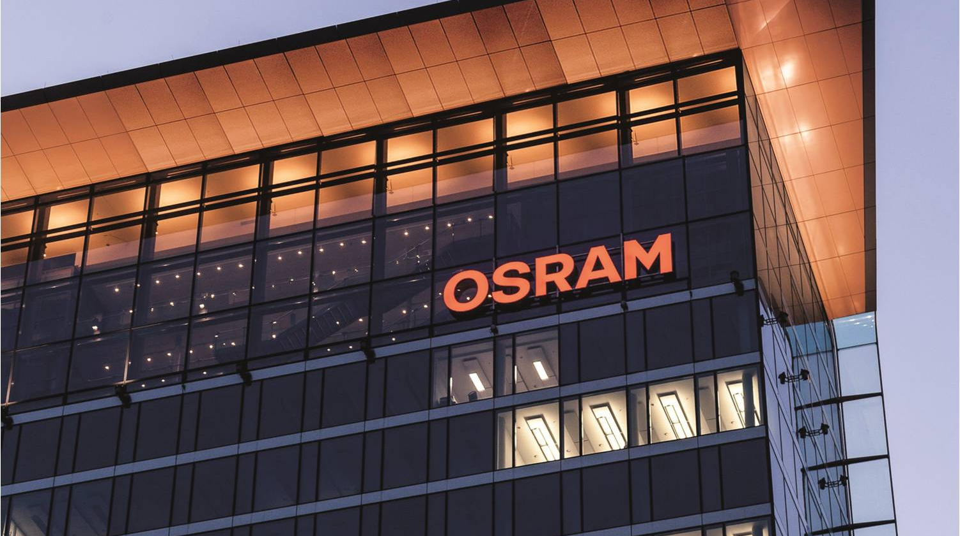



Pac-Lite Hardware Benchmark
Automotive
Devlin Paddock | 06/12/19
Light is OSRAM

Slide 2
Why do we need Pac-Lite
Camstar
    A Manufacturing Execution System.
    Communicates primarily in XML UDP packets
    Receives information directly from Pac
Pac
    A Process Automation Control software
    A Machine abstraction layer that allows communication between machine controls and Camstar
    Doesn’t mesh well with legacy machines
    $ 1000 license per machine
Pac-Light
    Black box to allow legacy machines to communicate with Camstar in the absence of an MDE
    Provides basic functionality for Camstar modules without the time and expense of a full blown MDE system but lacks the features of a full MDE system
Camstar
MQTT Packets
Pac
Pac Lite
Packetized data
MDE
Digital IO
UDP Packet
Machines
Legacy Machines

Slide 3
Pac-Lite Project Requirements
Report Machine Output
    Up/Down status
    Good/Bad part output
    Machine indexes
    Empty head
    What product is being produced
    Enable power on
    10 Input to pac-lite
Display Machine Status
    Status stack light
    Easy to use HMI
    4 outputs from pac-lite
HMI
    Product selection- NAED
    Defined DT button
    Self managed NAED list
    Display diagnostics.
Scope of the project in orange
Sample UI on a Siemens HMI
Camstar
MQTT Packets
Pac Lite
Pac
MDE
Digital IO
New NAED
Enter
Cancel
Sort
Legacy Machines
Machines

Slide 4
Proposed Pac Light Architectures
One CPU per machine solution
    Provide a local HMI for user input, information and diagnostics display.
    Easy for E-Techs to troubleshoot
    Reliably record output of a single machine and report it to Camstar
One CPU per three machine solution
    Integration with up to three target machines
    Provide up to four remote HMIs for user input, information and diagnostics display.
    Reliably record output of up to three machines and report it to Camstar as separate machines.
One CPU per line solution
    One remote IO bundle per machine.
    Provides one display at beginning or end of line
    Reliably record output of up to 32 machines and report it to Camstar as separate machines.
Pac Lite
Machine
HMI
Pac Lite
Machine
HMI
Machine
HMI
Machine
HMI
Pac Lite
HMI
HMI
Machine
Machine
Machine
Notes:
//Add original project def slide to backup slides. Add backup slides section after final slide.
//look into possibility of 1 HMI instead of 4. restriction was on HMI’s I believe that it was limited to 128 IO expansion at 8 per remote IO max.
//Check out support for communicating Between two plc’s in the 1200 series to allow switching the NAED at one location instead of two.
Replace diagrams on right with images of siemens pc’s
Shift slide 10-11 in as well

Slide 5
Proposed Pac Light Architectures
One CPU per machine solution
    Provide a local HMI for user input, information and diagnostics display.
    Easy for E-Techs to troubleshoot
    Reliably record output of a single machine and report it to Camstar
One CPU per three machine solution
    Integration with up to three target machines
    Provide up to four remote HMIs for user input, information and diagnostics display.
    Reliably record output of up to three machines and report it to Camstar as separate machines.
One CPU per line solution
    One remote IO bundle per machine.
    Provides one display at beginning or end of line
    Reliably record output of up to 32 machines and report it to Camstar as separate machines.
Pac Lite
Machine
HMI
Pac Lite
Machine
HMI
Machine
HMI
Machine
HMI
Pac Lite
HMI
HMI
Machine
Machine
Machine
Notes:
Make a slide transferring from architecture to device and which architectures devices support

Slide 6
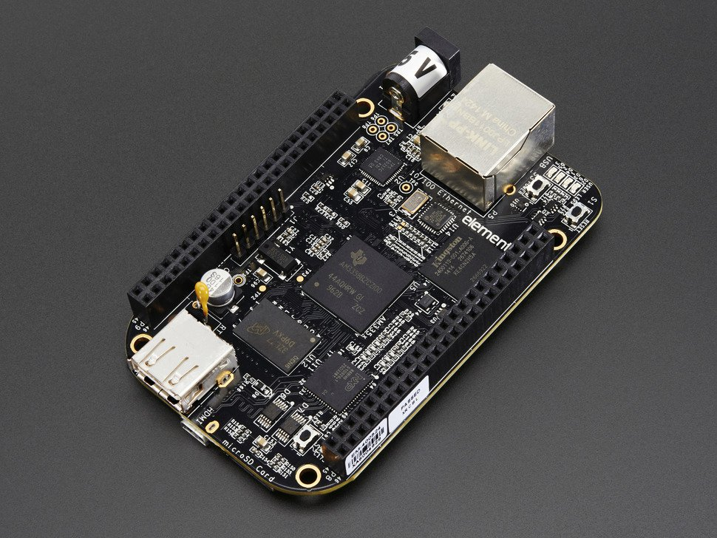
SCADA Box ,One Machine solution
Operating System:
    An IPC Linux operating system.
    Higher level language allows for more communication flexibility
Hardware
    Beagle Bone Black base
      4 GB internal storage
      Relevant IO
        USB, Micro HDMI,8 digital in, 8 digital out and 8 analog in.
HMI
    Freeboard Remote HMI for administration
    Node Red Local HMI for management of the machine and NAED selection.
    Outputs over HDMI allowing for much more freedom in
    display choices.
IO
Local HMI
Free Board
C/C++
Gamma
Middleware
Node Red
Also Supports High chart and Xibase Integration

Slide 7
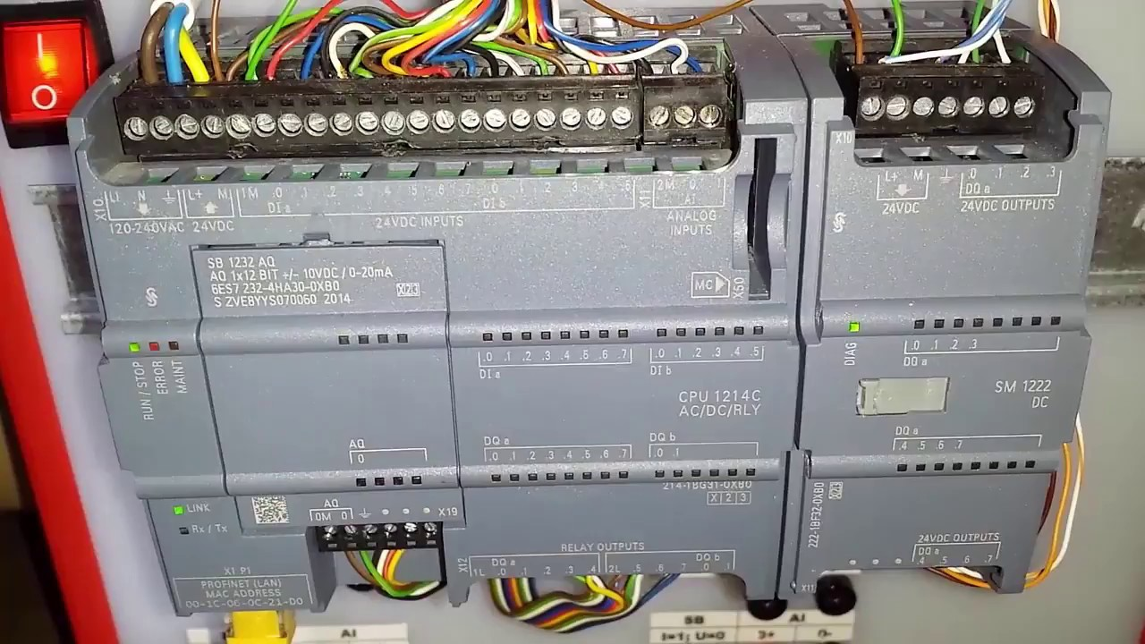
Siemens Products -Generic
Software
    Developed in Step7 or Tia Portal.
    Scan Based OS
    Lower level control.
    Requires HMI Displays capable of rendering themselves.
Hardware
    Limited number of connections that has to be split between Web, IO, HMI, Etc.
    Expandable by IO and communication Modules.
      Communication: Serial, Profibus, Profinet, Etc.
      IO: Timers, PWM output, analog, Relay, Etc.
Remote IO
Other Controllers
“Smart” HMI
Profinet Connection
IO
CPU
Memory

Slide 8
CPU solutions
1212C
    8 inputs and 4 outputs integrated
    Remote IO Via Profinet
    Lacks STL, and Graph support
    Lower cost than 1500 series.
    Slower operation speeds.
    Supports 3 HMIs
    Larger footprint
1510SP
    No integrated IO
    Supports 4 HMIs
    Supports STL, and Graph
    Remote IO via Profinet
    More expensive than 1200 series
    Fast operation speeds

Slide 9
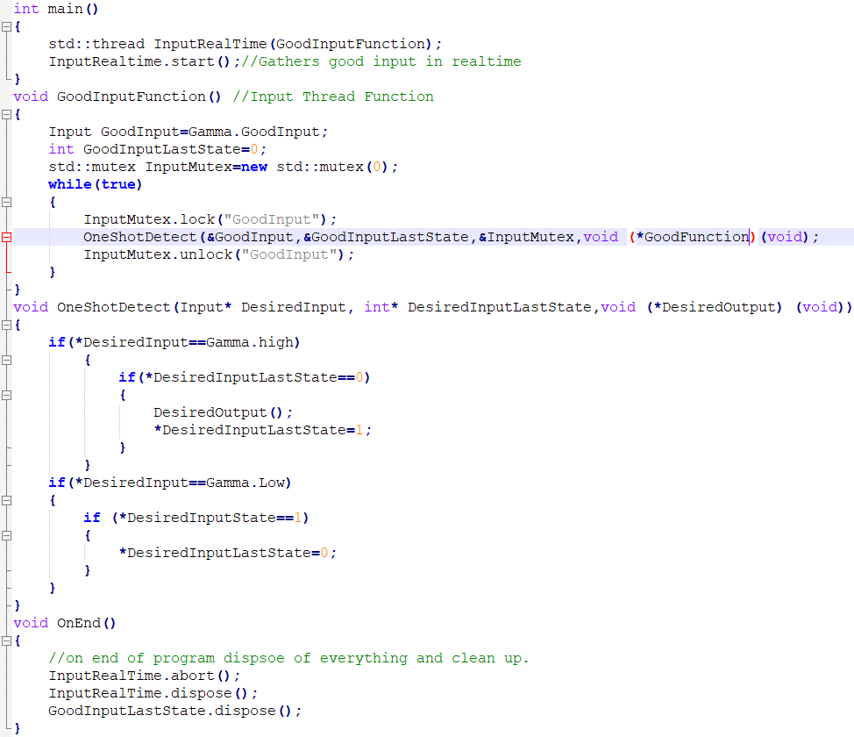
SCADA box Benefits
Higher Level Control:
    Easy deployment
      Administrative Free Board
      Local Node-Red HMI
    Different communication types
      MQTT,HTTPS,UDP,TCP Etc.
    Remote machine control
      Can poll servers for BOM data or machine lock signals
Useful for later Projects
    Adds a lot of resident IO
      2 Serial, 4 thermal interfaces, 8 analog Inputs, IDRA receiver
    Can be reused for other projects
      Could addon Environment monitoring
Misc.
    Web based management
    28% cheaper than 1212C and 42% cheaper than 1510sp

Slide 10
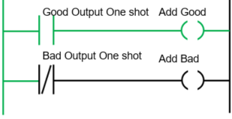
Siemens Solution Benefits
Better Maintainability:
    Local Factors
      Local Experience
      Replacement Parts
    Common Development Environment
      Better Forums
IO Expansion
    More IO available for more in depth error reporting
    Communication Modules
      Ability to add Serial, Profinet, Ethernet, Profibus, Etc.
Misc.
    Easy to deploy
    Easy to troubleshoot
    Durability tested to -20C, and 15g shock, IP20 protection rating

Slide 11
Cost Breakdown
CPU | Cost Per Device | Cost Per New Machine | Cost per 4 | Straight Base | CPU cost | Accessory Cost
Siemens 1212C | $738 | $738 | $2,952 | $4,427 | $232 | $506
Siemens Using Remote IO 1510sp | $1,729 | $754 | $3,991 | $5,870 | $816 | $913
SCADA Resistive Touchscreen keyboard Mouse | $527 | $527 | $2,108 | $3,162 | $430 | $97
 | HMI Cost | storage | Minimum Expansion
Siemens 1212 | $347 | $159 | $0
Siemens Using Remote IO 1510sp | $347 | $159 | $407
SCADA PIResistiveTouchscreen | $97 | $0 | $0
Cost For 4 Machines (best case for 1510)

Slide 12
Category Comparisons
1212C:
    Maintainability
      Better local experience
      More industrialized
      Siemens documentation
    Adaptability/Software Flexibility
      IO Expansion allows more descriptive fail reporting
1510sp:
    All benefits of 1212C listed.
    Adaptability/software flexibility
      1 Device can support up to 4 machines
      Supports Graph and STL programming
Scada:
    Maintainability
      Less local experience
      Poor documentation
    Adaptability/software flexibility
      Two way MQTT communication, and ability to run SQL queries.

Slide 13
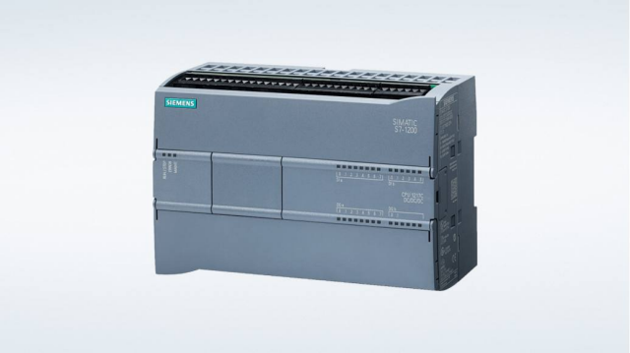
Conclusion
Siemens PLC 1510sp
    Environment
      Local experience
      Common development environment
      Easy troubleshooting
      Designed for an industrial setting
    Diverse Hardware
      More IO can allow for more complex error reporting
      Benefits of Scada IO can be added separately
    Simple Setup
      Flash the memory then set which line its running on, what server its reporting to, and its IP. Then it will be ready to run.
    Lower Cost With High Simplicity
      No need for higher level control

Slide 14
Thank you.

Slide 15
Backup Slides

Slide 17
Backup Slides

Slide 18
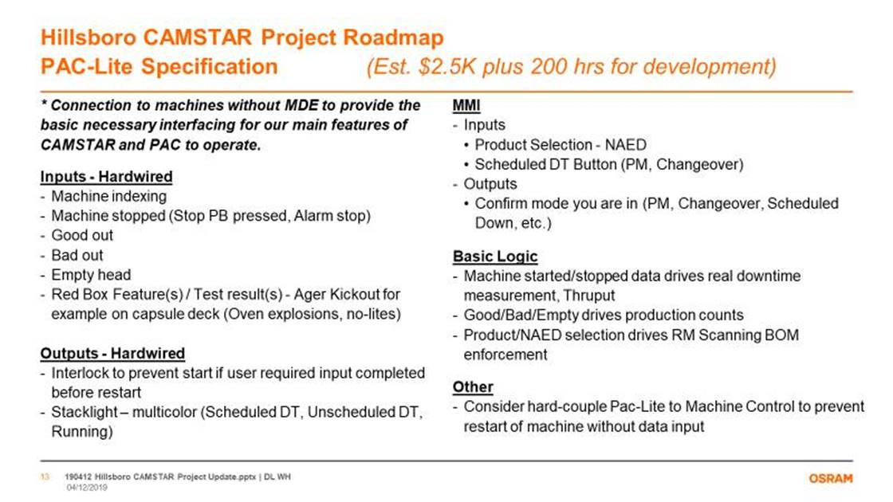

Slide 19
Proposed Pac Light Architectures
One CPU per machine solution
    10 input 4 output
    Provide a local HMI for user input, information and diagnostics display.
    Easy for E-Techs to troubleshoot
    Reliably record output of a single machine and report it to Camstar
    Programmed in Ladder and SCL
One CPU per four machine solution
    Integration with up to four target machines
    Provide up to four remote HMIs for user input, information and diagnostics display.
    Reliably record output of up to four machines and report it to Camstar as separate machines.
    Programmed in Ladder and SCL
Camstar
Pac Lite
Machine
Camstar
Pac Lite
Machine
Machine
Machine
Notes:
//Add original project def slide to backup slides. Add backup slides section after final slide.
//look into possibility of 1 hmi instead of 4. restriction was on HMI’s I believe that it was limited to 128 IO expansion at 8 per remote iO max.
//Check out support for communicating betwean two plc’s in the 1200 series to allow switching the naed at one location instead of two.
Replace diagrams on right with images of siemens pc’s
Shift slide 10-11 in aswell

Slide 20
Siemens PLC
Operating System:
    Realtime scan based OS
    Supports relay ladder logic FBD and SCL primarily
    Developed in Step7 or Tia Portal
PLCs
1212C CPU Single Machine Solution
Integrated IO
Simatic S7 Memory Card
1510SP Multi Machine Solution
IO Modules & Server Module
Simatic HMI
$199.99
$347
$347
$159
Simatic S7 Memory Card
$159
10 input 4 output
CPU Cost
170.89
CPU Cost
816.46
Simatic HMI

Slide 21
SCADA Box
Operating System:
    Stripped down Debian with Xenomai installed
    Graphics are programmed with Node Red
    Realtime logic is handled by C/C++
    Developed in a custom Eclipse install
Hardware
    Beagle Bone Black base
      4 GB internal storage
      Communication interfaces/ display
        Micro SD, USB, Ethernet, and micro HDMI
    Automation IO
      8 digital in 8 digital Out 8 analog in 2 rs232 1 IDRA
    Relevant IO 8 digital in 8 digital Out.
Scada Box Single Machine Solution
Price
Supports C/C++, and Node Red.
$430
Accessories
Resistive Touch Screen
$74.99
No storage or expansion needed.
Notes:
//Compress slides 5 and 6 together format similarly to slide four . Highlight that it’s a one cpu per machine setup. Compare it to an ipc instead of describing xenomai linux etc.

Slide 22
Cost Breakdown
CPU | Cost Per Device | Cost Per New Machine | Cost per 4 | Straight Base | CPU cost | Accessory Cost
Siemens 1212C | $738 | $738 | $2,952 | $4,427 | $232 | $506
Siemens Using Remote IO 1510sp | $1,523 | $706 | $3,641 | $5,870 | $816 | $706
SCADA Resistive Touchscreen keyboard Mouse | $527 | $527 | $2,108 | $3,162 | $430 | $97
 | HMI Cost | storage | Minimum Expansion
Siemens 1212 | $347 | $159 | $0
Siemens Using Remote IO 1510sp | $347 | $159 | $200
SCADA PIResistiveTouchscreen | $97 | $0 | $0
Cost For 4 Machines (best case for 1510)

Slide 23
SCADA Box HMI
Free Board
    Web based app
    Slow over network control
    Integrates well with node red, allows remote monitoring
Node Red
    Very simple graphic programming
    Fast local control of Scada box
    Interfaces with real-time logic through Gamma middleware
Output over Micro HDMI:
    Resistive touchscreen
      4 inch resistive touchscreen
      Can be mounted to control box
      Not shock or splash proof
Free Board
Local HMI
Node Red
IO
Gamma
Middleware
C/C++
Also Supports High chart and Xibase Integration
Notes:
Backup slide

Slide 24
Proposed Pac Light Solutions
1212C CPU Single Machine Solution
Price
1510SP Multi Machine Solution
Price
Supports STL, Graph, SCL, LAD, and FBD
$816.46
Supports SCL,LAD, and FBD
$170.89
Scada Box Single Machine Solution
Price
Supports C/C++ and Node Red
$430
Accessories
Integrated IO
Simatic S7 Memory Card
Accessories
IO Modules & Server Module
Simatic HMI
$199.99
$347
Simatic HMI
$347
$159
Simatic S7 Memory Card
$159
10 input 4 output.
Accessories
HMI ( touchscreen Keyboard Mouse ETC)
$97
Onboard storage no expansion needed

Slide 25
Maintainability/Misc.
Siemens:
      Common development environment /experience
      All data stored on a memory card
      Siemens forum support
      Easy troubleshooting
      Requires a “smart” HMI solution
      Realtime Delay:20μs
      Lower level solution
      More IO expansion
Scada:
      Renders itself allows for “dumb” HMI
      Realtime Delay: 20-50μs
      Higher level solution
      Custom development Environment
      Onboard storage
      Low documentation/ platform support

Slide 26
Score Breakdown
Score Breakdown
 | Scada | 1212C | 1510sp
Software Flexibility | 36 | 28 | 28
Maintainability | 16 | 34 | 32
Hardware Flexibility | 24 | 30 | 36
Ease of setup | 36 | 36 | 24
Adaptability | 20 | 28 | 32
Overall | 33 | 39 | 38
Cost | $2,108 | $2,952 | $3,642
 |  | Scada | 1212C | 1510sp
Software flexibilty | Supports MQTT | 3 | 2 | 2
 | Background Tasks | 3 | 2 | 2
 | Supports Local HMI | 3 | 3 | 3
Maintainability | Experience of local engineers | 1 | 3 | 3
 | Easy Remote Administration | 3 | 2 | 2
 | Low cost to repair or replace | 1 | 3 | 2
 | Designed for an industrial Setting | 1 | 3 | 3
 | Common Development Environment | 1 | 3 | 3
 | Documentation | 1 | 3 | 3
Hardware Flexibility | Built In IO | 2 | 3 | 3
 | IO Expansion | 1 | 3 | 3
Ease of setup | Complexity | 3 | 3 | 2
Adaptability | Adding Restrictions from server | 3 | 2 | 2
 | Multi Machine Support | 1 | 2 | 3
 | Error Reporting Complexity | 1 | 3 | 3
Better

Slide 27
Siemens,One Machine solution
Operating System:
    Realtime scan based OS
    Supports relay ladder logic and SCL primarily
    Developed in Step7 or Tia Portal

Slide 28
Siemens Solution Benefits
Better Maintainability:
    Local Factors
      Local Experience
      Replacement Parts
    Common Development Environment
      Better Forums
IO Expansion
    More IO available for more in depth error reporting
    Communication Modules
      Ability to add Serial, Profinet, Ethernet, Profibus, Etc.
Misc.
    Easy to deploy
    Easy to troubleshoot
    Durability tested to -20C, and 15g shock, IP20 protection rating

