Slide 1
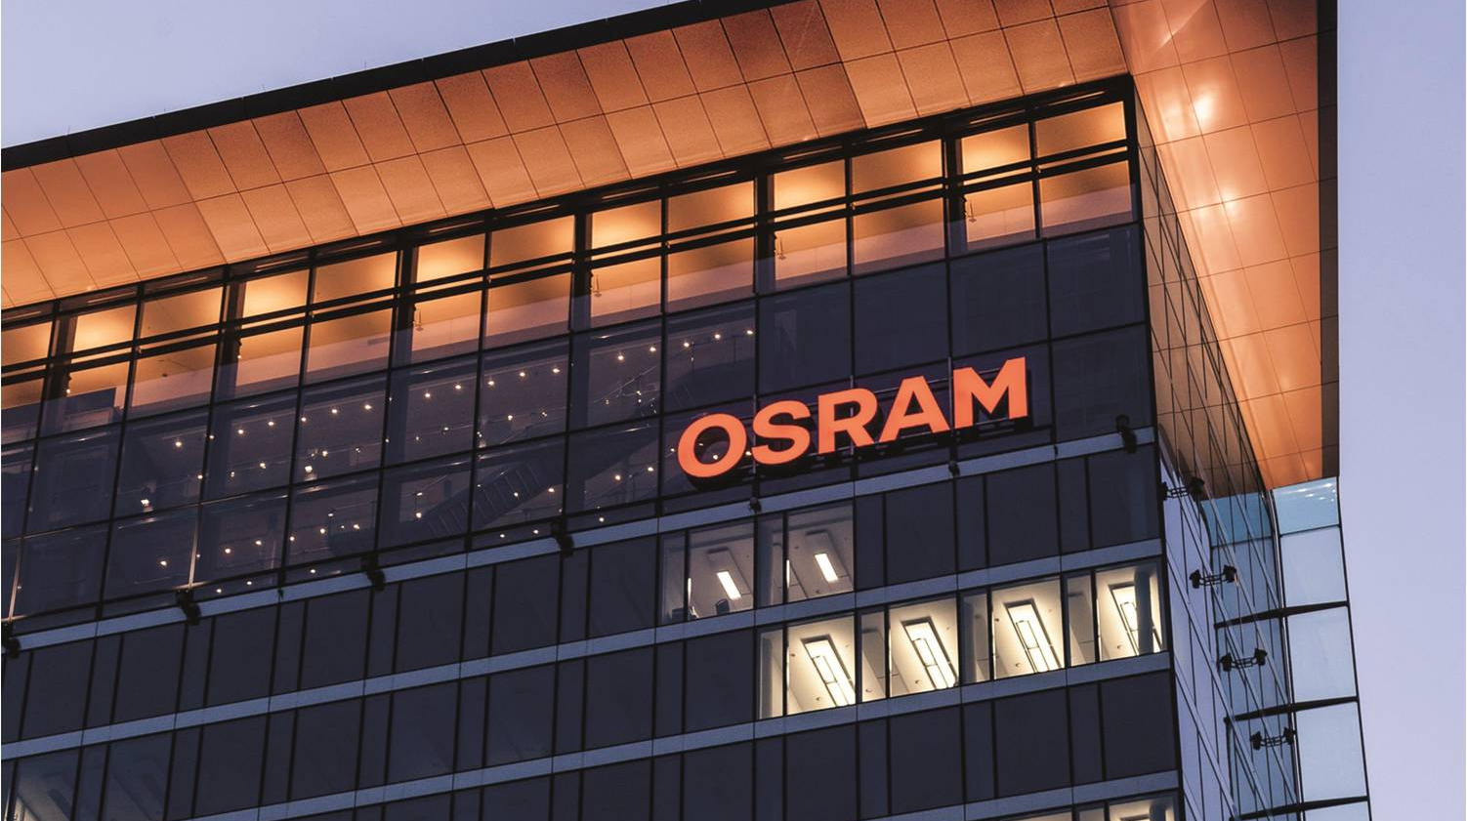



Pac-Lite Service
Automotive
Devlin Paddock | 06/28/2019
Light is OSRAM

Slide 2
Context
Old Model
Changes in messaging
Camstar no longer accepts MQTT.
Germany is looking into a gRPC communication layer.
Can only communicate with Camstar through TCP/IP or third party software.
Can only talk to Engineering database through an API or SQL Commands.
Changes in Structure
All Scrap is recorded in Engineering database not Camstar.
Need for a more flexible communication layer.
Camstar
MQTT Packets
Pac
Pac Lite
Packetized data
MDE
Digital IO
UDP Packet
Machines
Legacy Machines

Slide 3
Pac Light Service
Service Interface
Service for interfacing with many different Protocols.
Easily change the communication methods for all Pac-Lite machines at one location
One Universal interface for Pac-Lite to support.
Documented Packet structure for importing information to Camstar, Engineering Database etc.
Communicates to service through ActiveMQ in order to buffer data safely.
ENG_DB
ActiveMQ
Camstar
gRPC
Pac-Lite Service
TCP/IP
ActiveMQ
SQL Queries
MQTT
Pac-Lite
Pac-Lite
gRPC Calls
Pac-Lite
Pac-Lite
Pac-Lite
Pac-Lite
Pac-Lite
Pac-Lite

Slide 4
Connection Choice
MQTT
Publish, subscriber based connection good for abstraction.
Small Packet sizes with reliable sending.
Able to easily be sent from anything, whether it is a PLC/IPC or a Web/mobile application.
Send and forget. Does not require any in depth maintenance for the connection. Good for low power or possibly unreliable networks.
ActiveMQ Buffer Management.
Json
Very simple name value pair.
Much smaller and simpler than XML
Able to easily be generated on anything from a PLC/ IPC to a Web or mobile application.
Easy for low level programs to generate and high level programs to use in a class-full architecture.
{ “Machine": “Rat-Bat", “ResourceGroup":”XP1” , “Good":”42” , “Bad":”3”, “Index":”45” }

Slide 5
Pac-Lite Packets
Packet Types
Support created at the service level then implemented in PLC.
Packet contains all information needed for further routing by the service
Current Packet types are Throughput, Downtime, Index Summary.
Max Packet Size of 260 Bytes, Max Payload of 246 bytes (~5% packet overhead)
6 Bytes
1 Byte
1 Byte
1 Byte
5 Bytes
Up to 246 bytes
MQTT Header
Packet Header
Packet Type
Pac-Lite_ID
Reserved
JSON Pair/Values

Slide 6
Outputs Planned
ActiveMQ
Consuming applications would subscribe to a topic and configure what type of packets they would receive.
Naming Convention set per Topic.
Camstar
TCP/IP connection to Camstar.
Configure what packets it wants to receive and what packet format if applicable
SQL
Specify which Database and Naming Convention.
Auto Fills with data from packet.
gRPC
Will be capable of calling gRPC procedures with packets setup and defined in the service.

Slide 7
Thank you.
Automotive

