Slide 1




Pac- Light C&E matrix
Automotive
Devlin Paddock | 06/14/19
Light is OSRAM

Slide 2
Pac- Light C&E matrix
 |  | Page
1. | Description of Pac-Lite | 02
2. | Lean Six Sigma, C&E, and our goal | 07
3. | Category Description | 10
4. | Data Collection | 13

Slide 3
Why do we need Pac-Lite
Camstar
    A Manufacturing Execution System.
    Communicates primarily in XML UDP packets
    Receives information directly from Pac
Pac
    A Process Automation Control software
    Allows communication between machine controls and Camstar
    Doesn’t work with legacy machines
    $ 1000 license per machine
Pac Light
    Black box to allow legacy machines to communicate with Camstar in the absence of an MDE
    Provides basic functionality for Camstar modules without the time and expense of a full MDE system but lacks the features of a full MDE system
Camstar
MQTT Packets
Pac
Pac Lite
Packetized data
MDE
Digital IO
UDP Packet
Machines
Legacy Machines

Slide 4
Pac-Lite Project Requirements
Report Machine Output
    Up/Down status
    Good/Bad part output
    Machine indexes
    Empty head
    What product is being produced
    Enable power on
Display Machine Status
    Status stack light
    Easy to use HMI
HMI
    Product selection- NAED
    Defined DT button
    Self managed NAED list
    Display diagnostics.
Scope of the project in orange
Sample UI on a Siemens HMI
Camstar
MQTT Packets
Pac Lite
Pac
MDE
Digital IO
New NAED
Enter
Cancel
Sort
Legacy Machines
Machines

Slide 5
Proposed Pac Light Architectures
One CPU per machine solution
    10 input 4 output
    Provide a local HMI for user input, information and diagnostics display.
    Easy for E-Techs to troubleshoot
    Reliably record output of a single machine and report it to Camstar
One CPU per multiple machine solution
    Integration with up to four target machines
    Provide up to four remote HMIs for user input, information and diagnostics display.
    Reliably record output of up to four machines and report it to Camstar as separate machines.
One CPU per line solution
    One remote IO bundle per machine.
    Provides one display at beginning and end of line
    Reliably record output of up to 32 machines and report it to Camstar as separate machines.
Pac Lite
Machine
HMI
Pac Lite
Machine
HMI
Machine
HMI
Machine
HMI
Pac Lite
HMI
HMI
Machine
Machine
Machine

Slide 6
Base Requirements
Reporting
      Must be able to parse digital input into XML packets
      Requires MQTT support for sending packets.
      Must report accurate numbers to Camstar.
HMI
      Must be able to select a NAED for at least the beginning and end of a line.
      Stack light display for Up, Scheduled DT, and Unscheduled DT
Maintainable
      Must be a maintainable solution that scales well overtime.
IO
      Minimum 10 inputs 4 outputs
      Has a TCP/IP ethernet port.
      Be able to prevent startup based on system inputs.

Slide 7
Pac- Light C&E matrix
 |  | Page
1. | Description of Pac-Lite | 03
2. | Lean Six Sigma, C&E, and our goal | 07
3. | Category Description | 10
4. | Data Collection | 13

Slide 8
Lean and Six Sigma
Lean
    A way of thinking to better minimize waste and increase value
    Focuses on analyzing workflows to reduce the 7 causes of waste.
    Improves work standardization and flow
Six Sigma
    Six Sigma focuses on reducing process variation as a means to lower cost and waste.
    Structured more on measured differences in waste product per billion.
Lean Six Sigma
    Uses Lean methodology to reduce waste while using DMIAC from Six Sigma to enfore stricter process variation
    This Approach focusing on defects prevention helps improve industrial automation
    Lean, Six Sigma, and Lean Six Sigma all contain tools to evaluate possible solutions as well as locate wasted potential.

Slide 9
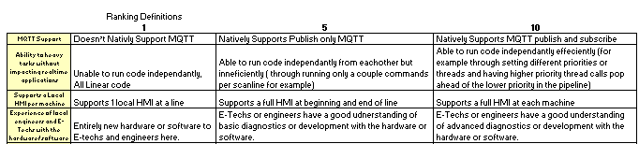
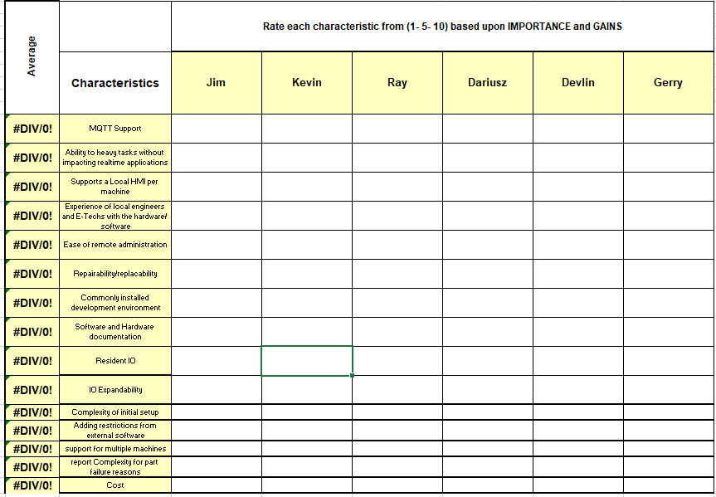
Lean Tool selection
Possible Lean/Six Sigma Tools
    X Matrix
    Need/Want Comparison Matrix
    Perato Charts
    C&E Matrix
What is a Cause and effect matrix
    Step1
      Used to determine importance, and weighting of categories
      Prevents tunnel vision by allowing multiple department concerns to be shown in the weights
    Step2
      Scores are assigned based of categorical requirements between 1-10.
      These scores are weighted then totaled for a product score.

Slide 10
Category Description
 |  | Page
1. | Description of Pac-Lite | 03
2. | Lean Six Sigma, C&E, and our goal | 07
3. | Category Description | 10
4. | Data Collection | 13

Slide 11
Category Descriptions
MQTT Support | MQTT Support must be supported publish at least.
Ability to heavy tasks without impacting realtime applications | Ability to run heavy workload code in the background ( such as being able to sort the NAED list while running instead of having to do it at PM)
Supports a Local HMI per machine | Whether it supports an HMI at each individual machine rather than a couple per line.
Experience of local engineers and E-Techs with the hardware/ software | How experienced the E-Techs are with the technology being used.
Ease of remote administration | Whether it be really easy like a website, non existent, or through step7/TIA portal.
Repairability / replacability | How easy it is to replace a broken part on the product.
Commonly installed development environment | Whether a new IDE would have to be installed to maintain/ debug the program.

Slide 12
Category Descriptions
Software and Hardware documentation | How much documentation is available as to what the hardware/ software is comprised of and how to use it efficiently.
Resident IO | How many extra IO pins are available on the device.
IO Expandability | Whether or not IO can be expanded in the chance more is needed.
Complexity of initial setup | How easy should it be to complete first time setup
Adding restrictions from external software | Ability to control the machine remotely from different software.
support for multiple machines | Whether the device supports 1, many, or an entire line of machines.
report Complexity for part failure reasons | Ability to report specific machine error codes for part failure rather than a generic part failed message.
Cost | The cost per supported machine

Slide 13
Pac- Light C&E matrix
 |  | Page
1. | Description of Pac-Lite | 03
2. | Lean Six Sigma, C&E, and our goal | 07
3. | Category Description | 10
4. | Data Collection | 13

Slide 14
Thank you.
Automotive

Slide 15
Backup Slides
 |  | Page
1. | Description of Pac-Lite | 03
2. | X Matrix | 07
3. | Pareto Chart | 00

Slide 16
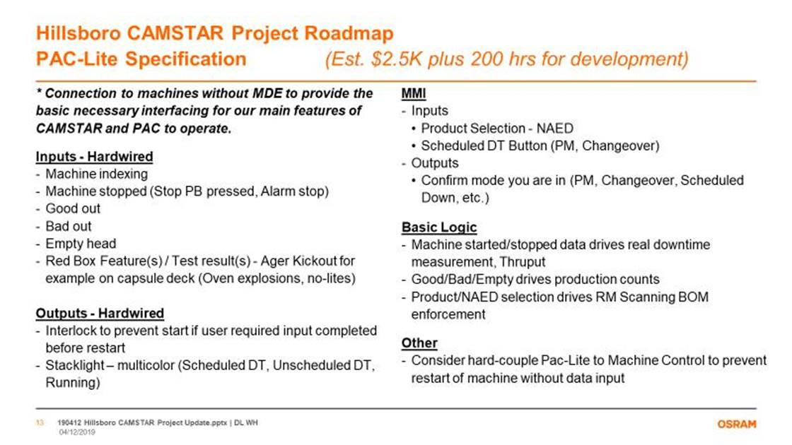

Slide 17
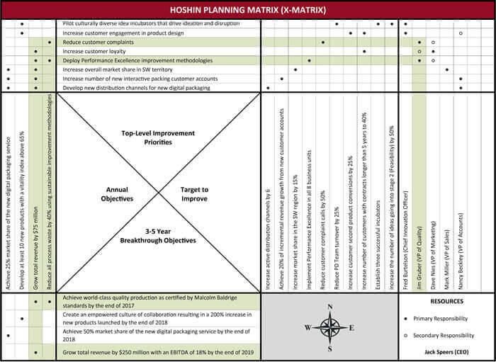
X Matrix Example.
North is Top Level Priorities
East is the metrics to improve
South is long term goals
And west is Annual Objectives.

Slide 18
1510 Line Pareto Chart
Pareto Chart
Line graph is the cumulative effect of previous columns
Each column is a different category
One would be made for each product
Used to better visualize a trend among the categories and to support more in-depth analysis methods.

