Slide 1
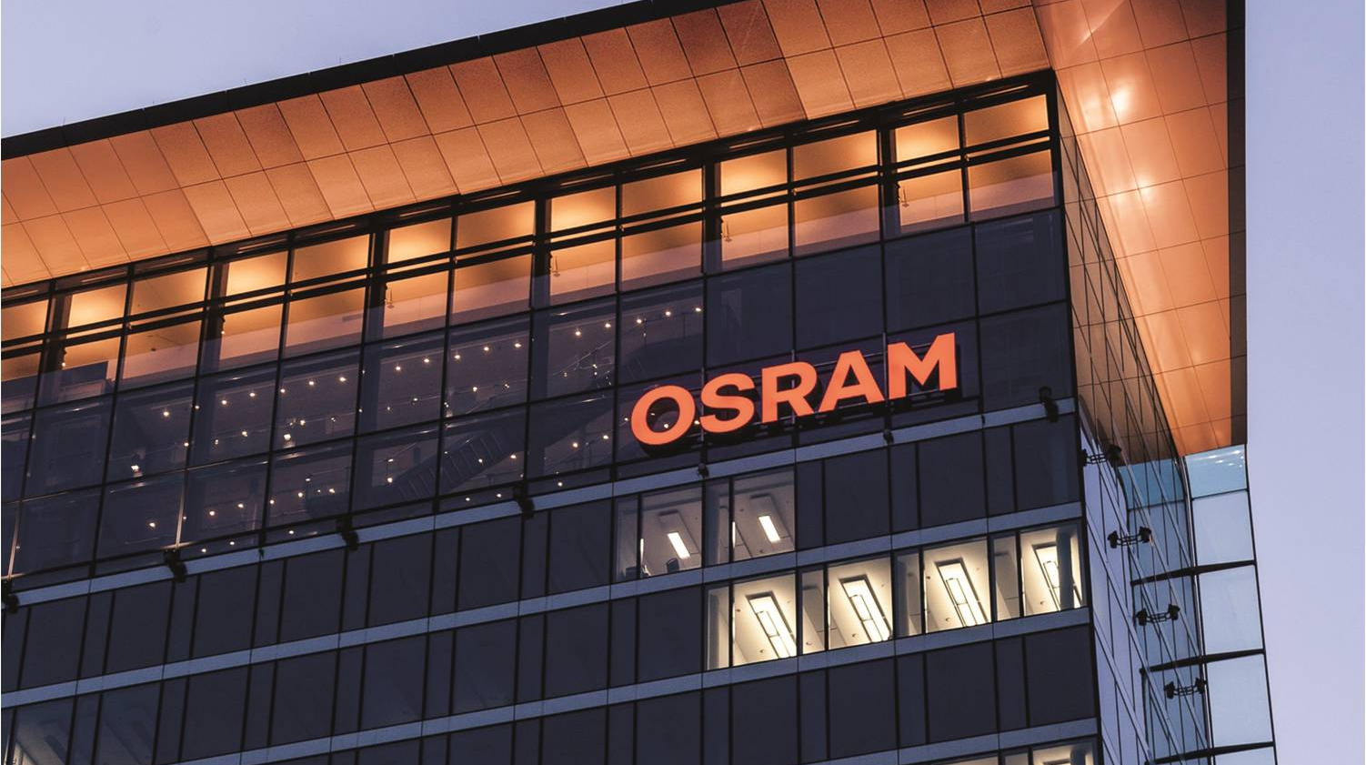



Pac-Lite
Automotive
Devlin Paddock | 06/28/2019
Light is OSRAM

Slide 2
Context
Old Model
Changes in messaging
Camstar no longer accepts MQTT.
Germany is looking into a gRPC communication layer which is not supported on siemens plc’s currently.
Can only communicate with Camstar through TCPIP or third party software.
Engineering Database stores all scrap info not Camstar. Meaning even for base requirements we need engineering database connection
ActiveMQ either runs through Pac or zIF.
Camstar
MQTT Packets
Pac
Pac Lite
Packetized data
MDE
Digital IO
UDP Packet
Machines
Legacy Machines

Slide 3
Proposed Solution 1
Pac-Lite Level Solution
All supported communications methods are supported at the Pac-Lite level.
Unable to communicate with gRPC without some form of intermediary.
Must maintain and support all communication methods on every Pac.
Very simple architecture.
Requires no external service.
ENG_DB
ActiveMQ
Camstar
gRPC
API Calls
SQL Querries
MQTT
TCP/IP
Pac-Lite

Slide 4
Proposed Solution 1.5
Addon Solution
AddOn
AddOn
ENG_DB
ActiveMQ
Camstar
gRPC
API Calls
SIMATIC ODK SQL driver (soft plc only)
MQTT
TCP/IP
Pac-Lite

Slide 5
Proposed Solution 2
Service Interface
gRPC Application with other APIs built on top.
Higher level for communicating over many different communication methods.
One universal interface down to the Pac-Light machines. Branches out to many above that.
Allows for more flexibility in terms of communication changes later.
Requires and external service.
ENG_DB
activeMQ
Camstar
gRPC
Pac-Lite Service
TCP/IP
SQL Queries
MQTT
Pac-Lite
Pac-Lite
gRPC Calls
Pac-Lite
Pac-Lite
Pac-Lite
Pac-Lite
Pac-Lite
Pac-Lite

Slide 6
Proposed Solution 3
Pac Solution
Use Pac as a translation layer.
One interface from Pac to Pac-Lite
Allows for more flexibility in terms of communication changes later.
Requires a Pac license
May be more restrictive than straight to output.
ENG_DB
ActiveMQ
Camstar
gRPC
Pac/zIF
GRCP Calls
SQL Calls
Pac-Lite
Pac-Lite
MQTT
Pac-Lite
Pac-Lite
TCP/IP
Pac-Lite
Pac-Lite
Pac-Lite
Pac-Lite

Slide 7
Pac-Lite TIA Portal
M1_DB
Downtime
Counts
Message
Machine Info
Status
Send Signal
ETC
Error
Status
Packets
Type of packet
Busy
Packet Options
User
Display
Naed Selection List
Resource
User Down Text
Connection interface

Slide 8
Pac-Lite TIA Portal
Message
Connection interface
Send
Busy
Receive
Status
Error
Connect Function
TRSCV SEND
Connection_DB
Packetizer Function
TRSCV RCV
Send Function
LMqtt_Publisher

Slide 9
Pac-Lite TIA Portal P2
MQTT
Created everything needed to send MQTT Packets out from the plc to activeMQ.
Set it up to communicated with the activeMQ server running locally by default.
Contacted Juri asking about what the XML packets were expected to look like an learned Camstar does not support MQTT.
Maintaining support for importing into engineering database.
TCP/IP
Since Camstar does not support MQTT we are switching Focus to communicating over a TCP connection.
Expecting XML Packets on port 2881.
Had a meeting with Chris to capture a sample packet.
Running this connection in parallel with the MQTT connection. Can be switched between when making packets.

Slide 10
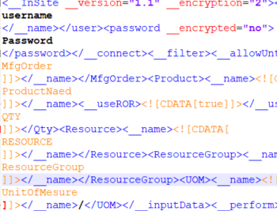
Pac-Lite Packets
Packet Generation
Created a function in SCL for generating the packet.
Too large to use strings so It is concatenating into a large char array.
Talking to wade about creating a user for the Pac-Lite project.
Talking to wade about how to create MFG Orders.
Need to create a resource group for each machine
Through put Packet
Through put packet for reporting Machine good output under a Resource Resource group.

Slide 11
Pac-Lite other Packets
Loss Packet
Packet for updating loss/scrap to the engineering database.
Downtime Packet
Packet for updating Downtime in EngDB/Camstar.

Slide 12
Pac-Lite Packet Sending
Packet Sending
Packet sending function
Ties together Packet Generation and TCP Classes
IO Processing
IO Processing function
Ties together M1_DB and physical Inputs and Outputs.
Records Real Reasons for Downtime

Slide 13
Software/Misc
API Reading
gRPC
Server client specific.
Problems at context boundaries due to forced roles. This can cause monolithic projects that are hard to breakup without an in between technology between the different sections. This can make maintainability difficult.
Relies heavily on specification rather than dynamic learning of the API.
Rest
Server Client suggestive
Great adaptability at context boundaries due very relaxed server client relationship. Allows for breaking up the API into many separate sections easily. Good for maintainability.
HATEOAS.

Slide 14
Software/Misc
API Reading
GraphQL
Field and data oriented rather than endpoint oriented.
Very light network and hardware requirements. (communicates over http with very small request size.)
Query based language rather than procedure based allowing for greater stability in some situations.
Designed primarily for ease of design on consuming applications not necessarily producing applications.
Evolvable due to its non static version management and querry like nature.
Good maintainability at context boundaries due and outbound points due to ability to setup server and client calls on the same server with a query lie nature.
Relies moderately on specification.

Slide 15
Thank you.
Automotive

