Slide 1
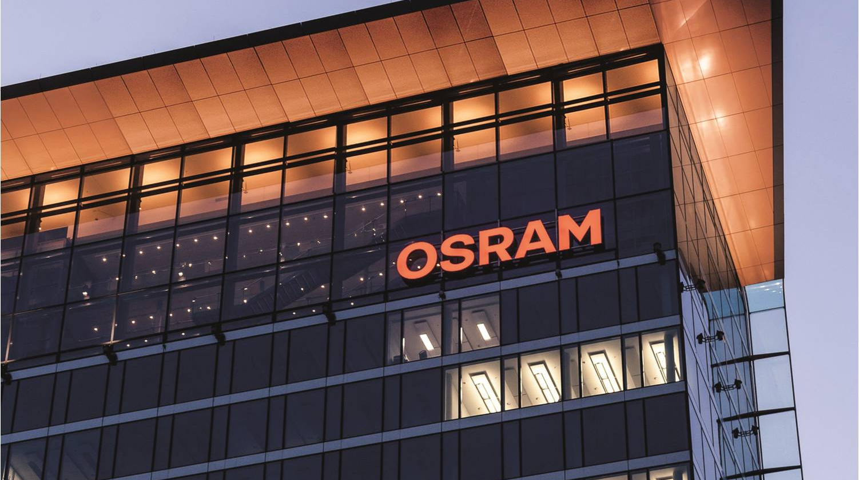



Intern Presentation
Automotive
Devlin Paddock | 08/8/2019
Light is OSRAM

Slide 2


Introduction
Name:
Devlin Paddock
Location:
Concord, NH
School:
Graduate
Computer Engineering
NHTI, Concord, NH
Junior
Data Science / Computer Science
University of New Hampshire, Durham, NH

Slide 3
The Project Interface Machines Without MDE to Camstar
Hardware Benchmarking
Research and compare different hardware models and approaches.
Benchmark these using Lean tools and methodology.
Service
Connect Devices incapable of generating large complex packets to Camstar and other databases.
Provide one interface to many databases for easier reporting from devices below the service
PLC Project
Connect Legacy machines to the service developed.
Avoids the cost of a PAC license and ongoing maintenance cost.
Camstar, SQL, Etc.
Organized Calls
PAC
SNP Service
Packeted Data
MDE
SNP
Raw Machine Signals
Machines
Legacy Machines

Slide 4
SNP PLC Machine Data-Packager
Machine Interfacing
Scrape signals directly off the machine with little to no existing machine/PLC modification.
Very low development effort to rollout for additional lines.
Allow product selection to support BOM enforced raw materials scanning and Camstar traceability.
Packetization
Type chosen (MQTT,Json) due to very low overhead compared to other packet types.
This type of packet is easy to generate on PLC.
Allows for buffering and assured delivery through ActiveMQ.
6 Bytes
1 Byte
1 Byte
1 Byte
1 Byte
5 Bytes
Up to 246 bytes
1 Byte
MQTT Header
Packet Length
Packet Header
Packet Type
Pac-Lite_ID
Reserved
JSON Pair/Values
Null

Slide 5
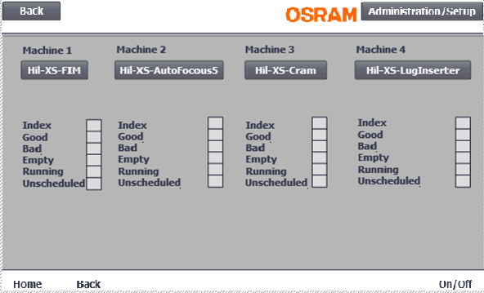
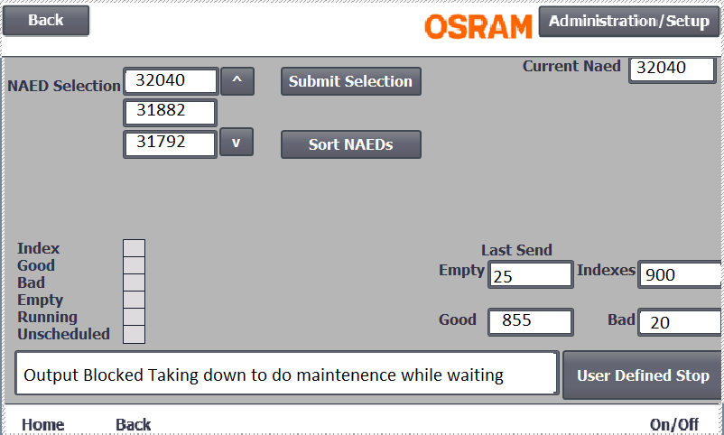
Results of the SNP project
Per Machine screen for control and more in depth information
Home Screen Displaying basic Information for each machine

Slide 6
SNP Service Communication Interface
QRQC
MDE/MDI
Communication Protocol
One communication interface to many data storage systems.
Allows for very simple communication between complex devices.
Expandability
Packet designed to accommodate many applications.
Service built to handle thousands of packets a minute from multiple applications.
ENG_DB
ActiveMQ Topics
Camstar
gRPC
SNP Service
UDP
TCP/IP
SQL Queries
MQTT
ActiveMQ
gRPC Calls
SNP
EMP
SNP
EMP
SNP
Other Producing App
SNP
OtherProducingApp

Slide 7
Results of the SNP project
Line automation
Enable lines like XS, H7 or H11 to automatically report data to Camstar, and other databases.
Make data available to new applications like QRQC and MDI.
Provides BOM enforced raw material scanning.
Opens up better reports for lines with limited data analytics.
API Access Point
Allows for future applications (like SCADA BOX for environmental monitoring) to have an easy way to access many databases at once.
Segregates all application packets allowing for internal payload to change drastically between applications to suit the applications needs.

Slide 8
Expectations/Surprises
New Skills
Learned many different data communication types and methods.
Gained experience setting up and interfacing with an MQTT Broker.
Expanded understanding of the .NET Framework and Siemens PLCs
Collaborating with a global development team and benchmarking for a global solution.
Dealing With Real World Limitations
Benchmarking hardware requires in-depth understanding of plant requirements.
Natural scope creep. (Short Term Statistics and per index data collection)
Large scale project redesigns. (Splitting application into PLC and Service)
Interfacing with other applications being developed at the same time. (QRQC and MDI)
Developing in a production environment with frequent priority shifts affecting resources.

Slide 9
Future Impact On Studies and Personal Growth
Develop systems with future changes in mind.
It may be worth splitting a project in two to leverage benefits of two different technologies.
Make clear and concise documentation.
The real world is a lot messier than projects in school.

Slide 10
Thank you.
Automotive

Slide 11
Backup Slides.
Automotive

Slide 12
Initial Requirements
Automotive

Slide 13
Pac-Lite Project Requirements
Report Machine Output
Up/Down status
Good/Bad part output
Machine indexes
Empty head
What product is being produced
Enable power on
10 Input to pac-lite
Display Machine Status
Status stack light
Easy to use HMI
4 outputs from pac-lite
HMI
Product selection- NAED
Defined DT button
Self managed NAED list
Display diagnostics.
Scope of the project in orange
Sample UI on a Siemens HMI
Camstar
MQTT Packets
Pac Lite
Pac
MDE
Digital IO
New NAED
Enter
Cancel
Sort
Legacy Machines
Machines
Notes:
Reduce slightly.

Slide 14
Proposed Pac Light Architectures
One CPU per machine solution
Provide a local HMI for user input, information and diagnostics display.
Easy for E-Techs to troubleshoot
Reliably record output of a single machine and report it to Camstar
One CPU per three machine solution
Integration with up to three target machines
Provide up to four remote HMIs for user input, information and diagnostics display.
Reliably record output of up to three machines and report it to Camstar as separate machines.
One CPU per line solution
One remote IO bundle per machine.
Provides one display at beginning or end of line
Reliably record output of up to 32 machines and report it to Camstar as separate machines.
Pac Lite
Machine
HMI
Pac Lite
Machine
HMI
Machine
HMI
Machine
HMI
Pac Lite
HMI
HMI
Machine
Machine
Machine
Notes:
//Add original project def slide to backup slides. Add backup slides section after final slide.
//look into possibility of 1 HMI instead of 4. restriction was on HMI’s I believe that it was limited to 128 IO expansion at 8 per remote IO max.
//Check out support for communicating Between two plc’s in the 1200 series to allow switching the NAED at one location instead of two.
Replace diagrams on right with images of siemens pc’s
Shift slide 10-11 in as well

Slide 15
Hardware Benchmarking
Automotive

Slide 16
Score Breakdown
 |  | Rating of Importance to Customer |  | 5.8 | 8.5 | 6.0 | 10.0 | 10.0 | 10.0 | 6.7 | 10.0 | 5.0 | 10.0 | 3.7 | 3.7 | 5.0 | 6.7 | 1.7
 |  |  |  | 1 | 2 | 3 | 4 | 5 | 6 | 7 | 8 | 9 | 10 | 11 | 12 | 13 | 14 | 15
 |  |  |  | MQTT Support | Ability to heavy tasks without impacting realtime applications | Supports a Local HMI per machine | Experience of local engineers and E-Techs with the hardware/ software | Ease of remote administration | Repairability/ replacability | Commonly installed development environment | Software and Hardware documentation | Resident IO | IO Expandability | Complexity of initial setup | Adding restrictions from external software | support for multiple machines | report Complexity for part failure reasons | Cost | Total
Area of opportunity | Description of Improvement | Process Input
Scada Single Machine Solution | Scada Box reporting to camstar with a local HMI Built in Node red and a remote administrative site in FreeBoard |  |  | 10 | 10 | 10 | 1 | 10 | 1 | 1 | 1 | 10 | 1 | 10 | 10 | 1 | 1 | 10 | 501.7
1212C single Machine solution | 1212C Siemens PLC Reporting a single machine to camstar with a local HMI |  |  | 5 | 5 | 10 | 10 | 5 | 10 | 10 | 10 | 10 | 10 | 10 | 5 | 1 | 10 | 5 | 833.3
1510SP Single Machine solution | 1510sp Siemens PLC Reporting a single machine to camstar with a local HMI |  |  | 5 | 5 | 10 | 10 | 5 | 10 | 10 | 10 | 10 | 10 | 10 | 5 | 1 | 10 | 1 | 826.7
1510SP Multi Machine Solution | a 1510SP CPU with remote IO, and HMI spread to each machine it is connected to. Limited to 4 machines |  |  | 5 | 5 | 10 | 10 | 5 | 10 | 10 | 10 | 10 | 10 | 5 | 5 | 5 | 10 | 5 | 835.0
1212C Multi Machine Solution | a 1212C with remote IO, and HMI spread to each machine it is connected to. Limited to 4 machines |  |  | 5 | 5 | 10 | 10 | 5 | 10 | 10 | 10 | 10 | 5 | 5 | 5 | 5 | 10 | 5 | 785.0
1510SP Line Solution | a 1510SP CPU with remote IO spread to each machine on a line. With 1 HMI at the end and beginning of the line only. Can support up to 32 machines. |  |  | 5 | 5 | 1 | 10 | 5 | 10 | 10 | 10 | 10 | 5 | 5 | 5 | 10 | 10 | 10 | 764.3
1212C Line Solution | a 1212Ccpu with remote IO spread to each machine on a line with 1 HMI at the end and beginning of the line only. Can support up to 32 machines. |  |  | 5 | 5 | 1 | 10 | 5 | 10 | 10 | 10 | 10 | 5 | 5 | 5 | 10 | 10 | 10 | 764.3

Slide 17
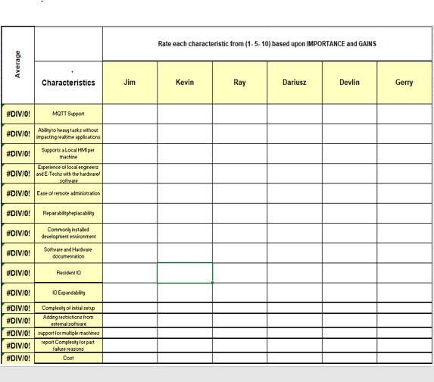
Score Breakdown

Slide 18
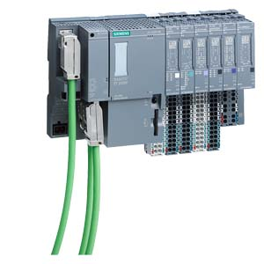
Hillsboro Recommendation
Siemens PLC 1510sp Line solution
Environment
Local experience
Common development environment
Easy troubleshooting
Designed for an industrial setting
Diverse Hardware
More IO can allow for more complex error reporting
Benefits of Scada IO can be added separately
Flexible setup
1 box is capable of up to 32 machines or 2 lines.
Support
More likely to get software/hardware support for longer (three year newer release date)
Better support for MQTT
Remote IO allows for a new CPU when this one loses support.
Pac Lite
HMI
HMI
Machine
Machine
Machine
Notes:
Wrong slide not sure how it got in here fix

Slide 19
Camstar Packet Sending
Automotive

Slide 20
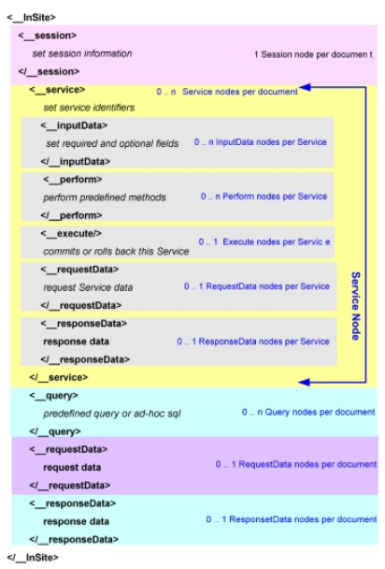
Scada Box
Packet Setup
__session always connecting by sending username and password in the attached XML Sample and encoding with the Camstar Dll’s
Any number of services. Can come before the execute tag. Currently I’m using ResourceThruput and ResourceSetupTransition
<__execute/> needs to be present to execute the service. Otherwise it just queries the information.
You must request a completion message in request data otherwise you will receive no indication of weather it succeeded or failed.
Make sure you use the Correct XML Header. Check a tracked packet to see which xml version and encoding version you should be sending.

Slide 21
Scada Box
Sending Setup
Currently I am just sending it through a TCP Connection to Camstar.
Camstar will accept any TCP connection request on the correct Ip and port and gracefully disconnect without warning.
Just send the data to that port then read the return message if requested
You must request a completion message in request data otherwise you will receive no indication of weather it succeeded or failed.

Slide 22
Scope Creep/Database questions
Automotive

Slide 23

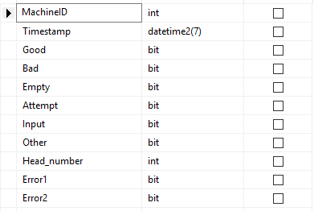
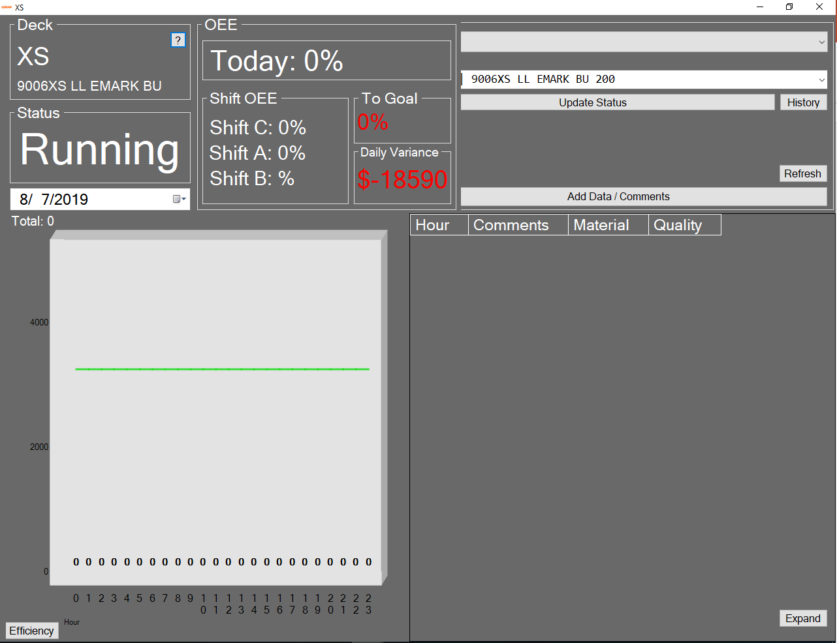
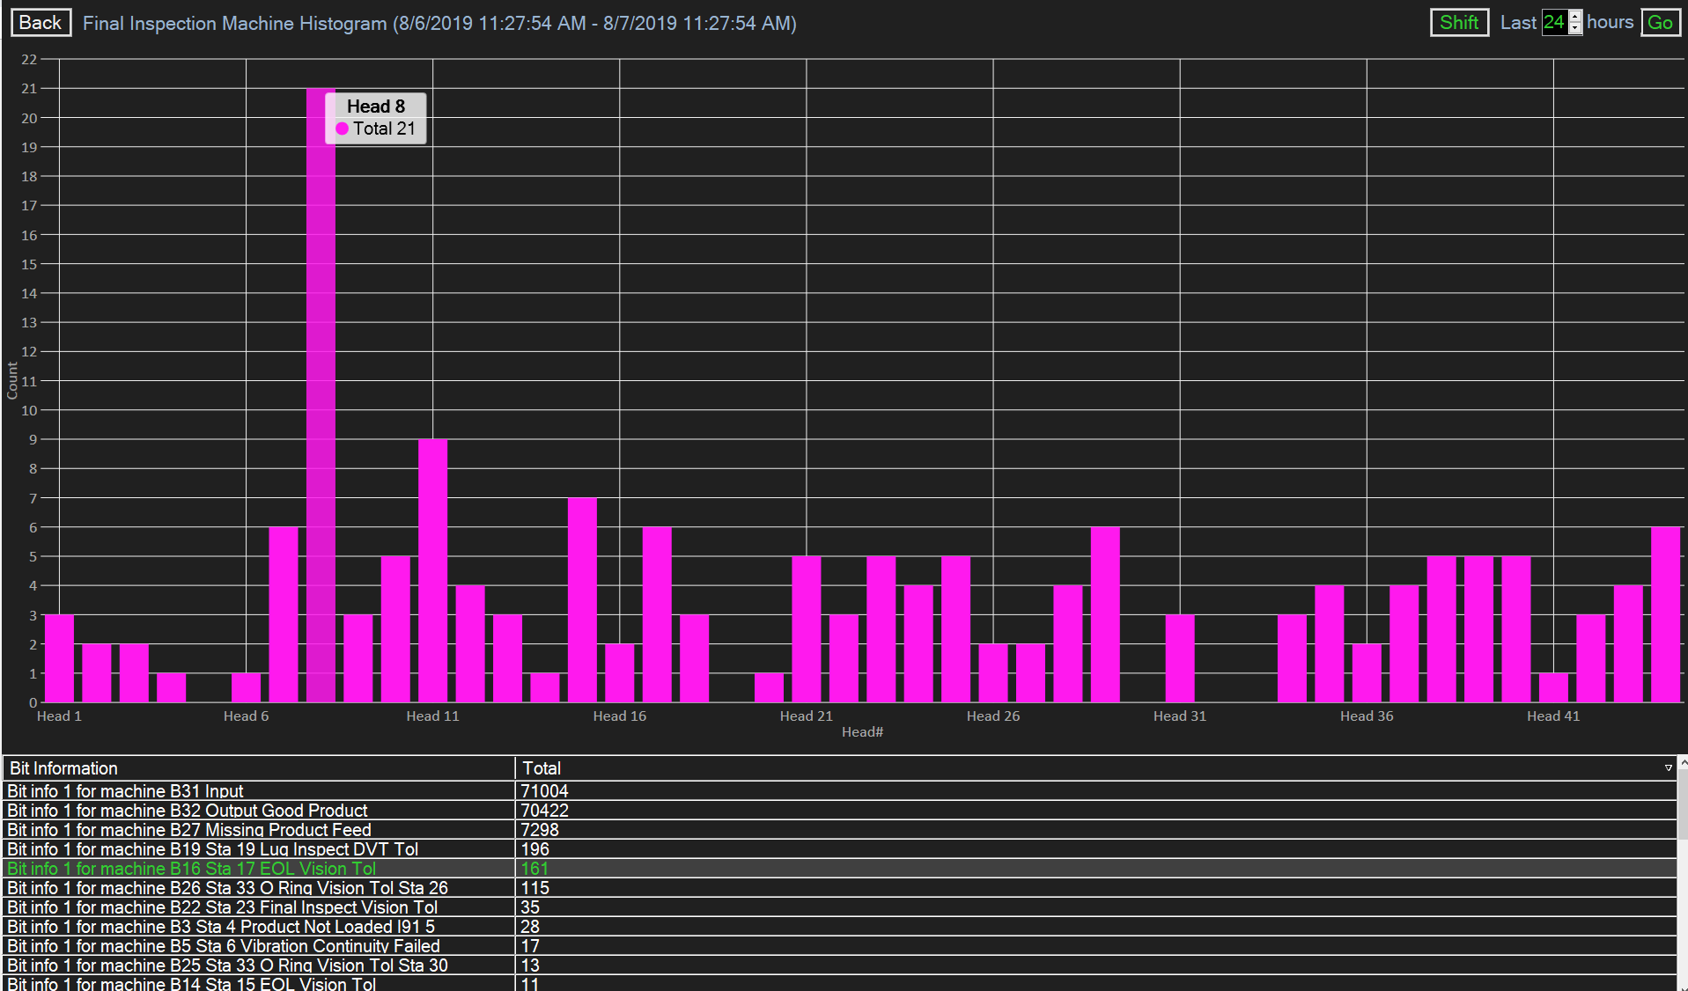
Automotive

Slide 24
Miscellaneous other projects
Automotive

Slide 25
Automotive
Machine Manager for creating all resources needed for a new line (except Camstar resources) on SNP
MQTT Batch sender
TestMessage Generator
TestLine Service
Service Installer Application

Slide 26
More info on this project can be found at https://lightweb.osram-light.com/content/10003873/HIEDO/IND40/CAMSTAR/ under documents/presentations/ intern presentations/ Devlin/ SNPDocumentation
Automotive

Slide 27
External Hobbies
Automotive

Slide 28
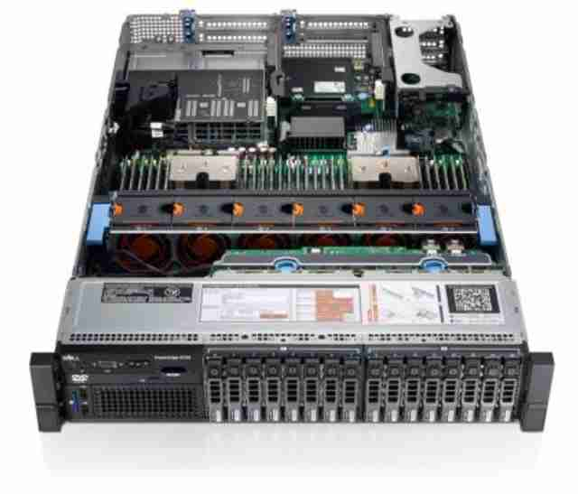
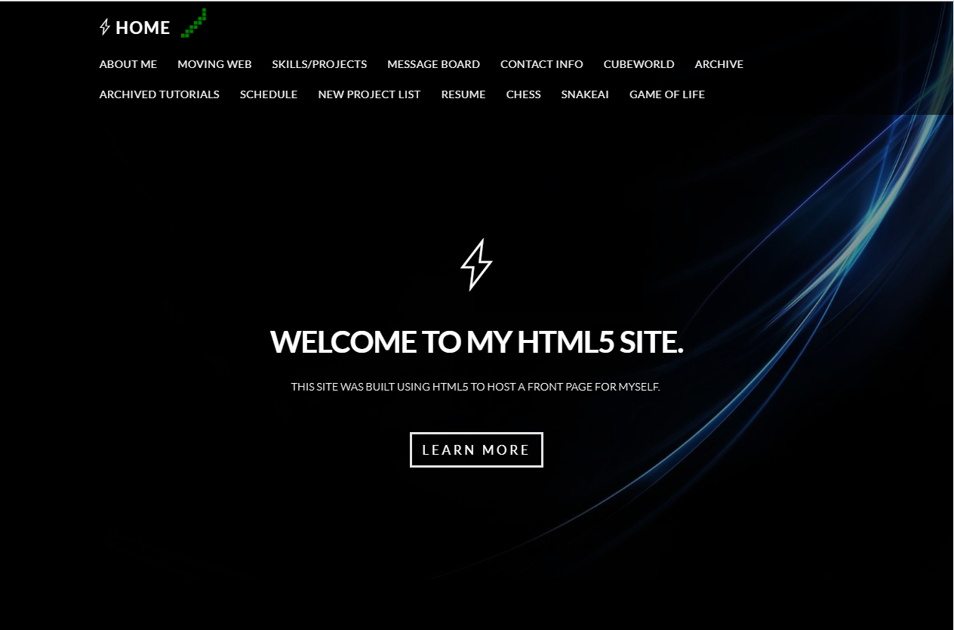
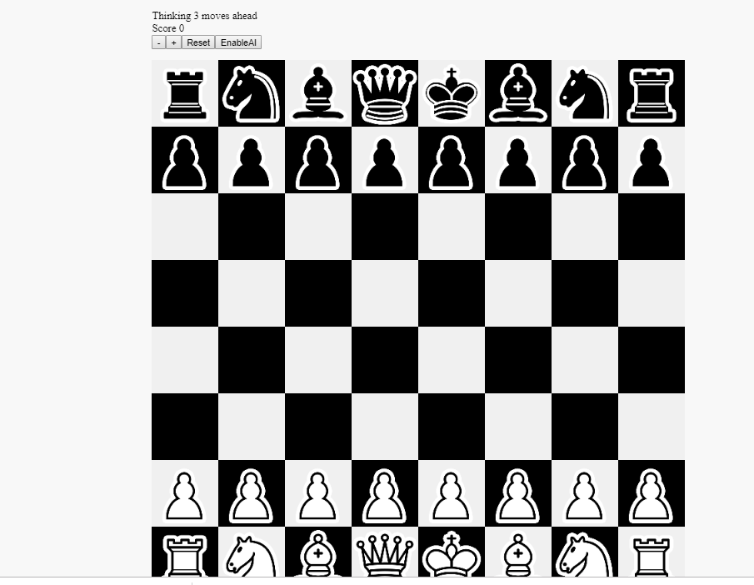

Automotive

