Slide 1
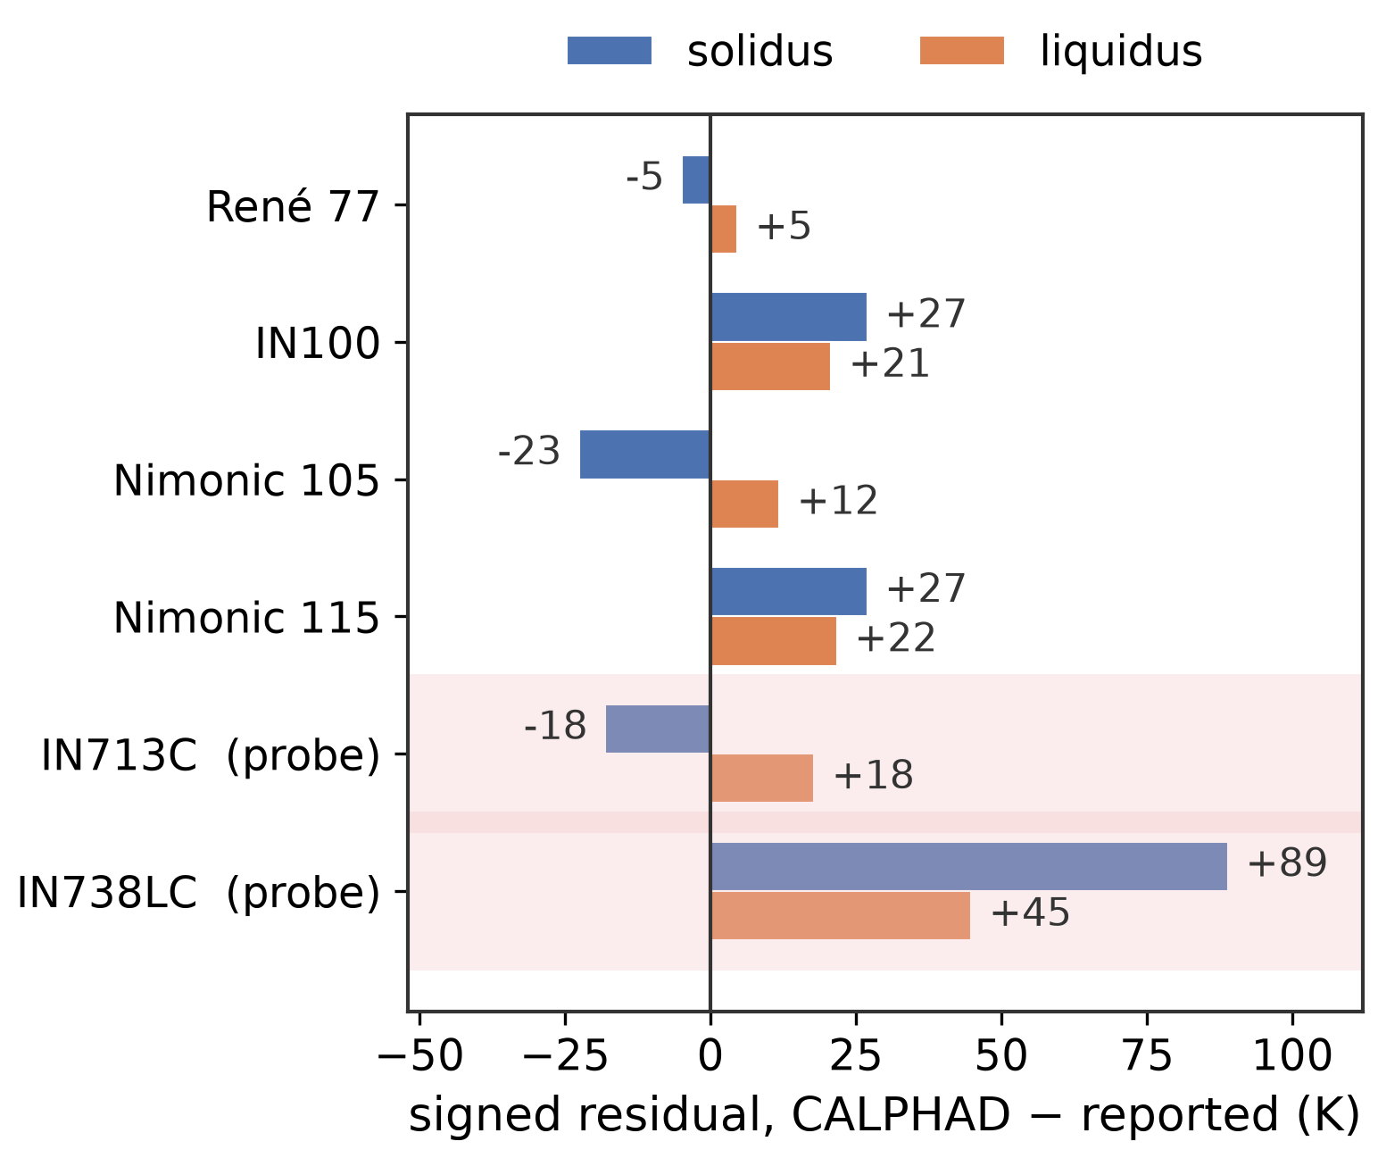
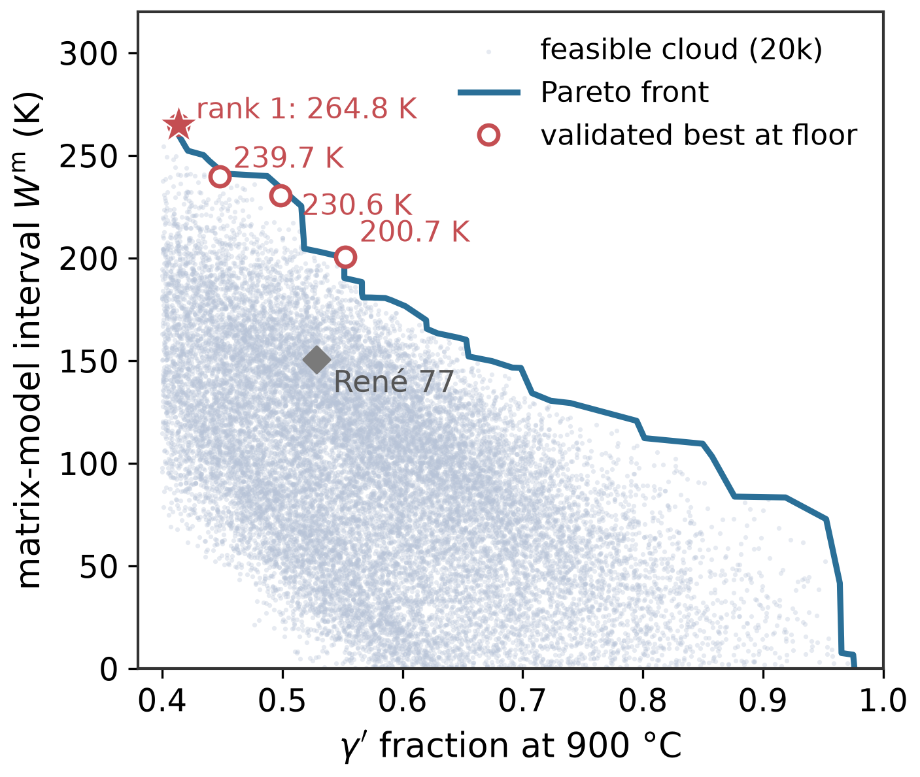
Uncertainty-aware CALPHAD–machine-learning screening of heat-treatment intervals
Six-solute Ni-base superalloys · open MatCalc thermodynamic database · validated against six commercial alloys
WORKFLOW
(a) Validation against calorimetry
(b) Pareto design curve
1
Two linked CALPHAD calculations
Ni–Co–Cr–Al–Mo–Ti–C composition space
480-alloy Latin-hypercube sample
matrix melting restricted to liquid + fcc
solid state — γ′, MC, M23C6, σ, bcc
2
Uncertainty-aware surrogates
GP · PCE · NN · PCA-GP
calibrated prediction intervals
learning-curve-based budget
3
Validation on six commercial alloys
mean absolute errors of 20.3 K (solidus) and 14.7 K (liquidus)
solvus cross-check: −0.1 K / +29.6 K · chemical, not geometric, domain
✓
Matrix-model equilibrium interval of 264.8 K — 114.3 K wider than René 77, achieved entirely by γ′-solvus depression
4
Inverse design and re-validation
✓
The sign of the interval gain is preserved with a probability of 98.1 % under all evaluated discrepancy models
120,000-candidate Sobol screen
Pareto front + γ′-floor sensitivity
σ-phase service screen at 750 / 900 °C
!
The interval is a calculated screening quantity, not a measured processing window — a pre-registered paired-DSC campaign is the falsification test

