Slide 1

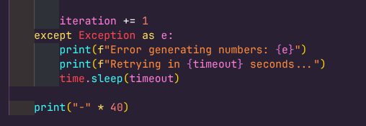


code review

Slide 2




Task 2 — Explain the Code

Slide 3
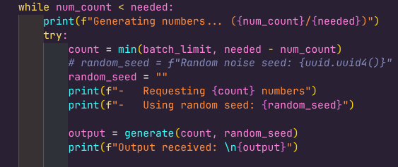

Task 3 — Add Comments

Slide 4
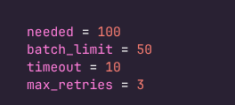
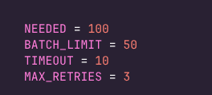


Task 4 — PEP8 Compliance

Slide 5
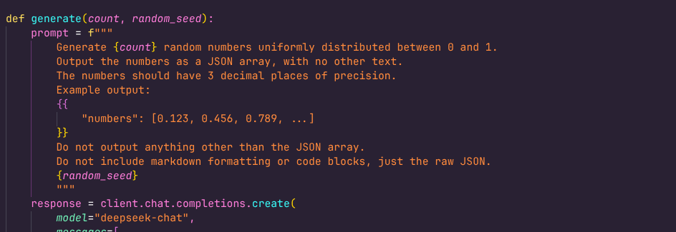
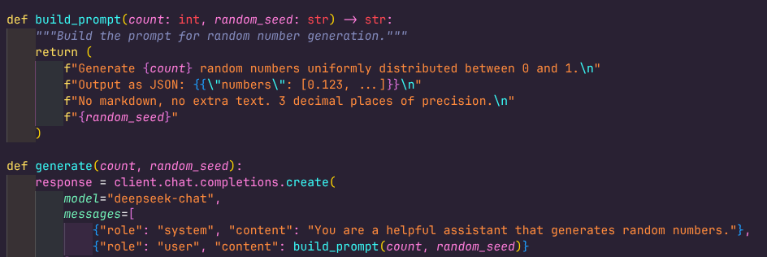
Task 5 — Clean Code Principles

Slide 6


Task 6 — Optimization
It told me to enable this uuid randomizer too

