Slide 1
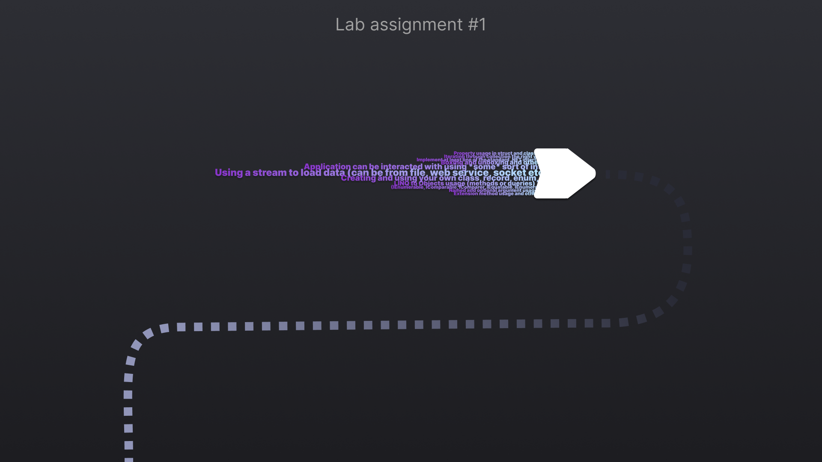

Slide 2

Requirements
1. Application can be interacted with using *some* sort of interface
2. Creating and using your own class, struct, record and enum
3. Property usage in struct and class
4. Named and optional argument usage
5. Extension method usage
6. Iterating through collection the right way
7. Using a stream to load data (can be from file, web service, socket etc.)
8. Boxing and unboxing
9. LINQ to Objects usage (methods or queries)
10. Implement at least one of the standard .NET interfaces (IEnumerable, IComparable, IComparer, IEquatable, IEnumerator, etc.)

Slide 3
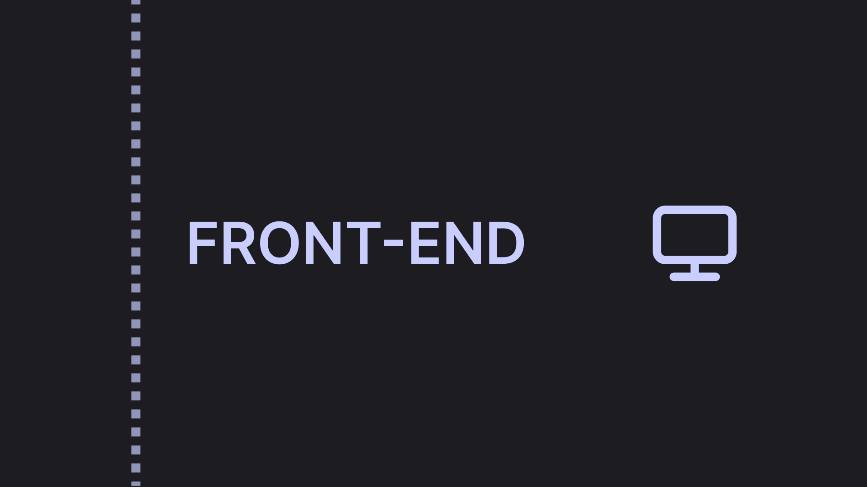

Slide 4


Slide 5
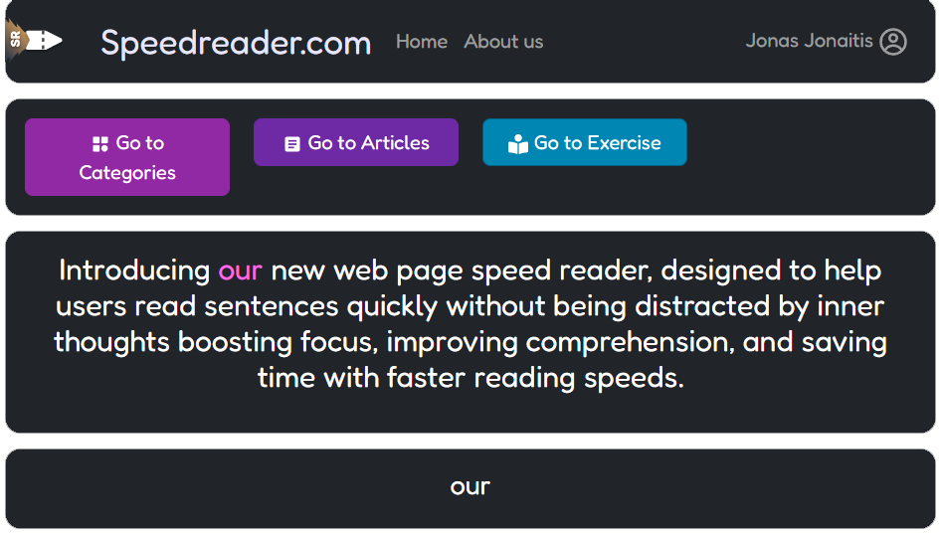


Slide 6

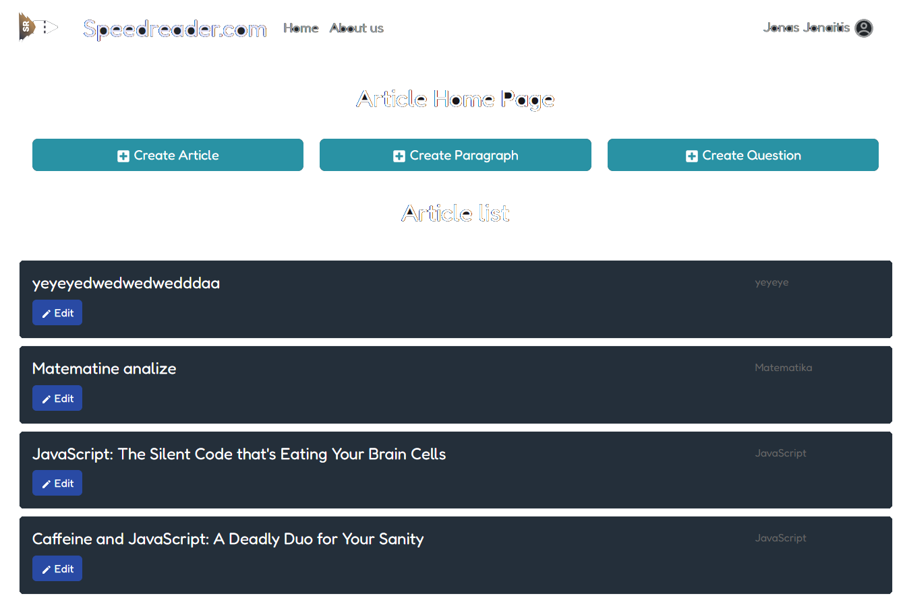
Application can be interacted with using *some* sort of interface
1

Slide 7
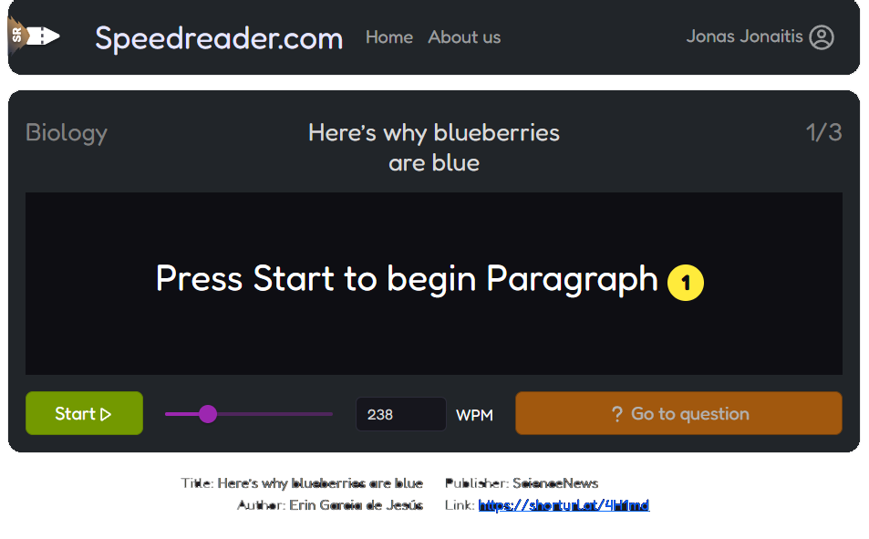
Application can be interacted with using *some* sort of interface
1

Slide 8
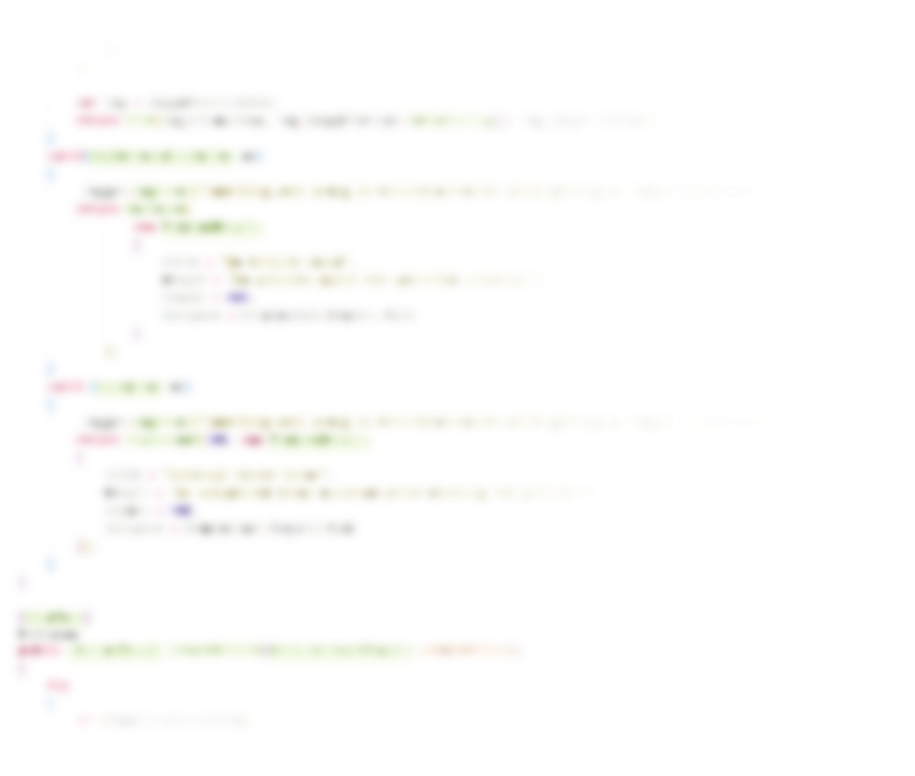
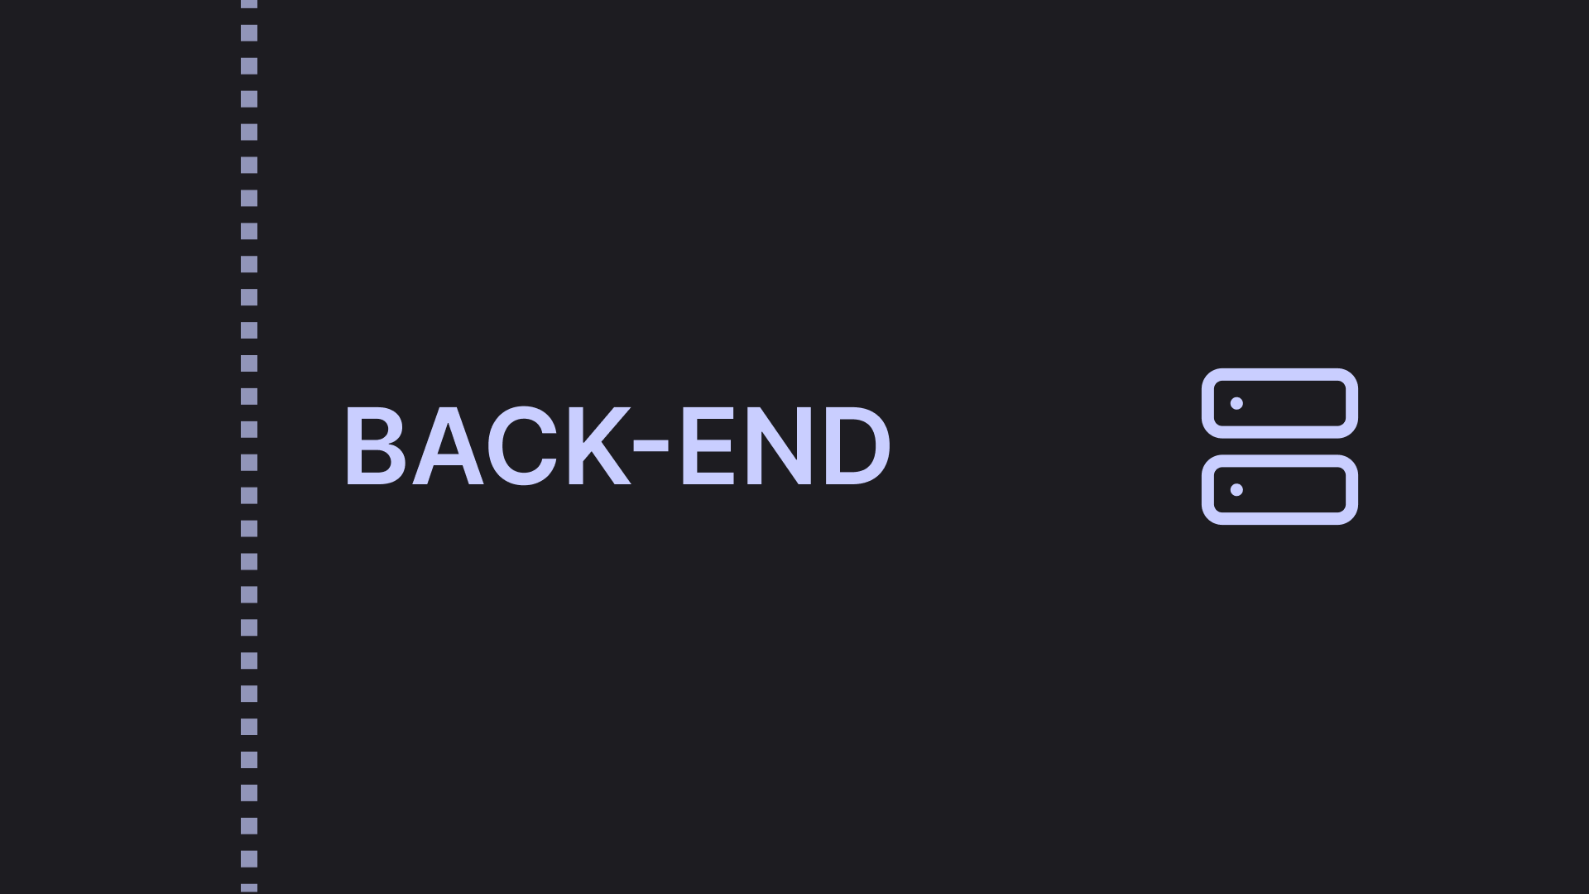

Slide 9

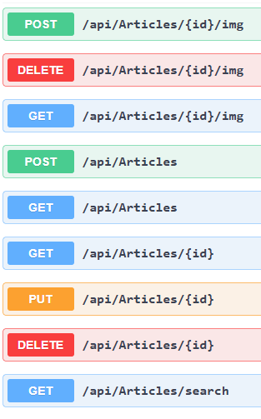
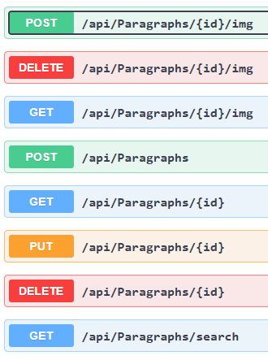
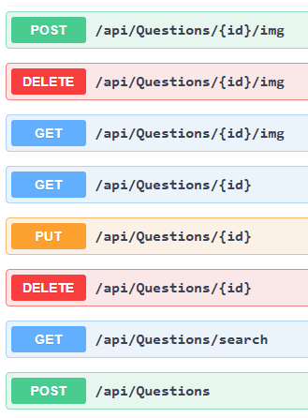

Articles
Paragraphs
Questions

Slide 10
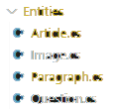
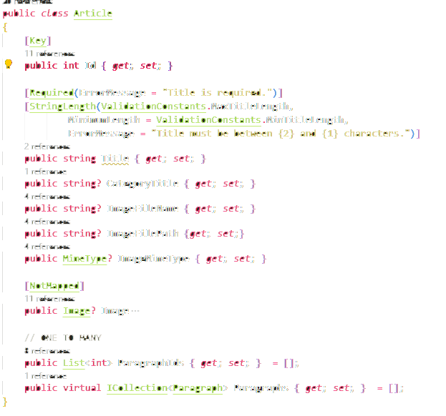
Creating and using your own class, struct, record and enum
2
class
Entities\Article.cs

Slide 11
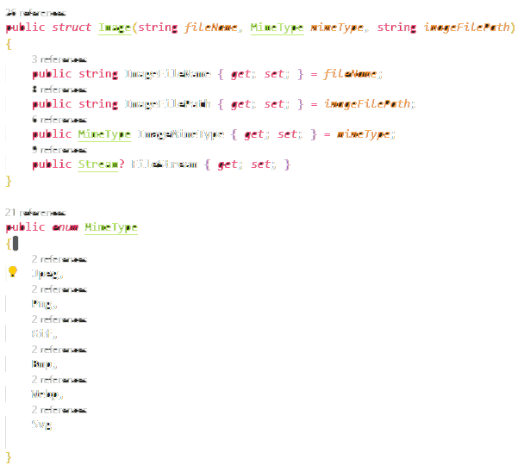
Creating and using your own class, struct, record and enum
2
struct
enum
Entities\Image.cs

Slide 12
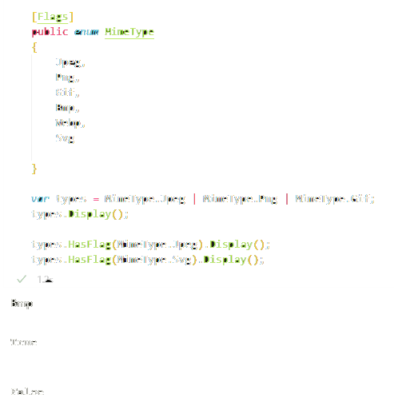
Creating and using your own class, struct, record and enum
2
struct
enum
notebooks\2-3-req.ipynb

Slide 13
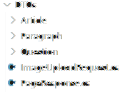
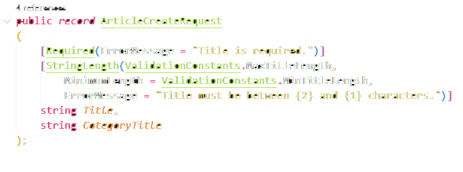
Creating and using your own class, struct, record and enum
(data transfer object)
2
record
DTOs\Article\Requests\ArticleCreateRequest.cs

Slide 14
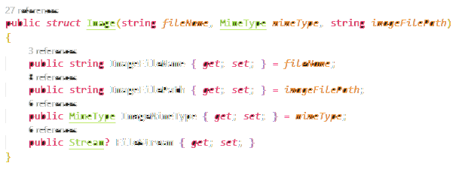
Property usage in struct and class
3
Entities\Image.cs

Slide 15
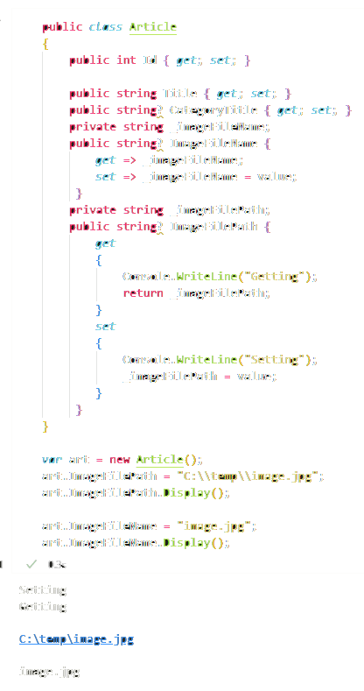
Property usage in struct and class
3
notebooks\2-3-req.ipynb

Slide 16
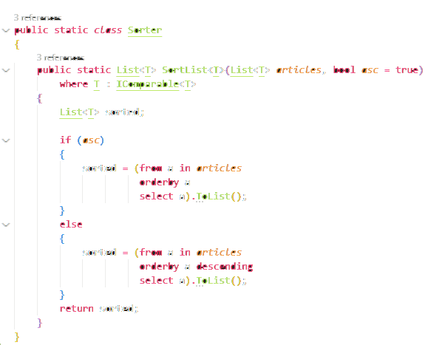

Named and optional argument usage
4
helpers\Sorter.cs

Slide 17
Named and optional argument usage
Services\Impl\QuestionService.cs
Services\Impl\ArticleService.cs
4

Slide 18
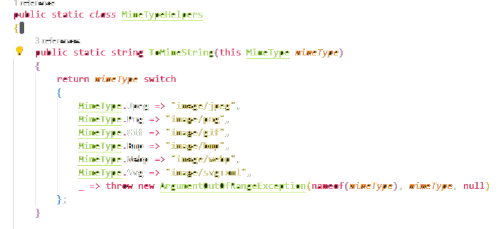

Extension method usage
5
Entities\Image.cs

Slide 19

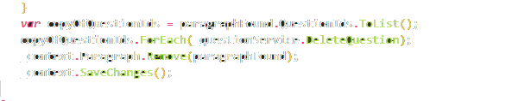
Iterating through collection the right way
6
Services\Impl\ArticleService.cs
Services\Impl\ParagraphService.cs

Slide 20
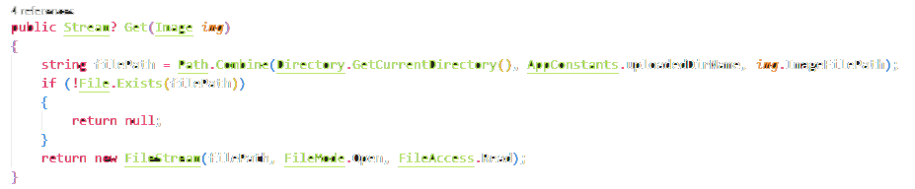
Using a stream to load data (can be from file, web service, socket etc.)
7
Services\Impl\ImageService.cs

Slide 21
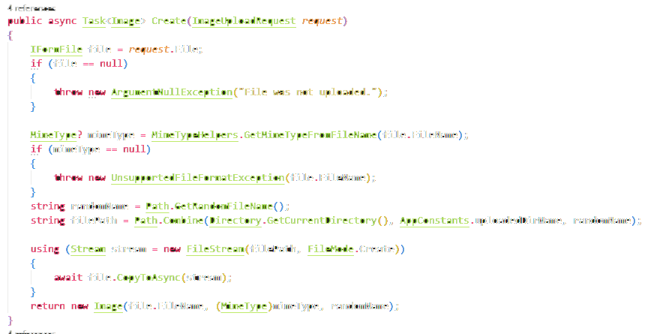
Using a stream to load data (can be from file, web service, socket etc.)
7
Services\Impl\ImageService.cs

Slide 22
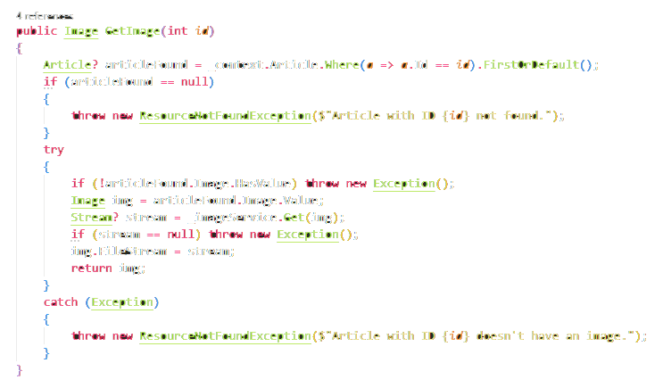
Using a stream to load data (can be from file, web service, socket etc.)
7
Services\Impl\ArticleService.cs

Slide 23
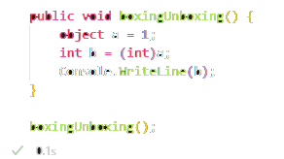
Boxing and unboxing
8
notebooks\2-3-req.ipynb

Slide 24
LINQ to Objects usage (methods or queries)
9
helpers\Sorter.cs

Slide 25
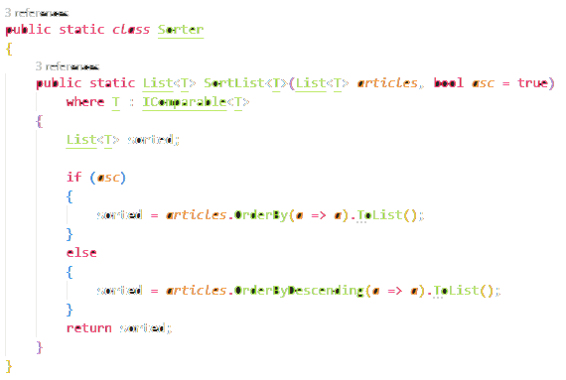
LINQ to Objects usage (methods or queries)
9
helpers\Sorter.cs

Slide 26
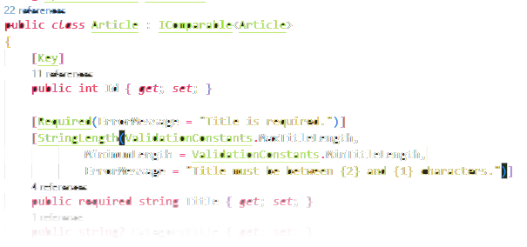
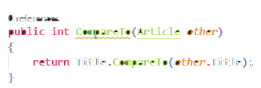
Implement at least one of the standard .NET interfaces
(IEnumerable, IComparable, IComparer, IEquatable, IEnumerator, etc.)
10
Entities\Article.cs
Entities\Paragraph.cs
Entities\Question.cs

Slide 27
Implement at least one of the standard .NET interfaces
(IEnumerable, IComparable, IComparer, IEquatable, IEnumerator, etc.)
10
helpers\Sorter.cs

Slide 28
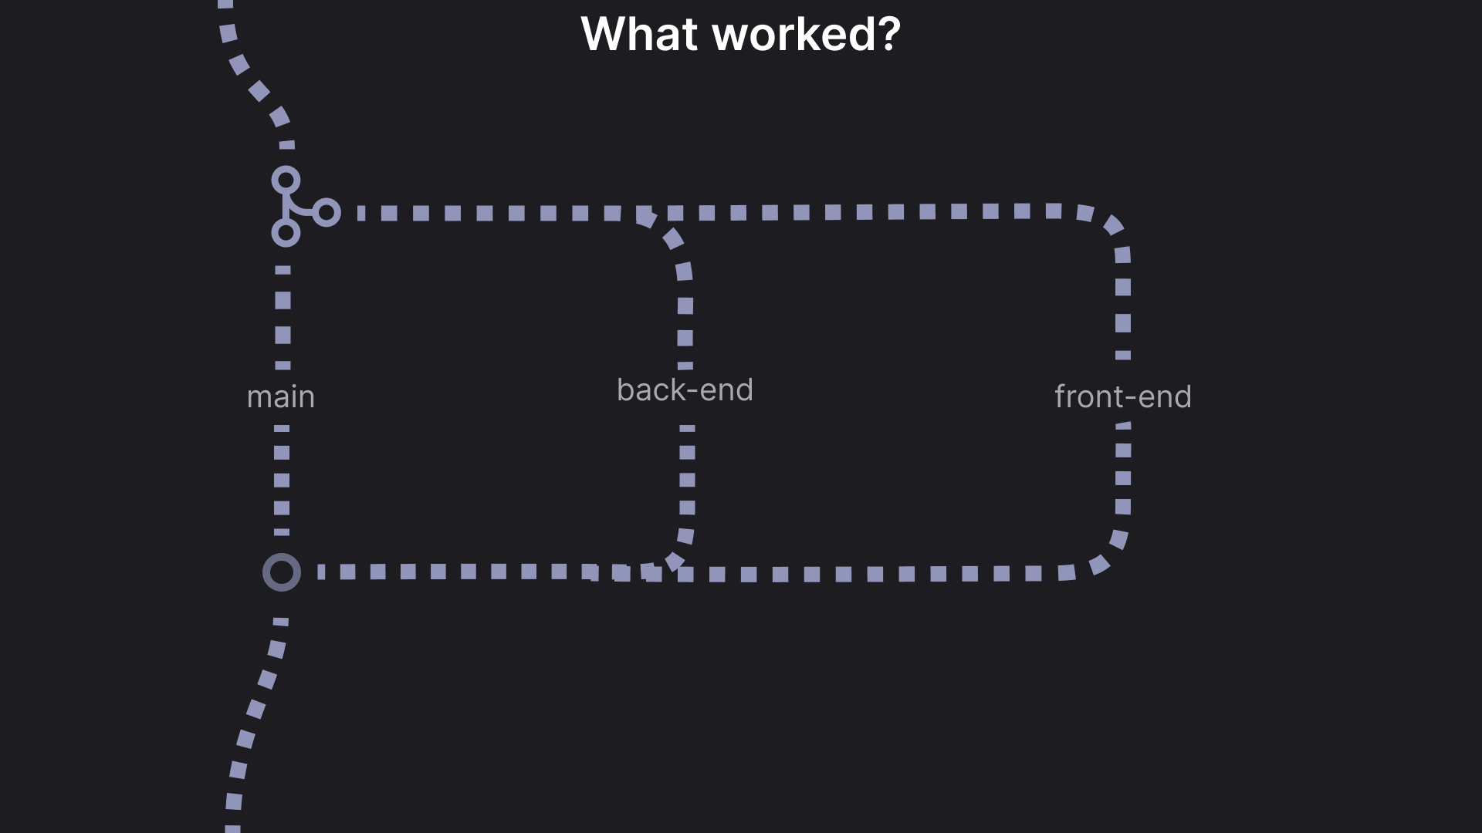

Slide 29
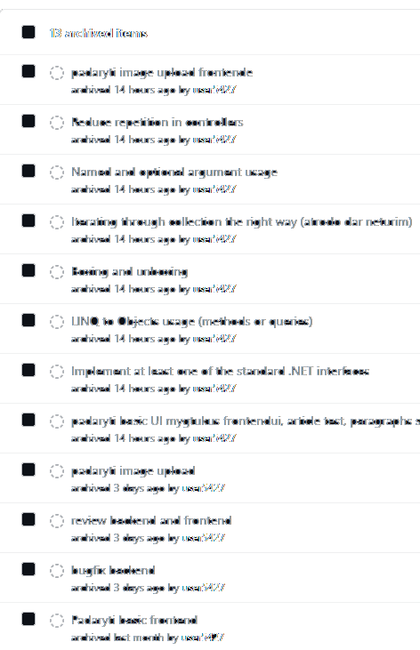


Slide 30
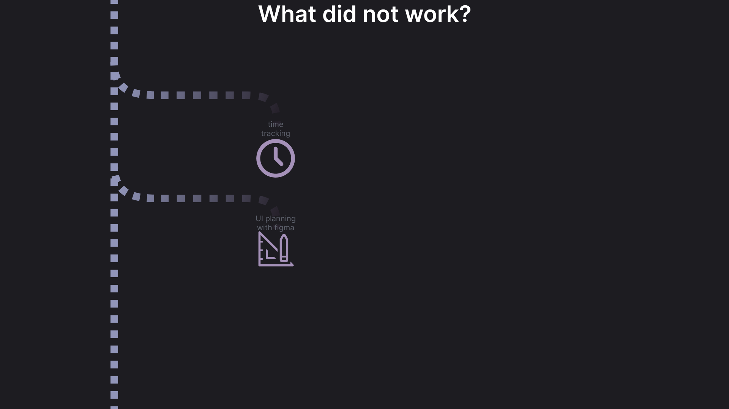

Slide 31
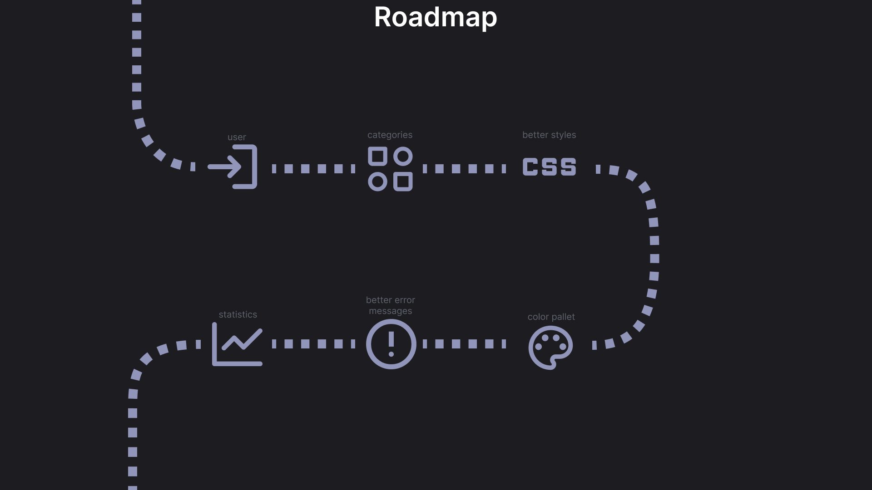

Slide 32
